Slide 1

Advancements in Visual Perception: Event Camera, Micro Expressions, and SNN
Victor MAYAUD
Elliot BOUCHY

Slide 2
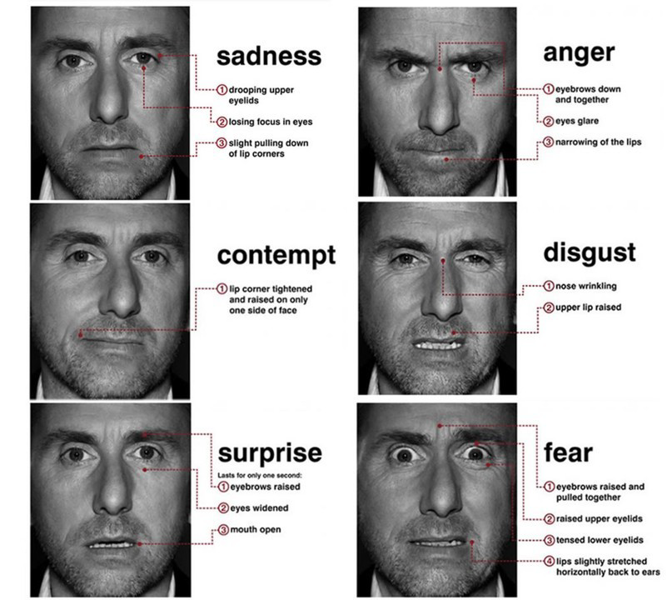
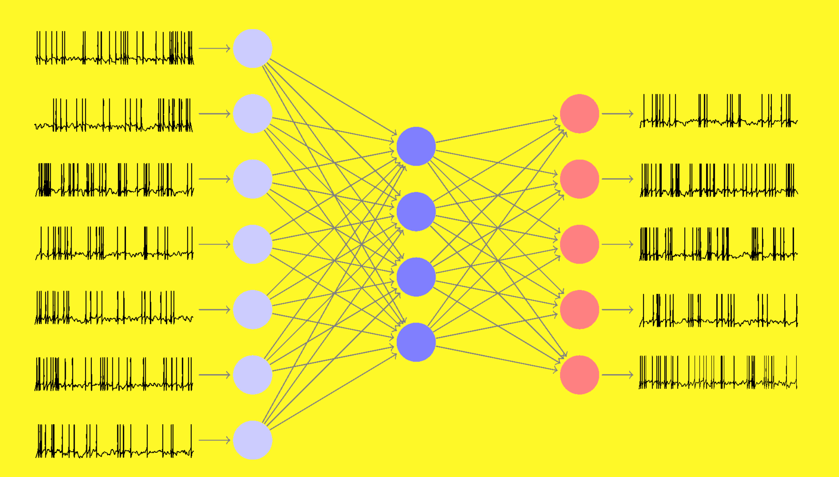
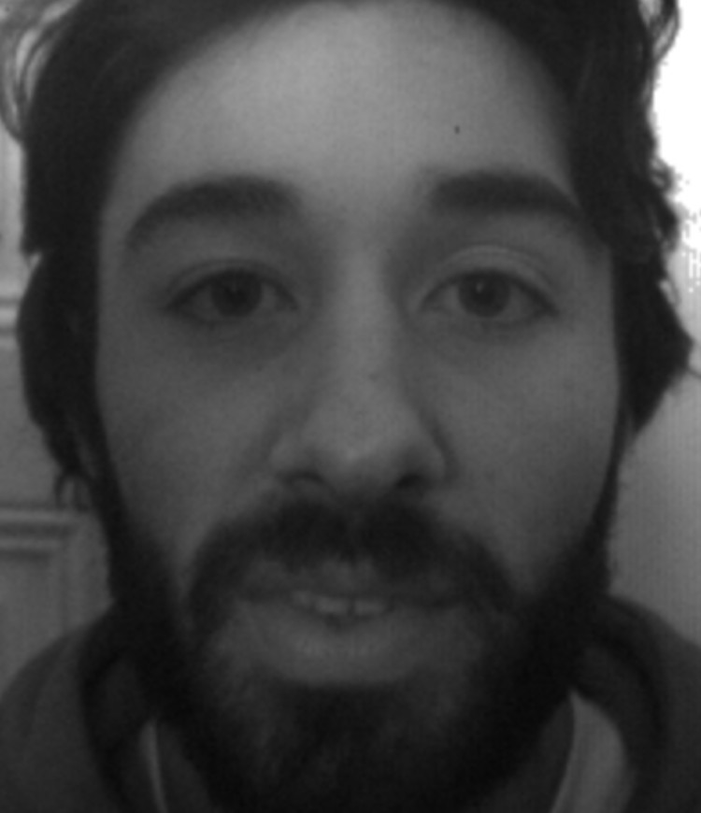
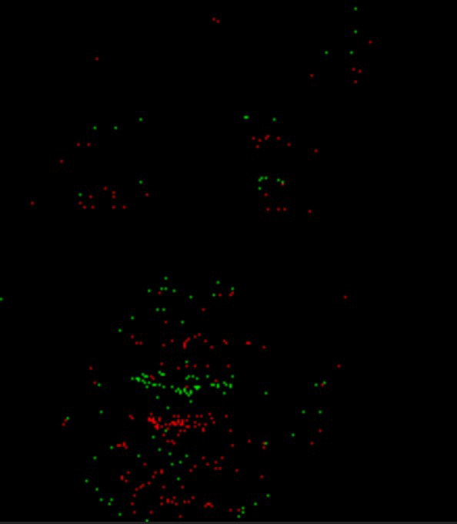
Introduction - Recap
Problematic : How we can detect micro-expressions on people ?
Facial movements : smile, blink eyes, frown, contract jaw, nose winkle, open mouth and upper lid raiser.

Slide 3
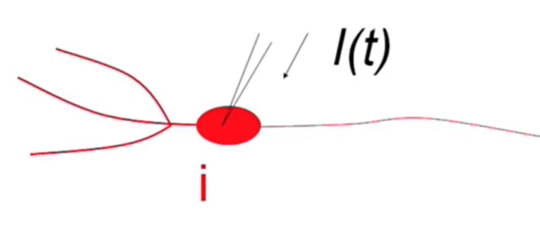
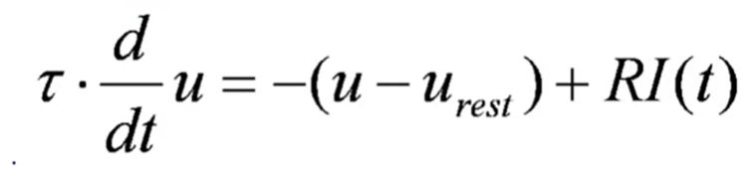
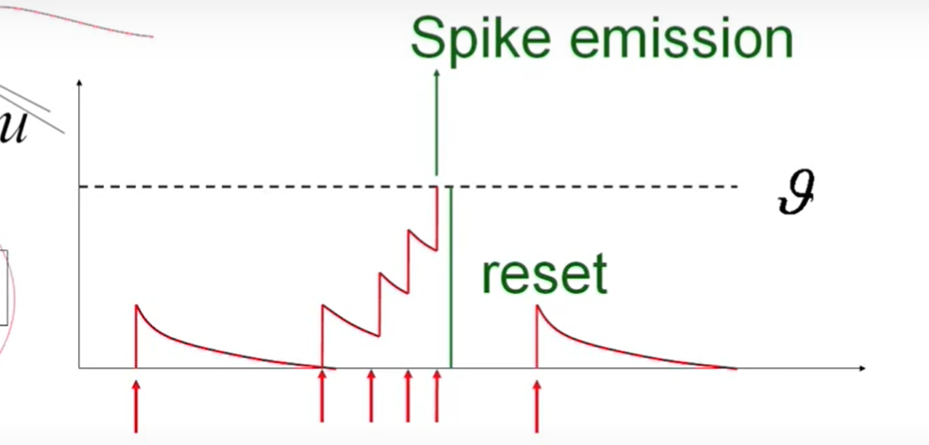
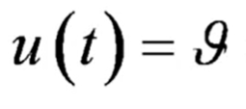
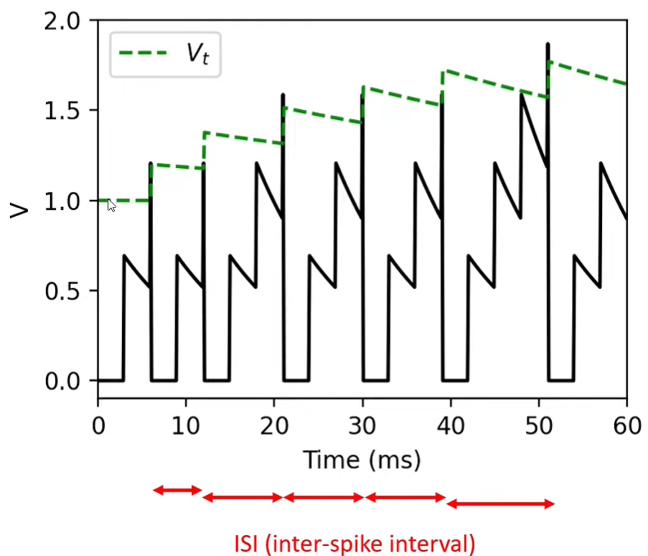
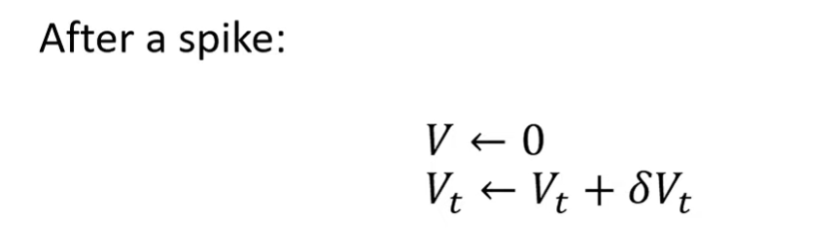
Spiking neural network
Integrate-And-Fire-Models :
2D leaky integrate-and-fire :

Slide 4
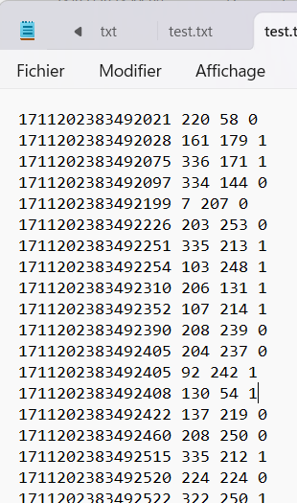
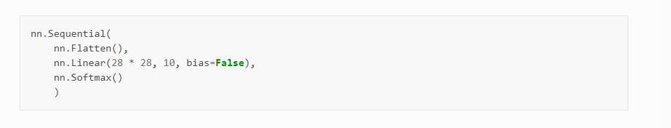
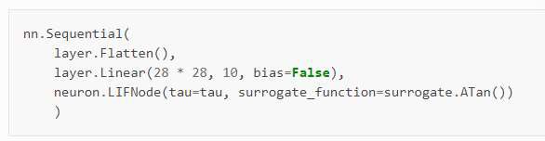
Spiking neural network
-Conversion of the event videos
- spikingjelly based on pytorch (https://github.com/fangwei123456/spikingjelly)
- SNN model : https://github.com/fangwei123456/Spike-Element-Wise-ResNet

Slide 5
Dataset
Protocol :

Slide 6
Dataset
Informations :

Slide 7
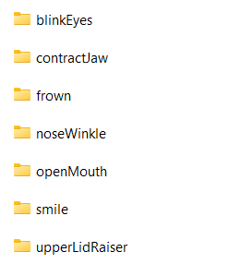
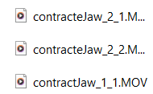
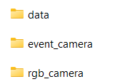


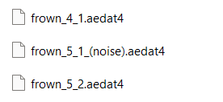
Dataset
Structure :
rgb_camera
Event_camera
data
Format label : facialMovement_id_number_(noiseOrNot)

