Slide 1

Beyond the Smile: Capturing Micro Expressions with Event-based Vision
Victor MAYAUD
Elliot BOUCHY

Slide 2
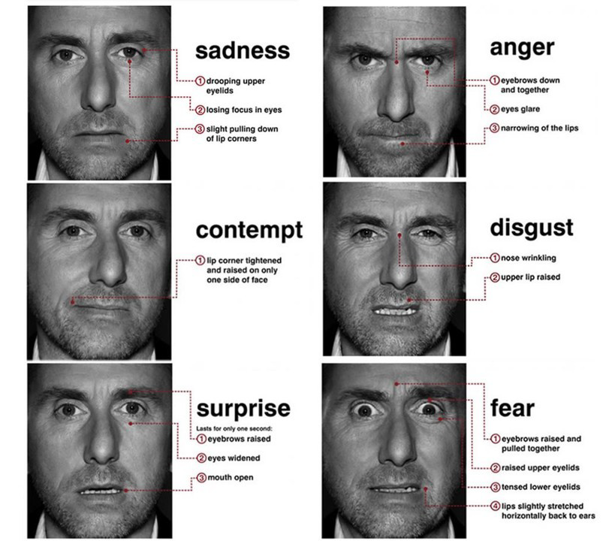
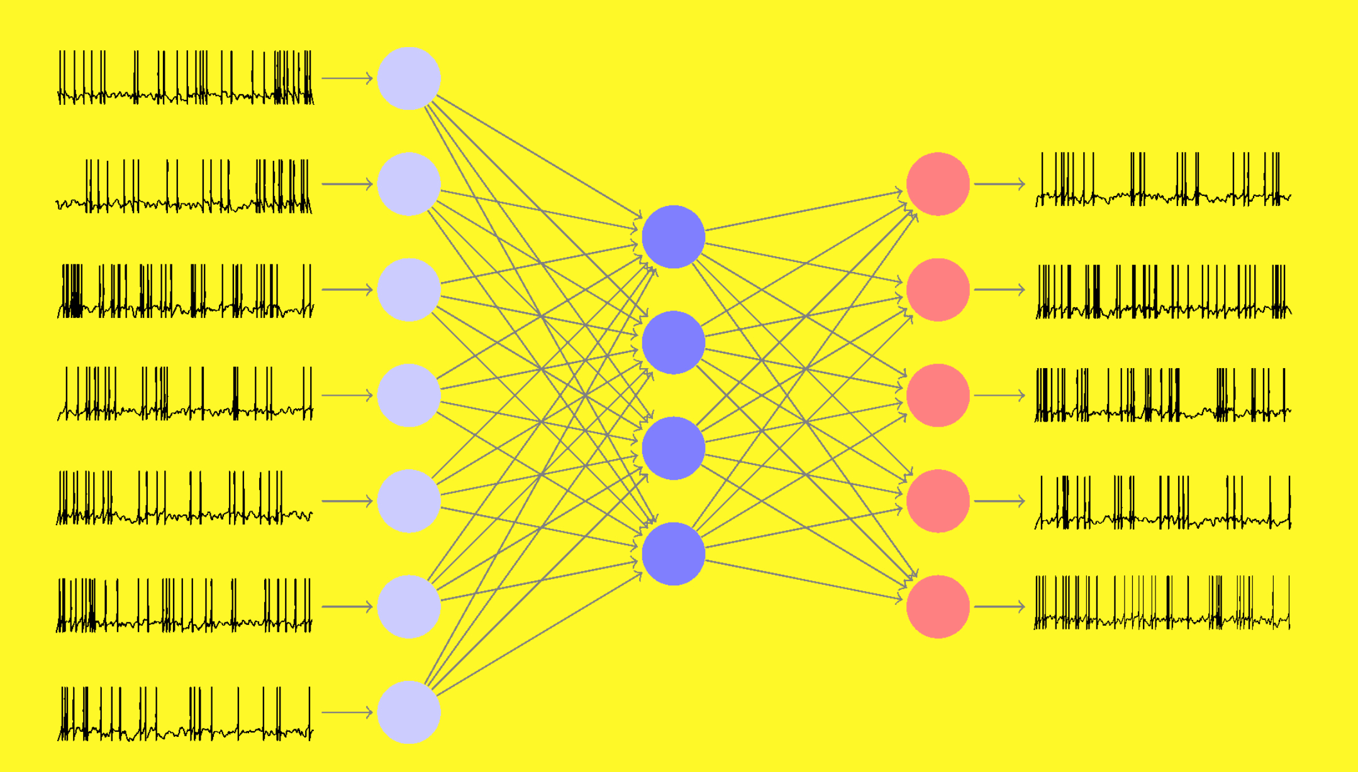
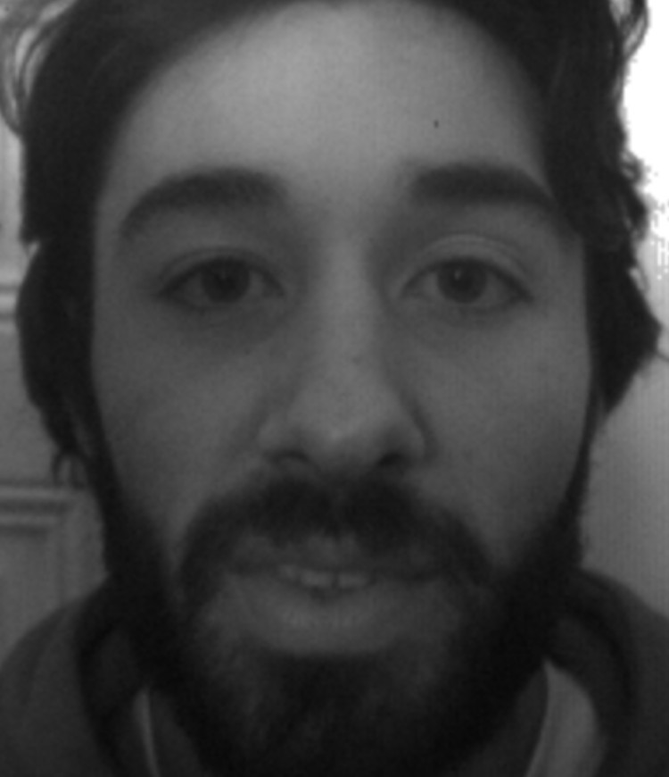
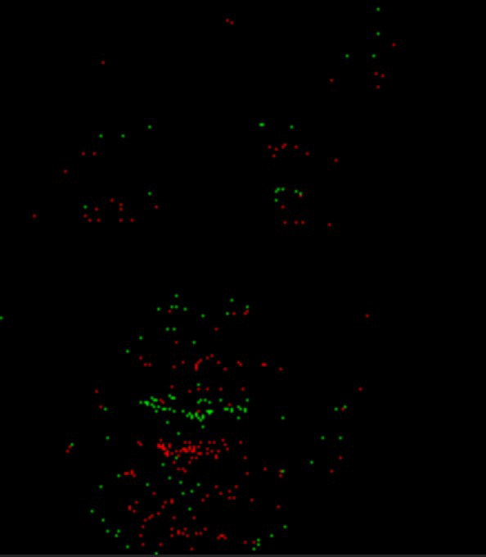
Introduction-
Facial movements : smile, blink eyes, frown, contract jaw, nose winkle, open mouth and upper lid raiser.

Slide 3
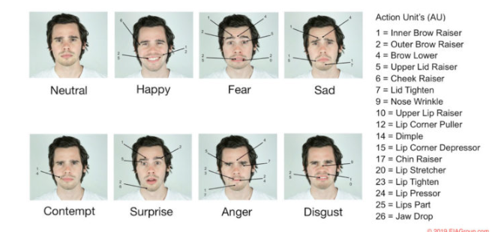
What is an emotion ?
Facial movements : smile, blink eyes, frown, contract jaw, nose winkle, open mouth and upper lid raiser.
Problematic : How to dectect real micro-expression with an event camera ?

Slide 4
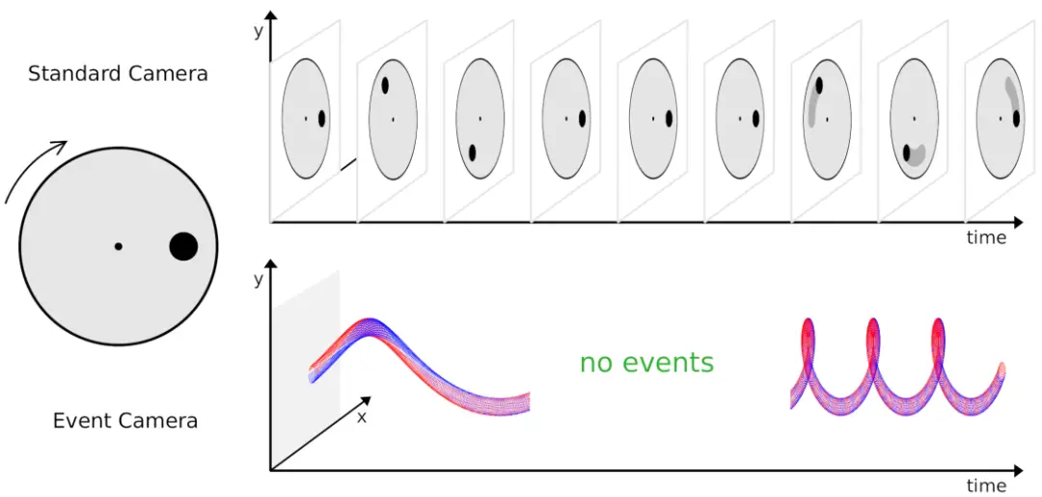
Event-camera
Event Camera RGB Camera
- Captures changes in brightness at each pixel -Captures images at regular intervals
asynchronously.
-Latency: Very low --Latency: Higher
-Energy Consumption: Lower, operates asynchronously. -Energy Consumption: Higher, requires
-Lighting Conditions: Excellent performance in low light, -Lighting Conditions: Sensitive to lighting conditions,

Slide 5
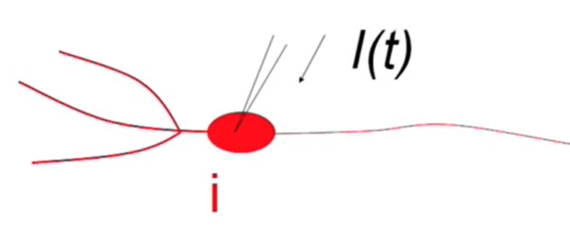
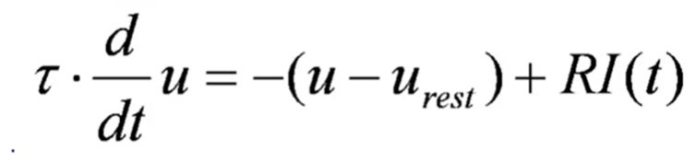
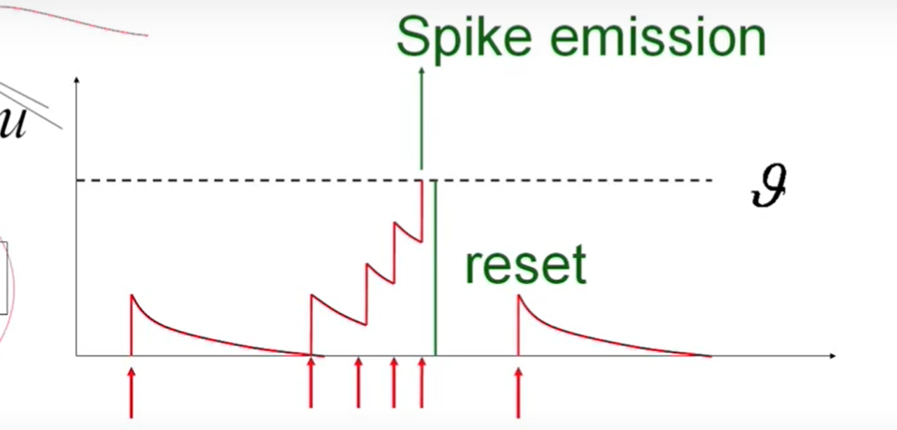
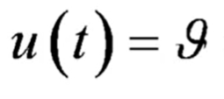
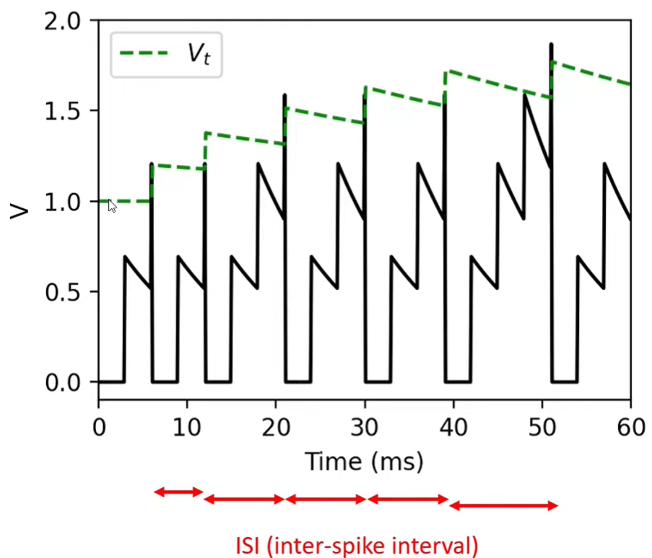
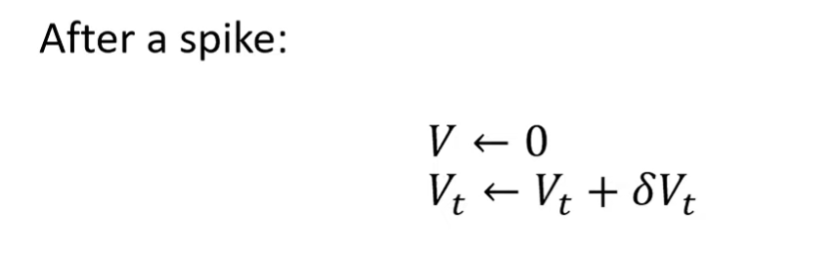
Spiking neural network
Integrate-And-Fire-Models :
2D leaky integrate-and-fire :

Slide 6
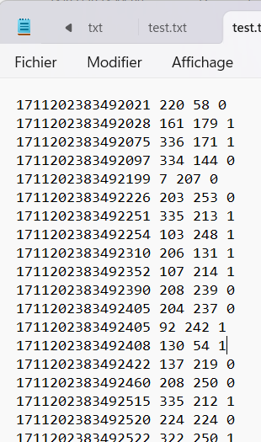
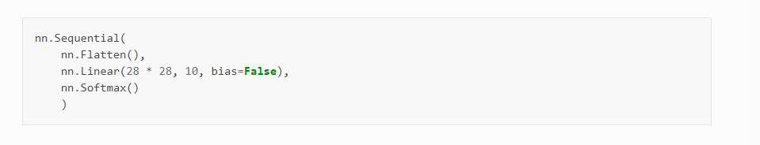
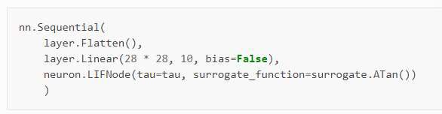
Spiking neural network
-Conversion of the event videos
- spikingjelly based on pytorch
- SNN model : SEWRESNET

Slide 7
Dataset
Protocol :
1) Positioned 30 cm from both cameras
2) Look at event camera
3) Be neutral
4) Use a paper to synchronize both
camera
5) Raise your hand when the actor has
to make his movement ( mouth opening,
frown...)

Slide 8
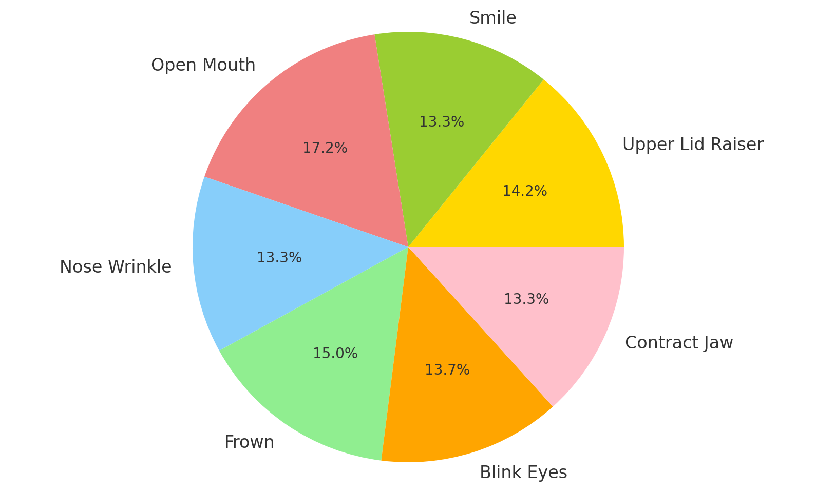
Dataset
Informations :
-number of videos : 233
-average time per video : 8s
-time : 30min of videos
Additional details :
-30 persons (someone 2-3 times, with and without glasses, men/women,around
7-8s on 7 facial expressions).
- Every data is sorted/labellled.
- RGB,Thermal, Event and Text data.

Slide 9
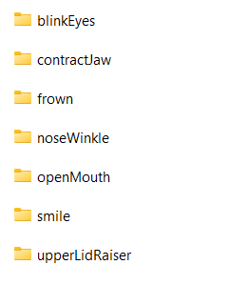
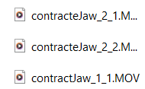
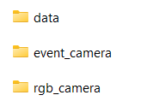


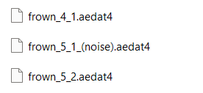
Dataset
Structure :
rgb_camera
Event_camera
data
Format label : facialMovement_id_number_(noiseOrNot)

Slide 10
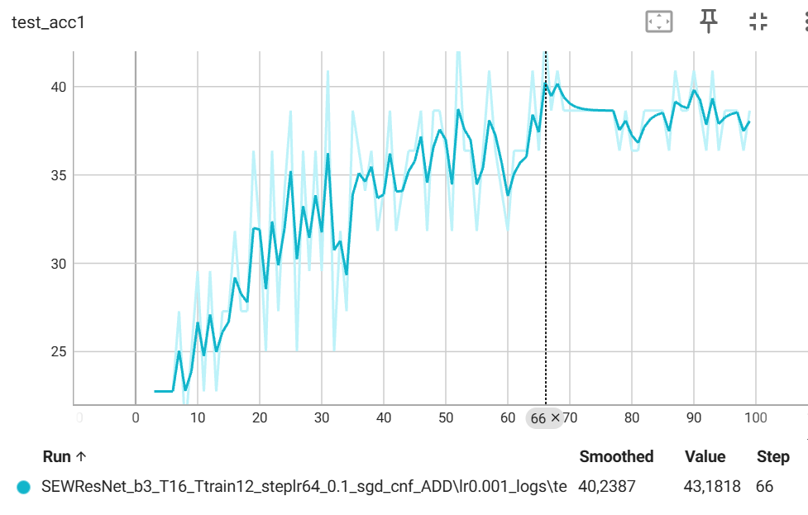
Result with comparaison
Detection micro expression | SNN | CNN
Accuracy | 43,18 % | 30.95%

Slide 11
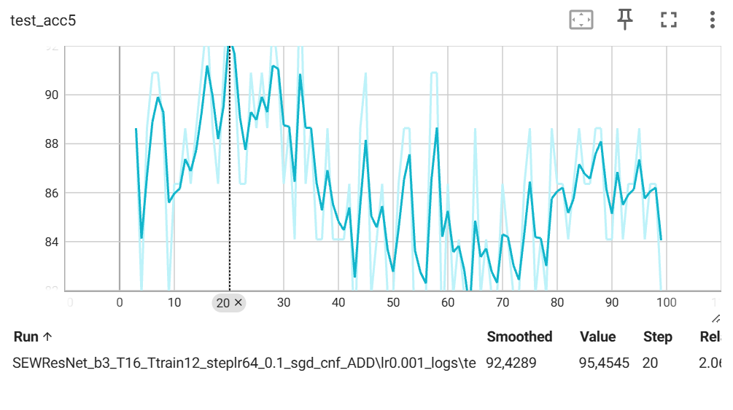
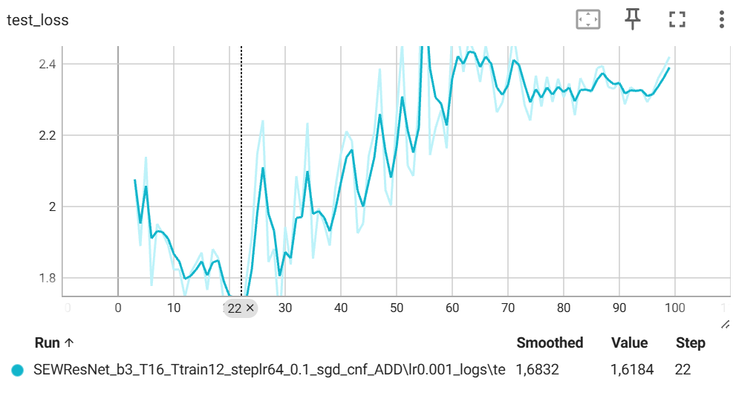
Result :

Slide 12
Conclusion

