Slide 1
Unit 9 Assignment
Mai, Elliot | Robinson, Cj | Samos, Adrienne | Turner, Gerald | Vega, Israel

Slide 2
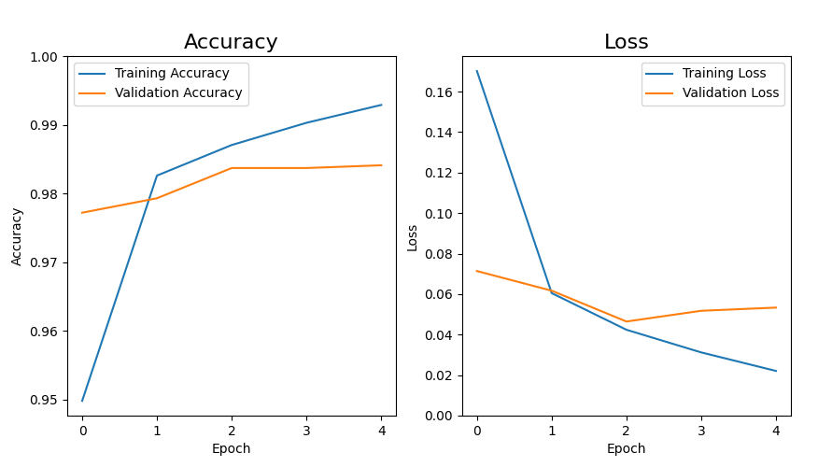
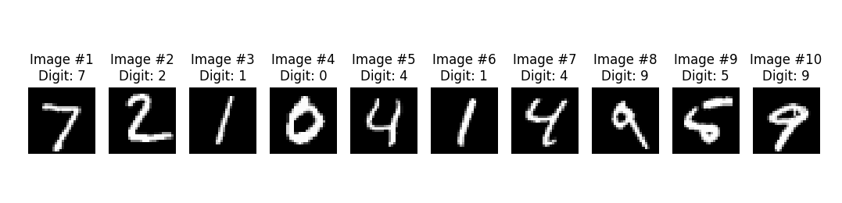
Baseline Model
Description: The baseline model is a simple Convolutional Neural Network (CNN) trained on the MNIST handwritten digit dataset. It consists of a single Conv2D layer with 32 filters (3×3, ReLU activation), followed by one MaxPooling2D layer (2×2, stride 2), then a Flatten layer, a Dense layer with 64 neurons (ReLU), and a final Dense output layer with 10 neurons (Softmax) for digit classification. The model was compiled with the Adam optimizer and sparse categorical cross-entropy loss, and trained for 5 epochs.
Results: The baseline model performed strongly out of the box. Training accuracy started at approximately 95% in epoch 1 and climbed steadily to ~99.2% by epoch 5. Validation accuracy began higher than training accuracy (~97.7% at epoch 1), reflecting good generalization from the start, and reached ~98.8% by the final epoch. Training loss dropped sharply from ~0.165 to ~0.022, while validation loss decreased from ~0.070 to ~0.055. The close tracking between training and validation curves indicates the model is not overfitting, and the single Conv2D block was sufficient to achieve high accuracy on this relatively simple dataset.

Slide 3
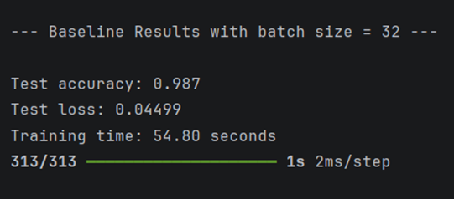
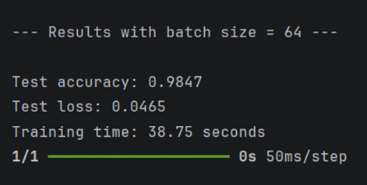
Variation 1: Adrienne Samos
Parameters Changed: Batch Size increased from 32 (baseline) to 64
Hypothesis: Increasing the batch size should make training faster, but accuracy may decrease slightly due to less frequent updates.
Results: Hypothesis is correct. The increase in batch size made training faster by 29% with a small 0.23% accuracy drop.
Metric | Baseline (batch size 32) | Variation (batch size 64) | Change
Test Accuracy | 98.70% | 98.47% | ↓ 0.23%
Test Loss | 0.04499 | 0.0465 | ↑ 0.00151
Training Time | 54.80 seconds | 38.75 seconds | ↓ 16.05 seconds (29% faster)

Slide 4
Variation 2: Conregan Robinson
Parameters Changed:
Hypothesis:
Results:

Slide 5
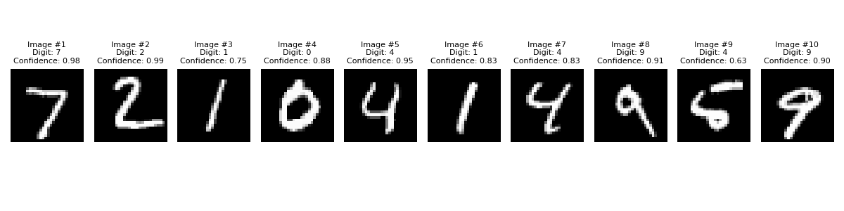
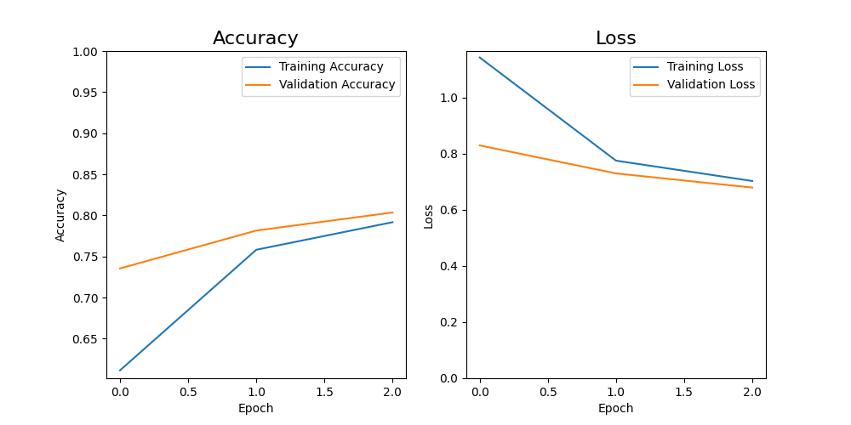
Variation 3: Israel Vega
Parameters Changed: Reduced CNN model complexity by lowering the number of convolution filters, hidden layer neurons, and training runs to evaluate the impact on training speed and model accuracy.
Training Runs (epochs): 5 → 3
Convolution Filters: 32 → 4
Hidden Layers: 64 → 4
Hypothesis: Reducing the number of filters, hidden neurons, and training runs will significantly reduce training time, while attempting to maintain model accuracy above 95%.
Results:
Training time reduced from 99.76s → 23.32s
Accuracy dropped from 98.67% → 80.35%
Loss increased, indicating reduced prediction quality
Model became too small and began underfitting
Conclusion: Hypothesis was partially correct that smaller models train and perfom faster but lose the ability to accurately predict.
Metric | Baseline | Variation
Test Accuracy | 98.67% | 80.35%
Test Loss | 0.0401 | 0.6788
Training Time | 99.76 s | 23.32 s
Evaluation Time | 1.43 s | 0.87 s
Prediction Time | 1.31 s | 0.80 s

Slide 6
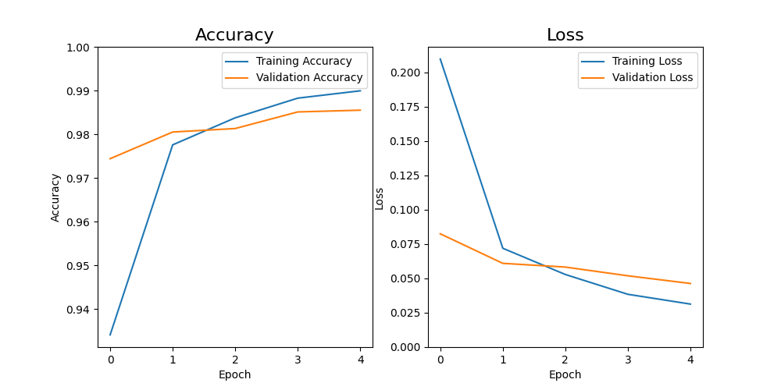
Variation 4: Elliot Mai
Parameters Changed: Added two additional Conv2D + MaxPooling2D blocks (32→64→128 filters)
Hypothesis: Deeper networks extract more complex features, improving accuracy
Results: V4 reached ~99.3% training accuracy vs ~99.2% baseline, with validation accuracy ~98.8% both - marginal improvement with signs of slight overfitting

Slide 7
Variation 5: Gerald Turner
Parameters Changed: Dropout layer added after convolution layers. Dropout layer added before the final dense layer. Dropout rates used: Dropout(0.25)Dropout(0.5)
Hypothesis: Dropout reduces overfitting and improves generalization. Adding dropout layers should reduce overfitting by preventing the network from relying too heavily on specific neurons. Slight increase in training time. Improved generalization on test data. Test accuracy remains similar or slightly improves compared to the baseline. Accuracy remained similar to baseline while improving stability.
Results: Test Accuracy: 98.80%, Test Loss: 0.041, Training Time: 60 seconds. Observed effects: Accuracy remained very similar to baseline. Dropout helped stabilize predictions. Model maintained strong performance on unseen data
Metric | Baseline | Variation
Test Accuracy | 98.70% | 98.80%
Test Loss | 0.0449 | 0.041
Training Time | 54.8 s | ~60 s

Slide 8
Summary
Larger batch size trades minimal accuracy for faster training.
Increasing batch size from 32 to 64 reduced training time by 29% with only a 0.23% drop in accuracy.
Model depth is the strongest driver of accuracy.
Adding two more Conv2D+Pooling blocks pushed training accuracy to ~99.3%, the highest of any version.
Over-reducing model size causes severe underfitting.
Shrinking filters, neurons, and epochs cut training time by 57% but collapsed accuracy to just 80.35%.
Dropout improves stability without sacrificing accuracy.
Adding dropout layers slightly improved test accuracy to 98.80% and reduced loss compared to baseline.

