Slide 1
CU04448 Intelligent Control Introduction and “Hello Python”
Hanshu Yu
2025

Slide 2
Today’s contents
Course Introduction
A very short introduction to Python
Introduction to the assignments.

Slide 3
Course introduction
Lecture 1.5 hr/wk
Includes: The very basic knowledge in Python programming; some selected topics in programming and data science that are applicable in industrial practices.
Excludes: the detailed usage of various python modules, you need to self-study those you need to use. (Like in real work :-D )
Labs 1.5 hr/wk
You need to self-study the usage of Raspberry Pi and the software you would like to use.
You may utilize this period of gathering each week to do anything you want related to this course.

Slide 4
Assessments
TOETS 01
One demo session & oral exam.
1 relative short report for your lab assignment
TOETS 02
One oral exam.
3 very short reports for lecture accompanying assignments.

Slide 5
Prerequisites
You have a computer that you can use.
Some programming experience:
ideally programming in C
programming Arduino, PLC will do.
If you do not have any programming experience,
I do expect you to at least know something about:
what is “programming”?
what is a “function” in programming?
some commonly seen datatypes.

Slide 6
Time management and expectations
Time consumption:
28 * 7.5 * 40% = 84 hours per student.
84/14 = 6 hours per student per week
(3 hours lecture & lab, 3 hours self-study + group work)
Each team 4 students, so 336 hours of work in total.

Slide 7
Assessment design
The assessment follows a basic + exploratory bonus structure.
Max points you get from basic is 8 points.
Exploratory bonus get you maximum 3 points.
Max points you can get is 11 but the passing grade is 5.5 .
Purpose:
I try to make the assignments practical and fun, but you can still pass eventually.
For both TOETS 01 and TOETS 02:
I have taken lecture hours in consideration in the following hours calculation.
The basic tasks are designed to be possible to complete within 250 hours.
Even if you exclude some repetitive work/study in a group (say 2.5 hours per week * 14 weeks) you still can complete everything in 285 hours.
You still have 51 hours per group for exploratory bonus.

Slide 8
Recommended tools – for local set-up on your computer
You must have:
Raspberry Pi
Free to choose:
hardware for your lab assignment
You must have:
Python version 3.10 or 3.11
Jupyter Lab
Free to use:
VS code / Pycharm/ … (Any IDE you want)
Python 3.12 or 3.13
Any OS mac/linux/windows
Do not use:
Python version older than 3.8.10
OS earlier than windows 10

Slide 9
Recommended ways of working & collaboration
Study together and teach each other
Start writing your reports now!
Practice a lot.
Be critical to any explanations you see or come up with.

Slide 10
A very short intro to Python 3

Slide 11
Lab – Map-aware Robot Bayesian Indoor Localization
You run a large factory, you have the map of the factory. You deploy multiple small robots in the factory, they reset every night to perform system upgrade and maintenance.
However, when the robots reboot every morning, they lose their location information and it’s impossible for these robots to function without knowing their location. It is impossible to localize the robots manually, the robot must localize itself in the factory.
Our solution to be implemented:
Particle filter for possible positions of the robot.

Slide 12
Lab – Map-aware Robot Bayesian Indoor Localization
Particle filter for possible positions of the robot.
Particle filter is based on the Bayesian rule:
You update your belief based on new information.
Where do I get new information?
Monte-Carlo sampling. (Random walk of the robot).
Biased sampling. (You move the robot based on some logic).
Task week 1 and 2:
Analyze and decide what do you want to do.
How should your robot move?
How do you know what’s happening to your robot?

Slide 13
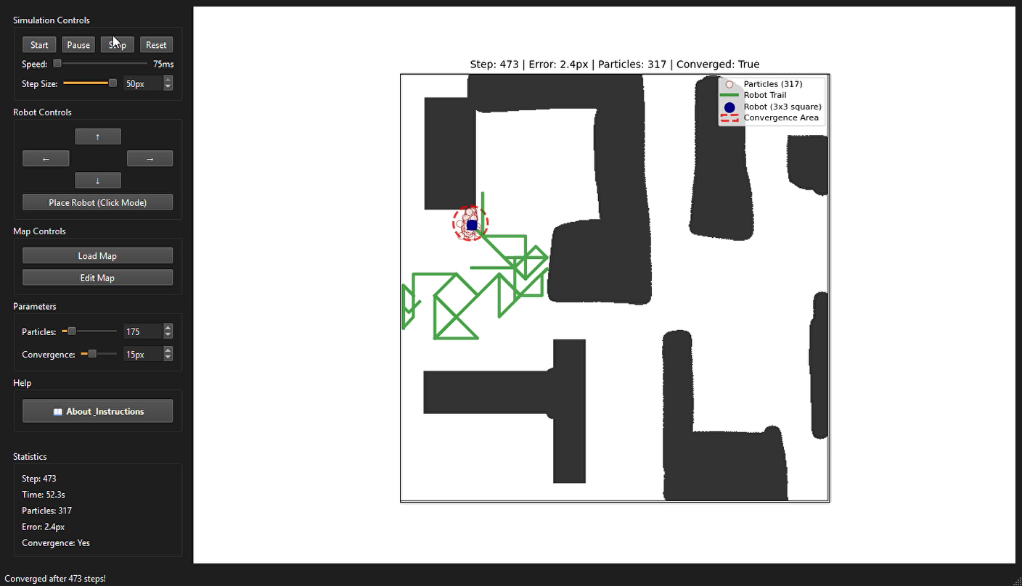
Lab – Map-aware Robot Bayesian Indoor Localization

Slide 14
The Ancient Imitation Game
Information is critical during wars.
“It would be great if enemies can not read my message.” Caesar thought. So he came up with the 1st encryption and decryption scheme: Caesar cypher.
Principle is simple:
You would like to send a plaintext: “ABC”. To keep it as a secret, you can not directly write “ABC” on paper, you must write something else. Caesar set a secret key k only he and his fellow officers know. k indicates how many positions in the alphabet you shift your plaintext to get the ciphertext.
If k = 2, you would write “CDE” on paper for “ABC” and send out the message.
When the officers receive the ciphertext, they can decrypt it by
switching 2 positions back.

Slide 15
The Ancient Imitation Game
It is easy to hack this system.
If you are talking in a certain language, you may find statistics of letter usage frequency. As long as you have enough samples of the ciphertext, you can count the frequency of the letters and match your statistics with the original letter frequency of the language used.
Once you have found a certain number of position shifting that has the least statistical difference with the original frequency spectrum, you have found the key k.

Slide 16
The Ancient Imitation Game
Manipulating different datatypes
Strings modification
Object oriented program design

Slide 17
PID controller simulator
MATLAB is too expensive, I cannot afford it.
But I need to simulate a control system………
Let’s program a PID controller simulator!

Slide 18
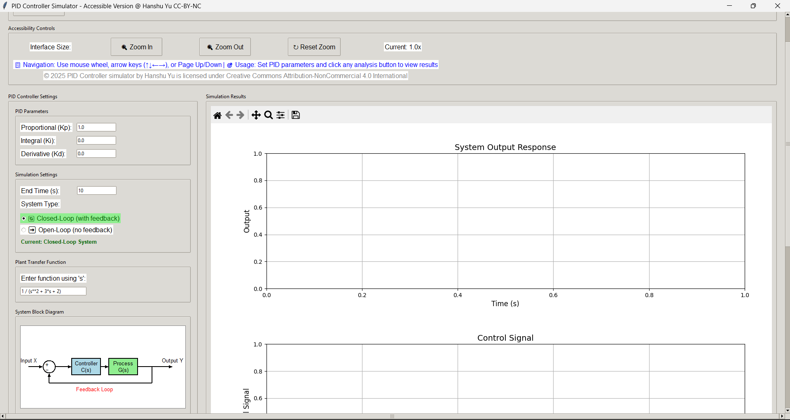
PID controller simulator

Slide 19
PID controller simulator
Using modules
Creating a graphical interface
Visualization design
Object oriented program design

Slide 20
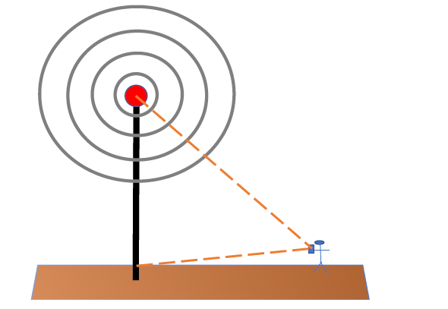
Cellular Mobile Network Operator Simulator
You are a phone service network designer.
You need to check the service quality in your area.
The air carries the electromagnetic waves, the call quality depends on the power received by the phone.
As the user move through your service region, you need to identify what kind of service you may provide to the user.

Slide 21
Cellular Mobile Network Operator Simulator
Analysis and modelling of a realistic problem
Combining business, physics and math
Visualization design
Object oriented program design

Slide 22
Fair or not? Synthetic hiring data exploration
In the era of big data and AI, lots of decisions are data-based. This imposes potential fairness issues: perhaps the AI system or a human-crafted algorithm prefers certain type of people.
However,
is the preference justified?
will there be fairness issues?
what is fairness exactly?
You need to explore the dataset, give your definitions, and examine whether the hiring procedure is fair or not. Discuss your perception of fairness based on what you find.

Slide 23
Fair or not? Synthetic hiring data exploration
Data cleaning and analytics
Ethics discussion
Interpretating data
Critical thinking

Slide 24
Instructions for groups
You must program the:
Lab assignment;
“The Ancient Imitation Game” – Decoding Caesar Cipher.
You do not need to let me know which other 2 you have selected before the final submission. That means if you are really stuck on one, you still can switch if you wish.
But make sure when you submit your report and code, you indicate which two you have done. And out of the 2 assignments selected, which one you have selected to do the exploratory bonus. If you do both, I grade both and choose the highest attained grade.

Slide 25
Homework
Go to python.org and read a little bit of the official tutorial.
Install Jupyter Lab.
If you are totally new to Python programming, I would urge you to install anaconda and jupyter lab in anaconda. This will save you a lot of trouble.
Run your first line of code using Python.
print(“Hello World!”)

