Slide 1
MACHINE LANGUAGE Image Classification task BASIC CNN(Convolutional Neural Network)
25509225
KUANLONG (ELLIOTT) LI / 20 oct. 2025
Notes:
Hello My name is Kuanlong Li, and today I’m going to present my project on image classification using a basic Convolutional Neural Network, or CNN.

Slide 2
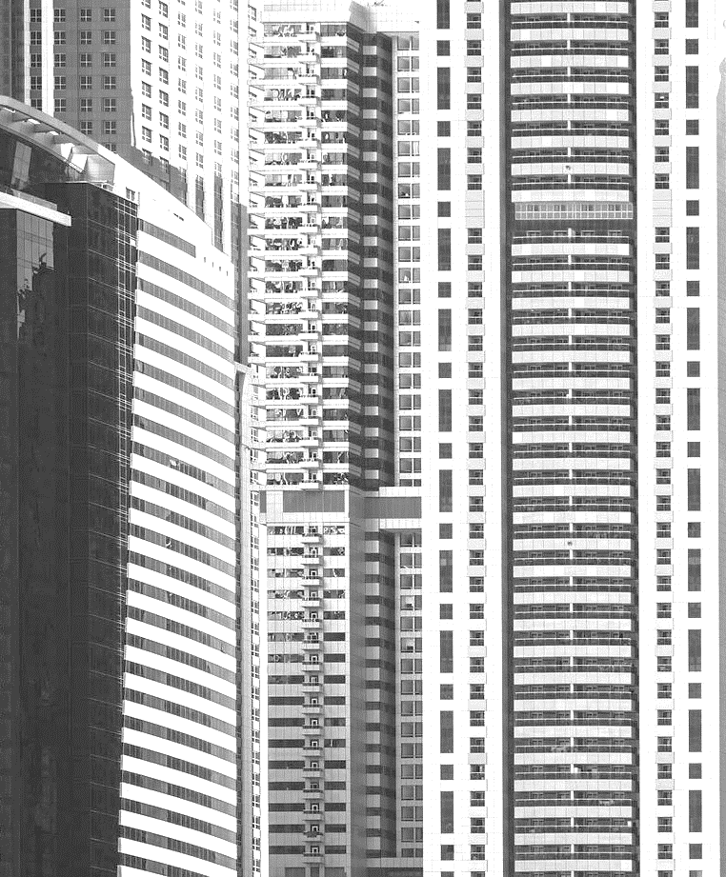

AGENDA
1. Project Overview
2. Data Preparation
3. CNN Container and Components
4. CNN Criterion and Optimizer
5. Training Framework
6. PERFORMING Training, Prediction and Evaluation

Slide 3

1. Project Overview
This project is all about building a Convolutional Neural Network, or CNN, completely from scratch (option 1) to really understand how it works, without using any high-level libraries.

Slide 4
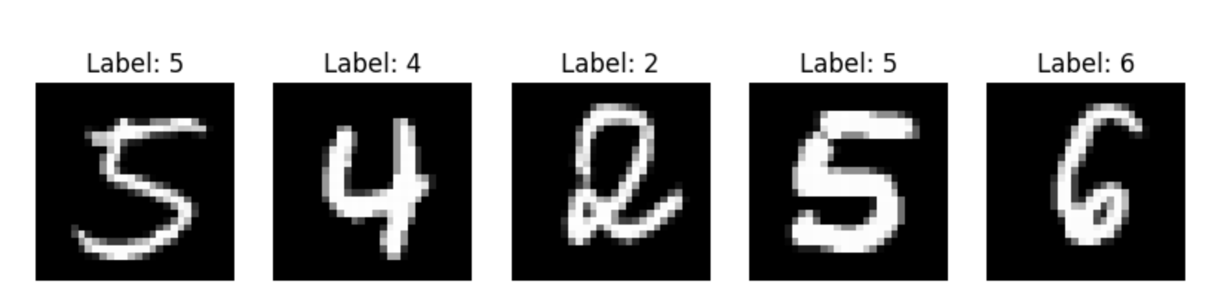
1.Project Overview
UTS KUANLONG LI / 20 OCT 2025
Task: handwritten digit images recognition (multi-classification task).
Dataset: the MNIST dataset (70,000 examples)
Input: 28×28 grayscale images Output: A probability distribution over 10 digit classes (0–9)

Slide 5
2. Data Preparation
Loading dataset and Splitting
Preprocess images
One-hot encode labels
Data augmentation
This ensures that data is ready for CNN input
NB: without manual low-level implementations, keeping the focus on the CNN model design and training in subsequent steps.

Slide 6
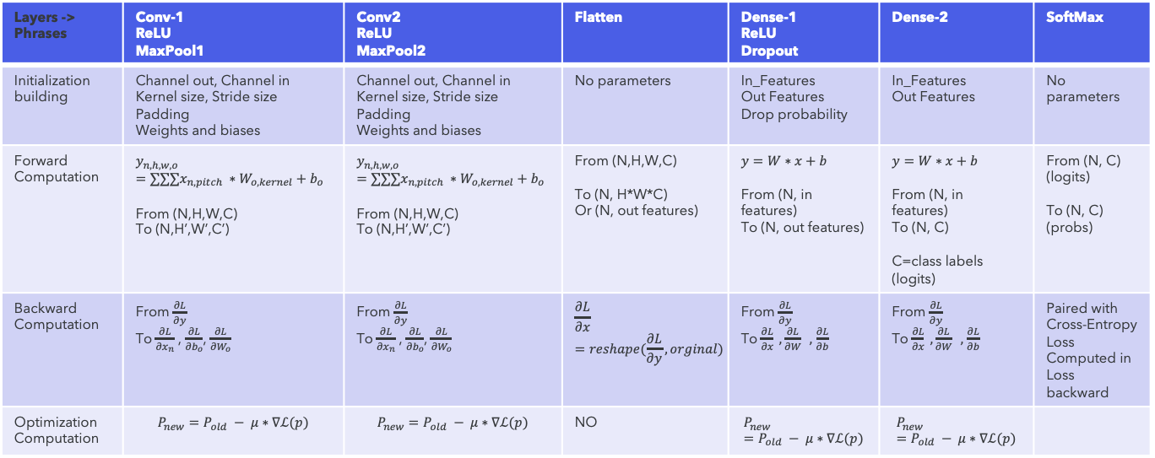
Simple CNN Structure Design
Data
Visualization
Data Loading and Preprocessing -> (Test Dataset + Validation Dataset + Test Dataset)
Prediction (test dataset)
CNN Training Framework (Algorithm)
2-Levels Loop Training
CNN Container
Criterion
Layers -> Phrases | Conv-1 ReLU MaxPool1 | Conv2 ReLU MaxPool2 | Flatten | Dense-1 ReLU Dropout | Dense-2 | SoftMax
Initialization building | Channel out, Channel in Kernel size, Stride size Padding Weights and biases | Channel out, Channel in Kernel size, Stride size Padding Weights and biases | No parameters | In_Features Out Features Drop probability | In_Features Out Features | No parameters
Forward Computation | $$y_{n,h,w,o}=∑∑∑x_{n,pitch} ∗W_{o,kernel}+b_{o}$$ From (N,H,W,C) To (N,H’,W’,C’) | $$y_{n,h,w,o}=∑∑∑x_{n,pitch} ∗W_{o,kernel}+b_{o}$$ From (N,H,W,C) To (N,H’,W’,C’) | From (N,H,W,C) To (N, H*W*C) Or (N, out features) | $$y=W∗x+b$$ From (N, in features) To (N, out features) | $$y=W∗x+b$$ From (N, in features) To (N, C) C=class labels (logits) | From (N, C) (logits) To (N, C) (probs)
Backward Computation | From $\frac{∂L}{∂y}$ To $\frac{∂L}{{∂x}_{n}}$ , $\frac{∂L}{{∂b}_{o}}$, $\frac{∂L}{{∂W}_{o}}$ | From $\frac{∂L}{∂y}$ To $\frac{∂L}{{∂x}_{n}}$ , $\frac{∂L}{{∂b}_{o}}$, $\frac{∂L}{{∂W}_{o}}$ | $$\frac{∂L}{∂x}=reshape(\frac{∂L}{∂y}, orginal)$$ | From $\frac{∂L}{∂y}$ To $\frac{∂L}{∂x} , \frac{∂L}{∂W} ,$ $\frac{∂L}{∂b}$ | From $\frac{∂L}{∂y}$ To $\frac{∂L}{∂x} , \frac{∂L}{∂W} ,$ $\frac{∂L}{∂b}$ | Paired with Cross-Entropy Loss Computed in Loss backward
Optimization Computation | $$P_{new}=P_{old} − μ∗∇ℒ(p)$$ | $$P_{new}=P_{old} − μ∗∇ℒ(p)$$ | NO | $$P_{new}=P_{old} − μ∗∇ℒ(p)$$ | $$P_{new}=P_{old} − μ∗∇ℒ(p)$$
Epoch-Level
Confusion Matrix
Batch-Level
Cross-Entropy Loss Function
CNN Forward
CNN Backward
Classification Report
Loss Fun
Optimizer
Early Stopping
Patience
ROC Curves and AUC
Criterion
Validation
Optimizer
SGD
Learning rate
Train losses
Val losses
Train accuracy
Val accuracy
Best epoch
Best Model (Hypothesis / Parameters)
Visualization of Training (loss curves / accuracy curve)

Slide 7

3. CNN Container and Components
3.1 CNN Components
3.2 CNN Container
3.3 Convolutional Computation Understanding

Slide 8
3.1 CNN Components
Convolution – Feature extraction
MaxPooling – Down sampling
Flatten – Converts feature maps to vectors
Dense – Fully connected layer for classification
ReLU – Non-linear activation
Dropout – Prevents overfitting
SoftMax – Outputs class probabilities

Slide 9
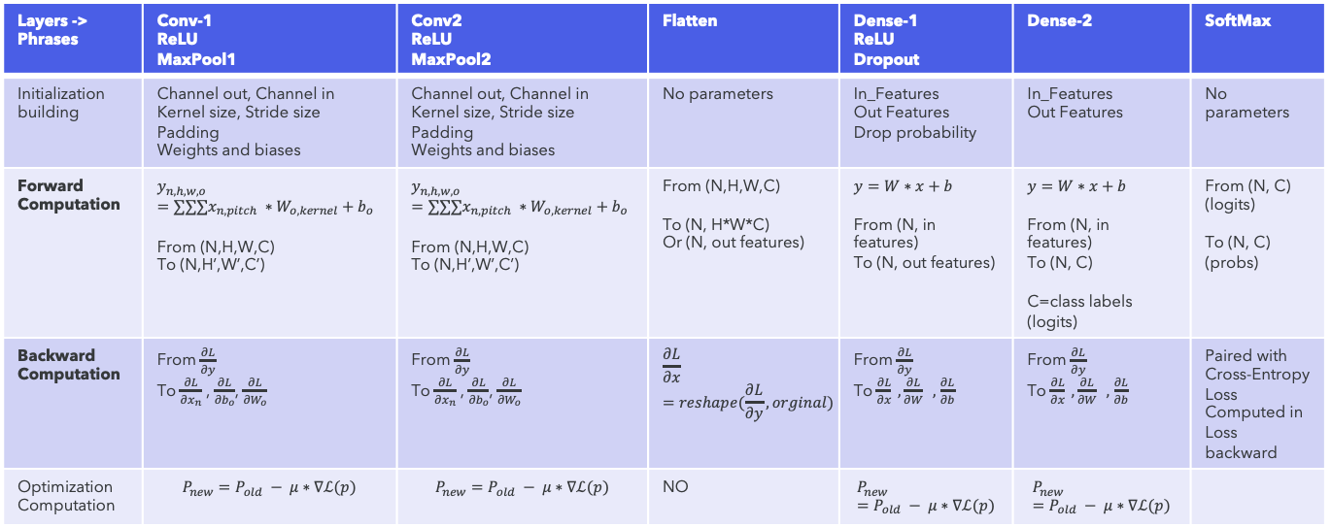
3.2 CNN Container
CNN Container
Layers -> Phrases | Conv-1 ReLU MaxPool1 | Conv2 ReLU MaxPool2 | Flatten | Dense-1 ReLU Dropout | Dense-2 | SoftMax
Initialization building | Channel out, Channel in Kernel size, Stride size Padding Weights and biases | Channel out, Channel in Kernel size, Stride size Padding Weights and biases | No parameters | In_Features Out Features Drop probability | In_Features Out Features | No parameters
Forward Computation | $$y_{n,h,w,o}=∑∑∑x_{n,pitch} ∗W_{o,kernel}+b_{o}$$ From (N,H,W,C) To (N,H’,W’,C’) | $$y_{n,h,w,o}=∑∑∑x_{n,pitch} ∗W_{o,kernel}+b_{o}$$ From (N,H,W,C) To (N,H’,W’,C’) | From (N,H,W,C) To (N, H*W*C) Or (N, out features) | $$y=W∗x+b$$ From (N, in features) To (N, out features) | $$y=W∗x+b$$ From (N, in features) To (N, C) C=class labels (logits) | From (N, C) (logits) To (N, C) (probs)
Backward Computation | From $\frac{∂L}{∂y}$ To $\frac{∂L}{{∂x}_{n}}$ , $\frac{∂L}{{∂b}_{o}}$, $\frac{∂L}{{∂W}_{o}}$ | From $\frac{∂L}{∂y}$ To $\frac{∂L}{{∂x}_{n}}$ , $\frac{∂L}{{∂b}_{o}}$, $\frac{∂L}{{∂W}_{o}}$ | $$\frac{∂L}{∂x}=reshape(\frac{∂L}{∂y}, orginal)$$ | From $\frac{∂L}{∂y}$ To $\frac{∂L}{∂x} , \frac{∂L}{∂W} ,$ $\frac{∂L}{∂b}$ | From $\frac{∂L}{∂y}$ To $\frac{∂L}{∂x} , \frac{∂L}{∂W} ,$ $\frac{∂L}{∂b}$ | Paired with Cross-Entropy Loss Computed in Loss backward
Optimization Computation | $$P_{new}=P_{old} − μ∗∇ℒ(p)$$ | $$P_{new}=P_{old} − μ∗∇ℒ(p)$$ | NO | $$P_{new}=P_{old} − μ∗∇ℒ(p)$$ | $$P_{new}=P_{old} − μ∗∇ℒ(p)$$
Organizes layers in sequence for easy model building
Handles forward and backward propagation automatically
Manages parameters and gradients for optimization
Supports layer initialization, training, debugging, and performance tracking

Slide 10
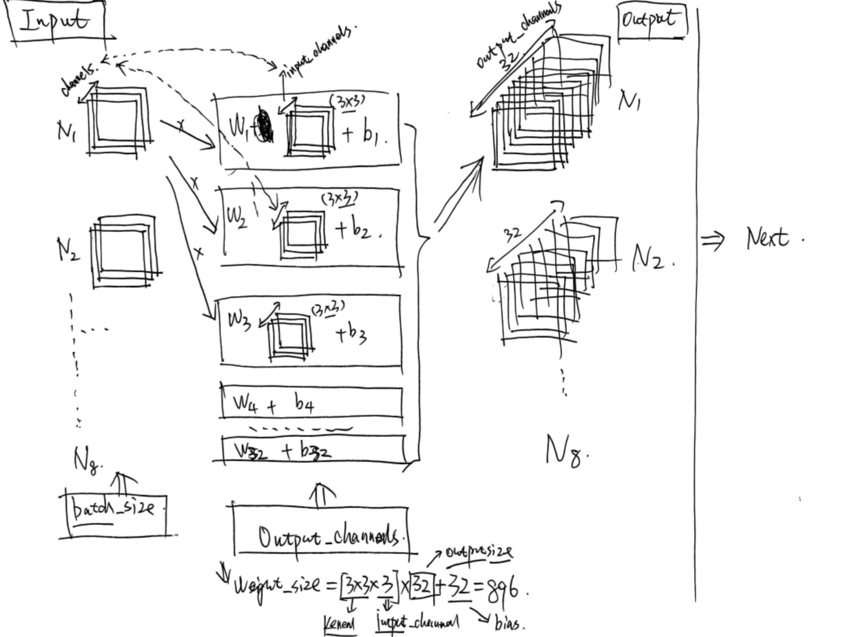
3.3 Convolutional COMPUTATION
Input shape (N,H,W,C)
(8, 28, 28, 3)
out channels = 32
kernel groups = 32
Biases = 32
1 kernel group = 3 single kernel
1 kernel group shape = (3,3,3)
1 single kernel shape = (3,3)
Number of Parameters:
(3*3*3) * 32 + 32 = 896
Output shape (N,H,W,C)
(8, 26, 26, 32)
(no padding, stride = 1)
One kernel group -> one feature map

Slide 11
4. CNN Criterion and OPTIMIZER
4.1 CRITERION - (CORSS-ENTORPY)
4.2 OPTIMIZER - (SGD)

Slide 12
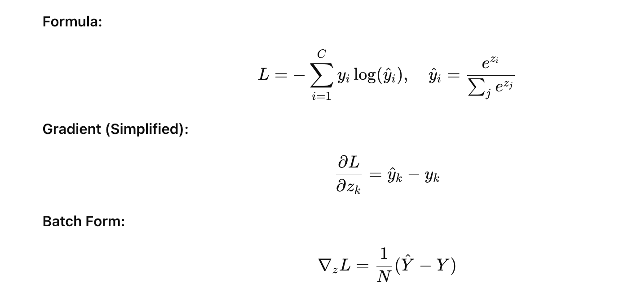
4.1 Cross-Entropy Loss(with Softmax)
Key Ideas:
Softmax converts logits to probabilities.
Cross-entropy measures the gap between predicted and true distributions.
Gradient shows how each logit should adjust during backpropagation.

Slide 13

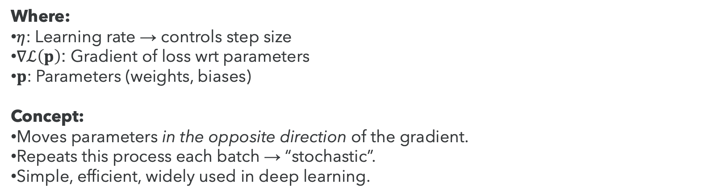
4.2 SGD(Stochastic Gradient Descent)
Core Idea: Update parameters step by step to minimize the loss.
Update Rule:
Where:
$η$: Learning rate → controls step size
$∇ℒ\left(p\right)$: Gradient of loss wrt parameters
$p$: Parameters (weights, biases)
Concept:
Moves parameters in the opposite direction of the gradient.
Repeats this process each batch → “stochastic”.
Simple, efficient, widely used in deep learning.

Slide 14

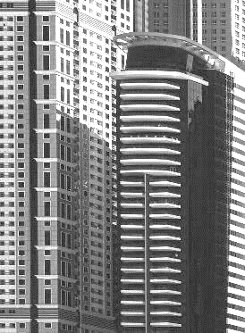


5. Training Framework
5.1 During one training batch
5.2 EPOCH-level TRAINING LOOP
5.3 Validation and Early Stopping

Slide 15
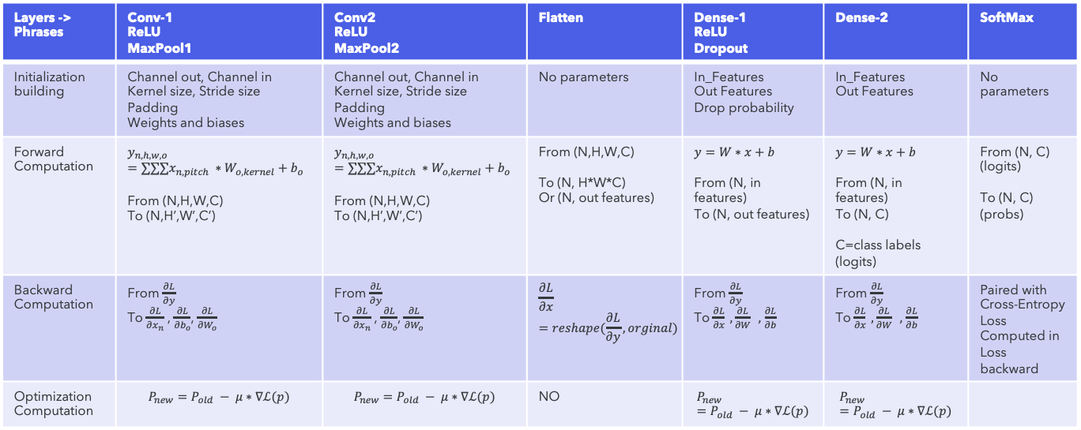
5.1 DURING ONE BATCH TRAINING
CNN Container
CNN Container
Criterion
Layers -> Phrases | Conv-1 ReLU MaxPool1 | Conv2 ReLU MaxPool2 | Flatten | Dense-1 ReLU Dropout | Dense-2 | SoftMax
Initialization building | Channel out, Channel in Kernel size, Stride size Padding Weights and biases | Channel out, Channel in Kernel size, Stride size Padding Weights and biases | No parameters | In_Features Out Features Drop probability | In_Features Out Features | No parameters
Forward Computation | $$y_{n,h,w,o}=∑∑∑x_{n,pitch} ∗W_{o,kernel}+b_{o}$$ From (N,H,W,C) To (N,H’,W’,C’) | $$y_{n,h,w,o}=∑∑∑x_{n,pitch} ∗W_{o,kernel}+b_{o}$$ From (N,H,W,C) To (N,H’,W’,C’) | From (N,H,W,C) To (N, H*W*C) Or (N, out features) | $$y=W∗x+b$$ From (N, in features) To (N, out features) | $$y=W∗x+b$$ From (N, in features) To (N, C) C=class labels (logits) | From (N, C) (logits) To (N, C) (probs)
Backward Computation | From $\frac{∂L}{∂y}$ To $\frac{∂L}{{∂x}_{n}}$ , $\frac{∂L}{{∂b}_{o}}$, $\frac{∂L}{{∂W}_{o}}$ | From $\frac{∂L}{∂y}$ To $\frac{∂L}{{∂x}_{n}}$ , $\frac{∂L}{{∂b}_{o}}$, $\frac{∂L}{{∂W}_{o}}$ | $$\frac{∂L}{∂x}=reshape(\frac{∂L}{∂y}, orginal)$$ | From $\frac{∂L}{∂y}$ To $\frac{∂L}{∂x} , \frac{∂L}{∂W} ,$ $\frac{∂L}{∂b}$ | From $\frac{∂L}{∂y}$ To $\frac{∂L}{∂x} , \frac{∂L}{∂W} ,$ $\frac{∂L}{∂b}$ | Paired with Cross-Entropy Loss Computed in Loss backward
Optimization Computation | $$P_{new}=P_{old} − μ∗∇ℒ(p)$$ | $$P_{new}=P_{old} − μ∗∇ℒ(p)$$ | NO | $$P_{new}=P_{old} − μ∗∇ℒ(p)$$ | $$P_{new}=P_{old} − μ∗∇ℒ(p)$$
Cross-Entropy Loss Function
1. Forward
2. Loss
Computation
3. Backward
4. Optimization Computation
Criterion
Optimizer
SGD
Learning rate

Slide 16
5.2 EPOCH-LEVEL TRAINING LOOP
Data
2 levels of loops of Training) – A complete training training cycle
Container / Loss / Optimizer
CNN Container
Criterion
Epoch-Level (Ep1)
Epoch-Level (Ep 2)
Batch-Level 1
Batch-Level 2
Batch-Level 1
Batch-Level 2
Forward
Forward
Forward
Forward
1. Forward
2. Loss computation
Loss Fun
Loss Fun
1
Loss Fun
2
Loss Fun
Backward
Backward
Backward
Backward
3. Backward
Optimizer
Optimizer
Optimizer
Optimizer
4. Optimization
Optimizer
Outer experimental loop (manually)
Train losses
Val losses
Train accuracy
Val accuracy
Best epoch
Best Model (Hypothesis / Parameters)
Visualization of Training (loss curves / accuracy curve)

Slide 17
5.3 Validation & Early Stopping
Validation
Performed after each epoch to check generalization.
Uses the validation dataset (not used in training).
No parameter updates — only evaluation.
Metrics:
Validation Loss
Validation Accuracy
Early Stopping
Prevents overfitting.
Stop training if validation loss doesn’t improve for several epochs (called patience).
Keeps the best model before performance drops.

Slide 18
6.Training, Prediction, Evaluation and Visualization
Data
Part1: Data Preparation
Part2: Pipeline Initialization
1. Model Building
2. Optimizer Initialization
3. Loss Function Initialization
Part3: Training
Part4: Evaluation
1. Prediction on test dataset
2. Confusion Matrix
3. Classification Report
4. ROC & AUC Visualization
Data Loading and Preprocessing
Prediction (test dataset)
Visualization
Confusion Matrix
CNN Training Framework (Algorithm)
Classification Report
Criterion
ROC Curves and AUC
Best Model

Slide 19
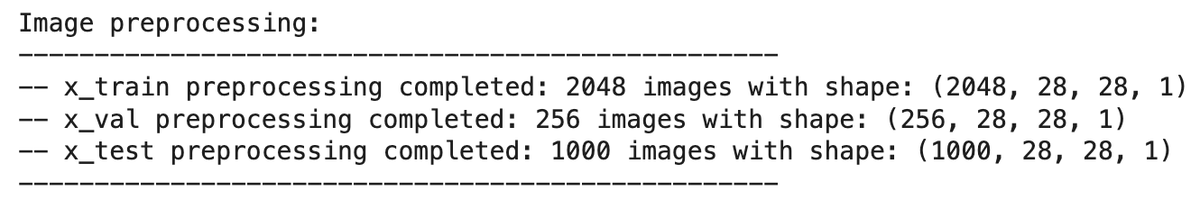
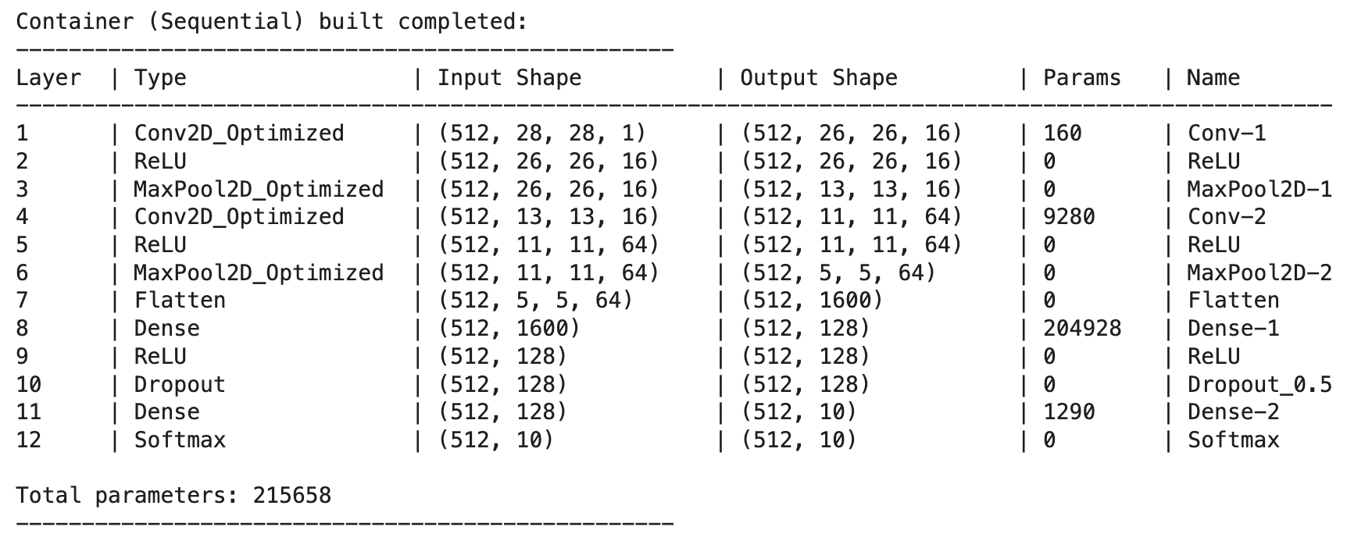
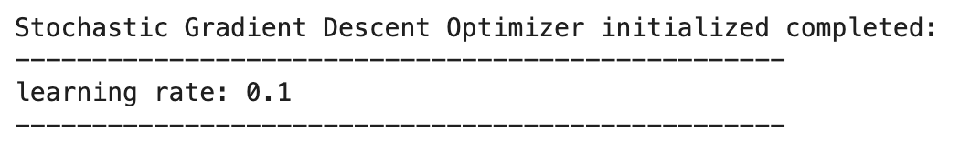
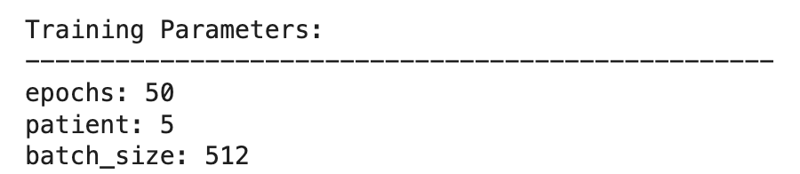
6.Training, Prediction, Evaluation and Visualization
Example 1
Input size: 2048/256/1000
Conv1 : C_out = 16
Conv2: C_out = 64
Dense1: F_out = 128
Dense2: F_out = 10
Total Params: 215,658
LR: 0.1 (bigger)
Epochs: 50
Batch size: 512

Slide 20
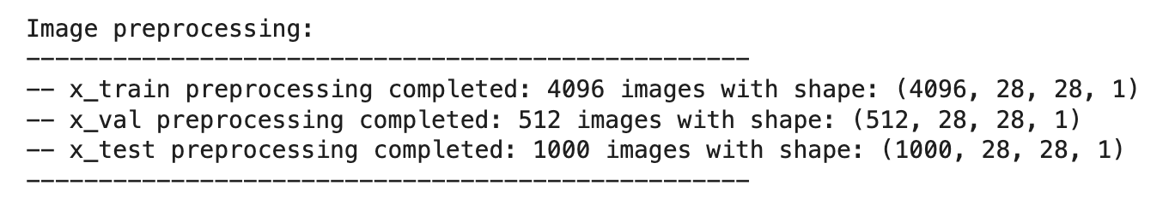
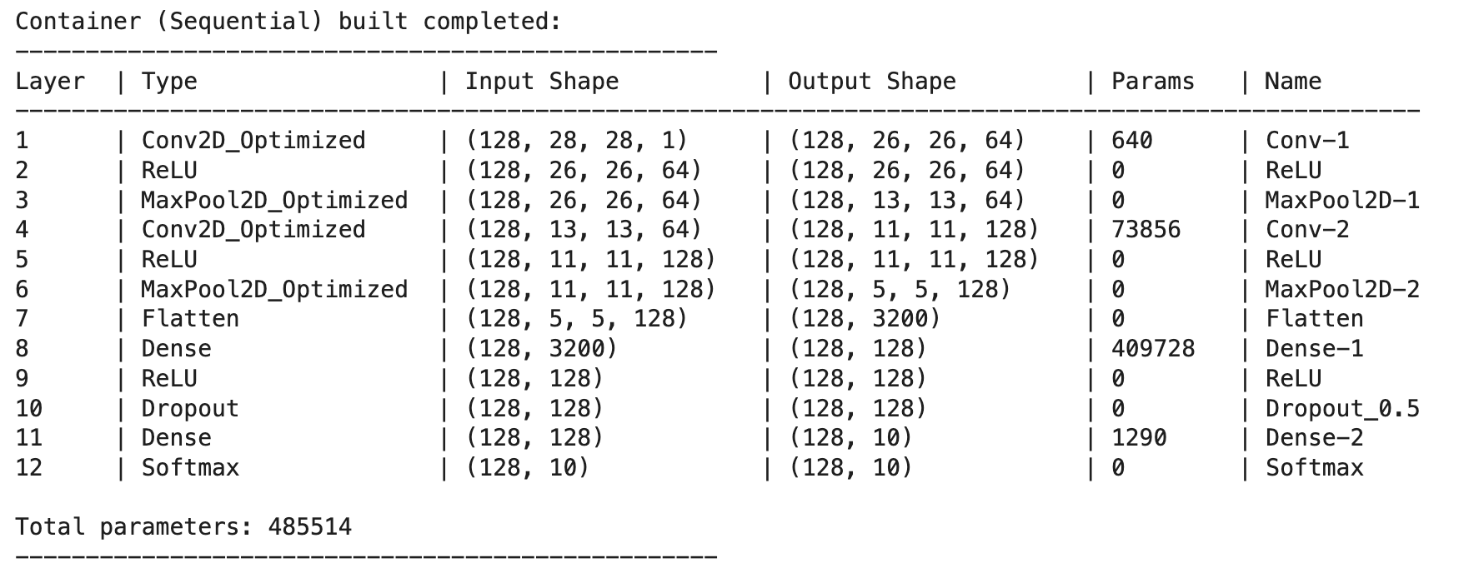
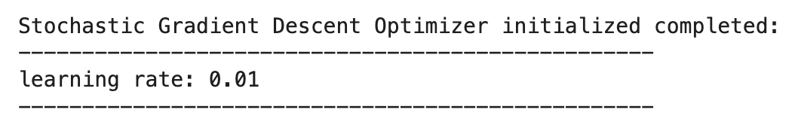
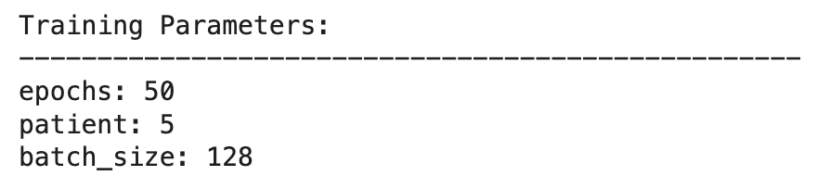
6.Training, Prediction, Evaluation and Visualization
Example 2
Input size: 4096/512/1000
Conv1 : C_out = 64
Conv2: C_out = 128
Dense1: F_out = 128
Dense2: F_out = 10
Total Params: 485,514
LR: 0.01 (smaller)
Epochs: 50
Batch size: 128

Slide 21
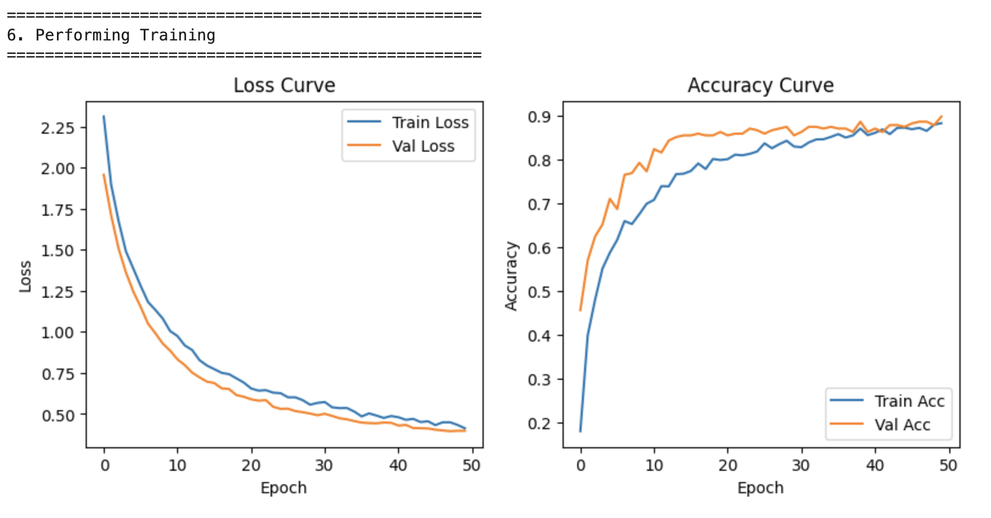
6.Training, Prediction, Evaluation and Visualization
Example 1

Slide 22
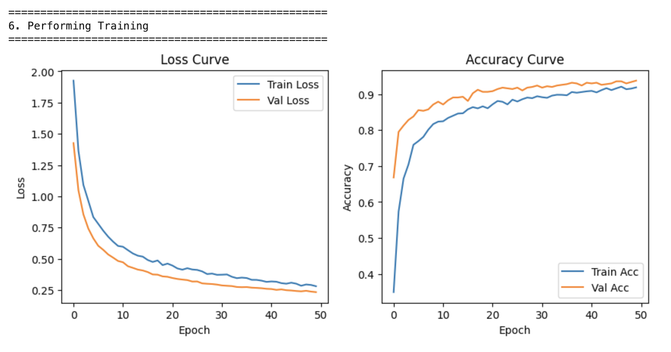
6.Training, Prediction, Evaluation and Visualization
Example 2

Slide 23
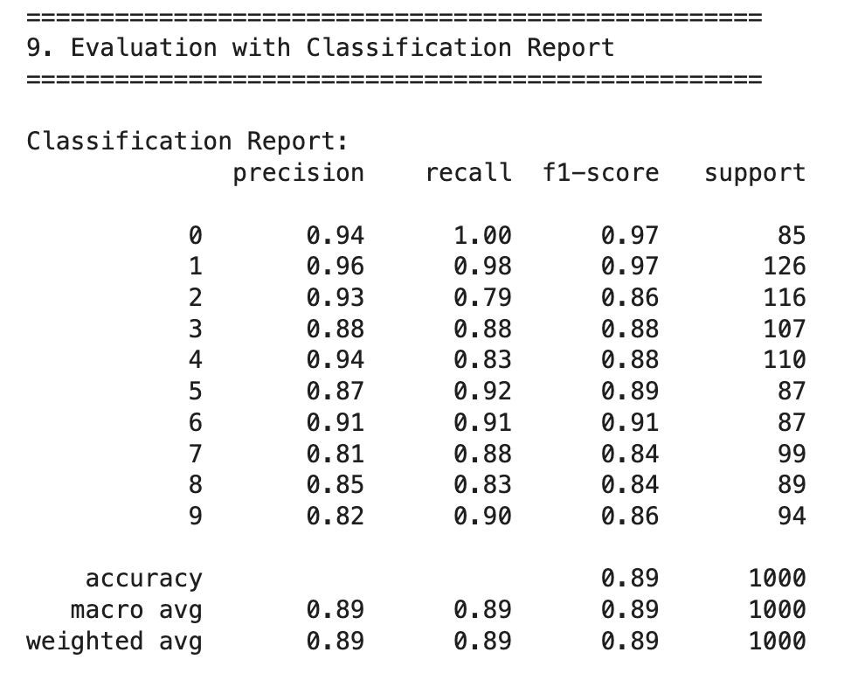
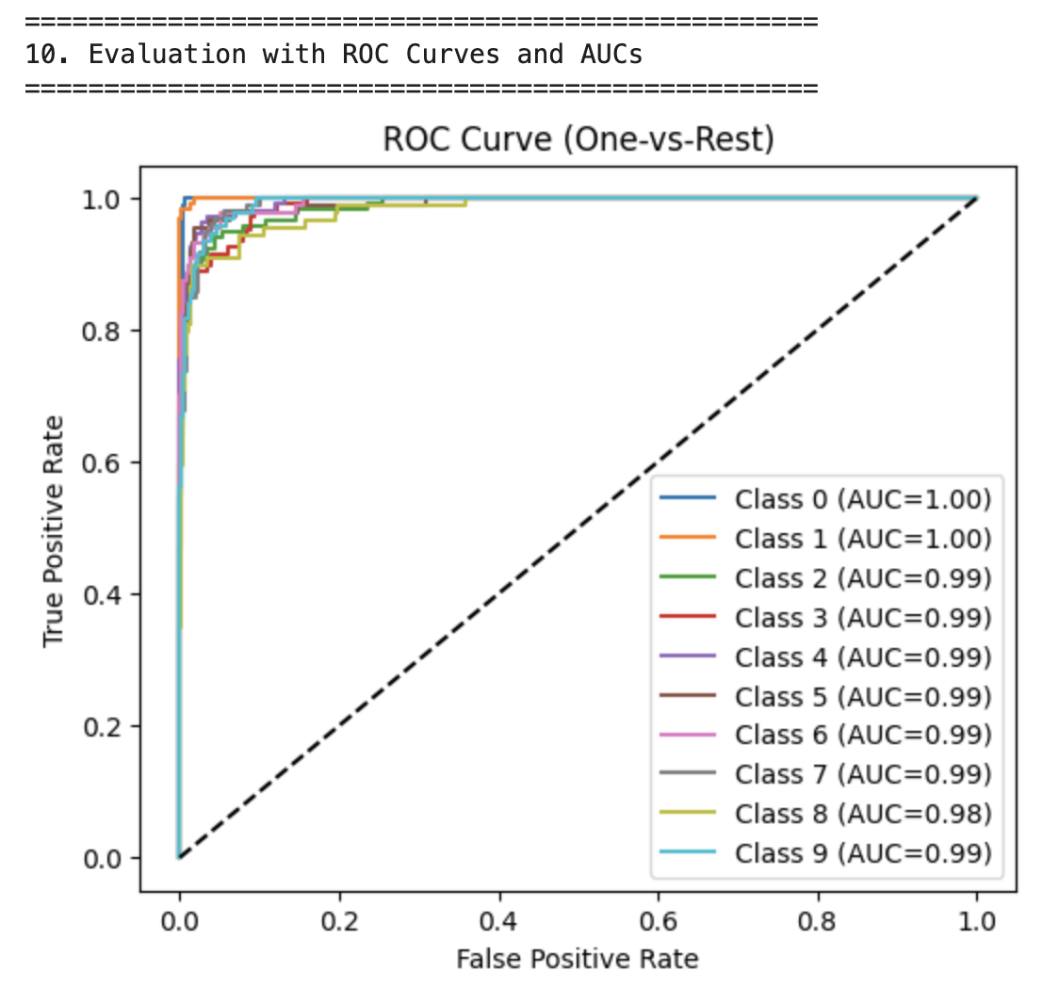
6.Training, Prediction, Evaluation and Visualization
Example 1

Slide 24
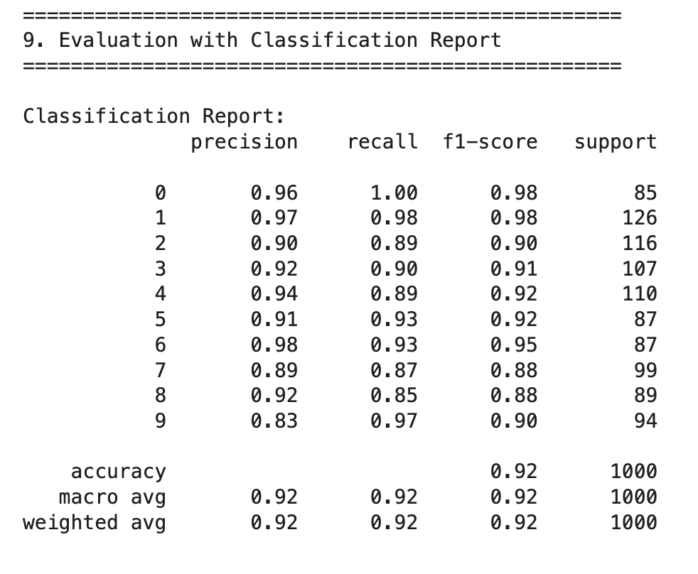
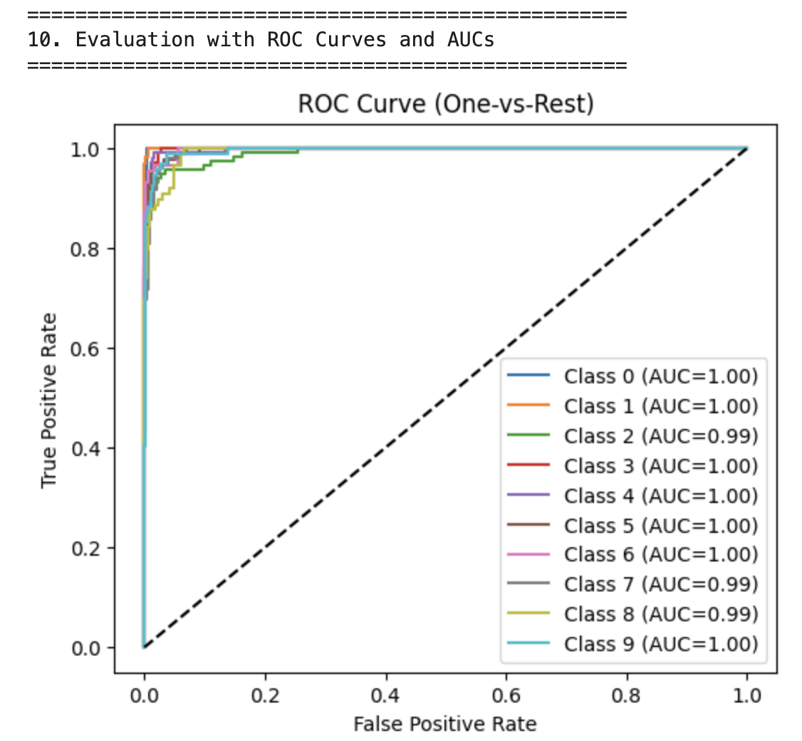
6.Training, Prediction, Evaluation and Visualization
Example 2

Slide 25
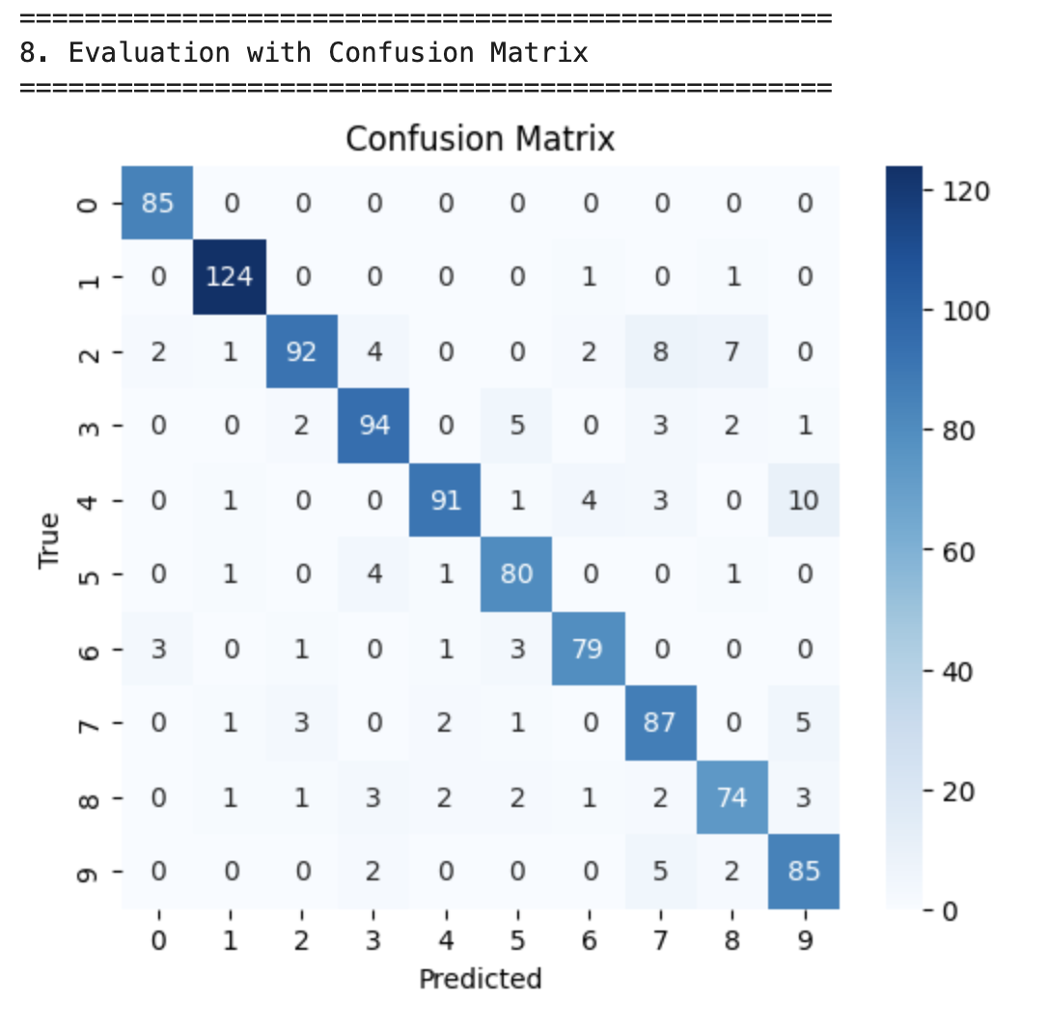
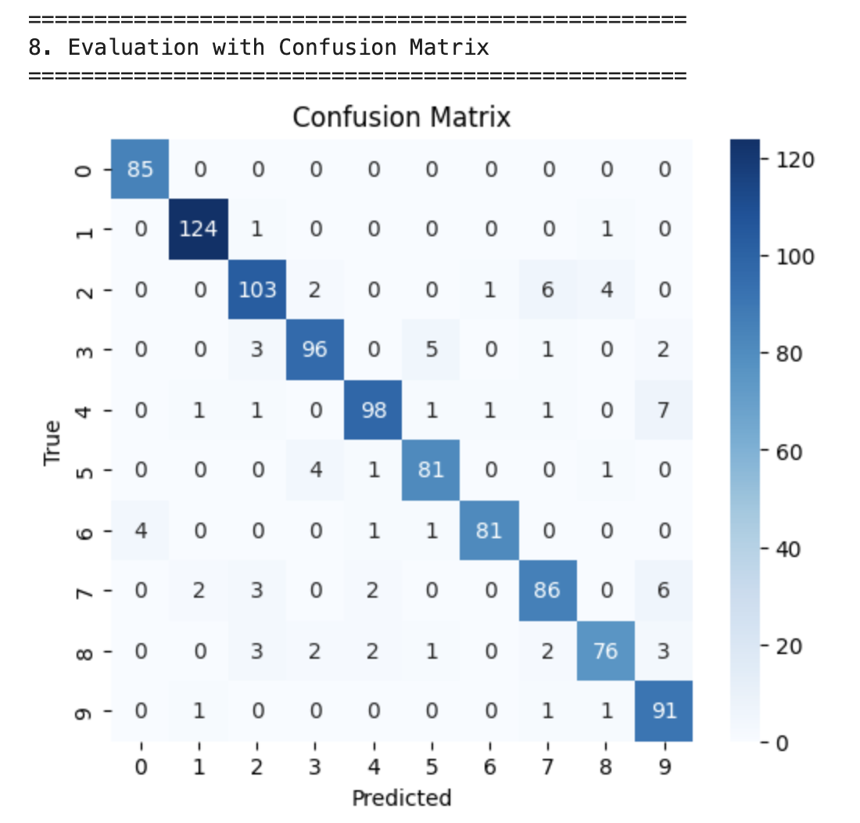
6.Training, Prediction, Evaluation and Visualization
Example 1
Example 2

Slide 26
Challenges
Architectural Design Uncertainty
Still uncertain about how deep the network should be
Unsure how to choose kernel size, stride, and output channels
Hard to balance pooling without losing key features
Batch size trade-off between stability and memory cost
Challenge: I’m still exploring how to design the best architecture. These design choices involve complex trade-offs that I don’t fully understand yet.
Limited Hyperparameter Tuning
Slow training limited tuning experiments
Hard to understand how different parameters interact
Result: I couldn’t perform full tuning, so some hyperparameters remain unexplored. The model likely hasn’t reached its best potential yet.

Slide 27
Q&A THANK YOU
Kuan long (Elliott) Li

