Slide 1
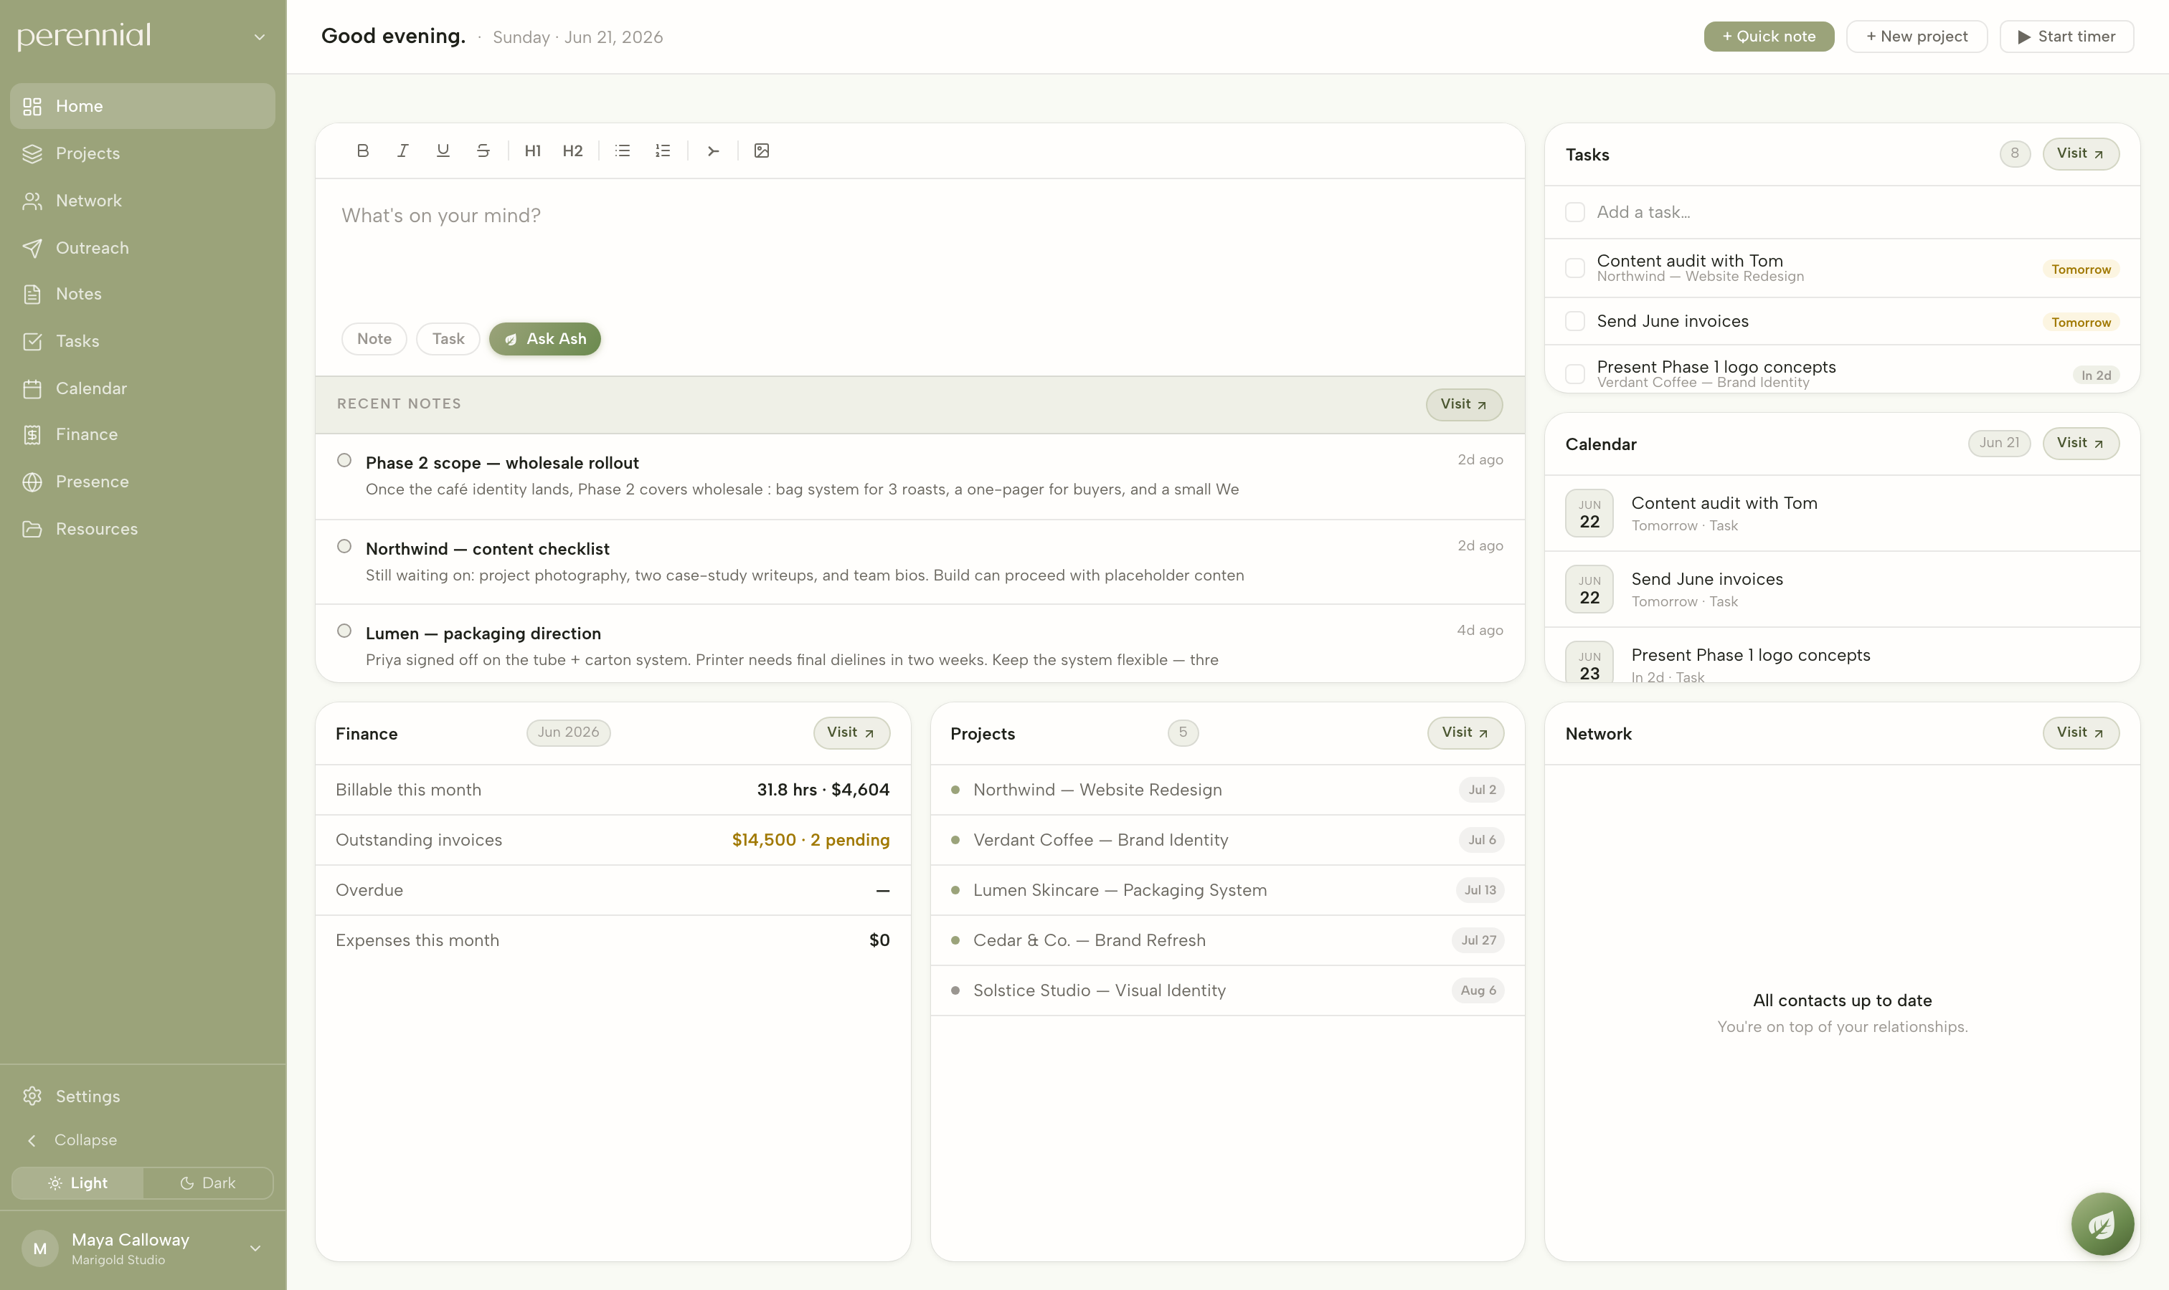
Perennial
Studio-management software for designers and makers — designed and built end to end.
Perennial helps artists and designers turn their craft into a business, so they can spend more time making the work because it finally pays for itself. It gives an independent practice the few tangible pieces it actually needs — clients, projects, money, and visibility — without assuming you speak the language of operations.
PRODUCT WALKTHROUGH · APP.PERENNIAL.DESIGN · ELLIOTT ROSENBERG
PERENNIAL
01

Slide 2
HOME — DASHBOARD
/home
The home screen pulls together data from every other module into a single view. Tasks coming due, invoices outstanding, active projects, and recent notes all surface here, so the first thing you see each day is an accurate read on the studio — without opening anything else.
PERENNIAL
02

Slide 3
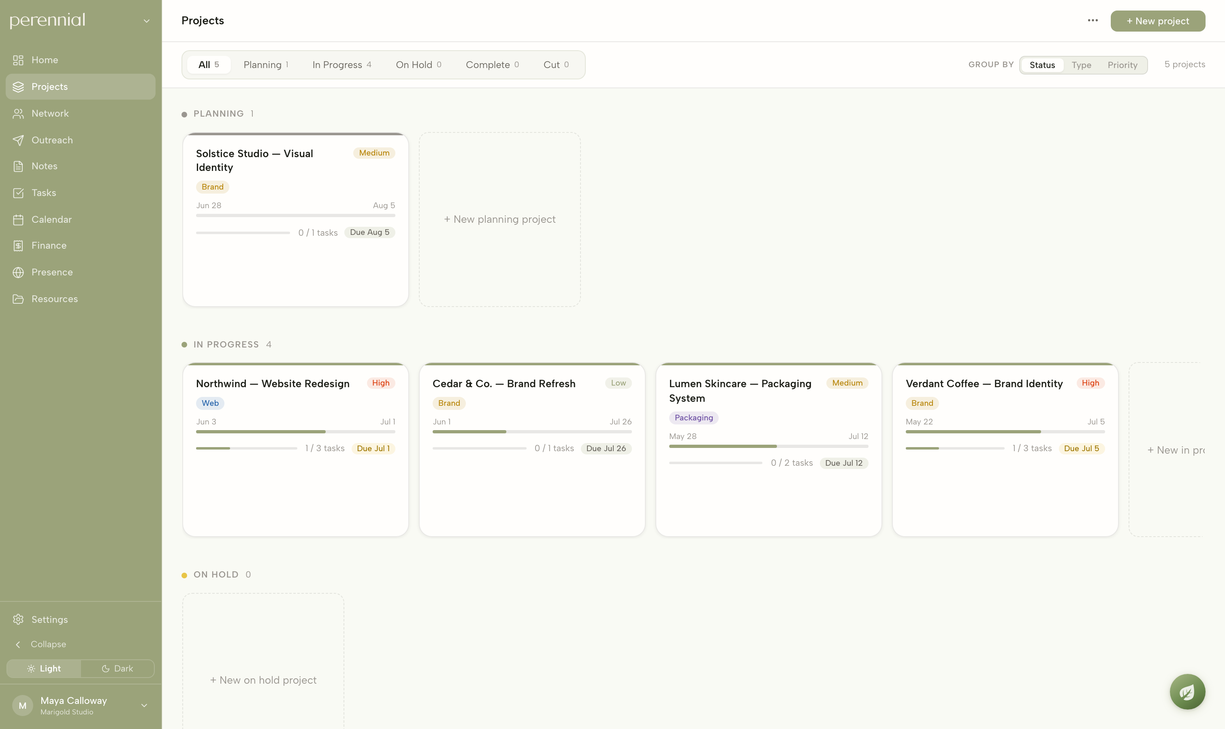
PROJECTS — BOARD
/projects
Projects are arranged on a board by status, and each card shows its type, client, value, and progress. The progress bar is calculated from the project’s underlying tasks, so the board stays current on its own as work gets checked off.
PERENNIAL
03

Slide 4
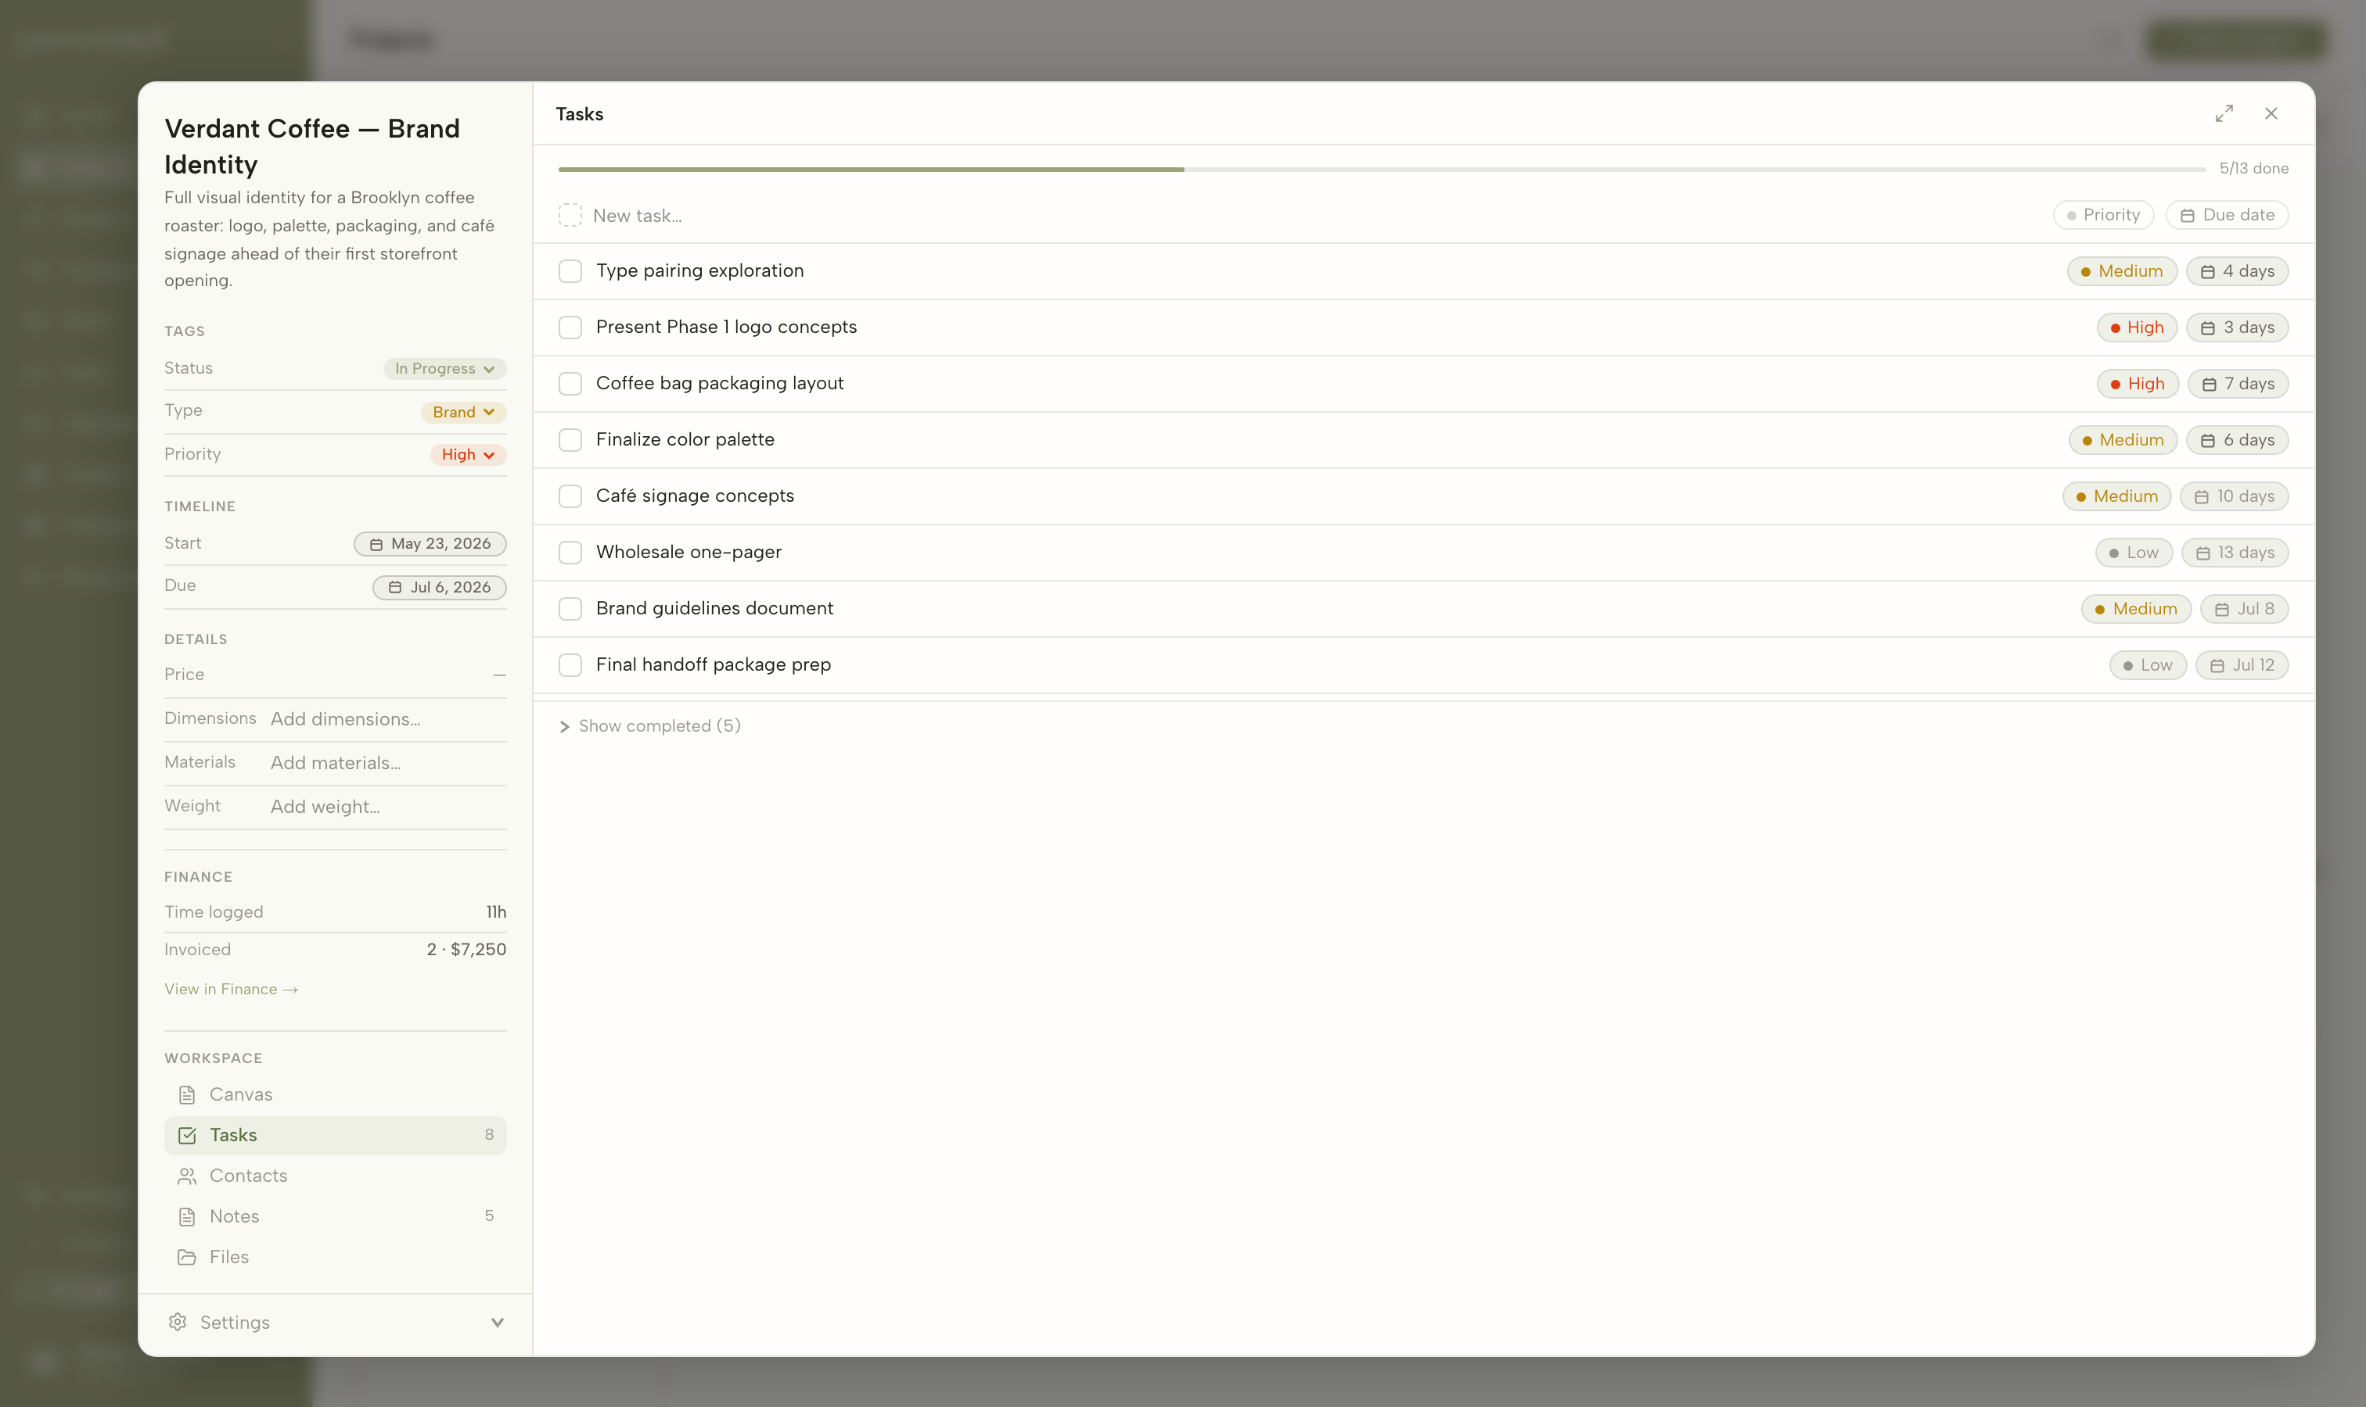
PROJECTS — A PROJECT’S TASKS
/projects · detail
Opening a project reveals a panel that holds everything about it in one place. The Tasks tab is a checklist with due dates and priorities, and the time logged against these tasks feeds directly into the studio’s billable hours and, eventually, an invoice.
PERENNIAL
04

Slide 5
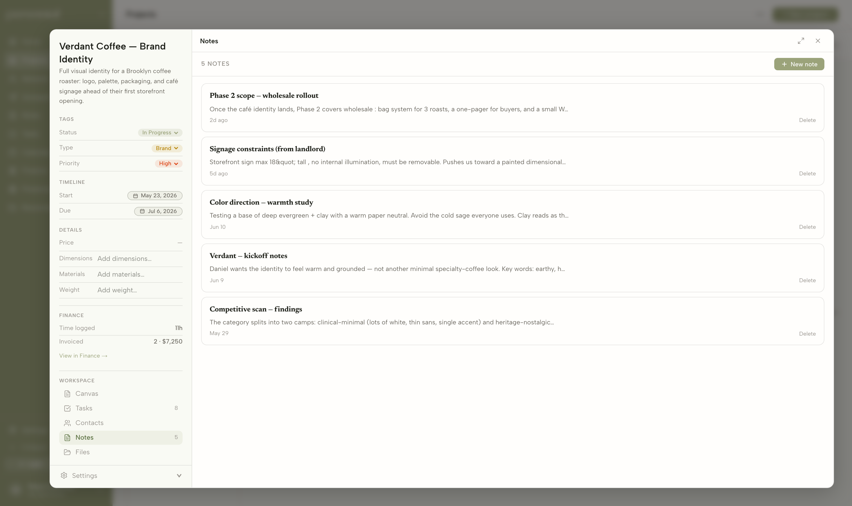
PROJECTS — A PROJECT’S NOTES
/projects · detail
The same panel keeps the project’s notes beside its tasks, files, and people. Research, creative direction, client constraints, and scope all live with the work they belong to, rather than scattered across a separate notes app.
PERENNIAL
05

Slide 6
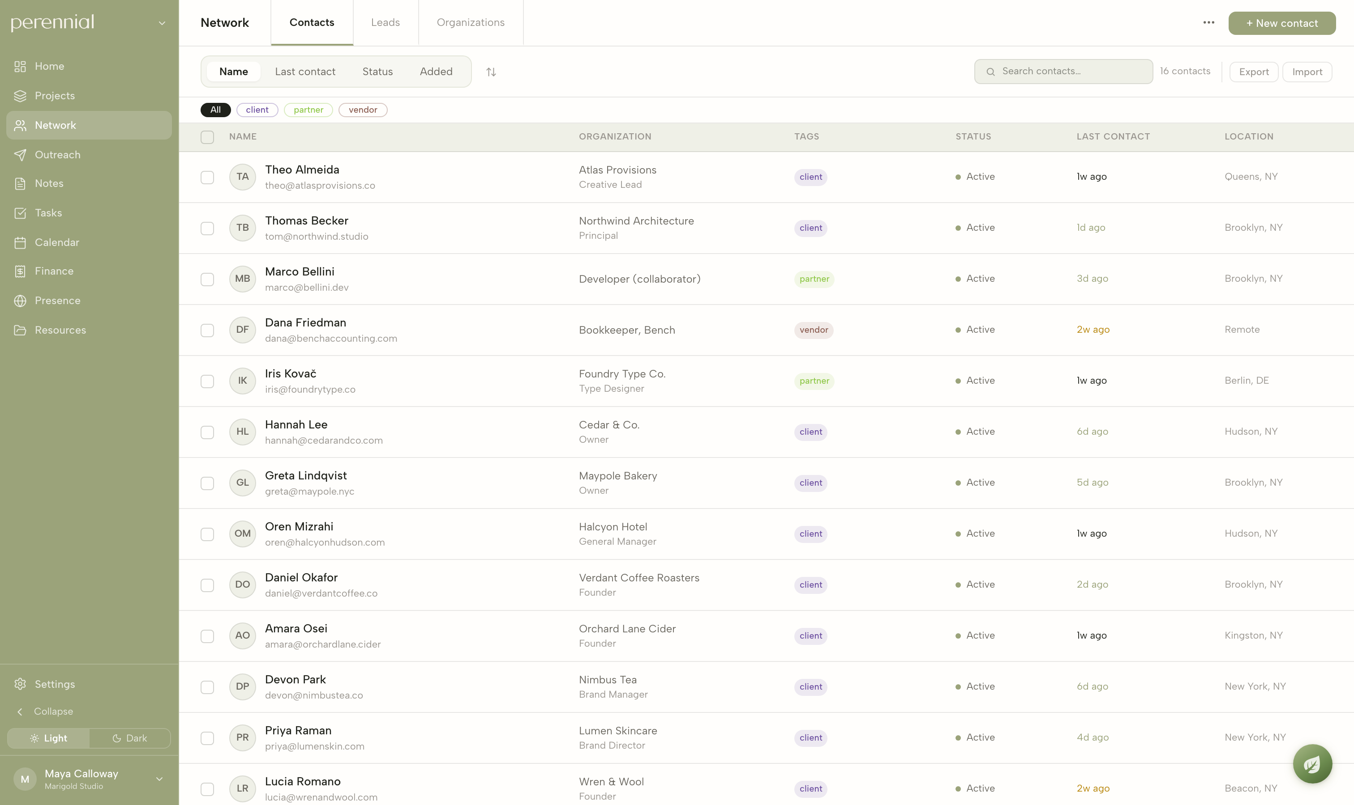
NETWORK — CONTACTS
/network
The Network module is a CRM for everyone the studio works with — clients, collaborators, press, and vendors. Each person is linked to their organization and to the projects they’re part of, so a contact, a company, and a piece of work are never more than a click apart.
PERENNIAL
06

Slide 7
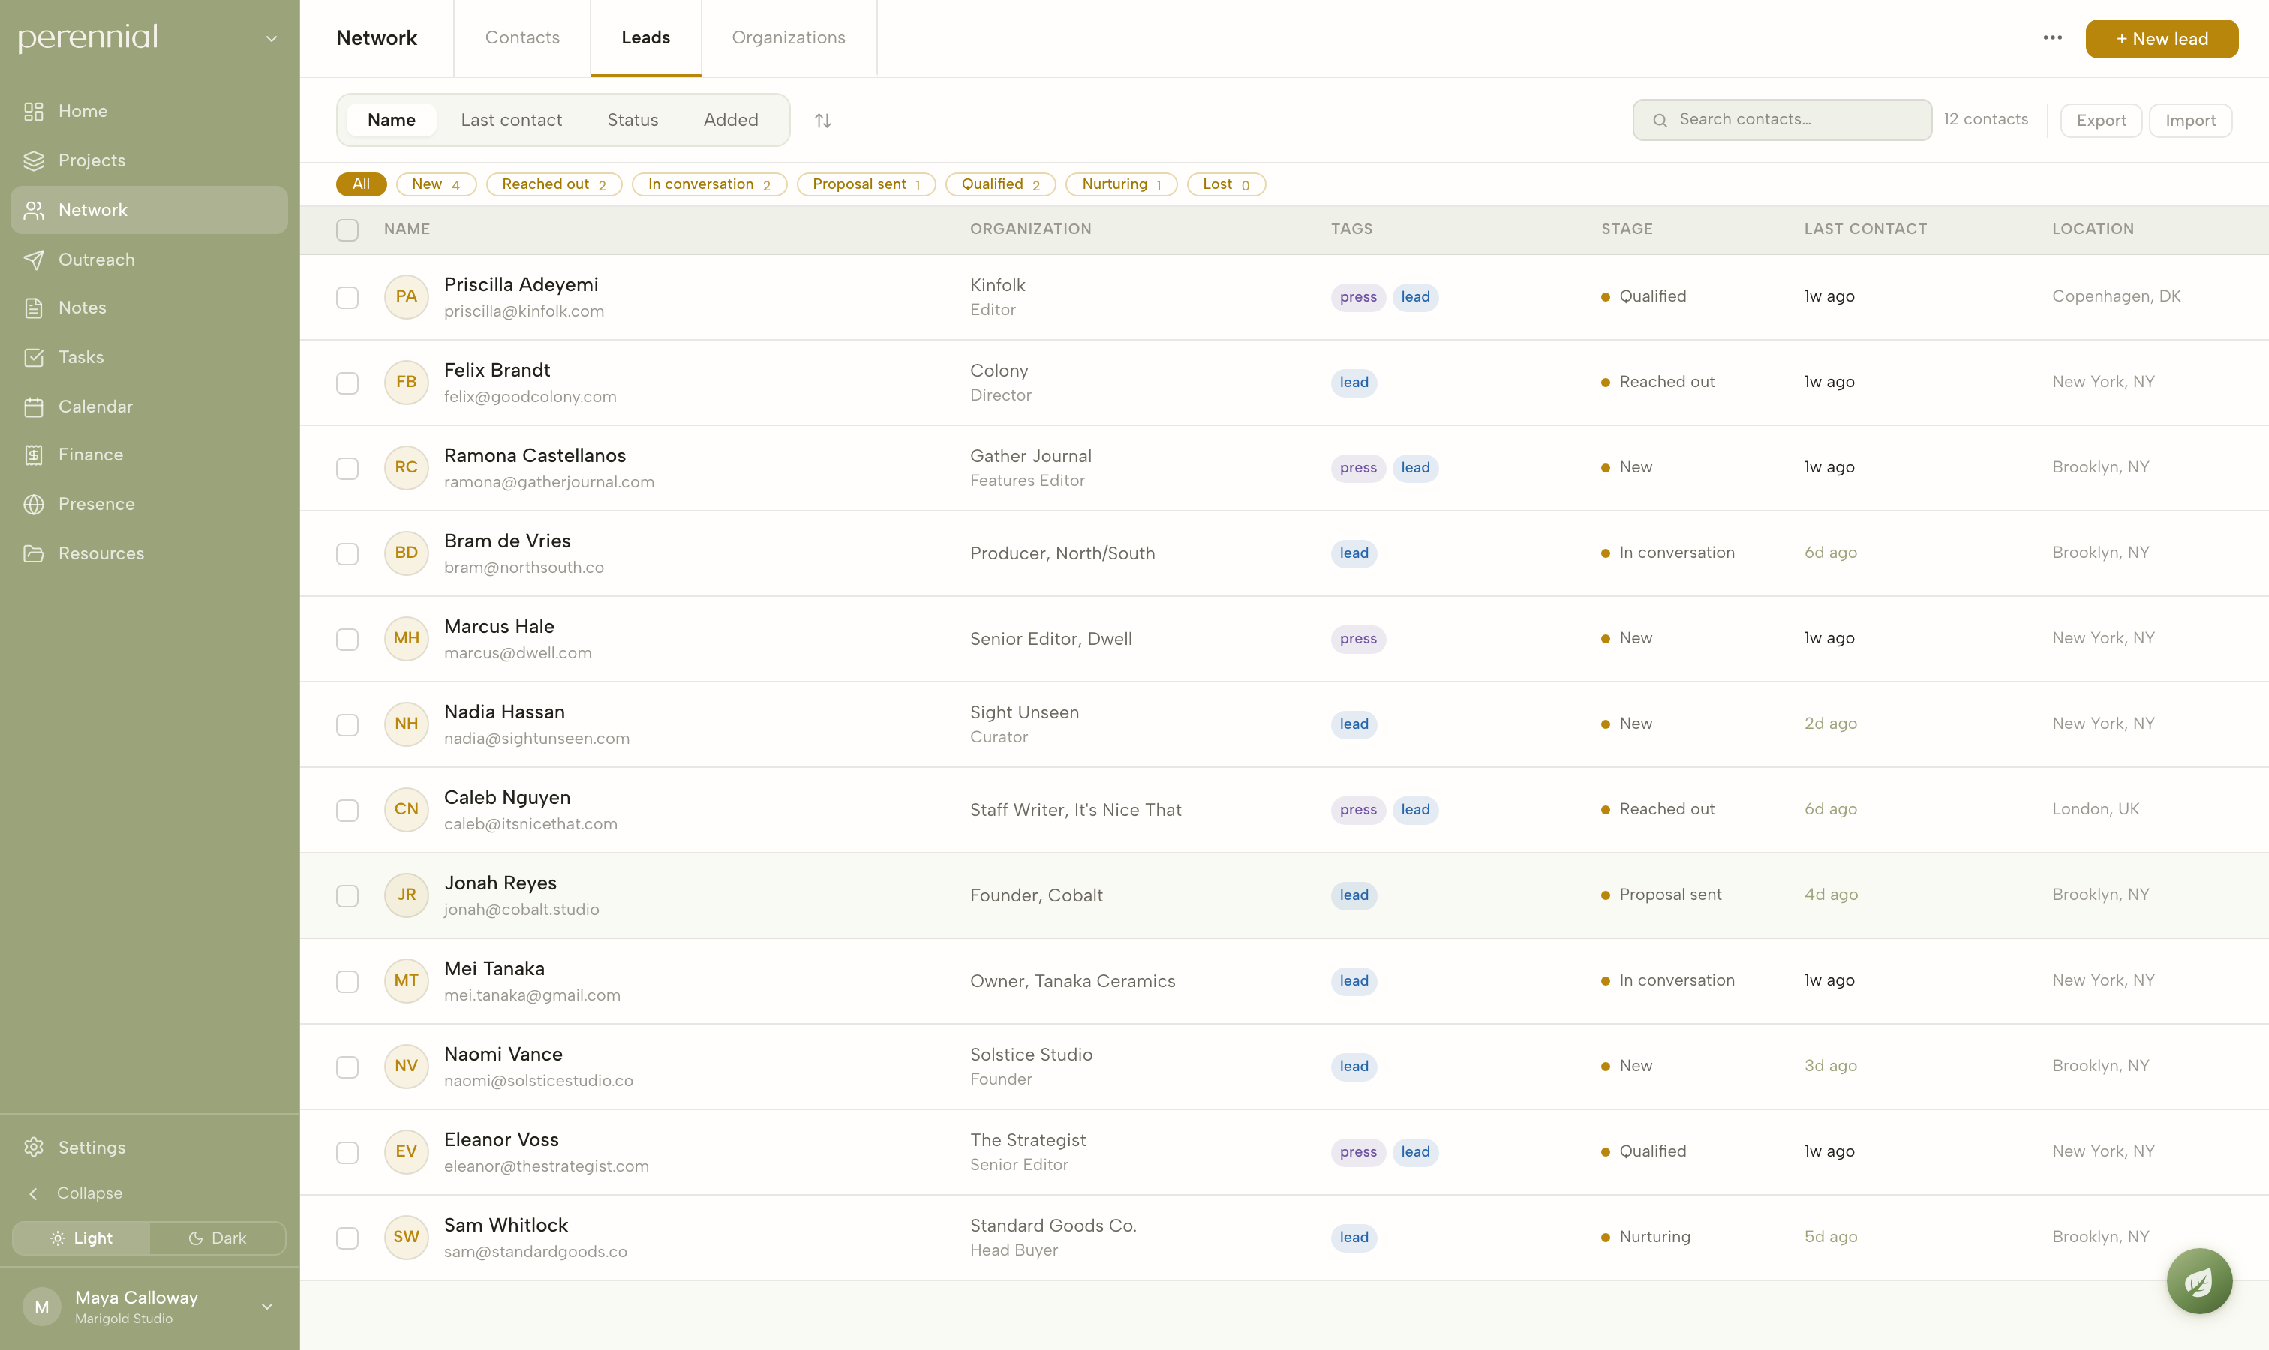
NETWORK — LEADS
/network · leads
Potential work is tracked as leads that move through stages, from first contact to qualified. New business, press, and stockists all run through the same pipeline, and one person can be a client, a lead, and a press contact at once without duplicating their record.
PERENNIAL
07

Slide 8
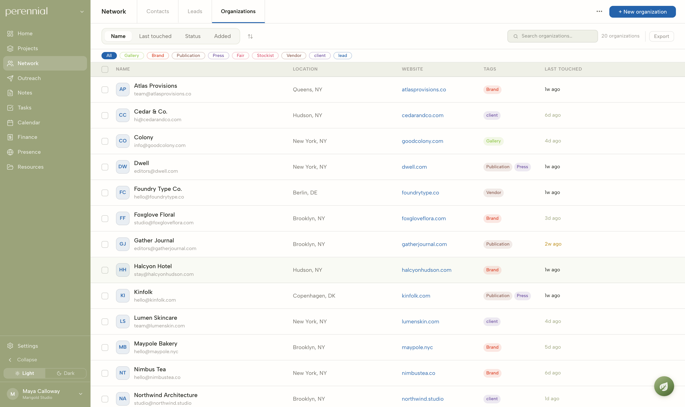
NETWORK — ORGANIZATIONS
/network · organizations
Companies are tracked separately from people and tagged by type — brands, publications, galleries, fairs, and vendors. Opening an organization shows the people who work there and the history the studio has built with them.
PERENNIAL
08

Slide 9
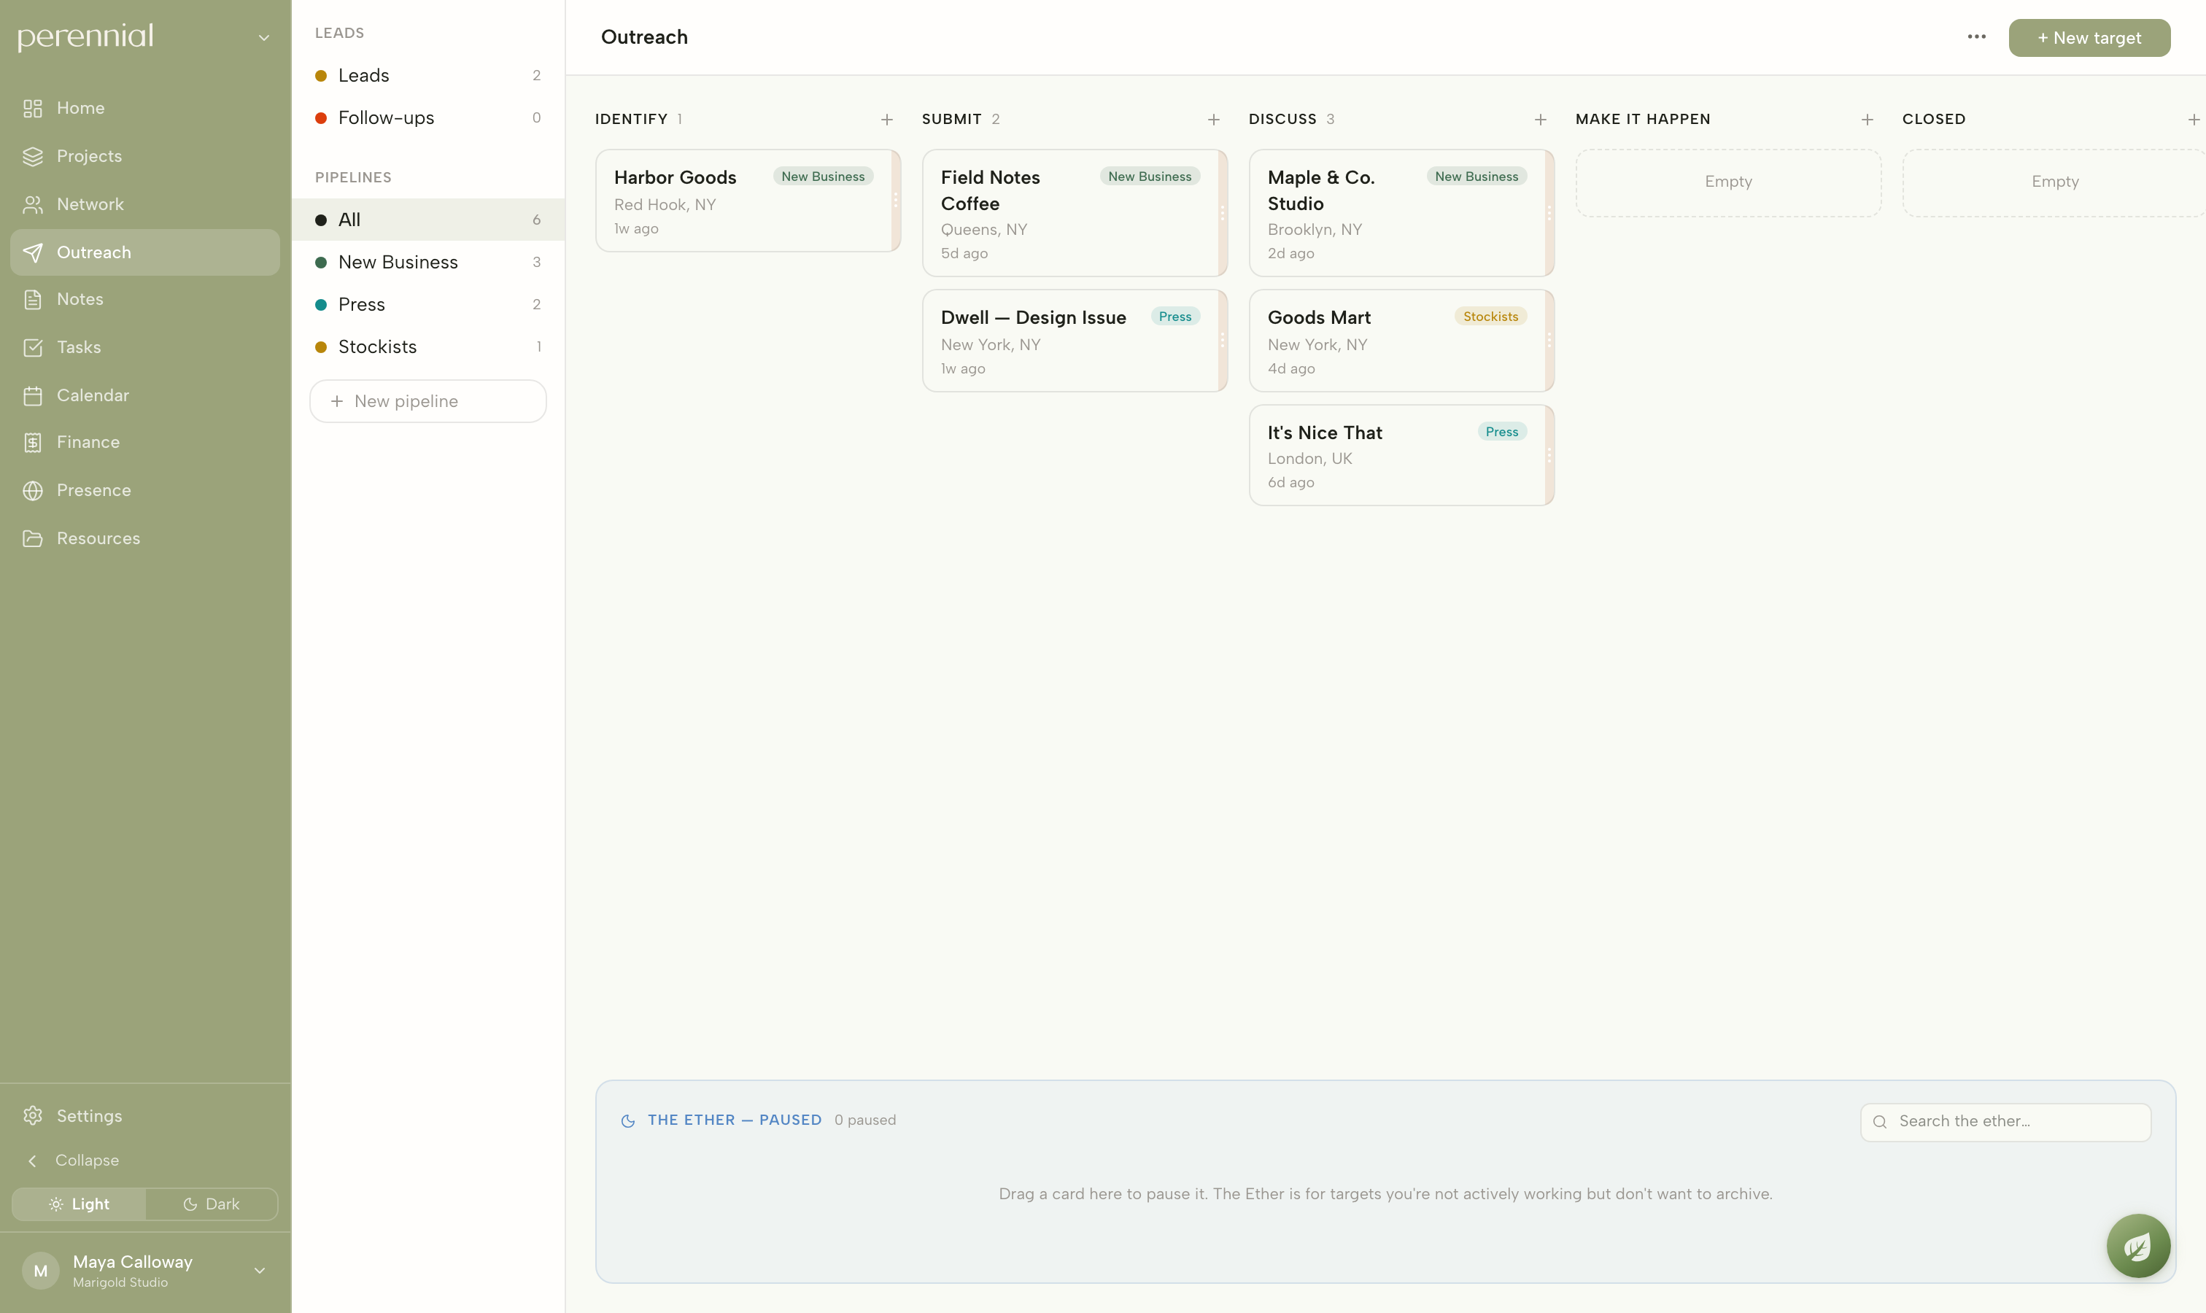
OUTREACH — PIPELINES
/outreach
Outreach turns those relationships into visual pipelines for pursuing press, galleries, stockists, and new business. Each target moves through stages as it progresses, and the outcomes recorded here connect back to the contacts and coverage tracked elsewhere in the app.
PERENNIAL
09

Slide 10
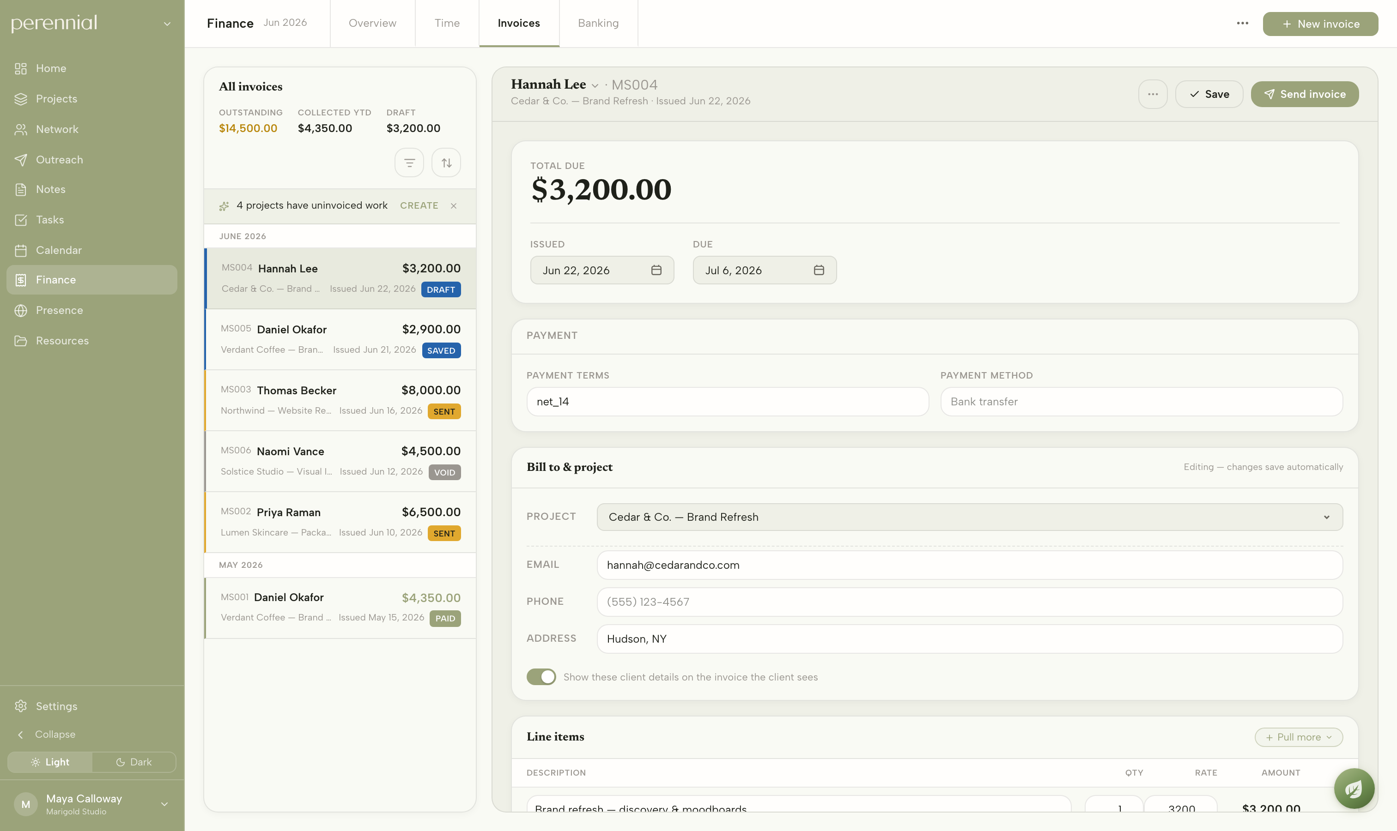
FINANCE — INVOICES
/finance · invoices
Invoices are built from data the app already holds — the client, the project, and the rate carry over automatically. The selected invoice opens its full editor, where line items can be drawn straight from logged time before the invoice is sent.
PERENNIAL
10

Slide 11
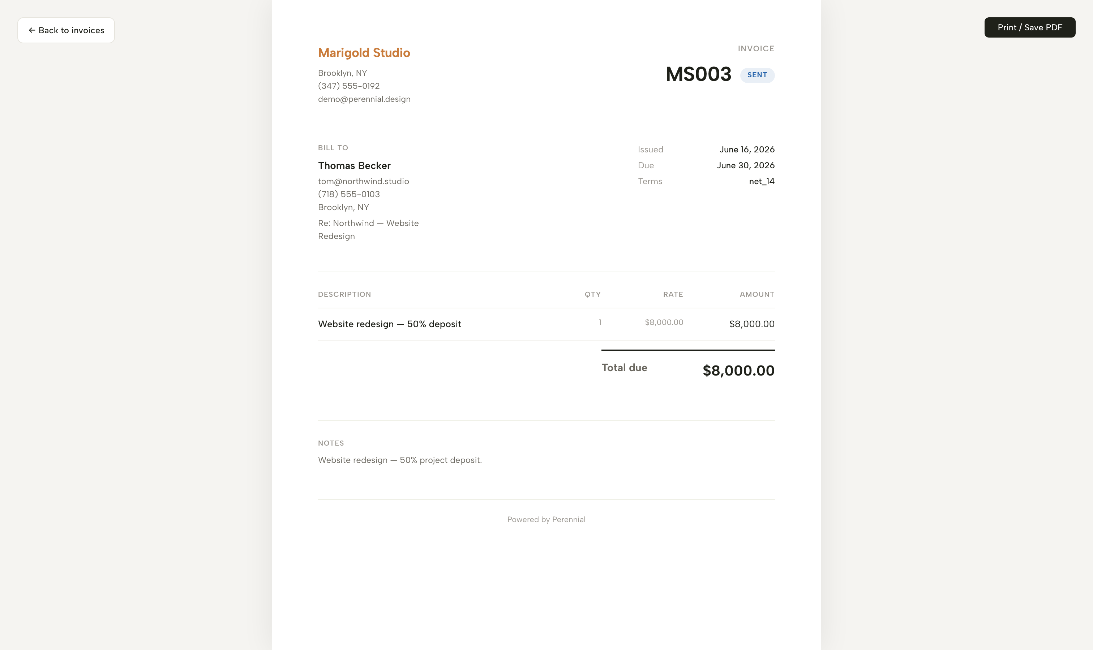
FINANCE — A SENT INVOICE
/finance · invoices
Once sent, an invoice becomes a clean, branded document carrying the studio’s name and colors. Clients pay online through Stripe, with funds landing directly in the studio’s own connected account — and the payment is later matched against the bank feed.
PERENNIAL
11

Slide 12
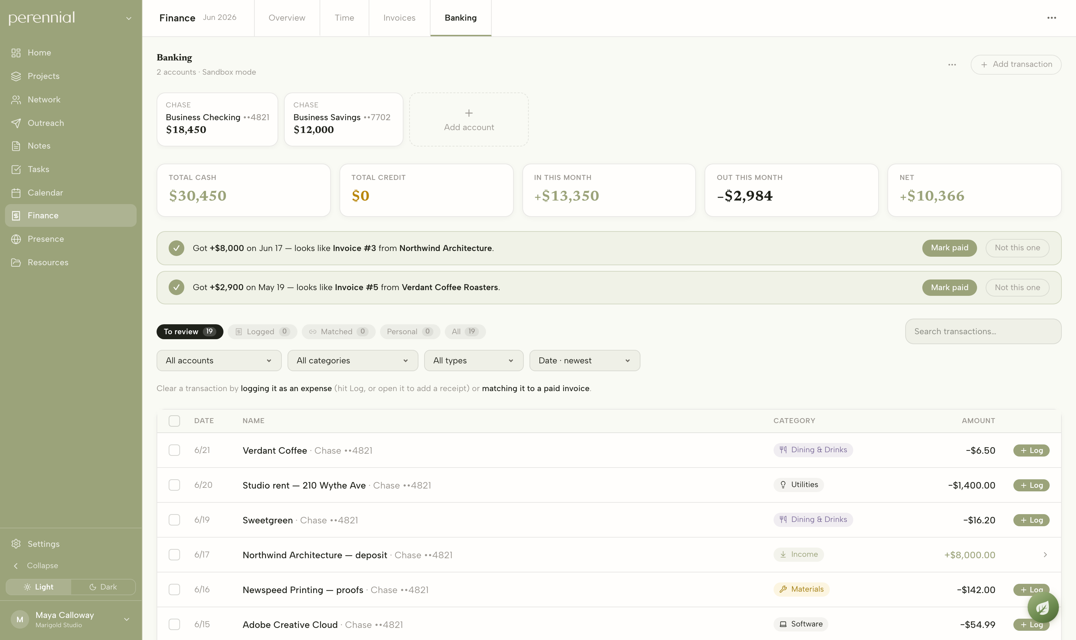
FINANCE — BANKING
/finance · banking
A live bank feed connected through Plaid brings every transaction in and categorizes it automatically. Incoming payments are matched back to the invoice that produced them, so reconciling what was billed against what actually landed takes a single click.
PERENNIAL
12

Slide 13
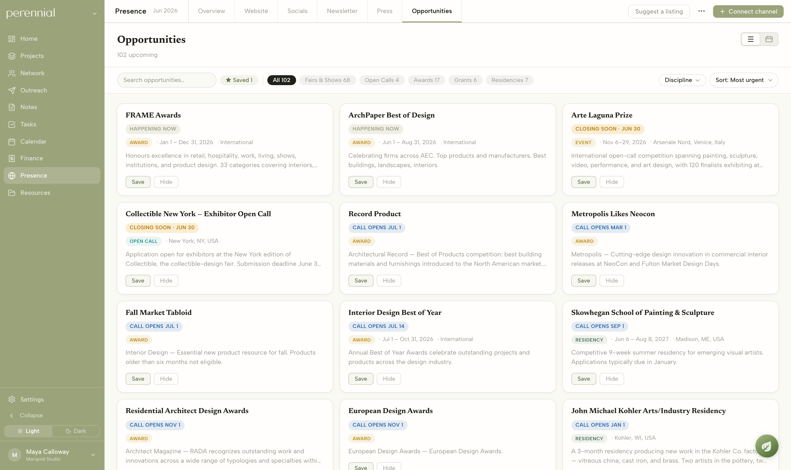
PRESENCE — OPPORTUNITIES
/presence · opportunities
The Opportunities feed is a curated, continuously updated list of fairs, open calls, grants, and awards relevant to independent studios. Items can be filtered by type and saved, where they connect into the calendar and outreach for follow-up.
PERENNIAL
13

Slide 14
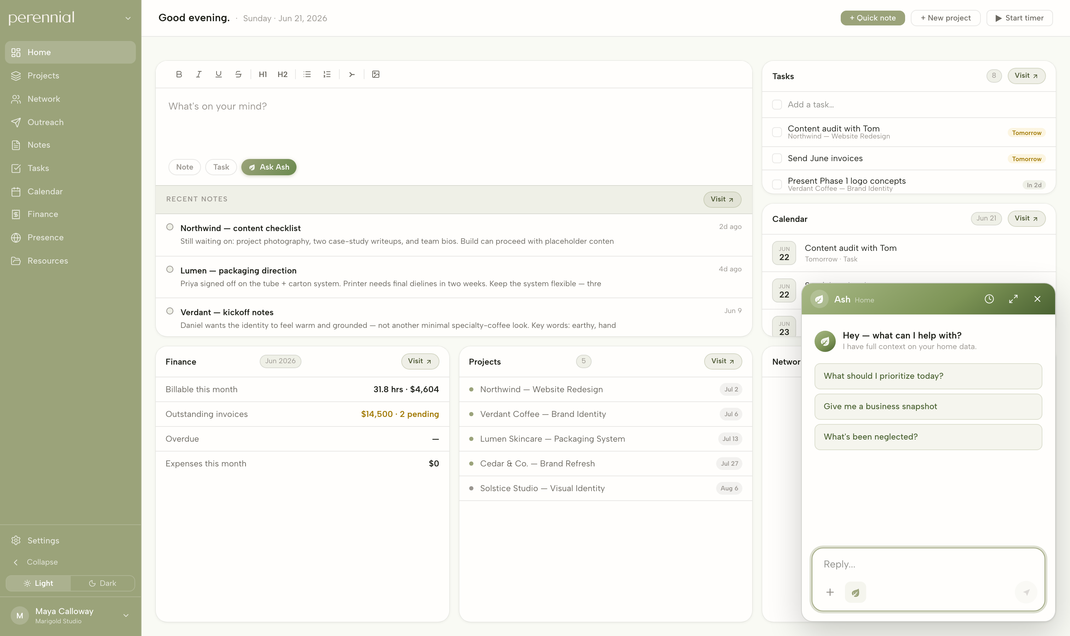
ASH — ASSISTANT
global
Ash is built into every screen and already understands the studio — your clients, your projects, how your money moves, even how you write. Rather than sending you elsewhere with generic answers, it can do the task itself: draft the client update, build a cost list, or surface what to prioritize, using the context the rest of the app already holds.
PERENNIAL
14

Slide 15
Perennial
Studio-management software for designers and makers.
app.perennial.design
DESIGNED & BUILT END TO END BY ELLIOTT ROSENBERG
15

