Slide 1
CSCI 2400 Computer Systems
Fall 2019
Professors Rick Han, Shivakant Mishra and Henry Tufo
Department of Computer Science
University of Colorado at Boulder

Slide 2

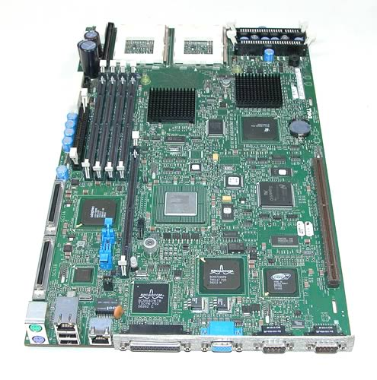
Goal of 2400:
Learn how a computer works!
More precisely, how software executes on modern computer hardware
More Magic!
2400 Magic
App
.exe
Python,
Java,
C code
Great Material but Challenging!
Notes:
Computer Systems focuses primarily on understanding how a *single* program executes on a computer, though Chapter 8 starts to introduce the notion of multiple programs. To fully understand how a computer works, you really have to take Operating Systems, which explains with how a computer handles *multiple* programs executing on a computer.

Slide 3
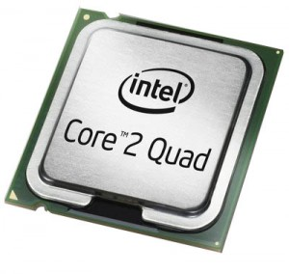
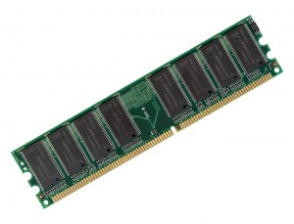
2400 In a Nutshell
add a,b
sub a,b
move a…
Python,
Java, C
code
Pre-processor
&
Compiler
Lines of
Assembly
code
Assembler
&
Linker
10101010
00001010
10101010
01010111
Lines of
Binary
code &
data
Memory
11101110
00111011
10000111
Notes:
This is simplified. There are actually more steps, like operating system (OS) interactions, I/O and more hardware, like a disk/flash for permanent storage, caching, etc.

Slide 4
Chapter Mapping
Chapter 3
add a,b
sub a,b
Chapter 7
move a…
Lines of
Source
code
Pre-processor
&
Compiler
Lines of
Assembly
code
Assembler
&
Linker
Chapter 8
Chapter 2
Chapter 5
Operating
System
10101010
00001010
Chapter 9
01010111
10101010
Lines of
Binary
code &
data
Memory
11101110
Chapters 3, 4, 5 and 6
00111011
10000111
Notes:
Not shown is Chapter 8, which covers how an executing program interfaces with the OS via system calls and exception handling.

Slide 5
Approximate Timeline
Week | Topics | Due
1 | Ch 1-2: Intro, Two’s Complement
2 | Ch 2: Integer Arithmetic
3 | Ch 3: Assembly memory, arithmetic | Data Lab
4 | Ch 3: Assembly control flow, loops
5 | Ch 3: Assembly: stacks, arrays
6 | Ch 3: Assembly: structs, 64-bit | Bomb Lab
7 | Ch 2: Floating point | MT 1
8 | Ch 4: ISA, Pipelining
9 | Ch 4-5: Pipelining, Optimization | Attack Lab
10 | Ch 5: Performance Optimization
11 | Ch 6: Caching | Performance Lab
12 | Ch 6: Caching, Storage | MT 2
13 | Ch 8: Exceptions, Signals
14 | Ch 9: Virtual Memory | Shell Lab
15 | Ch 7: Linking
Finals | Final Exam | Final Exam

Slide 6
Announcements
Let’s go to moodle.cs.colorado.edu, the primary rendezvous point for CS 2400
Sign up for an account, using ‘2400Rocks!’ as the enrollment key
Walk through the syllabus at http://www.cs.colorado.edu/~rhan/CSCI_2400_Fall_2019/syllabus.html
Also on the moodle

Slide 7
Announcements
Optional C Assessment quiz
Go to the moodle and do the C Assessment quiz
Make sure you understand C pointers
If your score <= 70%, we strongly suggest that you study C refresher tutorial/study links, such as:
http://www.tutorialspoint.com/cprogramming/
http://learn-c.org/
In general, look to moodle for announcements on any assignments such as quizzes, recitation exercises, labs, exams, etc.

Slide 8
Announcements
First data lab to be released on moodle, due in ~3 weeks
First recitation with TAs this week
Introduce data lab
Bit manipulation operations
Read Chapter 1 and 2.1-2.3 (skip floating point)

Slide 9
Hints!
Do not fall behind on the reading in this class!
Do all practice problems in the textbook! (solutions are there)
Attend lectures!
Skip roadblocks and circle back
Notes:
Especially through Chapter 3, you cannot afford to skip readings for even a week!
Don’t worry if you don’t understand a sentence or paragraph. Move forward to the next paragraph, circle back, ask the TA, CA and prof Qs.

Slide 10
Systems as a Springboard…
CS 4273
Networks
Network
Protocols
CS 3753
Operating
Systems
CS 3155
Programming Lang
ECE 347
Architecture
CSCI 3656
Numerical Comp
Processes
Mem. Mgmt
Machine Code
Optimization
Exec. Model
Memory System
CS 2400
Systems
Data Structures
Applications
Programming
CS 2270
Fundamental
Structures
CS 1300
Programming

Slide 11
Why C?
A good compromise between a high-level programming language and low-level hardware
Maps well to assembly and binary machine code instructions
Low level enough to manipulate memory with pointers
Learn from C about the dangers of pointer arithmetic, array out-of-bounds memory accesses, etc. – we’ll study some of these
Most operating systems and network protocol stacks are built with C, as are many high-performance applications

Slide 12
2400 In a Nutshell
add a,b
sub a,b
move a…
Python,
Java, C
code
Pre-processor
&
Compiler
Lines of
Assembly
code
Assembler
&
Linker
10101010
00001010
10101010
01010111
Lines of
Binary
code &
data
Memory
11101110
00111011
10000111
Notes:
This is simplified. There are actually more steps, like operating system (OS) interactions, I/O and more hardware, like a disk/flash for permanent storage, caching, etc.

Slide 13
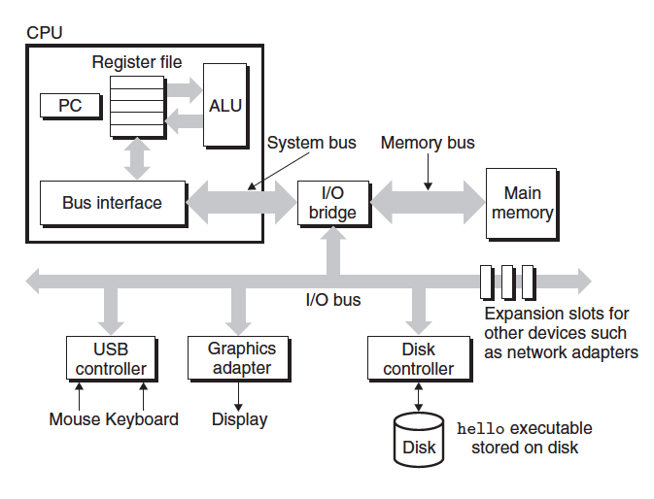
Hardware Organization of a Computer System (Von Neumann)
General Architecture
10101010
00001010
01010111
Lines of
Binary
code &
data
load
11101110
00111011
10000111
Notes:
This architecture enabled *progammable computing*, which was a huge improvement over mechanical computers with relays, which could typically only run one program ever, or were very difficult to reprogram.
Also there's a Harvard architecture for computers, which has separate memories and buses for instructions and data. It's used in embedded microcontrollers and DSPs for speed because both data and instructions can be fetched in parallel, unlike pure Von Neumann architectures. The Harvard separation of instructions and data is often used in today's CPU caches, though not necessarily for main memory.

Slide 14
Hardware Organization of a Computer System
General Architecture
10101010
00001010
01010111
Lines of
Binary
code &
data
11101110
00111011
10000111

Slide 15
Hardware Organization of a Computer System
General Architecture
10101010
00001010
01010111
Lines of
Binary
code &
data
store
11101110
00111011
10000111

Slide 16
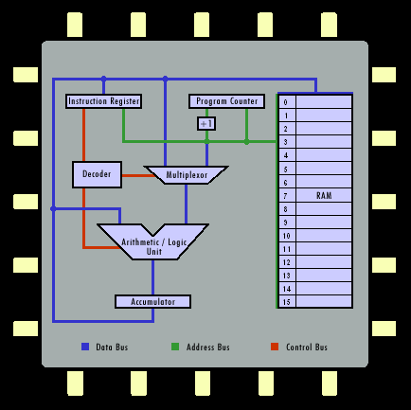

Inside the CPU - Building Blocks
Registers
Data (16 in IA64)
Instruction register (IR) = current instruction
Program counter (PC) = pointer to next instruction in memory
Control Unit (not shown)
Communicate with RAM
Data registers
RAM

Slide 17
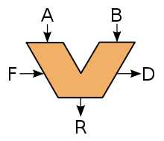
Arithmetic Logic Unit (ALU) of CPU
Performs two types of operations
Arithmetic: ADD, SUBTRACT, etc.
Logic: AND, OR, NOT, XOR, >, <
In the picture,
A and B are the input data or operands
F = function to perform, i.e. +, -, AND, XOR, etc.
R = result
D = any flags due to operation, such as a carry, overflow, sign, etc.
A, B, and R are all stored in registers
As we will see, one type of instruction moves instructions and data to/from CPU from/to memory
i.e. fetch A and B from memory, move R to memory
Another type of instruction uses ALU to operate on this data

Slide 18
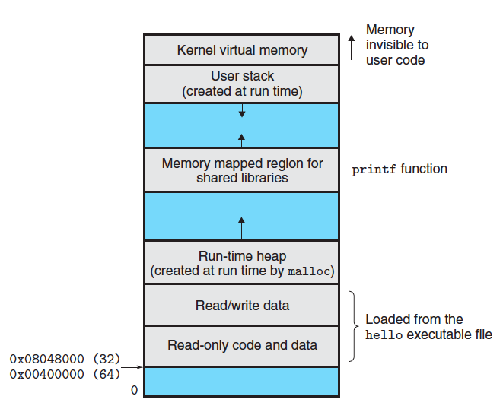
Layout of a Program in Memory
Program memory is divided into 4 sections
Code
Data
Heap
Stack
Stack grows down from high memory by convention on IA32
Heap grows up from low memory by convention
MAX
Notes:
This is actually virtual memory, not physical memory. The Stack stores local variables and supports function calls. The Heap supports dynamic run-time memory allocation like malloc(). Arguably, memory-mapped libraries constitute a 5th “region” of virtual memory.

Slide 19
Cache For Faster Data/Code Access
10101010
00001010
01010111
Lines of
Binary
code &
data
Slow
Fast
Cache
11101110
00111011
10000111

Slide 20
Cache For Faster Data/Code Access
Caching
Going to memory is quite slow compared to the speed of the CPU
RAM access time is ~ microseconds.
CPU executes multiple instructions per nanosecond.
So CPU waits ~1000 cycles to fetch data from memory!
Solution: create a smaller but faster buffer called a cache, and cache data there that is going to be used soon
In reality, cache data that was more recently used
Why not cache all data in registers?
Too expensive/byte

Slide 21
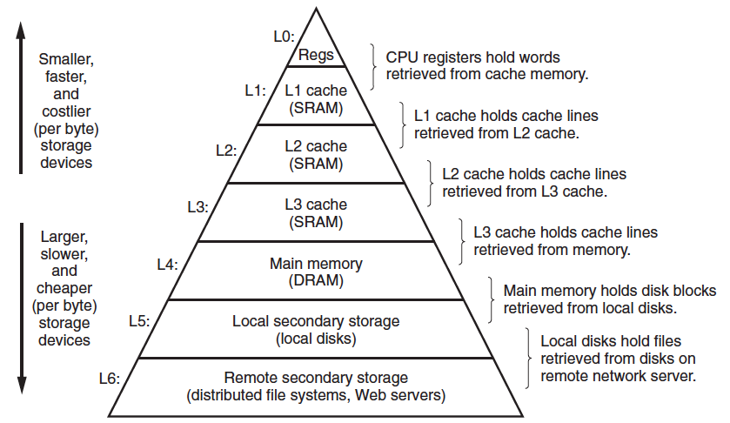
Memory Hierarchy

Slide 22
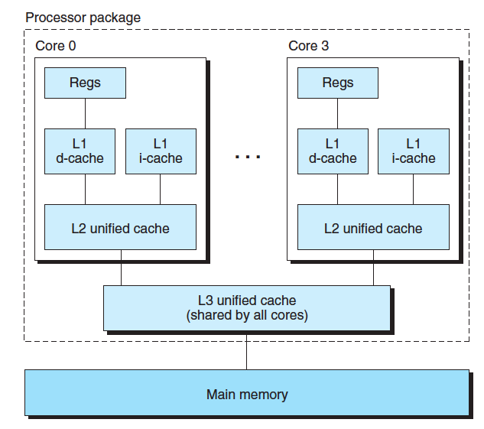
Memory Hierarchy
Intel Core i7 organization
4 cores
Each core has an L1 data cache, an L1 instruction cache, and a larger but slower L2 unified cache
Across cores, there is an L3 unified cache

Slide 23
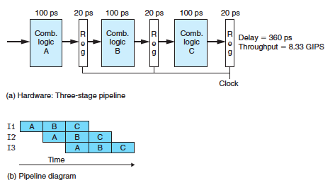
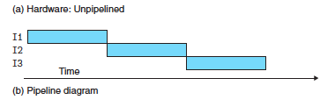
Pipelining to Improve Throughput
Pipelining
Instructions can be broken up into stages.
Design CPU with multiple stages or “pipeline”.
As a stage finishes, it accepts the result from the previous stage -> Faster!
Sequential non-pipelined is slower, some stages empty.

