Slide 1
Linux File Security

Slide 2
Linux File Security
Every file and directory has permissions set that determine who can access it.
Permission are set for:
  The owner of the file (called the “user”,)
  The group members
  All others
Permissions that are set are called read, write, and execute permissions.

Slide 3
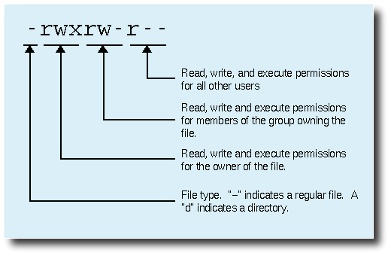

Slide 4
Permission Types
Four symbols are used when displaying permissions:
  r permission to read a file or list a directory’s content
  w permission to write to a file or create of remove files from a directory.
  x permission to execute a program or change into a directory
  - no permission (in place of r, w, or x)
A file may be removed by anyone who has write permission to the directory in which the file resides regardless of the ownership or permissions on the file itself.
The first character of the long listing is the file type.

Slide 5
Linux Process Security
When a process accesses a file, the user and the group of the process are compared with the user and group of the file.
  If the user matches, the user permission apply.
  If the group matches, but the user doesn’t, the group permission apply.
  If neither match, the other permissions apply.
Every process runs as a under the authority of a particular user and with the authority of one or more groups, this is called the process’s security context.

Slide 6
P115
Chmod (u,g,o,a) (+-=)(r,w,x) filename

Slide 7
Changing Permissions-
Symbolic Method
To change access modes:
  chmod [-R] mode file…
Where mode is:
  u,g or o (a) for user, group and other
  + or – (=) for grand or deny
  r,w or x (s,t) for read, write and execute
Examples:
  ugo+r Grant read access to all.
  o-wx Deny write and execute to others.
Multiple comma separated operations can be give in a single command

Slide 8
example
Chmod u=rwx, go=r abc
Chmod a+w abc
Chomod go=rx abc

Slide 9
Changing permissions- Numeric Method
Uses a three-digit mode number.
  First digit specifies owner’s permissions.
  Second digit specifies group permissions.
  Third digit represents other’s permissions.
Permissions are calculated by adding:
  4 (for read)
  2 (for write)
  1 (for execute)
Example:
  chmod 640 myfile

Slide 10
Chmod -R 744 mydir
Chmod 600 mydir

Slide 11
Permission on Directory
The read bit allows the affected user to list the files within the directory
The write bit allows the affected user to create, rename, or delete files within the directory, and modify the directory's attributes
The execute bit allows the affected user to enter the directory, and access files and directories inside

Slide 12
Make a directory that can be accessed freely by anyone in your own group , but completely inaccessible by anyone out of this group
Mkdir testdir
Chmod 770 testdir

Slide 13
Default Permissions
Default permission for files is 666
Default permission for directories is 777
umask is subtracted from default to determine new file/directory permissions.
Non-privileged users’ umask is 002
  Files will have permission of 664.
  Directories will have permission of 775.
Root’s umask is 022.
Executive privilege is always denied a newly-create file, regardless of the umask in effect. Execute privilege always has to be explicitly granted to a file. Execute permission is given to a directory upon creation, unless explicitly denied by the umask.

Slide 14
Using root to create a new file and new directory
Touch testfile
Using unprivileged account to create file and directory
Mkdir testdir

Slide 15
~/.bashrc
When bash shell is started, bash reads and executes commands from ~/.bashrc, if that file exists.
The file is just shell command, it is typically used to change prompt, set environment variables, and define shell procedures.
Add “umask 077” at the end of the file
And see what will happen

Slide 16
chown
chown command changes the user and/or group ownership of for given file.
The syntax is:
chown owner-user file
chown [options] owner-user:owner-group file/directory

Slide 17
Chown wjh testfile
Chown -R root:root testDir

Slide 18
chgrp
chgrp − change group ownership of the file/directory
Chgrp root testfile

Slide 19
example
“root” user copy a file to someone else's home directory
Cp abc /home/jerrywjh
Can jerrywjh modify this file?

Slide 20
Special Permissions
Special permissions: a fourth permission set (in addition to user/group/other)
Applicable in four cases:
  suid for an executable (4)
  sgid for an executable (2)
  sgid for a directory (2)
  sticky bit for all directory (1)
Set with chmod or Nautilus.
chmod 3775 groupdir

Slide 21
Ls -a /usr/bin/passwd
-rwsr-xr-x s????

Slide 22
Special Permission for Executiables
Special Permission for Executables:
  suid: Command run with permission of the owner of the command, not the executor of the command. Like passwd.
  sgid: command runs with group affiliation of the group of the command.
In a long listing, the suid permission is displayed as a lower case “s” where the “x” would otherwise be located for the user permission

Slide 23
Special Permission for Directories
Special permissions for directories:
  Sticky bit: files in directories with the sticky bit set can only be removed by the owner and root, regardless of the write permissions of the directory.

Slide 24
On Sticky Bits
The sticky bit for a directory sets a special restriction on deletion of files: with the sticky bit set, only the owner of the file, and the superuser, can delete files within the directory.
For example:
drwxrwxr_x testdir
Group abc has two users : aaa , bbb
Aaa create a file : afile
Bbb create a file : bfile
Only owner of file can delete the file

Slide 25
Chmod 5755 testdirectory
SUID :4
SGID: 2
SBIT: 1

