Slide 1
Checkpoint Parameters
Checkpoint_timeout
MAX_WAL_SIZE
CHECKPOINT_COMPLETION_TARGET

Slide 2
Checkpoint
It is a point in the write-ahead log sequence at which all data files have been updated to reflect the information in the log.
Checkpoint ensure that all the dirty buffers created up to a certain point are sent to disk so that the WAL up to that point can be recycled.
Checkpoint can be triggered when checkpoint_timeout value is reached, max_wal_size is reached, When a Super user issues a checkpoint command or pg_start_backup, CREATE DATABASE, or pg_ctl stop|restart)
Checkpoint_timeout : Maximum time between automatic WAL checkpoints. The default is five minutes (5min). Increasing this parameter can increase the amount of time needed for crash recovery.
Max_wal_size : Maximum size to let the WAL grow during automatic checkpoints. This is a soft limit; WAL size can exceed max_wal_size under special circumstances, such as heavy load, a failing archive_command or archive_library, or a high wal_keep_size setting.
Checkpoint_completion_target :Specifies the target of checkpoint completion, as a fraction of total time between checkpoints. The default is 0.9, which spreads the checkpoint across almost all of the available interval, providing fairly consistent I/O load.

Slide 3


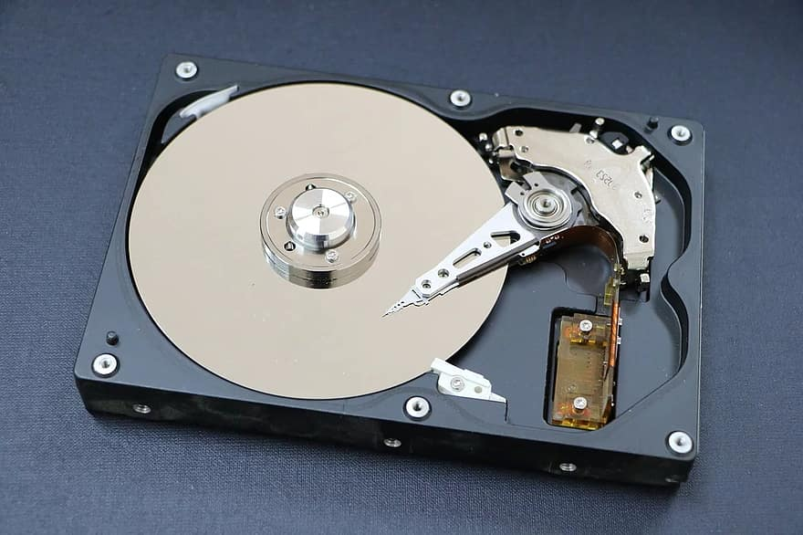

Shared Buffer
Wal Buffer
Wal Files
Checkpoint
Disk IOPS

Slide 4
Checkpoint_timeout:
5 Minutes
Idle Value:
20/30 Minutes
Pros: 1) Faster after-crash recovery, since less work will need to be redone.
2) If WAL has been written since the previous checkpoint, new checkpoints will be skipped even if checkpoint_timeout has passed.
Cons : Checkpoint requirement of flushing all dirty data pages to disk can cause a significant I/O load causing huge performance impact.
For Ex: Checkpoint_timeout every 24 hours.
Last Checkpoint 12pm
System Crash @4pm
Disk + 4 hours of change/wal logs
Checkpoint
Disk IOPS
Wal Files

Slide 5
Max_Wal_Size: 1G
Maximum size to let the WAL grow during automatic checkpoints.
Once the limit is reached a checkpoint is requested and the space is recycled.
Ensure Majority of checkpoints should be timed based checkpoints rather than requested ones.
4) Increasing this parameter can increase the amount of time needed for crash recovery.
5) Use “pg_stat_bgwriter” to monitor the number of requested and timed checkpoints.
Checkpoint
Disk IOPS
Wal Files

Slide 6
`
Checkpoint_completion_target
Checkpoint_Timeout = 10 Minutes
Checkpoint_Completion_Target = 0.5
Checkpoint_Completion_Target =0.9
Dirty Pages = 900MB
10:00
10:10
900/5 =180 MB
900/9 = 100MB

Slide 7
Thank You
For Your Time

