Slide 1
Goals
Language tailored to liquid handling robots
Abstracts away the details of robot control
Portable between labs
Portable across robots
Extensible with new peripheral devices
Can handle complex and tedious tasks

Slide 2
Current capabilities
Fairly intelligent pipetting (tip handling, pipetting policy, cleaning, source well choices)
Portable protocols involving pipetting and various devices
User-defined functions (but not easily shared)

Slide 3
Current work
Compile Roboease scripts
Compatibility with Weizmann robots
Capable of handling import CADMAD protocols
Productive tasks in our lab
Dynamic robot control based on readouts and feedback

Slide 4
Sample code
// Liquids
val liquid1 = new Liquid(Properties.Water, CleanPolicy.Thorough)
val liquid2 = new Liquid(Properties.Glycerol, CleanPolicy.Decontaminate)
// Wells
val wells1 = new EmptyWells()
// Generic instructions
pipette(liquid1, wells1, 30 ul)
pipette(liquid2, wells1, 5 ul)
// Customize
val plate1 = new EmptyPlate() at Site.cooled1 model LabwareModel.pcr96
liquid1 at Site.reagents50(1)
liquid2 at Site.reagents15(1)
wells1 at plate1(A1-D4)

Slide 5
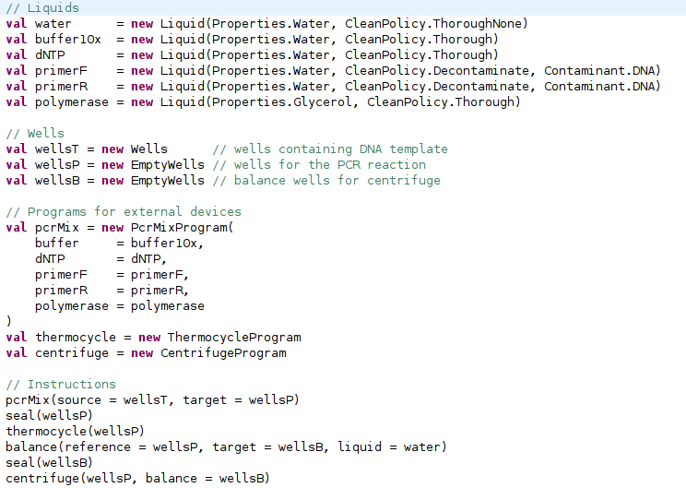

Slide 6
Commands in generic protocol
Structure:
  Command ID
  Command arguments (type-safe)
  Essentially a token to invoke a function
Levels of abstraction
  Level 1: commands for target robot
  Level 2: low-level portable commands (mix, move...)
  Level 3: high-level commands, fully specified
  Level 4: high-level commands, indeterminate

Slide 7
Pipetting Algorithm
Input
  Partially ordered set of items (liquid, dest, vol)
State
  Bit string to indicate whether the items are finished
  Initial state: 0's, Goal state: 1's
Actions per state
  All subsets of pending items
  All permutations of items in subset
  All partitions of items among syringes
  All assignments of syringes to valid source wells
Branching factor is exponential in number of items

Slide 8
Pipetting Algorithm
Input
  Ordered list of items (liquid, dest, vol) (but good order???)
State
  Integer to indicate how many items are finished
  Initial state: 0, Goal state: n
Actions per state (size=O(n), time=O(n^2 ln(n)))
  Iteratively defined for the next pending item in each step
  All permutations of items in subset
  All partitions Assignment of items among syringes
  All assignments Assignment of syringes to valid source wells
A* search visits at most n^2/2 nodes

Slide 9
Other open questions
How to implement response to readouts in scripts?
With regard to protocol verification, how to deal with quantities whose values are obtained dynamically during protocol execution?

