Slide 1

Corporate Experiences, Elevated
A Membership Built for Atlanta's Best Companies
ATLANTA'S PREMIER EVENT EXPERIENCE COMPANY · SINCE 2018

Slide 2
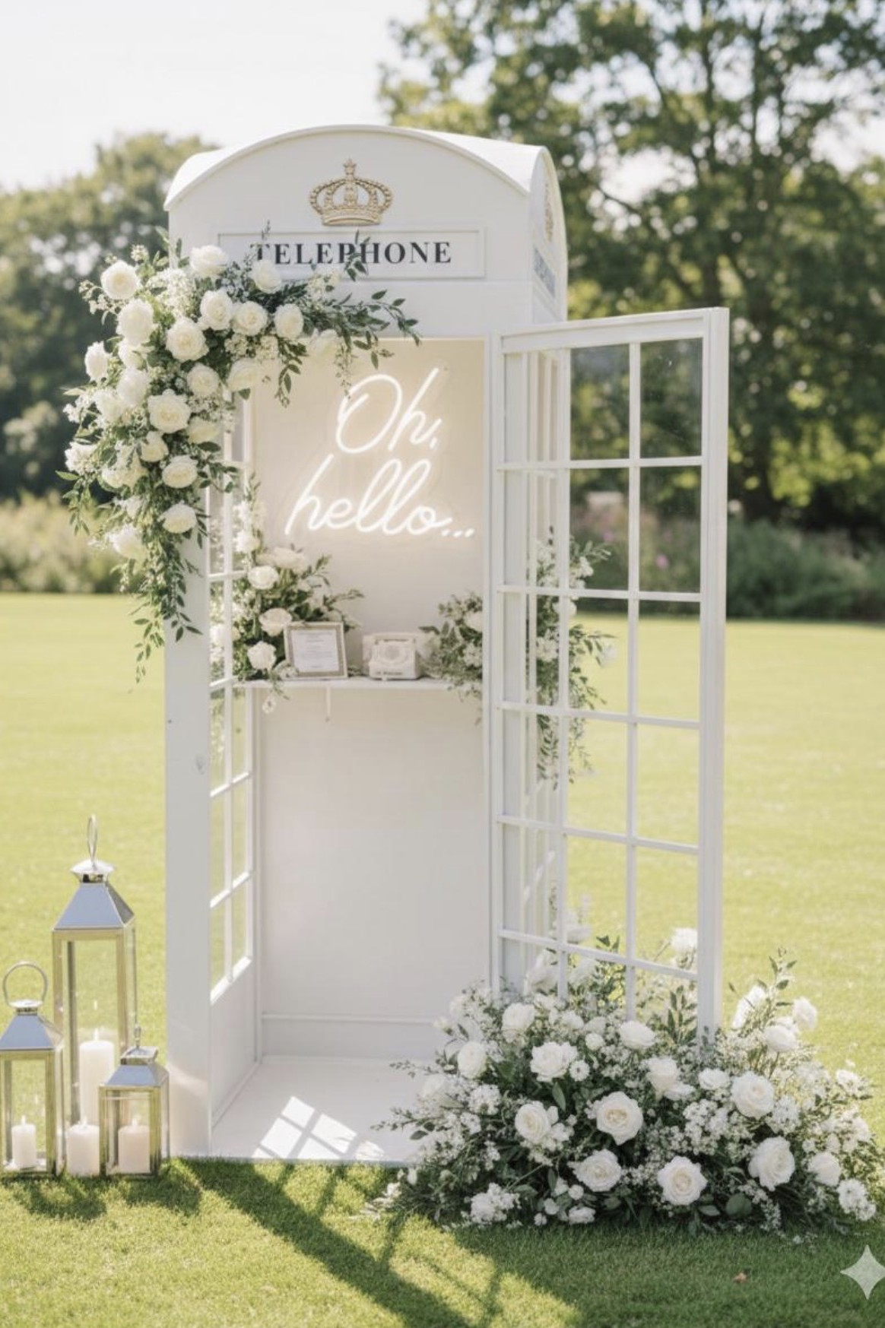
A step-and-repeat backdrop
isn't a company culture moment.
Black Tie Booth turns holiday parties, product launches, and client events into something your team actually talks about — long after the last photo prints.

Slide 3
Who We Are
01
Atlanta-Based Since 2018
Trusted for luxury photo booth and event experiences across the metro area.
02
Six Distinct Experience Formats
From vintage-styled photo booths to full custom LED video walls.
03
Weddings, Galas & Corporate Events
Hundreds of celebrations produced for clients who expect it done right.
04
Full-Service Production
Professional setup, on-site staffing, and breakdown — handled end to end.

Slide 4
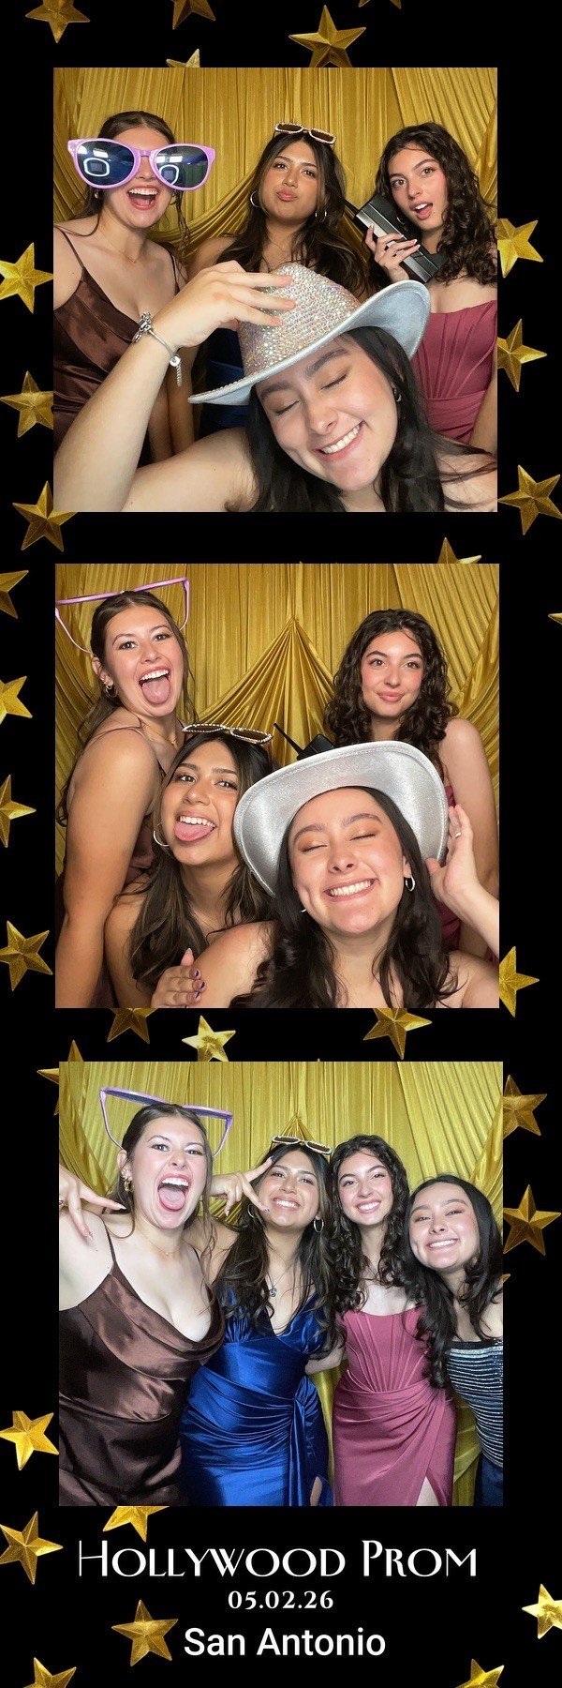
What We Offer
Vintage Photo Booth
Classic Photo Booth
British Phone Booth
Classic styled photo booth with unlimited prints.
All-day drop-off rental — no attendant needed.
A striking, conversation-starting installation.
360 Video Booth
Mirror Booth
Video Wall
Cinematic slow-motion video guests share instantly.
Interactive touchscreen mirror — always a crowd favorite.
Custom branded LED display for any size space.

Slide 5
Built For Moments That Matter
Holiday Parties
Award Ceremonies
Product Launches
Client Appreciation Events
Company Milestones
Galas

Slide 6
Introducing the Black Tie Booth
Corporate Membership
Lock in Black Tie Booth for the year — without re-negotiating every event. One predictable cost. Priority scheduling. One point of contact who already knows how you like your events done.

Slide 7
Membership Tiers
TIER 1
TIER 2
$199 /mo
$275 /mo
One experience activation included per quarter (4 per year)
One combined multi-experience event per year — up to 3 experiences, one date (e.g. Mirror Booth + Video Wall + 360 Video Booth together)
Choice of any single experience
Priority scheduling on your preferred dates
Additional build-outs available at a member discount off standard corporate pricing
Priority scheduling + dedicated account contact
Membership pricing is a 12-month commitment billed monthly — this keeps your rate locked while letting us guarantee your dates.

Slide 8
Why a Membership
1
2
3
Predictable Budget
Guaranteed Scheduling
One Relationship
Lock your rate for the year instead of re-quoting every event.
Priority access to popular dates before they sell out.
A dedicated contact who already knows your events, every time.

Slide 9
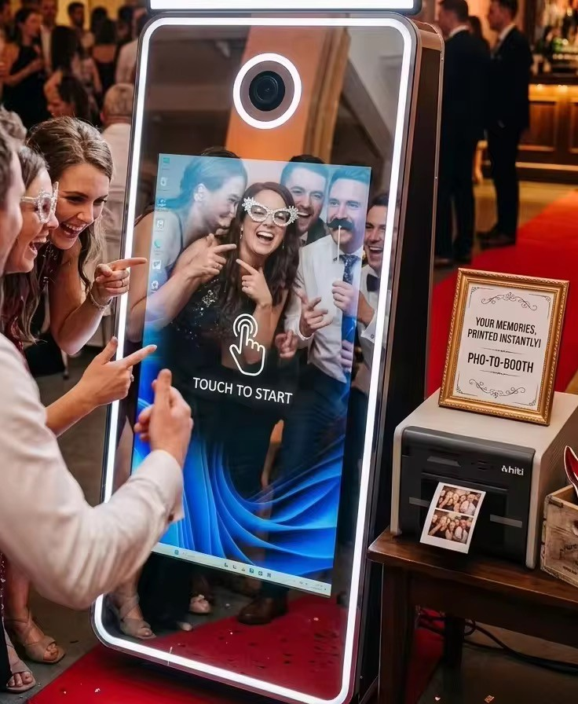
What's Included
✓
Professional setup & breakdown
✓
On-site staffing where applicable
✓
Custom branding options
✓
Digital gallery delivery
✓
Dedicated account contact
✓
Priority date scheduling

Slide 10
Let's Make Your Next Event
the One Everyone Talks About
Reply for a custom quote, or grab 10 minutes on our calendar.
[phone number] · blacktiebooth.com

