Slide 1
Reproducible Neuroimaging: Principles
A Core for Neuroimaging Acquisition and Analysis Workshop
Sponsored by the UNMC CoNDA Center
Friday December 10th, 2021
Dr. David E. Warren, PhD

Slide 2
Welcome
Reproducibility is essential for good science
Neuroimaging is complex in all phases
Today’s aim: to introduce key concepts and techniques that can enhance the reproducibility of neuroimaging research

Slide 3
Instructors
Lead
Dr. David E. Warren
Co-Instructors
David G. Ellis
Connor Phipps

Slide 4
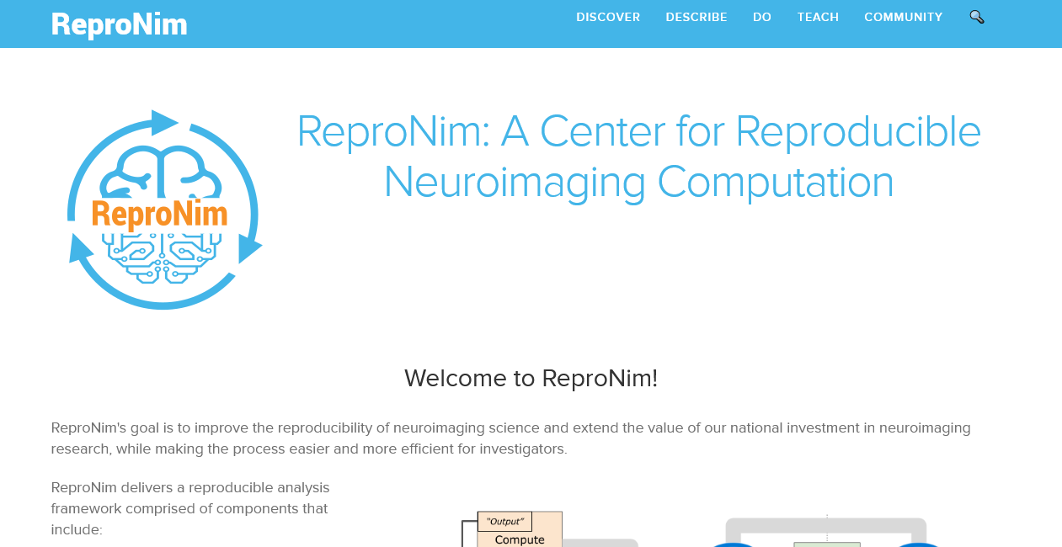
Origins

Slide 5
How to get Help
In-person
Flagging system
Green Post-It OK or I’m done
Red Post-It Help! or Still working
Virtual/Remote
Slack chat

Slide 6
Tools
Python (lots)
Jupyter (Jupyter notebooks & JupyterHub)
UNIX (shell & commands)
Neuroimaging software (FSL, etc.)

Slide 7
First steps
Connect your device to the network
Open your web browser
In your web browser, open:
Course server https://inbrehub.unmc.edu
Server hosting course materials & exercises
Course chat (Slack) https://bit.ly/30fHo8s
Chatroom for questions, discussion, links, etc.

Slide 8
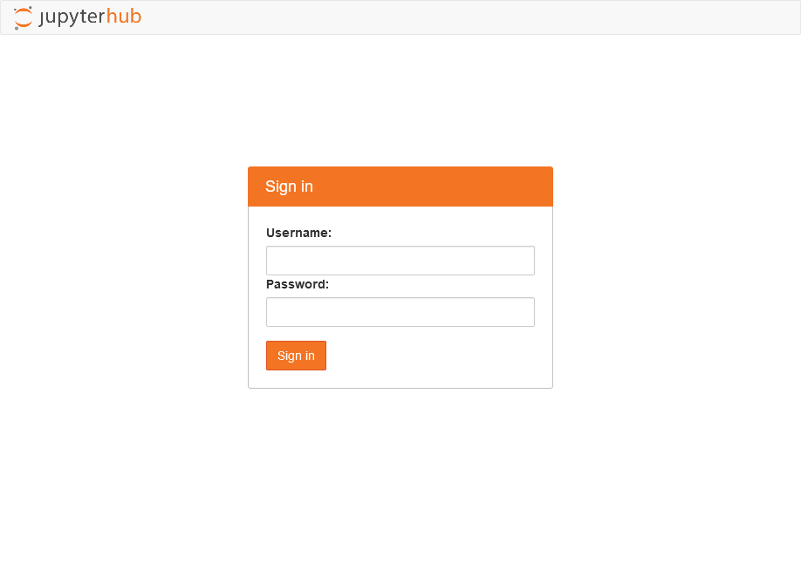
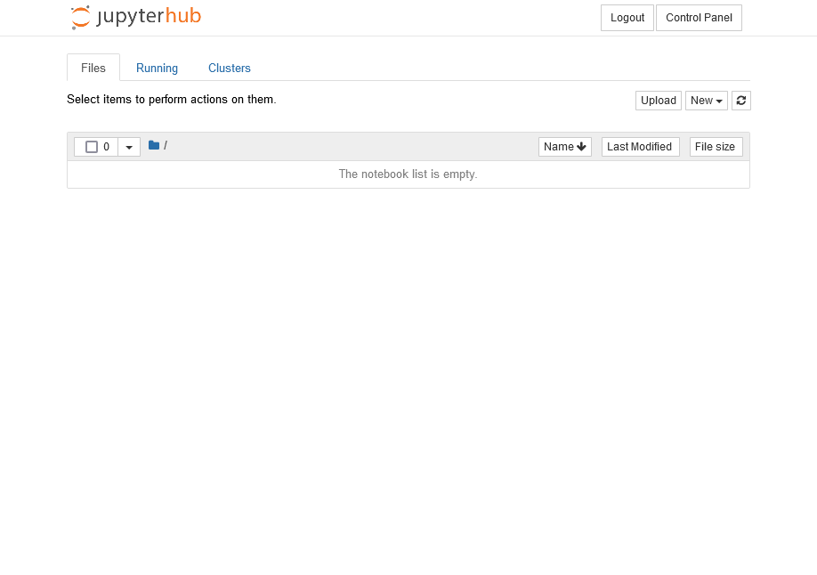
Course SERVER
Login to the course server with your username
The part of your email address before the @
david.warren@unmc.edu
Before login
After login

Slide 9
Course SERVER

Slide 10
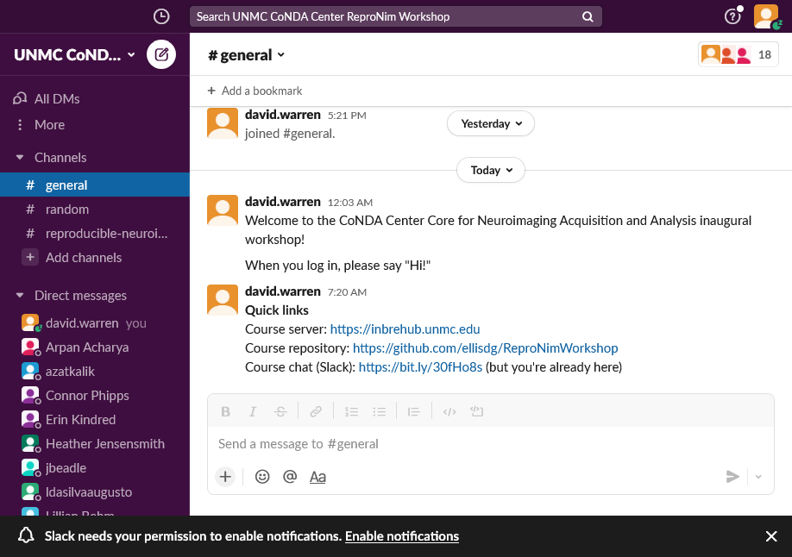
Course Slack

Slide 11
Schedule
Time | Activity | Instructor
1:00 | Welcome & Overview | Warren
1:15 | Orientation to tools | Ellis
1:30
1:45 | Reproducibility: Motivation & Basics | Warren
2:00
2:15 | Plotting your data (matplotlib) | Phipps
2:30
2:45 | Break
3:00 | Organizing your data (BIDS) | Warren
3:15
3:30 | Neuroimaging workflows (nipype) | Ellis
3:45
4:00 | Brain network connectivity (bctpy) | Phipps
4:15
4:30 | Questions/open discussion | —
4:45 | Reproducibility: Conclusions | Warren
5:00 | End

Slide 12
Questions?

