Slide 1
Reproducible Neuroimaging: Motivation
A Core for Neuroimaging Acquisition and Analysis Workshop
Sponsored by the UNMC CoNDA Center
Friday December 10th, 2021
Dr. David E. Warren, PhD

Slide 2
Reproducibility
Defining the problem and the term

Slide 3
Reproducibility is a Problem
Ioannidis, 2005, PLoS Medicine

Slide 4
Reproducibility is a Problem
Open Science Collaboration, 2015, Science

Slide 5
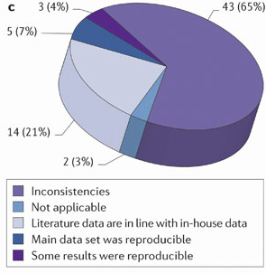
Reproducibility is a Problem
“In almost two-thirds of the projects, there were inconsistencies between published data and in-house data…”
Prinz et al., 2011, Nature Reviews Drug Discovery

Slide 6
Examples from your FIELD
What are some examples of challenges for reproducibility in your field?

Slide 7
Defining Reproducibility
What does reproducibility mean?
How would you define reproducibility?
Is there one definition of reproducibility?

Slide 8
Defining Reproducibility
Re-executability or “publication-level replication”
Same data + Same analysis = Same result
How many publications provide enough information to evaluate?
Generalizability
Same Data + Similar Analysis = Similar Result
Similar Data + Same Analysis = Similar Result
Similar Data + Similar Analyses = Similar Result
What constitutes similar?

Slide 9
Reproducibility
Challenges for neuroimaging

Slide 10
Critiques of reproducibility in neuroimaging
Eklund et al., 2016, PNAS

Slide 11
Issues for Reproducibility in Neuroimaging
Low power
Mistakes
Lack of data sharing/ineffectual sharing
Methodological variation
P–hacking (P-phishing)
Publication Bias

Slide 12
Issues for Reproducibility in Neuroimaging
Low power — More/better data sharing
Mistakes — More rigorous Methods/Results description
Lack of data sharing/ineffectual sharing — Share
Methodological variation — Methods regularization
P–hacking (P-phishing) — Analysis Pre-Registration
Publication Bias — Results databases

Slide 13
Examples from your FIELD
What are some examples of challenges for reproducibility in your field?
What are some potential answers to these challenges?
Are those answers generalizable to other disciplines?

Slide 14
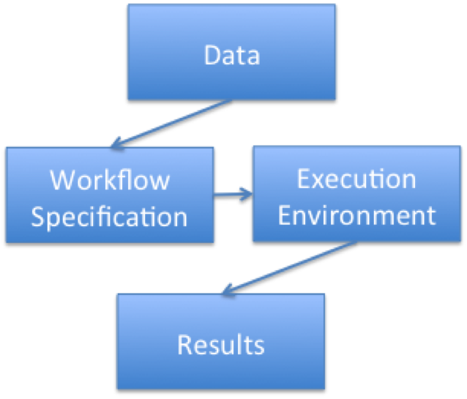
A Reproducible Publication
The paper
Prose for introduction, methods, results, discussion
Figures, Tables, etc.
But also
Data
Workflow specification
Environment specification
Complete results

Slide 15
Examples from your FIELD
What are some examples of challenges for reproducibility in your field?
What are some potential answers to these challenges?
Are those answers generalizable to other disciplines?

Slide 16
Reproducibility
Everyday reproducibility

Slide 17
Day-To-Day Reproducibility
Reproducibility requires knowledge of what, when, and how
What data were collected?
When was each step of data processing conducted?
How was data processing/analysis performed?
Any approach that helps capture this information enhances the reproducibility of your research
Applying ideas and techniques from this workshop should help to boost reproducibility immediately

Slide 18
Day-To-Day reproducibility: Tools
Command line/Shell
Scripting/Coding
Version control systems
Package managers and distributions

Slide 19
Day-To-Day reproducibility: Concepts and approaches
Keep reproducibility in mind from the beginning
Share data
Always check licenses/other limitations
Request appropriate permissions
Use open/libre software when possible
Report bugs
Share scripts under open licenses

Slide 20
Reproducibility
Everyday reproducibility

Slide 21
Summary
Reproducibility is a challenge for science
Reproducibility can be defined many different ways
Neuroimaging present unique challenges for reproducibility
Best practices can enhance reproducibility
Small changes to everyday behaviors can have large impact

