Slide 1
Reproducible Neuroimaging: Organization
A Core for Neuroimaging Acquisition and Analysis Workshop
Sponsored by the UNMC CoNDA Center
Friday December 10th, 2021
Dr. David E. Warren, PhD

Slide 2
Scenario: Subject numbering
You’ve just enrolled three new participants in your study
You need to create a simple system for labeling their data
Also, your study has two sessions
Exercises
What labels would you create for your first three participants?
What labels would you create to distinguish the two sessions?

Slide 3
Organizing data is challenging
Internal consistency is challenging for idiosyncratic systems
Even consistent idiosyncratic systems require interpretation or inference
The “post-doc problem”
Misunderstandings are trivially easy even among colleagues
UIUC example

Slide 4
Challenges of organizing Neuroimaging data
Neuroimaging produces complicated data
Many different arrangements of data possible
Different arrangements are hard to compare
Misunderstandings can arise and confound analysis

Slide 5

BIDS: A scheme for Organizing neuroimaging data
BIDS: The Brain Imaging Data Structure
An open specification (“spec”) for the layout of neuroimaging data
https://bids-specification.readthedocs.io/en/stable/
Internally consistent, freely available approach for organizing data
Addresses key challenges of organizing brain imaging data

Slide 6
GUIDED exploration of a BIDS dataset
Through Jupyter, please open a terminal
Follow along with the instructor’s examples

Slide 7
(Return from BIDS Exploration)

Slide 8
BIDS: Further Motivation
Many open datasets are organized using BIDS
Sharing your data often requires BIDS validation
BIDS-Apps can be applied to any valid BIDS dataset

Slide 9
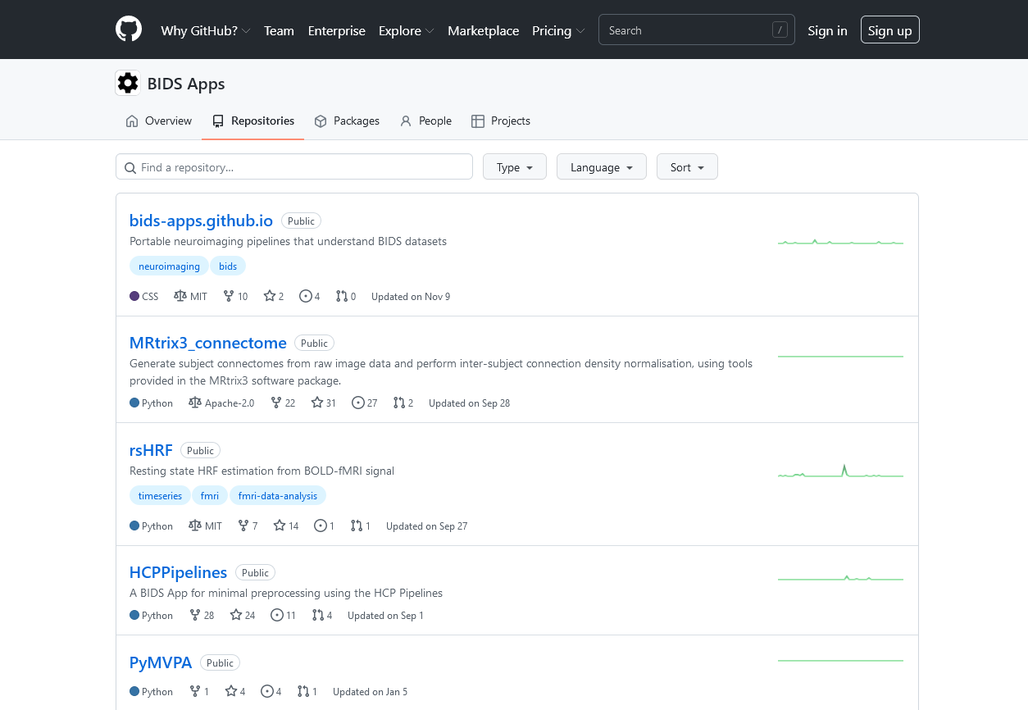
BIDS-Apps

Slide 10
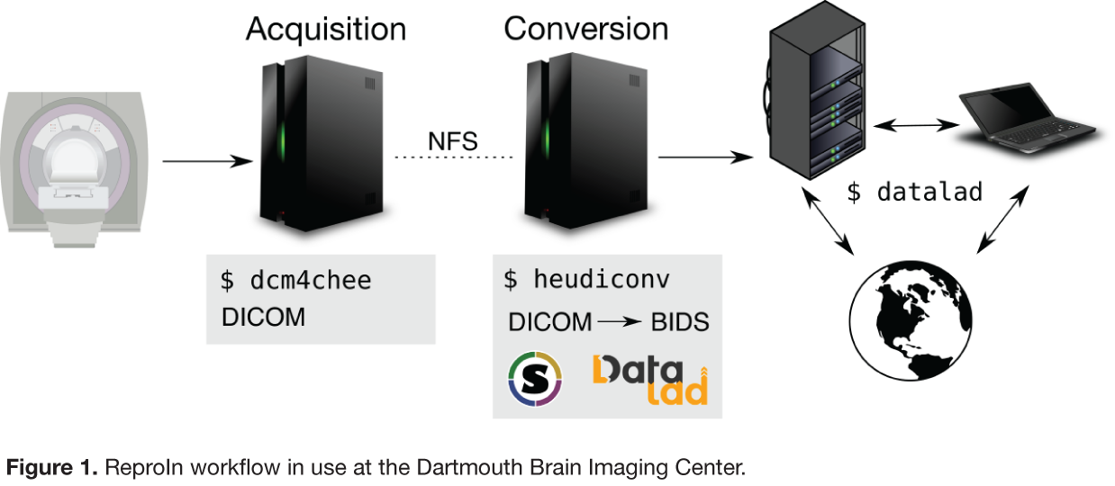
ReproIN: A Scanner-to-Server Solution

Slide 11
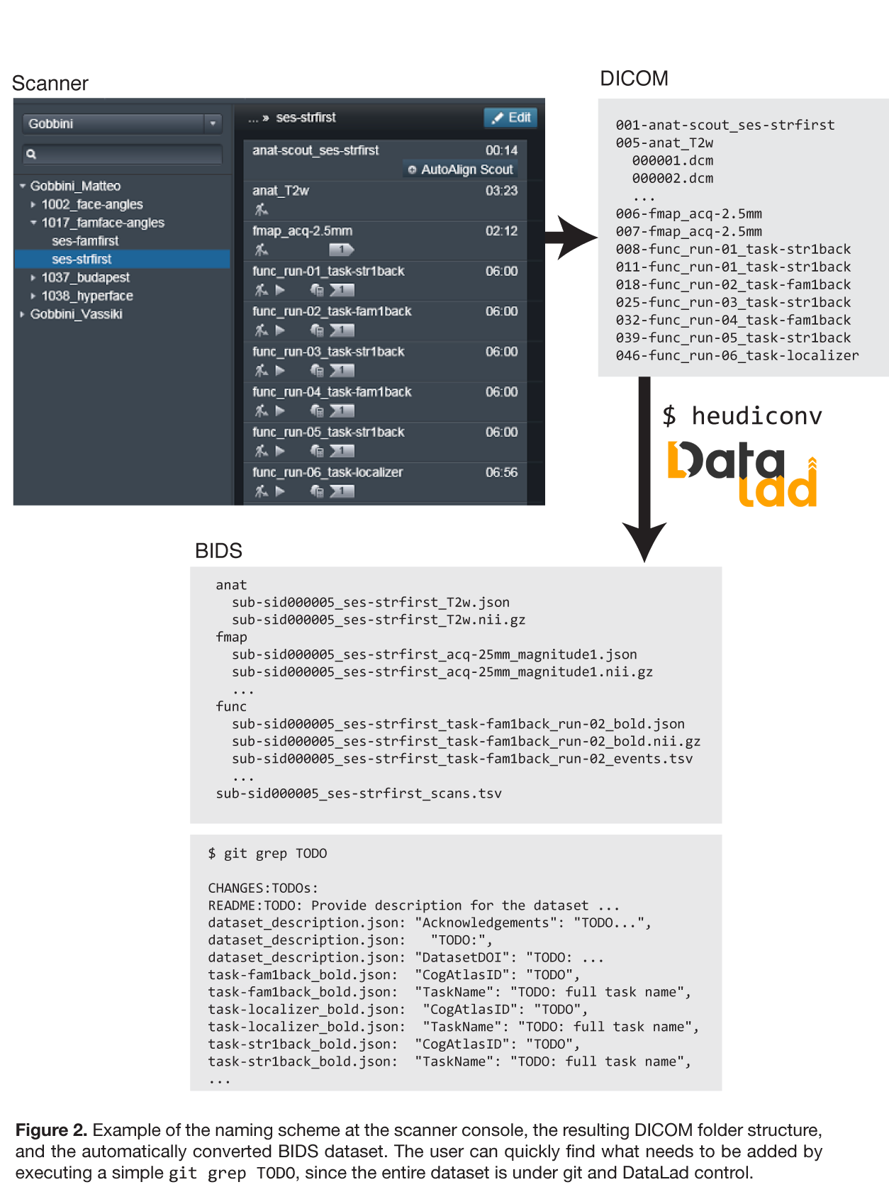
ReproIN: A Scanner-to-Server Solution

Slide 12
ReproIN: A Scanner-to-Server Solution
Collect (MRI) data with BIDS-like naming conventions
Bring data into version-controlled data management system
Convert native DICOM images to NIFTI using open tools
Extract information during conversion and use to organize into BIDS format
Proceed with planned analyses

Slide 13
Summary
Data organization is complex and non-trivial
Idiosyncratic approaches can create confusion
Specifications can provide structure and consistency
BIDS is a specification for layout of neuroimaging data
ReproIn is an integrate approach spanning data collection, data conversion, data processing, and data analysis.

