Slide 1
Go Manual Testing

Slide 2
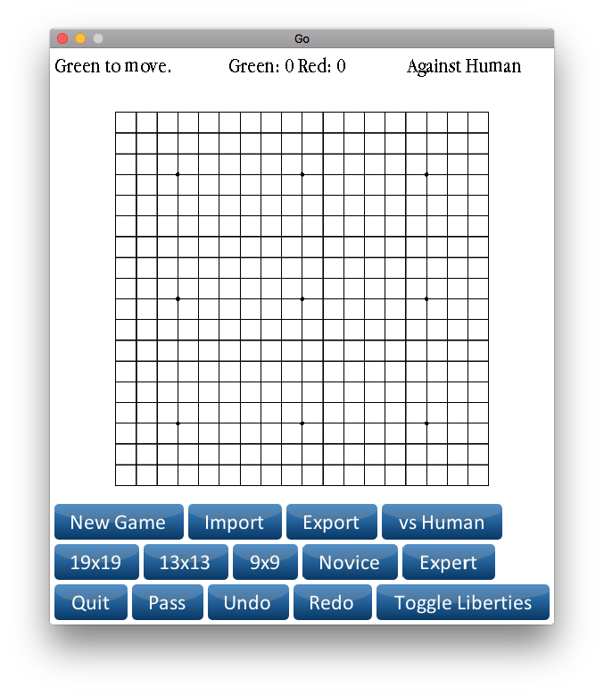
Open the application

Slide 3

Select 9x9 to start a new game

Slide 4

Select Expert to play against the computer

Slide 5
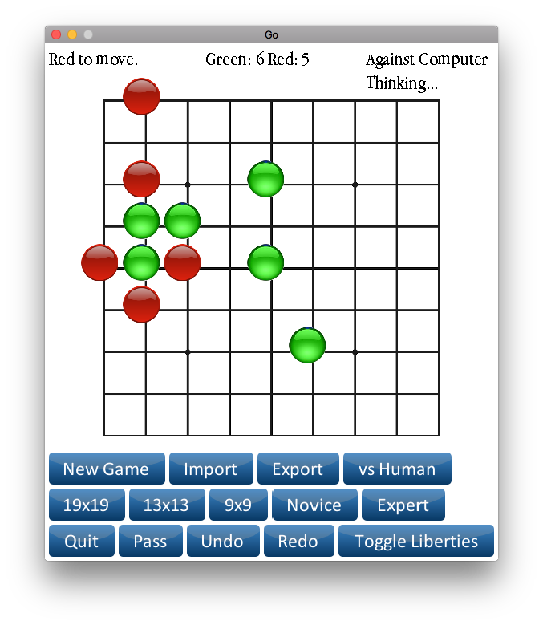
The user plays green stones and the computer plays red stones. ”Thinking…” should display before the computer makes the move.

Slide 6
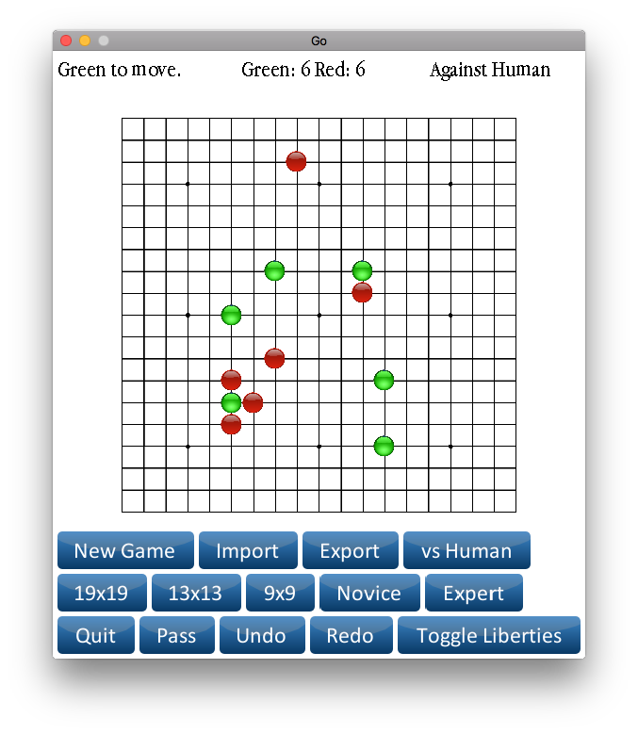
Select vs Human and 19x19 to start a new game against a human on a 19x19 board.

Slide 7

Select Toggle Liberties to view liberties.

Slide 8

Red can capture stones according to the rules.

Slide 9
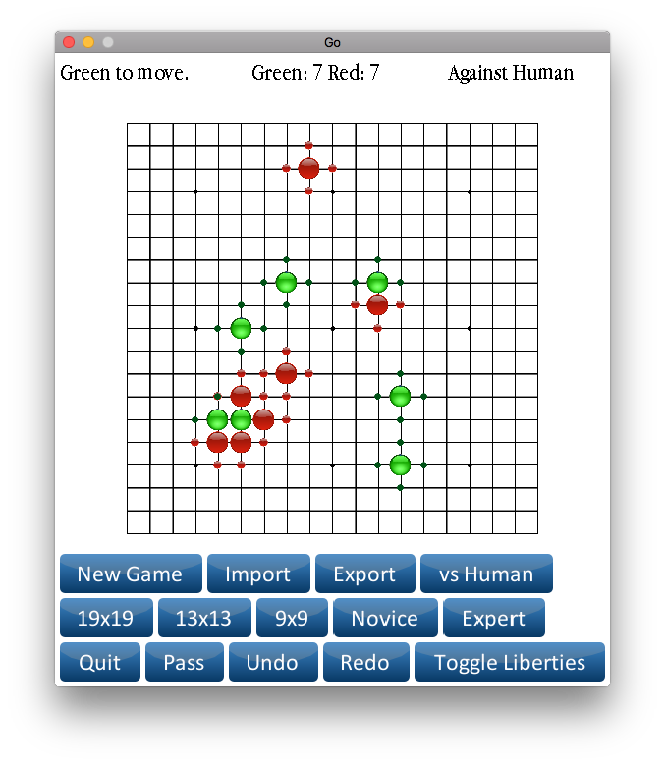
The user can undo moves and make different moves.

