Slide 1
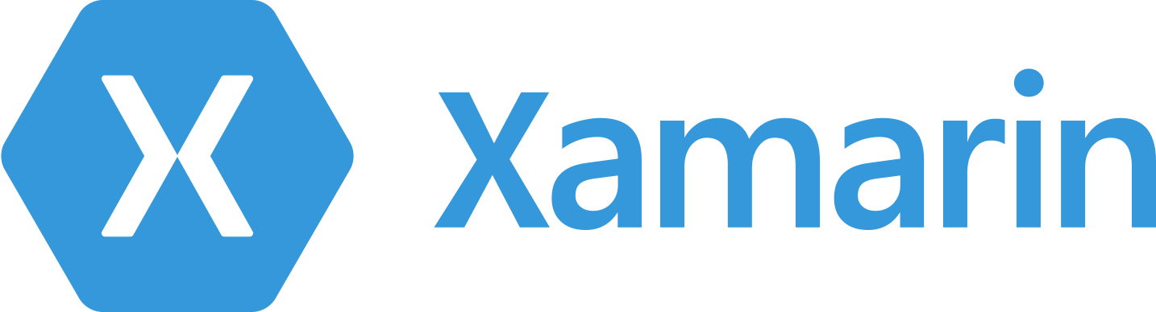

Getting past
Hello World with Xamarin and MvvmCross
Jeremy Ellis
jeremy@ellisnet.com
@misterdos

Slide 2
Why talk about MvvmCross?
Key to Rapid Application Development (RAD) of Cross Platform (XPlat) native applications
Key to my own experience of getting past “Hello World” with MonoTouch (Xamarin.iOS) and Mono for Android (Xamarin.Android)
Maybe form a “support group” for MvvmCross-heads in the Minneapolis

Slide 3
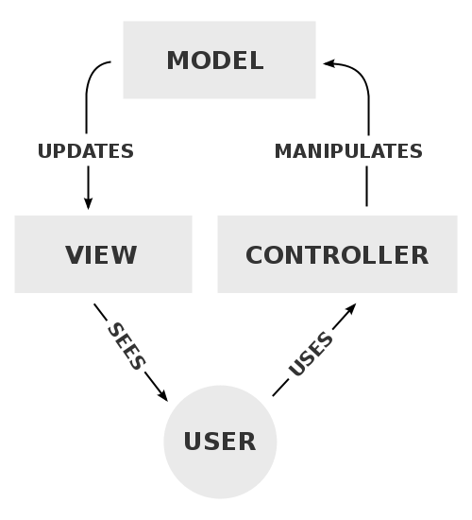
MVC vs. MVVM
MVC = Model View Controller – gaining a lot of popularity for web applications. iOS development is based on this pattern.

Slide 4

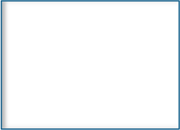




MVC vs. MVVM
MVVM = Model View ViewModel
VM (ViewModel) is a “model of the view” – presents the View to the Model as another Model
USER
VIEW
VIEWMODEL
MODEL

Slide 5
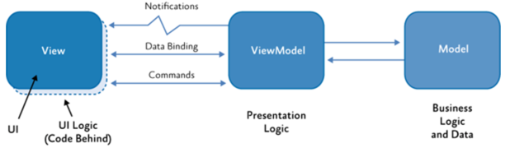
MVVM Details
UI Controls in View are bound to properties in ViewModel – when property changes, UI control updates
UI Controls call ICommands when user does something that requires handling

Slide 6
A few MVVM Options
Windows
  WPF and Silverlight – PRISM, Caliburn
  Many, many others…
JavaScript
  KnockoutJS, AngularJS, KendoUI
Mobile
  CaliburnMicro - http://caliburnmicro.codeplex.com
  ReactiveUI - https://github.com/reactiveui/ReactiveUI
  MonoCross (MVC) - http://monocross.net

Slide 7

Why MvvmCross?
Rapid Application Development framework built on, and built for, Xamarin platforms
Seems to be gaining traction in the Xamarin community.
Stuart Lodge (@slodge) – Amazing guy, incredibly smart and committed to improving the framework.
Open source, free.
It has made me a better C# programmer – helped me learn about Portable Class Libraries (PCLs), when/why to use interfaces, dependency injection/inversion of control and the MVVM pattern.

Slide 8
Tutorials, tutorials, tutorials
GitHub page - https://github.com/MvvmCross/MvvmCross
Stuart’s blog – http://slodge.blogspot.com
YouTube videos – www.youtube.com - search for “slodge”
  Please, please, please watch the N+1 video series
Twitter - @mvvmcross and @slodge

Slide 9
What I have
Beefy MacBook Pro with:
  Xamarin.iOS (Business Edition)
  VMWare Fusion, running Windows 8.1 virtual machine, with:
    Visual Studio 2013
    Xamarin.iOS VS plugin
    Xamarin.Android (Business Edition)
    SQL Server 2012
  Tablet, tablets, tablets…

Slide 10
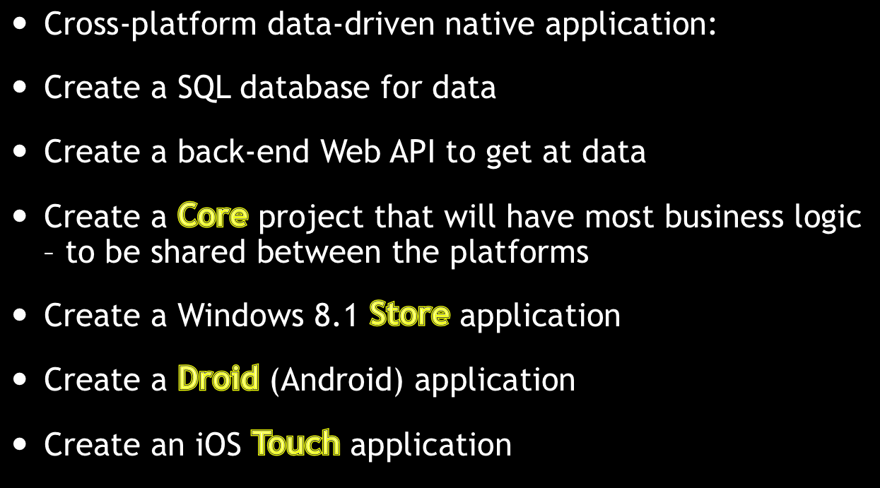
Preview of Demo

Slide 11
DEMO

Slide 12
Resources
Watch the “slodge” N+1 videos on YouTube
Me:
  Jeremy Ellis
  jeremy@ellisnet.com
  @misterdos
Everything you saw is on GitHub:
  http://github.com/ellisnet/MNEnterpriseMobile
  Plus links to important MvvmCross resources – to be added

