Slide 1
POSTER
A Low-Complexity Speech Codec Using Parametric Dithering for ASR

Slide 2
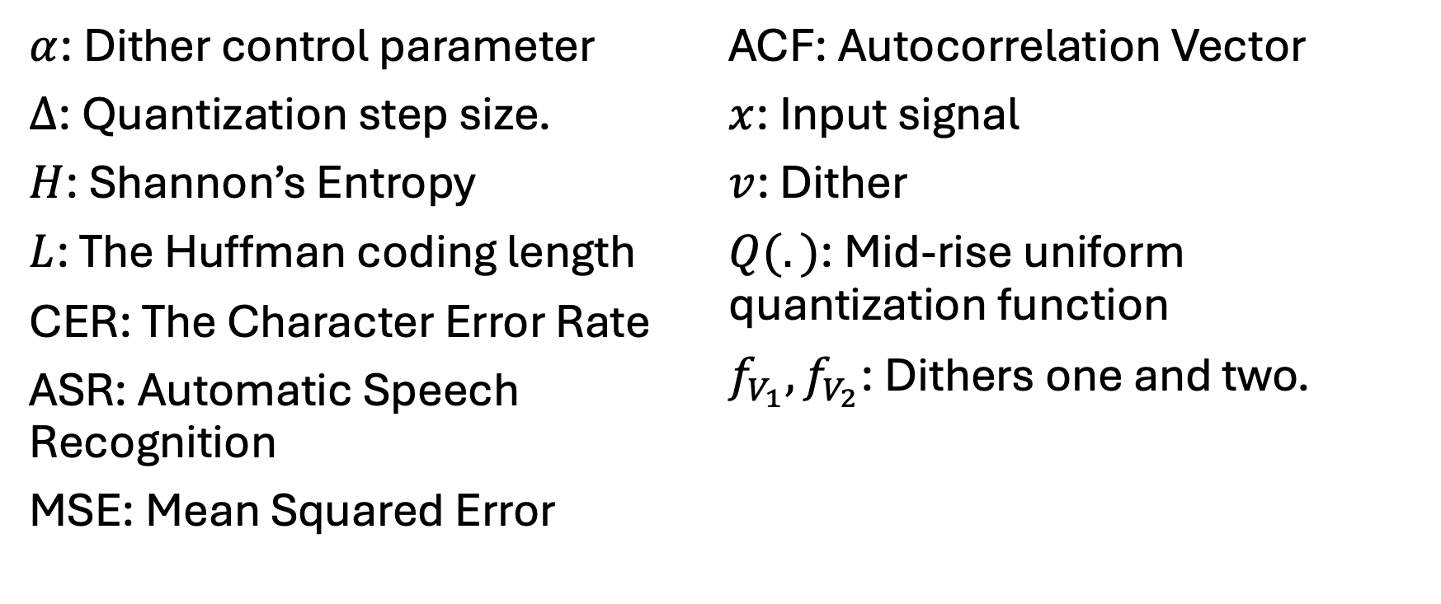
Variables/Terms
$α$: Dither control parameter
$Δ$: Quantization step size.
$H$: Shannon’s Entropy
$L$: The Huffman coding length
CER: The Character Error Rate
ASR: Automatic Speech Recognition
MSE: Mean Squared Error
ACF: Autocorrelation Vector
$x$: Input signal
$v$: Dither
$Q(.)$: Mid-rise uniform quantization function
$f_{V_{1}}, f_{V_{2}}$: Dithers one and two.

