Slide 1
Prediction intervals for ensemble time series forecasts
Peter Ellis
December 2016

Slide 2
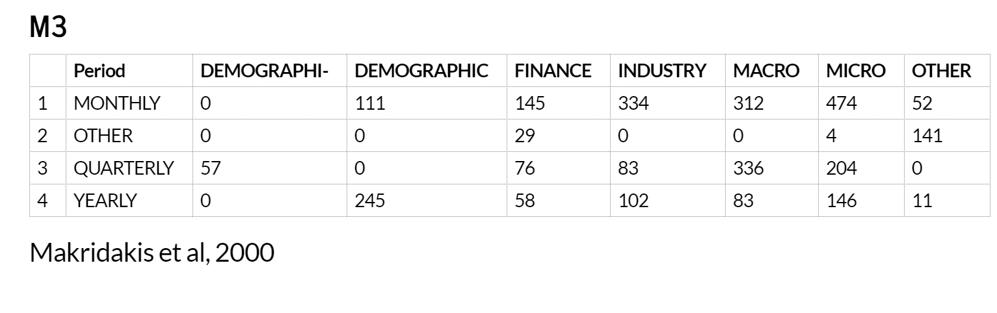
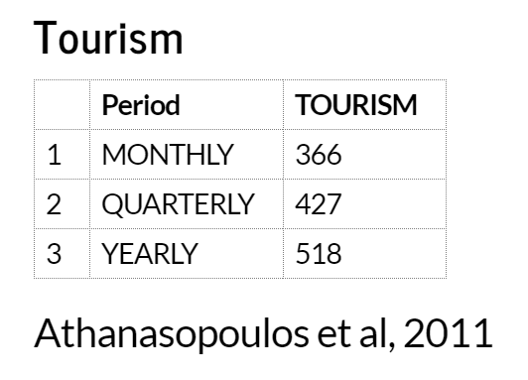
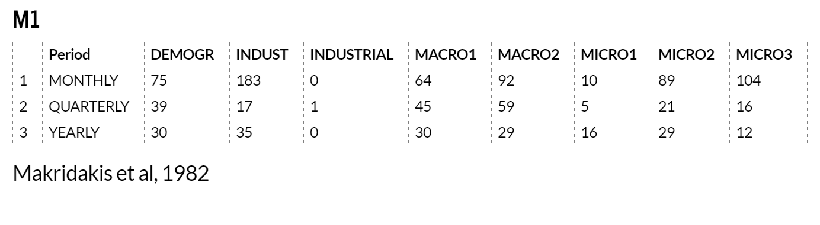
Data used – Mcomp and Tcomp R packages

Slide 3
Theme A – prediction intervals
Need to be given much more attention by researchers, practitioners, and end users

Slide 4
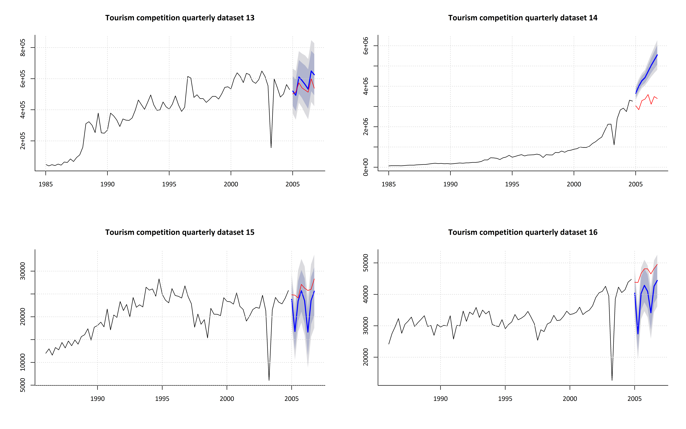

Slide 5
Sources of prediction uncertainty
Random errors
Random estimates of parameters
Uncertain meta-parameters (eg number of autoregressive terms)
Unsure if the model was right for the historical data
Even given #4, unsure if the model will continue to be right
Standard prediction intervals most often only take #1 into account
Notes:
This is a slight expansion of http://robjhyndman.com/hyndsight/narrow-pi/
I split his model uncertainty into #3 and #4 above.

Slide 6
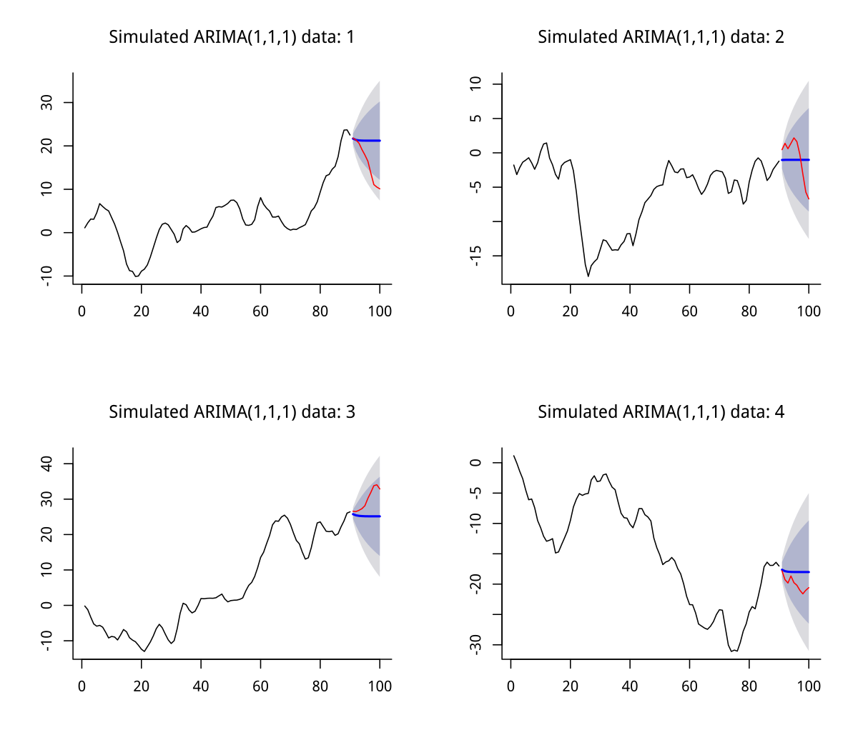
An example – illustrate error sources 2 and 3
If we create our own data, we can compare models that have only 3/5 of those challenges with those that have only 2/5.
Plots on the right are example different realisations of identical ARIMA(1,1,1) processes, with forecasts from forecast::Arima which has been provided the correct 1,1,1 meta-parameters.
Their prediction interval coverage could be compared to that from forecast::auto.arima with 10,000 datasets.

Slide 7
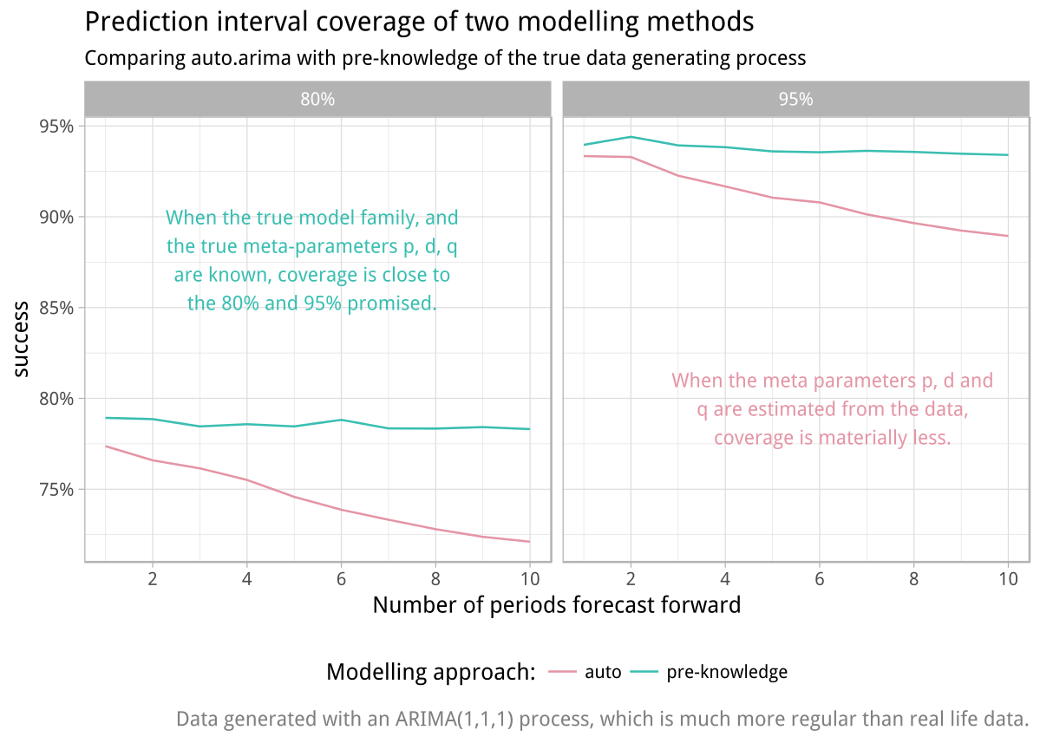
From estimating parameters
From estimating meta-parameters

Slide 8
More issues
Coverage success depends on frequency
Seasonal data gets better prediction intervals
Generally, coverage is pretty poor
Makridiakis (1987)
Athansopoulos et al (2011)

Slide 9
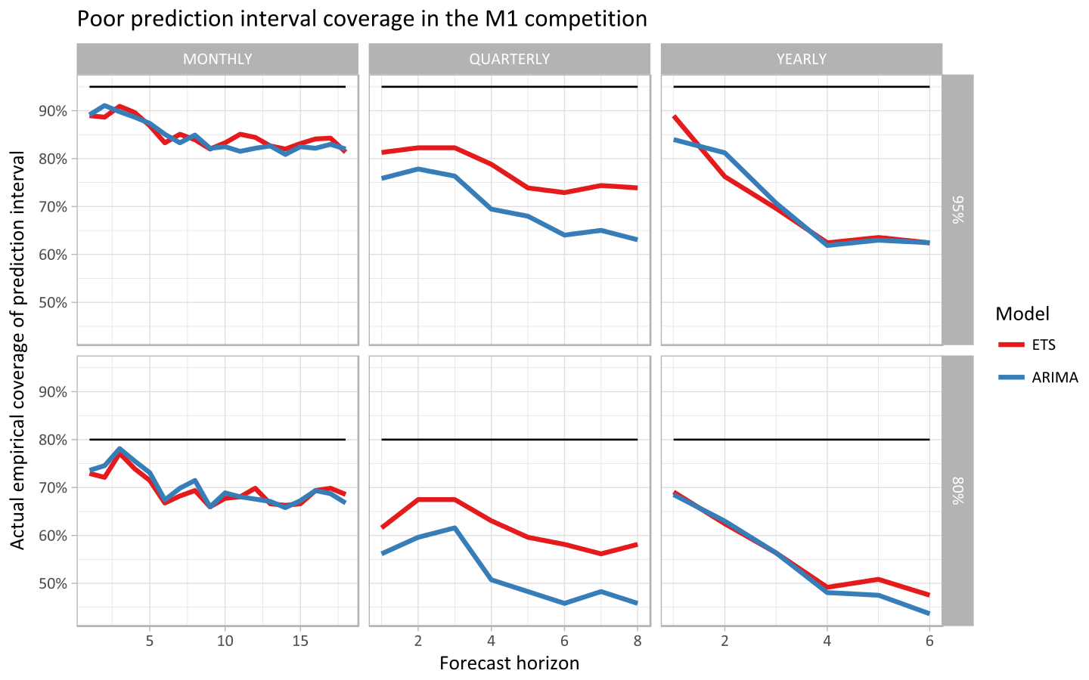

Slide 10
Theme B – ensemble forecasts
Known since 1969 to work well with time series and many confirmations since
New energy with recent gains in computing power, application to machine learning, the rise of Kaggle, etc…
Different philosophies for why to do this
Theoretical – should only benefit if one model has information the other doesn’t (more likely to find economists in this field)
Pragmatic – Find uncorrelated, reasonable quality forecasts and just average them (I’m with the pragmatists, because I’m sceptical about the models)
Bates and Granger (1969) The Combination of Forecasts
http://mlwave.com/kaggle-ensembling-guide/
Notes:
See http://mlwave.com/kaggle-ensembling-guide/ on Kaggle

Slide 11
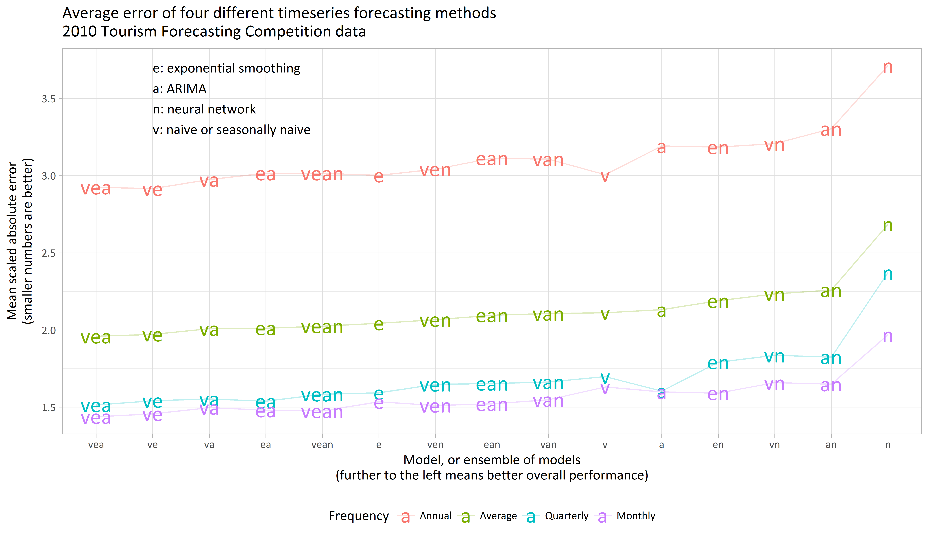
Adding poor quality forecasts to the ensemble (like nnetar) reduces performance, but combining good quality forecasts improves it.

Slide 12
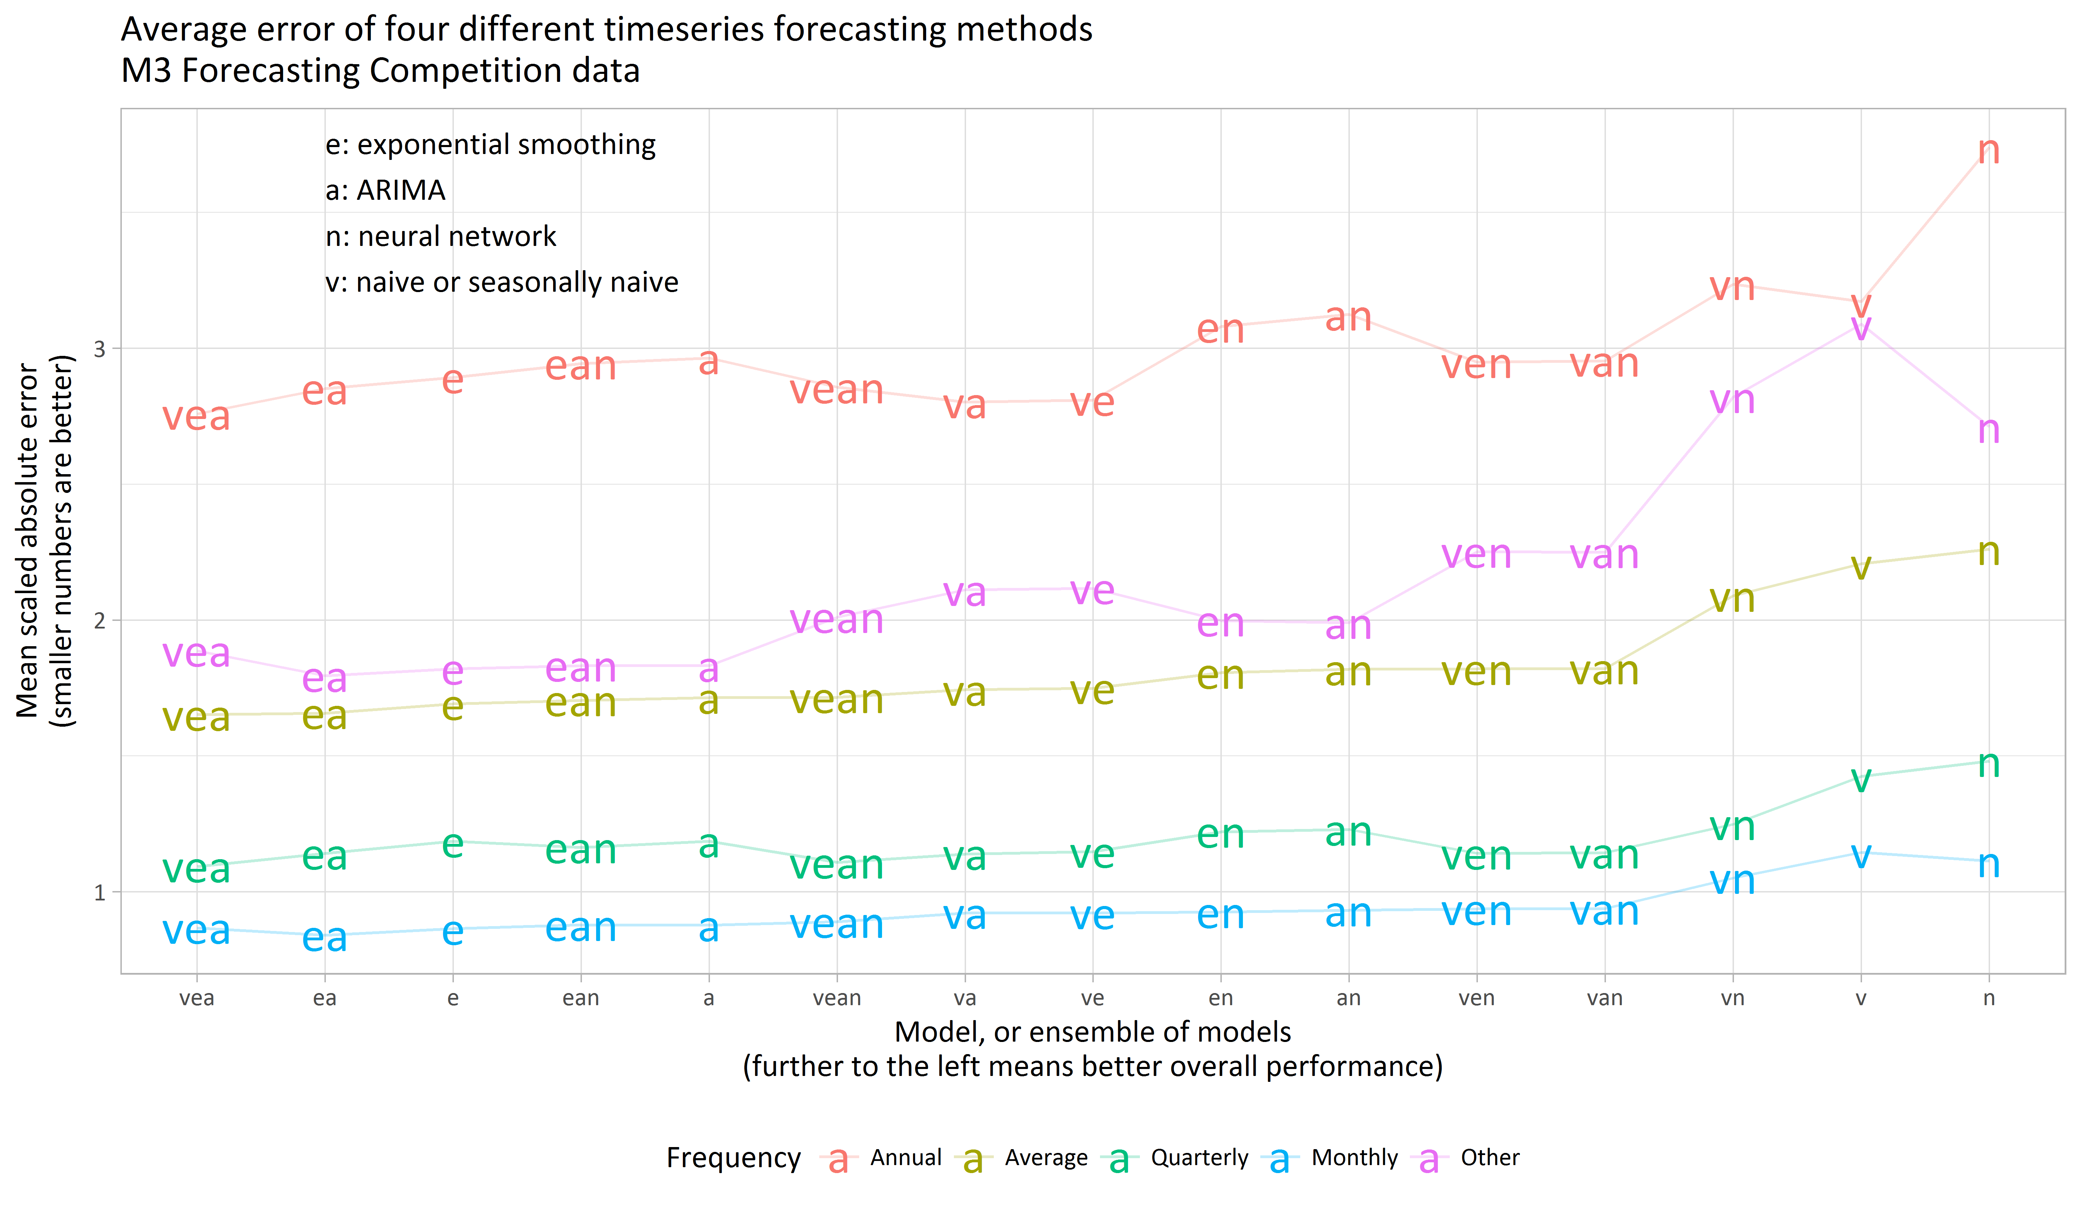

Slide 13
Theme C – bring it together
Prediction intervals needed for ensemble forecasts
Usually presumed this would be some kind of weighted average of the limits, based on estimating covariance of the ensemble forecasts
But when the actual result is outside of both forecasts, this still fails
A conservative approach is to take the extremes of the overlapping forecasts
This has been implemented in the forecastHybrid R package
When the ensemble is large and some forecasts are low quality this is too conservative, particularly for seasonal data
But with high quality component forecasts…

Slide 14
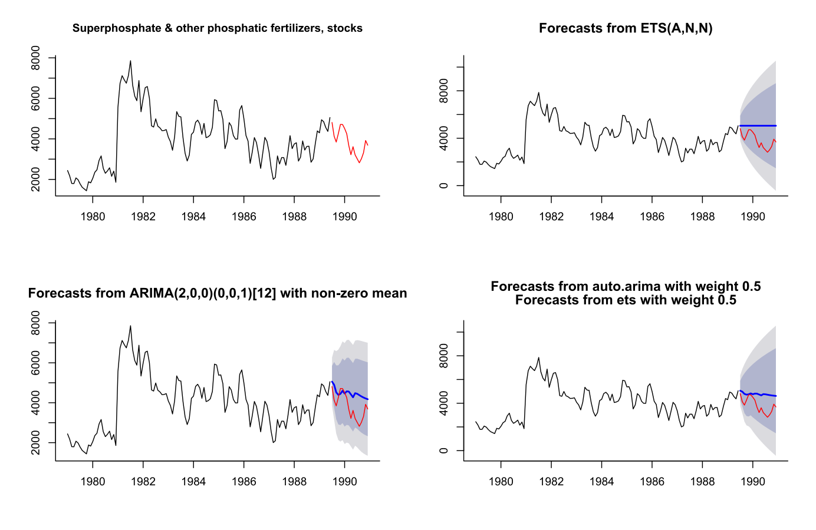
When it works

Slide 15
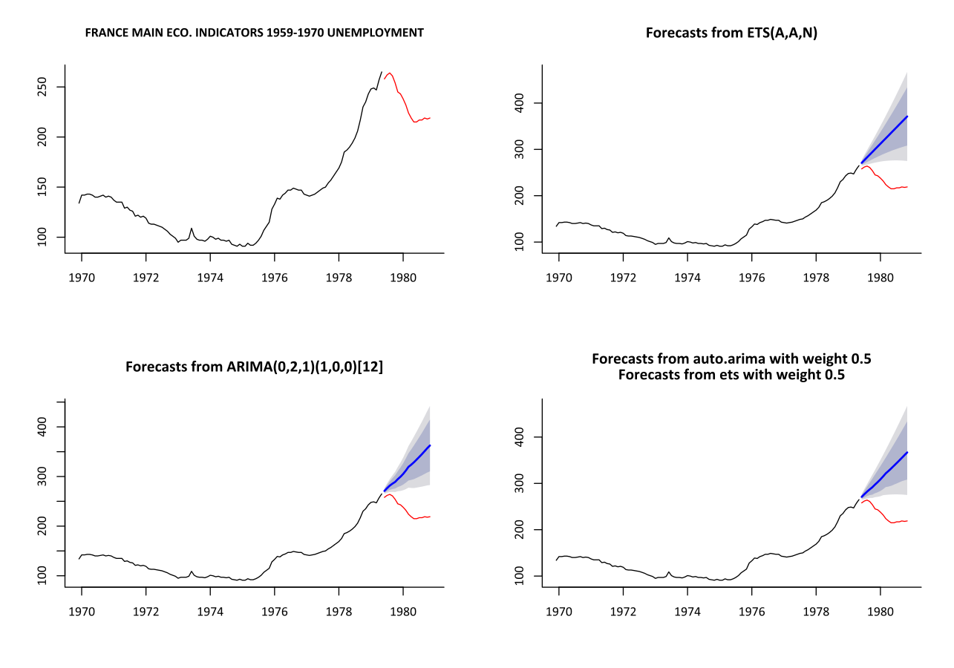
When it doesn’t

Slide 16
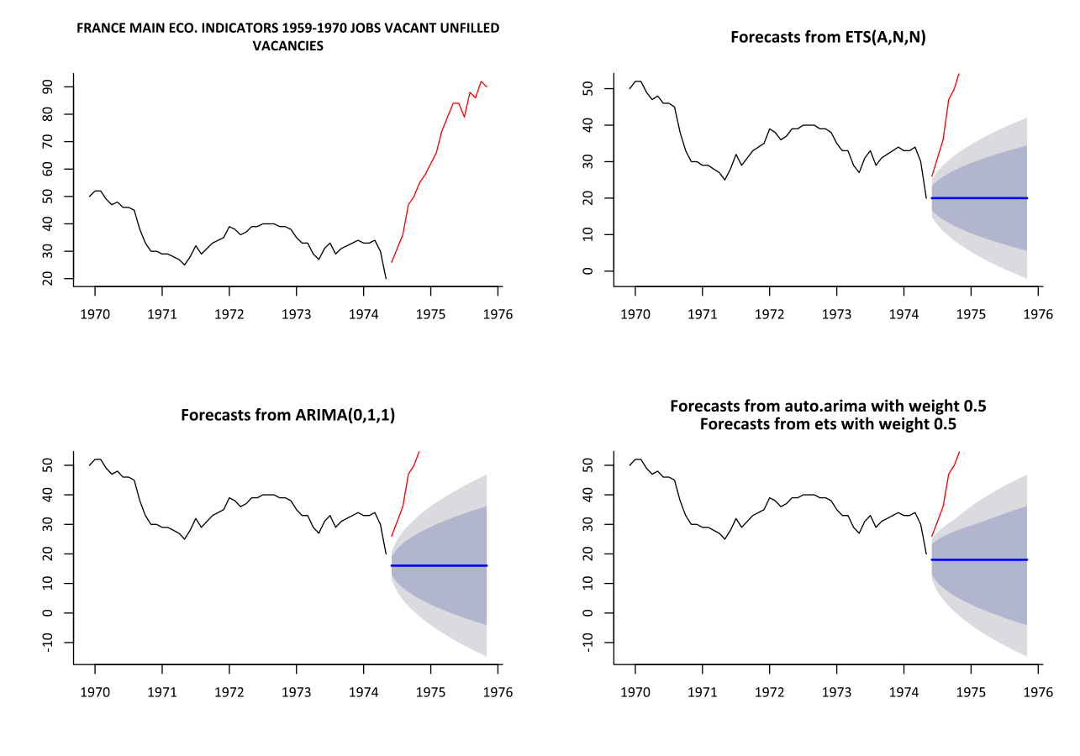
When it doesn’t

Slide 17
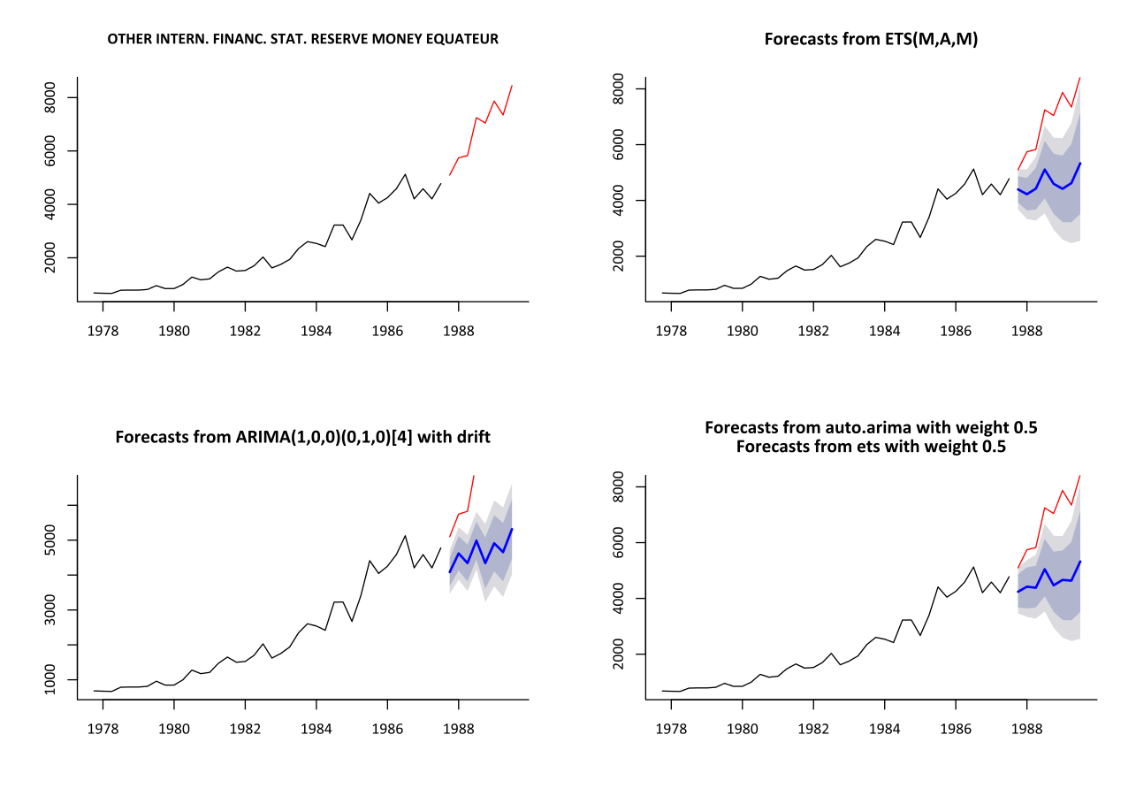
When it doesn’t

Slide 18
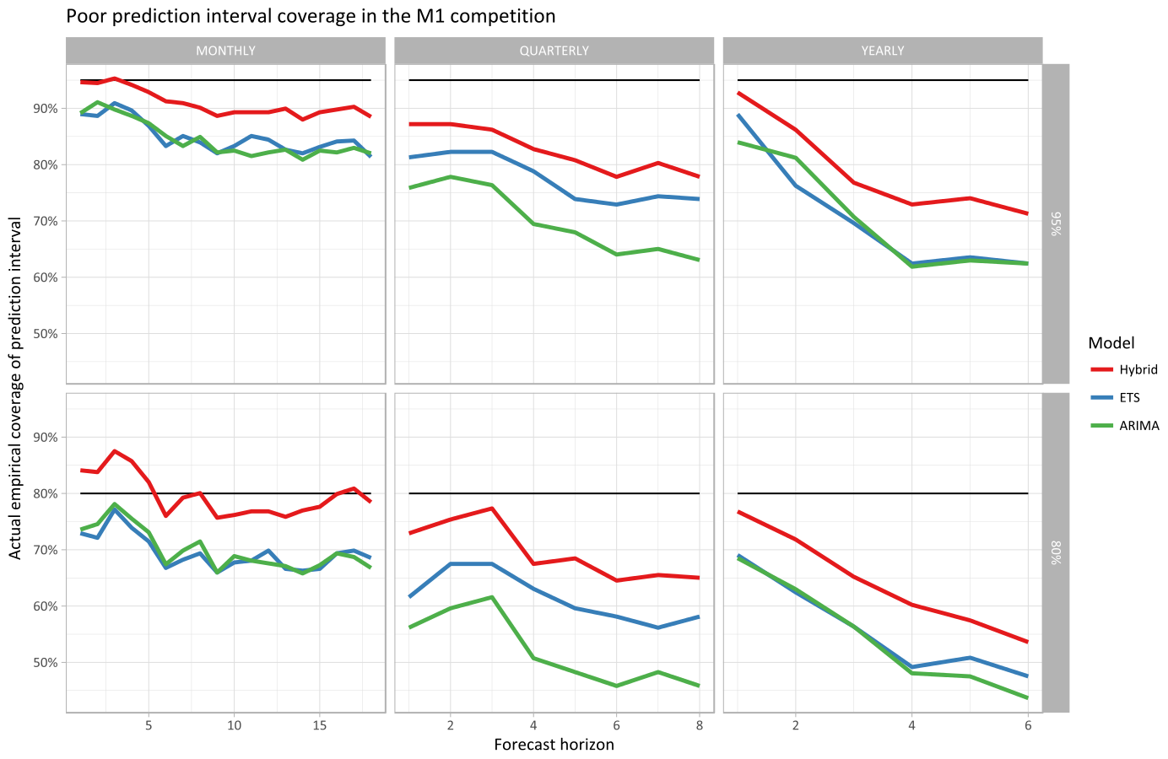

Slide 19
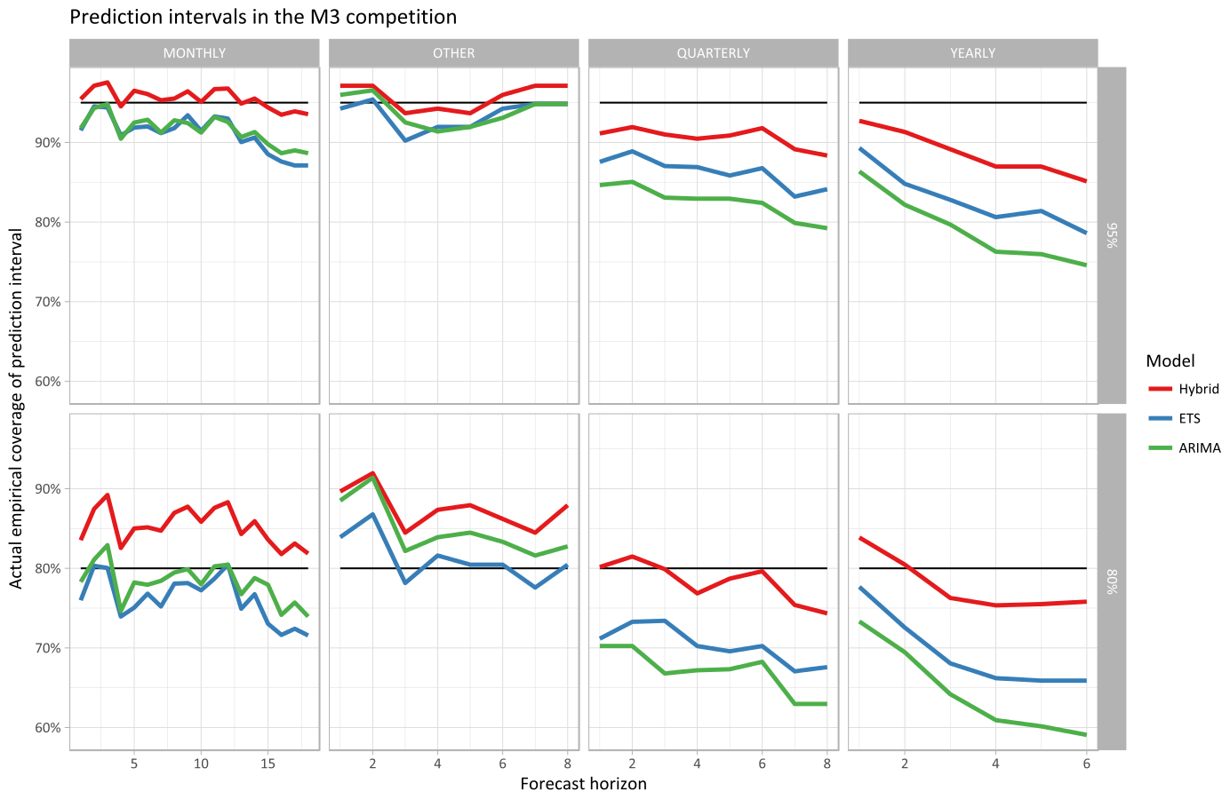

Slide 20
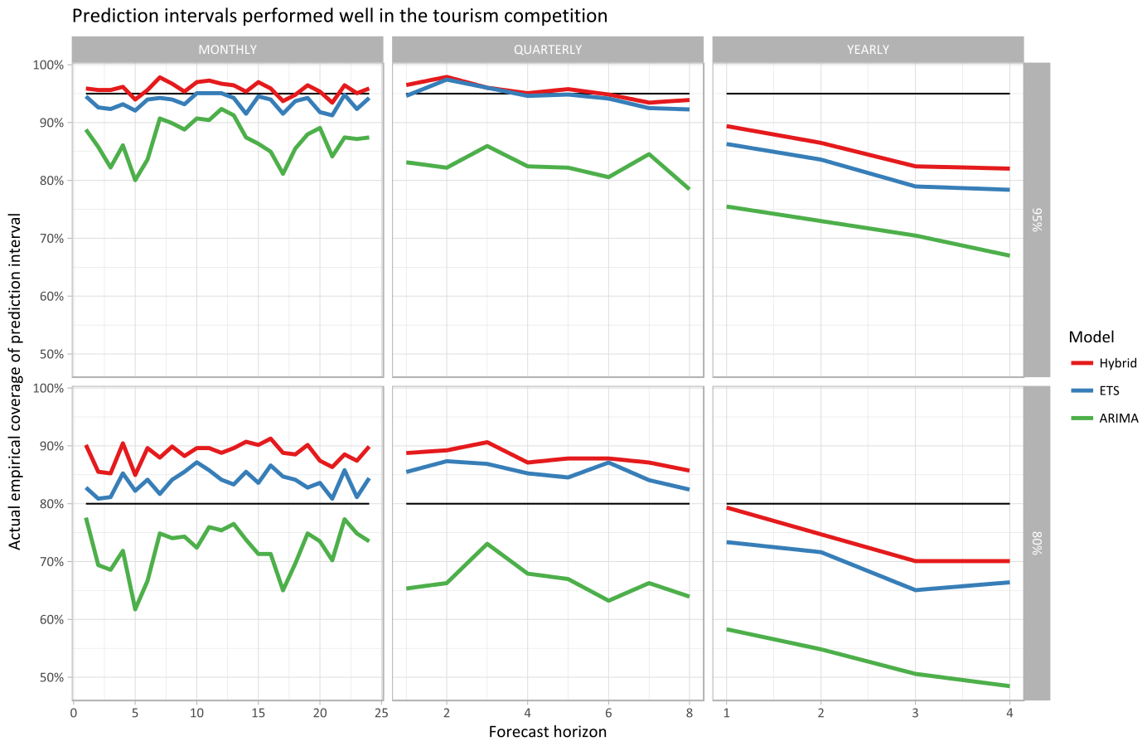

Slide 21
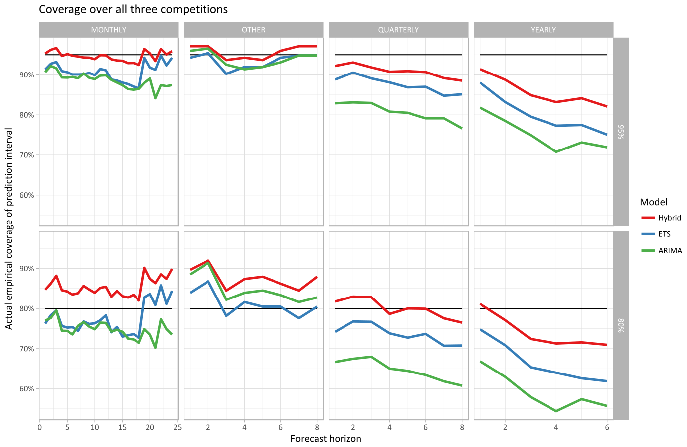

Slide 22
Conclusions
Confirm that higher frequency leads to more accurate advertised coverage
Domain makes a real difference. The original tourism data ETS prediction intervals have accurate or even better coverage than advertised for all seasonal data, but only for monthly in M3 and never in M1
For 80% prediction intervals and seasonal data, the trial method has too high coverage in the Tourism and M3 competitions, but not in M1
For non-seasonal data, even the trial method isn't conservative enough, in all three competitions, for 80% or 95% intervals
The trial conservative method gives good results for 95% confidence intervals of seasonal data - better than the individual components

Slide 23
Summary of the conclusions
When combining ets and auto.arima with real life social and economic data and estimating prediction intervals by the maximum-range forecastHybrid method:
 | 80% | 95%
Monthly |  (too conservative) | 
Quarterly |  | 
Yearly |  (not conservative enough) |  (not conservative enough)

Slide 24
Notes
George Athanasopolous, Rob J. Hyndman, Haiyan Song, Doris C. Wu (2011) “The tourism forecasting competition”, International Journal of Forecasting 27 (2011) 822-844.
Bates and Granger (1969) The Combination of Forecasts
Ellis (2016), Tcomp R package
Hyndman (2013), Mcomp R package
Hyndman (2016), forecast R package
Makridakis, S., Hibon, M., Lusk, E., and Belhadjali, M. (1987). Confidence intervals: an empirical investigation of the series in the M-Competition. International Journal of Forecasting, 3:489–508.
Makridakis, S., A. Andersen, R. Carbone, R. Fildes, M. Hibon, R. Lewandowski, J. Newton, E. Parzen, and R. Winkler (1982) The accuracy of extrapolation (time series) methods: results of a forecasting competition. Journal of Forecasting, 1, 111–153.
Makridakis and Hibon (2000) The M3-competition: results, conclusions and implications. International Journal of Forecasting, 16, 451-476.
R Core Team (2016). R: A language and environment for statistical computing. R Foundation for Statistical Computing, Vienna, Austria. URL https://www.R-project.org/.
Shaub, D and Ellis, P (2016) forecastHybrid R package
Source code for analysis in this presentation at https://github.com/ellisp/prediction-intervals-asc

