Slide 1

Making work in government
Peter Ellis - Director Statistics for Development Division
Ihaka Lecture at Auckland University – 26 September 2024

Slide 2
Sneaky spoiler
Analytics in government is often a mess
R is a great tool but it doesn’t solve everything by itself
Change is hard but possible
Notes:
An early thing I learnt as a manager in the public sector is the importance managing stakeholder expectations…
This isn’t a talk about the 7 things for CEs to know to transform their dept with AI
Or a talk with lots of flash R code and output
I have nothing to offer but Git, peer review, tests, and toil.

Slide 3

A quick history of me and government
Notes:
Evalution and how I got into statistics – to win arguments with economists. So took up studying stats at ANU – we used S-Plus there, which was great software, but pricy ($3k in 1990s dollars). R wasn’t available, or at least not stable enough, then

Slide 4

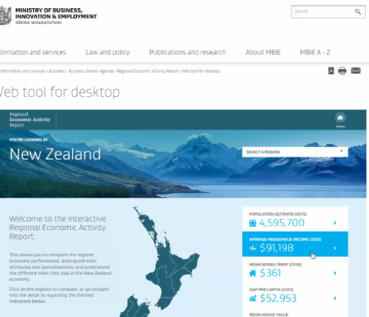
A quick history of me and government
Notes:
Left Australia and the aid industry for reasons that are surprisingly interesting but not a good way to take up time here. NZ MBIE was the place I first R, as part of a big transformation of how we did a lot of data, starting with tourism statistics; on the right is a movie of the flagship, didn’t use R but was at the end of a pipeline with a lot of R. Assessing it against SAS and Stata and SPSS; biting the bullet to go with R and seeing how it went

Slide 5
Now, we no longer worry for R:
No corporate support
Steep learning curve
Not recognised like SAS (e.g. for FDA)
Lack of learning materials
Slow 32 bit architecture
Can’t parallel process
Can’t handle large data
“Can’t use it in production”
Options like Microsoft, Posit if worried.
tidyverse and others fixed this.
FDA and friends got over this long ago.
Unmatched blogs, tutorials, courses.
R 3.0 fixed this in 2013.
Multiple solutions for this now.
Use it in conjunction with a database, or just get more RAM.
Frankly, this never really meant anything.
Notes:
Comparing my notes for this talk for ones on a similar subject ten years ago…
Was worried that this particular talk there would be nothing to say, about as interesting as talking about the use of carpet in government offices. Maybe interesting for specialist floor coverers, but most of us just get on and use the stuff on the floor whatever type of carpet or tiles or plastic or wood or whatever it is.

Slide 6
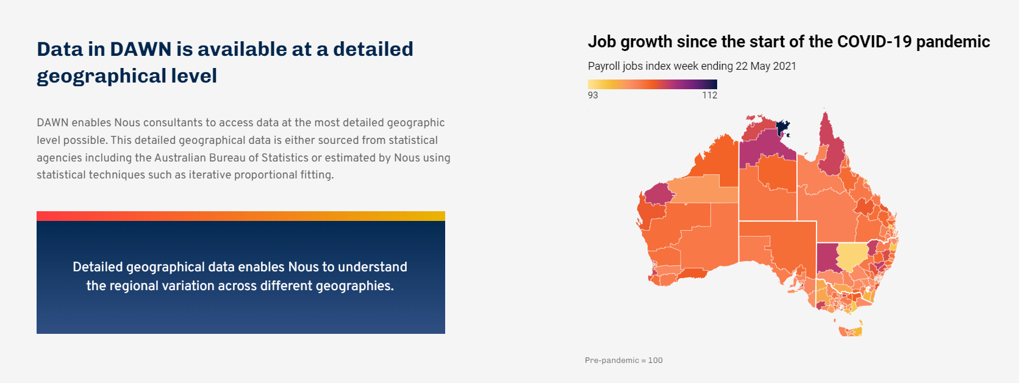
A quick history of me and government
From my time as Nous Group’s Chief Data scientist

Slide 7
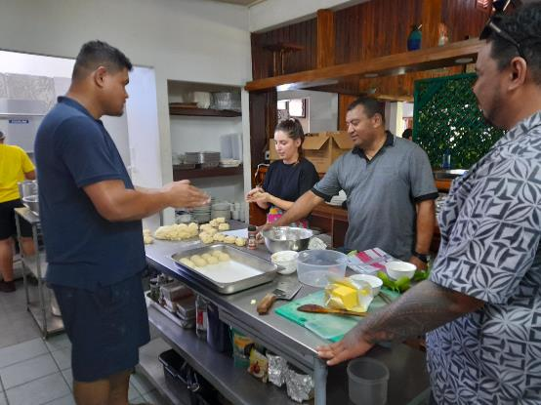
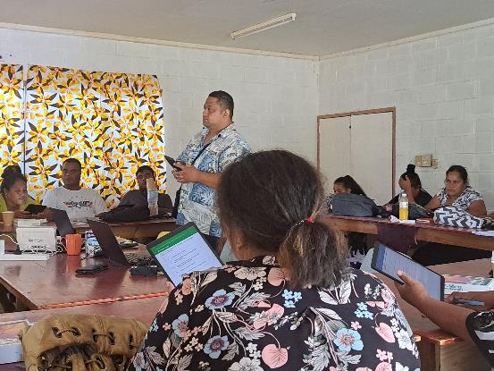

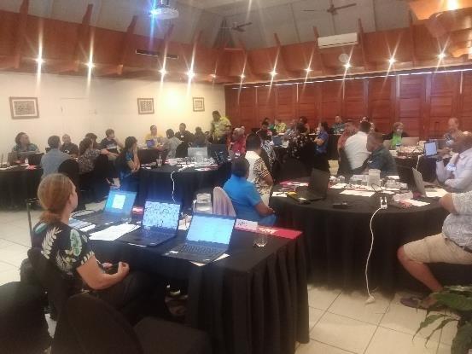
A quick history of me and government

Slide 8
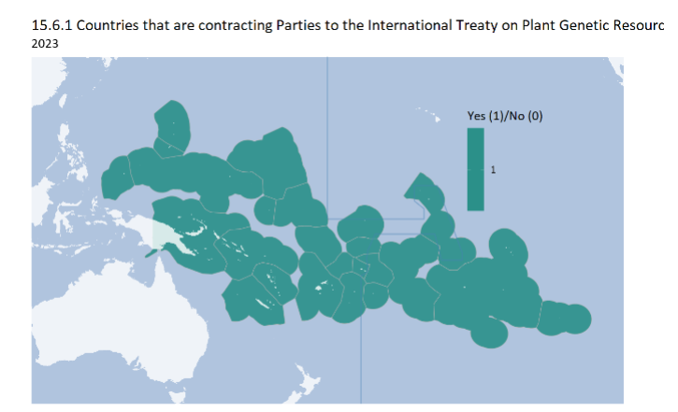
A quick history of me and government

Slide 9
Analytics in government often a mess
Issues to cover are massive in scope
Data is poor
Expectations nearly always unrealistic
Managers often don’t know what good looks like
Processes, systems and people usually a legacy hodge-podge

Slide 10
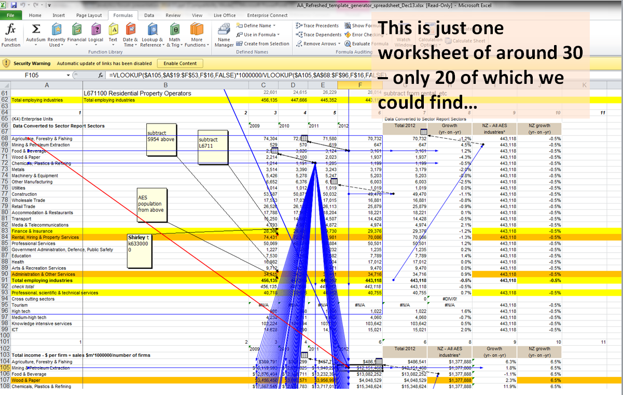
Analytics in government often a mess
Notes:
Sectors Report story – demands, stakeholders, lots of data – then “great, just update it all and publish”

Slide 11
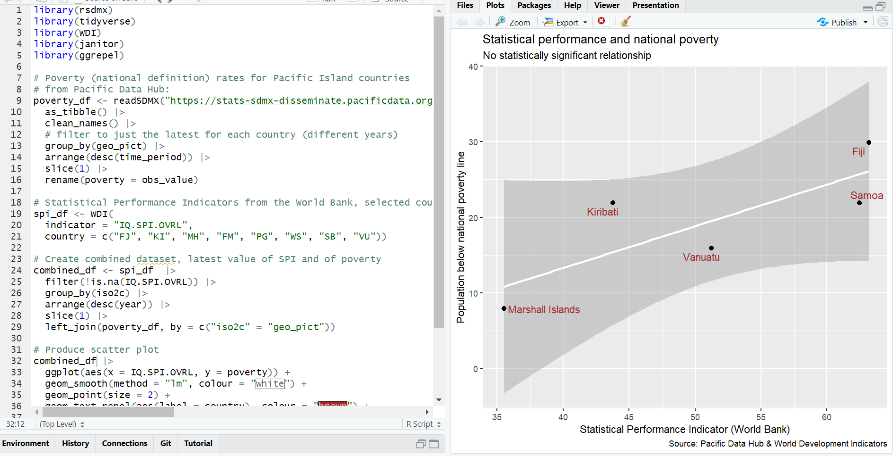
Notes:
Similar sorts of operations as they look in code – perhaps still as daunting to the first viewer, but at least in a sequential sort of order

Slide 12
Requirements
Wrangle large amounts of data from many sources, often external, often messy
Repeat it and update it, on exactly the same basis*
Be absolutely sure how it changed
Be absolutely sure* it’s right
Make statistical inferences on the fly, all the time
Do it FAST, with inadequate resources*
Respond to the Official Information Act and similar accountability mechanisms
Only well-managed code gives necessary rapid transparency and scalability for all this
* to the degree possible…

Slide 13
R is perfect for the job
Safely handle complex, multiple datasets
Intuitive approach to rectangular data
Easy to extend via functions and packages
All the statistical functionality
Data visualisation
Geocomputation
All in readable code and integrated with version control
Integrate analysis, output and formatted text
> (“better than”) Stata, SPSS, Excel
> Python (ok, maybe a bit harsh)
> SPSS, SQL, Power BI, Excel
> Excel, Power BI, SPSS, SQL
> SAS, Stata, SPSS, Excel, SQL
> Stata, SPSS, Excel, Power BI
> Excel, Power BI, SPSS, Stata
> SPSS, Stata, SAS, SQL

Slide 14
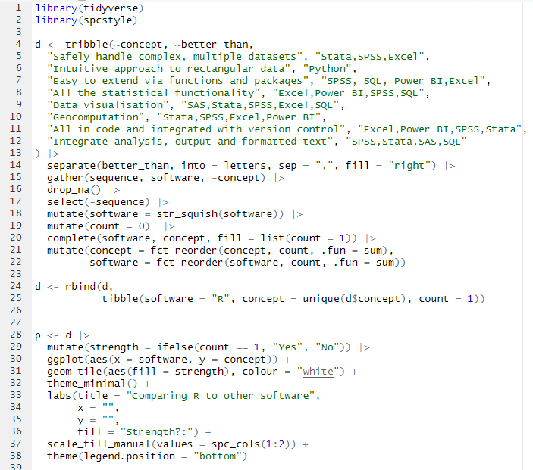
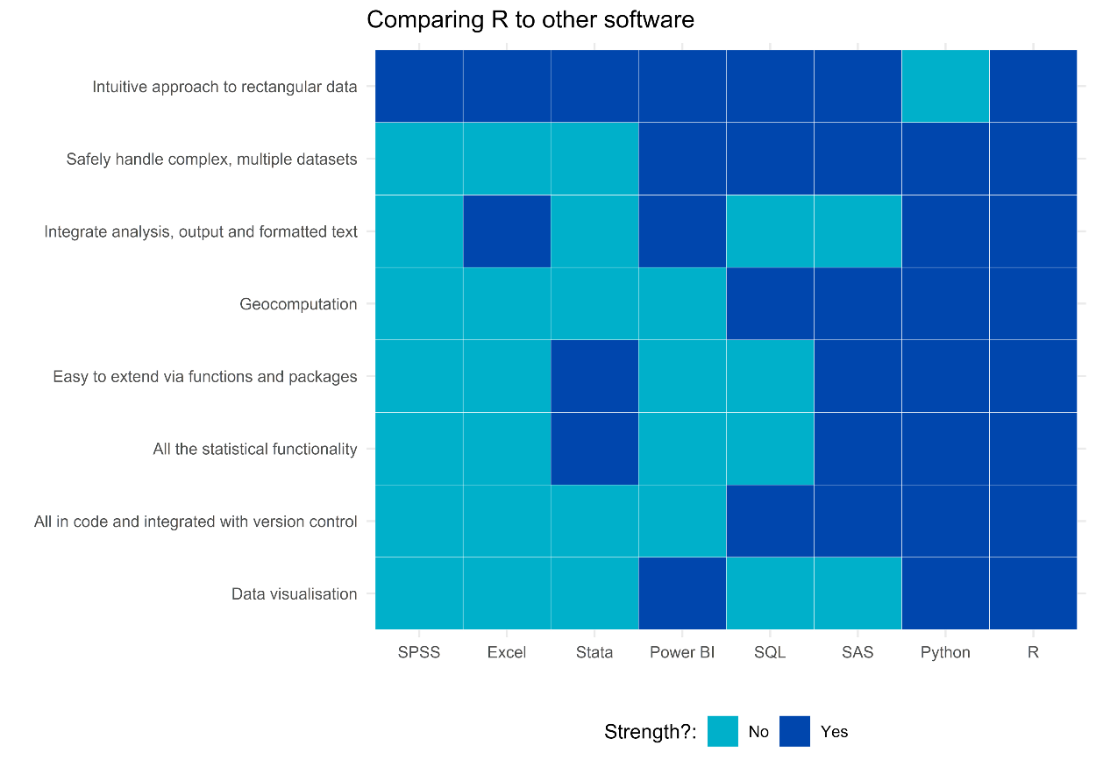
R is perfect for the job
Notes:
Also use this to talk about the importance of being fully directive in exactly how you want the graphic to appear. AI can actually be good for generating lots of poor quality graphics but when you have your final one you want to do it yourself

Slide 15
Official Statistics CRAN taskview
Production
Preparation
Sampling
Data collection
Data processing
Weighting etc
Editing
Imputation
Seasonal adjustment
Analysis of surveys
Estimation and variance estimation
Visualisation
Statistical disclosure control
Unit level
Aggregated
Remote access
Access
From international organisations
From national organisations
Related methods
Small area estimation
Microsimulation
Indices and indicators
Notes:
This is some particularly public-sector oriented things but actually most of the things an analytic team does is with tidyverse and related visualisation extensions, web tools and the full range of statistical modelling

Slide 16
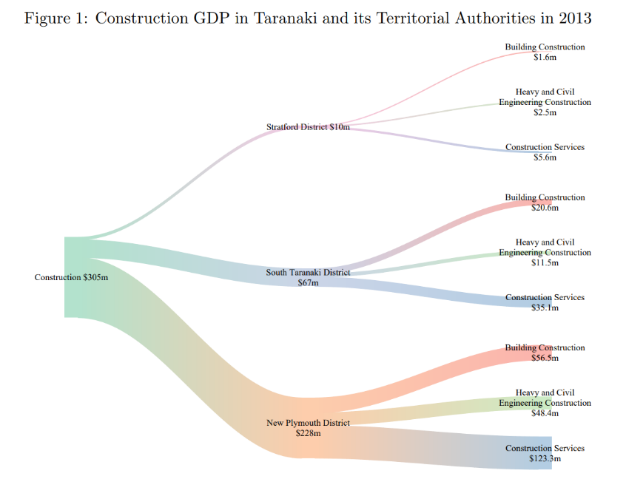
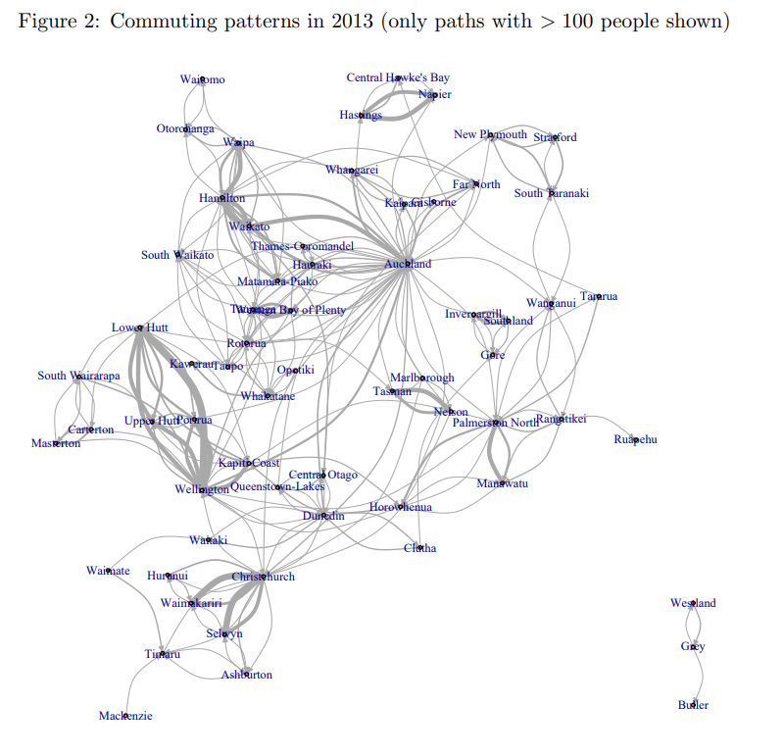
R in government
Notes:
Small area estimation
Analysis in the IDI and MADIP – often as simple as regression eg on mental health outcomes. But doing this well is R’s core business

Slide 17
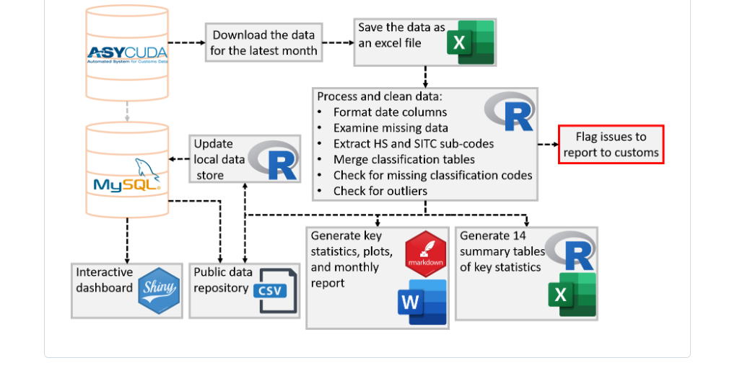
R in government
Vanuatu Bureau of Statistics: https://github.com/Vanuatu-National-Statistics-Office/vnso-RAP-tradeStats-materials
Notes:
But even in official statistics, a lot of the work is just data management – getting it safely and transformed the right way from one spot to another

Slide 18
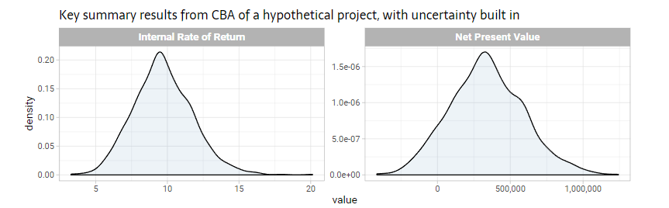
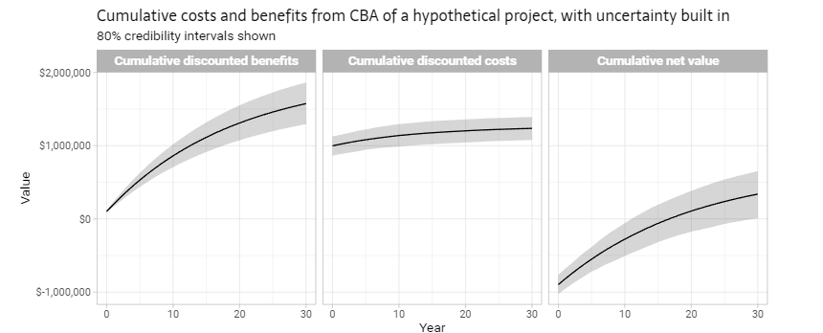
R in government

Slide 19

R in government
Full talk at https://www.youtube.com/watch?v=WqqDXWP7YJ8
Notes:
Possibly the biggest single use and selling point is the visualisation – with or without integratin into Quarto, markdown, LaTeX
Also mention automating of reports (as in for NSW Health, tourism forecasting)

Slide 20
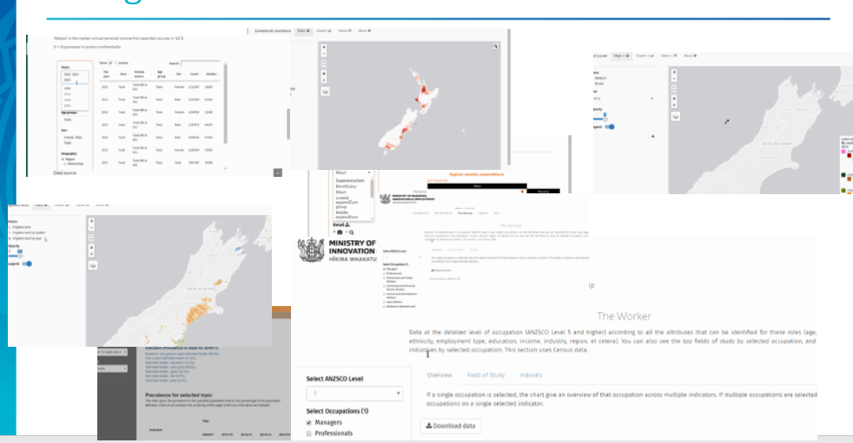
R in government
Notes:
Shiny – very popular in government.
Three choices for statistical web apps or dashboards: Power BI / Tableau or sim; full stack web app; or Shiny

Slide 21
The problem is…
Once we have a great tool for data manipulation, analysis and visualisation…
… it draws attention to other problems
Typically, these include:
Data pipelines and management
Data access and control
Quality control
Teamwork
Statistical inference
Statistical literacy and unclear needs of end users
Notes:
At this point tell the sector trends story, how we started with training on statistics, then realised we needed a new tool because SPSS wasn’t up to the job, so we got R; then realised we needed to improve the data management which led to TRED, and data manipulation skills, and then team work, version control, peer review and pull requests etc

Slide 22
But there is a solution
Databases
Solid and robust for the whole organisation, with traditional IT management
Quick and flexible spin-ups for the analytics team
Git
Peer review
Reproducibility as a fundamental principle
Improve data governance
Connect better with policy and program clients
Notes:
Story of me being able to clone any repo as Chief Data Scientist at Nous and run it and if it doesn’t run (after arranging data access) being able to require it be fixed
But note now we see that what started as “let’s use R” became everyone learning SQL and Git; getting IT to do some serious data warehousing and similar projects; creating a platform where we can stand up data bases ourselves
Also note that it’s critical that we use databases not store all the dat ain R. The only vertically integrated solution is SAS.
This is the place to note the tendancy of R users to over-use R. We want a web tool? Write one in Shiny. Want to do bash operations? Duplicate them in R. Python is better at handling XML or Office documents? Do it by hand, or with inferior R tools.

Slide 23












“Git, peer review, tests, and toil”
tests – frequent integration – peer review
Reusable, multi-project data
Project-specific data
Modelling and analysis
Reports
Dashboards
Data warehouse
Labour-intensive clean, join, filter, impute, reshape
Project database
Web apps

Slide 24












Accept R as part of a bigger toolkit
Notes:
Some things that often you are often best off using even though you could do it in R.
This particularly applies when your organisation has already decided to use the specialist tool.
R users are notorious for trying to use R for everything
Shiny is in the same relationship to web development with HTML, CSS and JS as Excel is to R

Slide 25
Unfortunately this is a lot of change
Everyone has to learn Git and SQL, not just R.
Most people agree this is Less Fun.
People have to get their work peer reviewed and use pull requests
Boring! And I don’t have time!
IT need to invest in a proper data warehousing system, process and team
This is seriously expensive, and draws attention to Other Problems.
And the analytics team needs to be able to spin up databases, using proper tools, on demand, for its own little projects
That sounds risky, and will the data feed back into the DW?
And we need to set up data governance committees and working groups, and talk to internal clients and stakeholders
Uurgh, meetings…

Slide 26
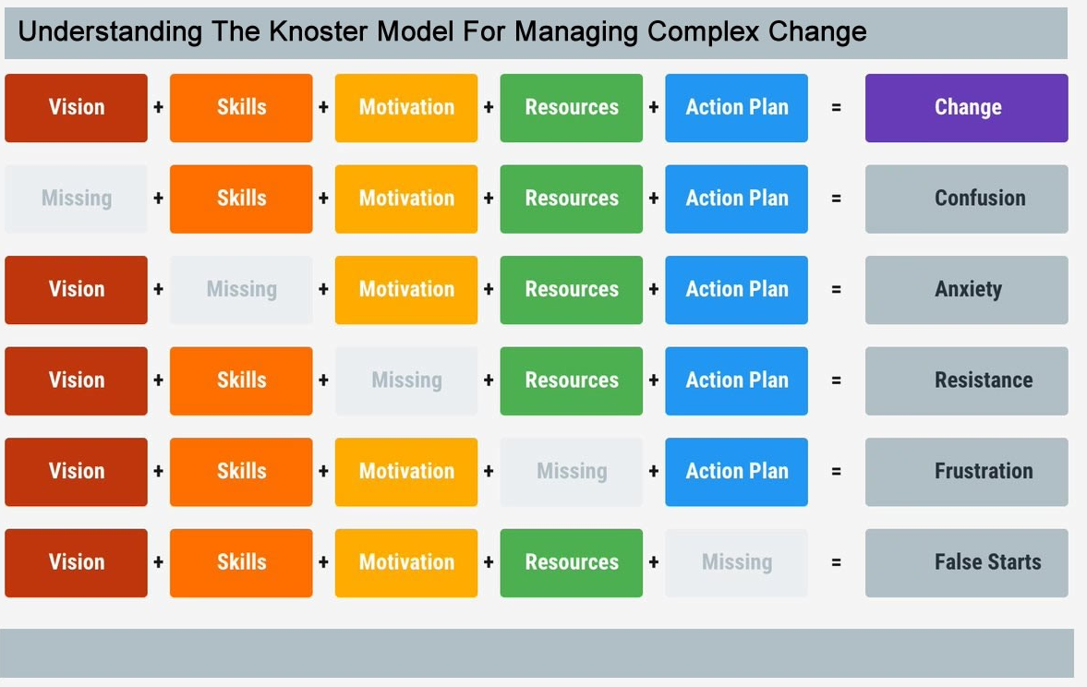
And change can lead to problems
Credit: https://agilityportal.io/blog/knoster-model-for-change

Slide 27
People need to be convinced
Errors are everywhere
Tests can help
Peer review can help
Better data systems and skills will – eventually – make things much, much faster
Better statistical modelling and inference understanding will help decisions but also (surprisingly) help data management
Inappropriate data use – too much, and too little – is everywhere
Data governance can help

Slide 28
Specifics to make it easier
Get concrete wins quickly
Leverage external drivers, like Ministerial enthusiasm or demand
Get specialist help when needed, particularly to get things rolling
Note: visuals on right are not made in R, although it was an important part of the overall project and data pipeline.

Slide 29

Specifics to make it easier
Feverish atmosphere of learning and innovation
Light a fire, don’t fill a bucket
Break learnings into bits to avoid overwhelm
Use peers to train eachother

Slide 30
Some practical things that need doing
Make sure IT officially enables users install R, an IDE, Git and a database tool
Develop package/s with styles, colours, logos, Word and PowerPoint hooks, Quarto templates, database connections etc. for your organisation
Develop easy to use examples for common data access, analysis and reporting tasks
Re-engineer processes so:
peer review is built in
analytical products can be reproduced and updated at will
Have someone roam to do spot check feedback on repositories
Get the data into databases
Build all of this into induction
Notes:
This is a bit repetitive of the ‘but there is a solution’ slide

Slide 31
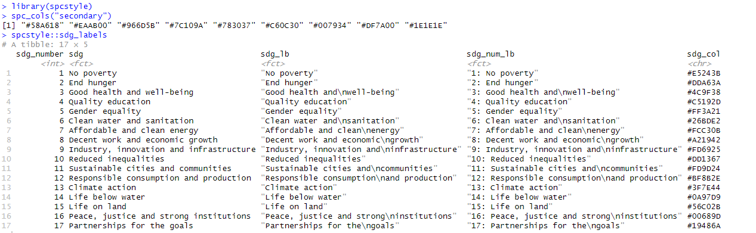
Small things make it easier

Slide 32
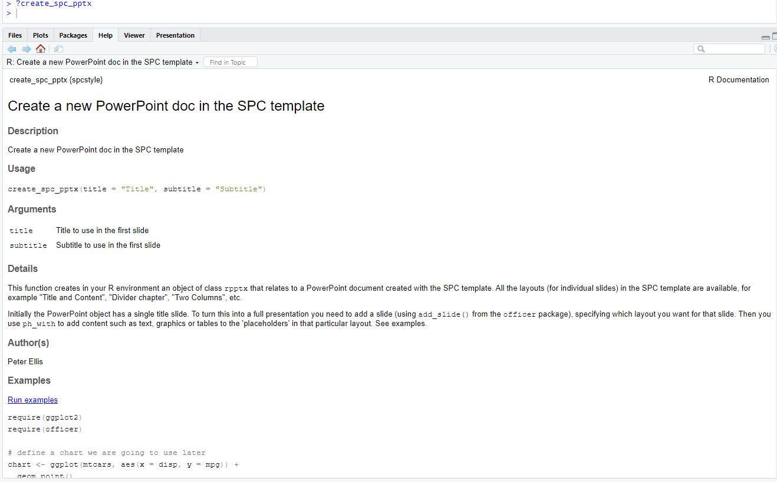
Small things make it easier

Slide 33
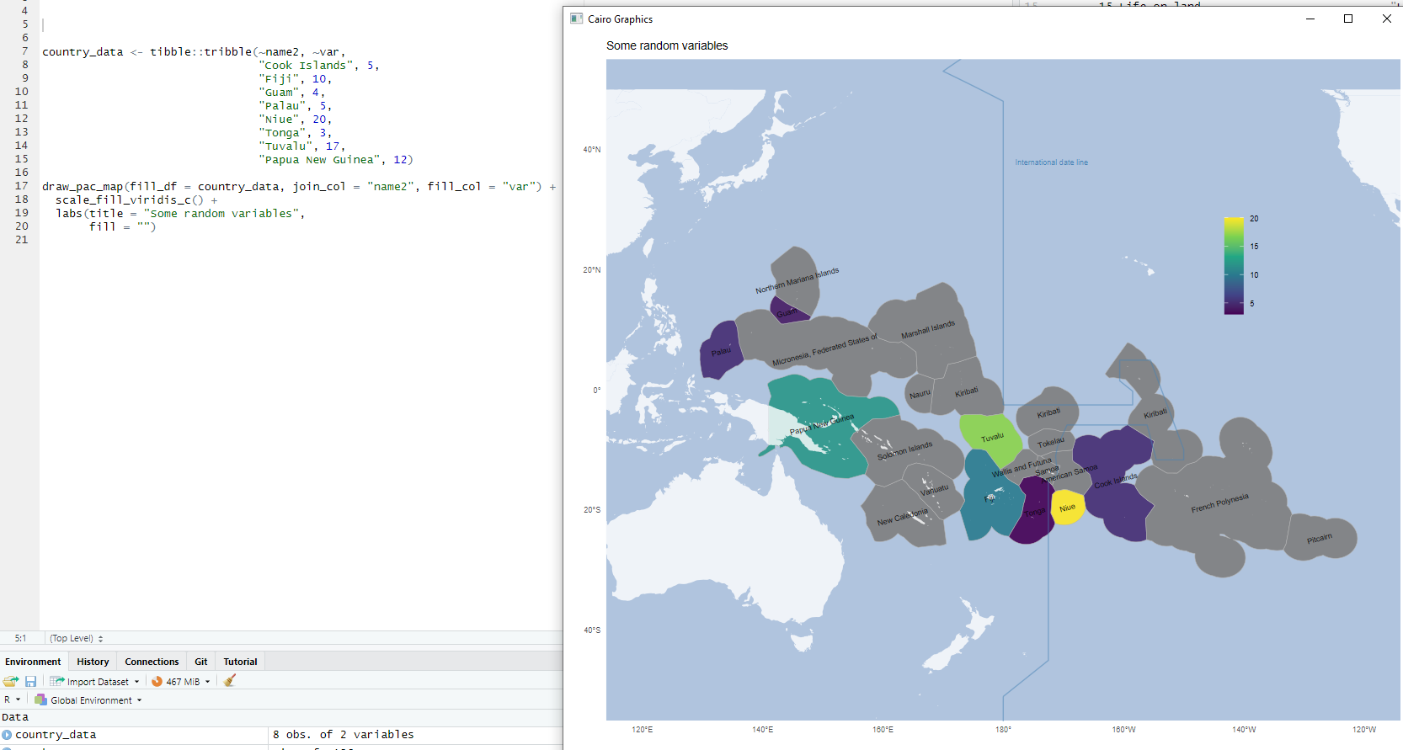
Small things make it easier

Slide 34
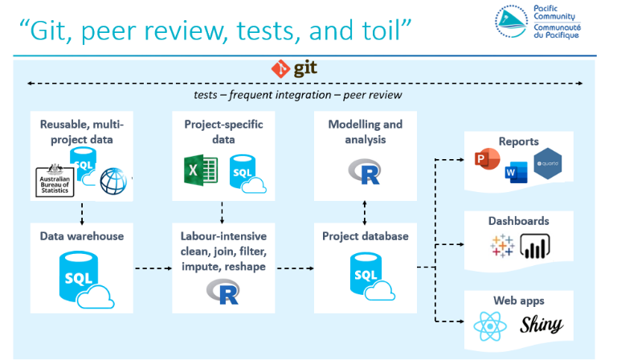
Making R work in government
Analytics in government is often a mess
R is a great tool but it doesn’t solve everything by itself
Change is hard but possible

