Slide 1



The joint ranking of micro-RNAs and pathways
Ellis Patrick, Michael Buckley, Samuel Mueller, Dave M. Lin and Jean Yang

Slide 2
www.ellispatrick.com/presentations www.ellispatrick.com/r-packages

Slide 3
What am I interested in?
Specific questions might give more specific answers
Statistical significance
Biological significance
Notes:
Improve inference in experiments with limited replication using prior biological knowledge.
Produce results which are biologically more interpretable.

Slide 4
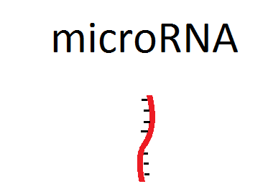

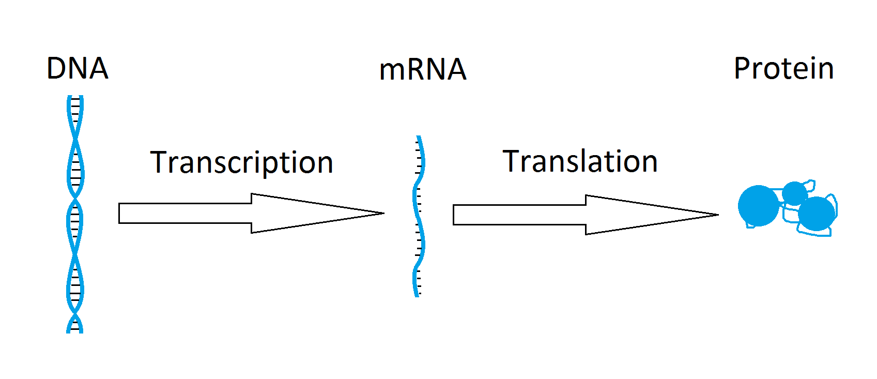
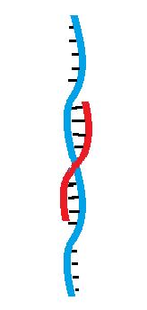
What is a microRNA (miRNA)?

Slide 5
Can we...
Identify groups of genes (mRNA)
that are
being regulated by a microRNA in response to some stimulus?
gene 1
gene 2
mir 1
gene1
gene 1
gene 3
gene2
gene 7
mir2
mir 2
gene 6
gene3
gene 8

Slide 6
Data Structure
Number of samples
~1000 microRNA
mRNA-Seq
Data
~20000 mRNA
~20000 mRNA
Target Matrix
Number of samples
miRNA-Seq
Data
~1000 microRNA

Slide 7
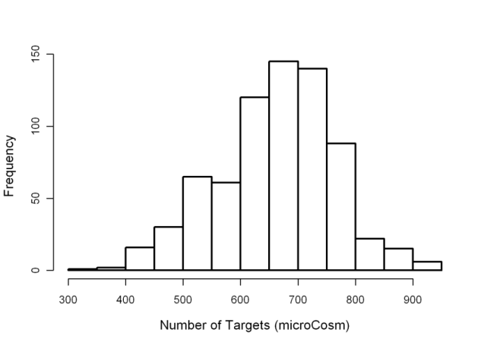
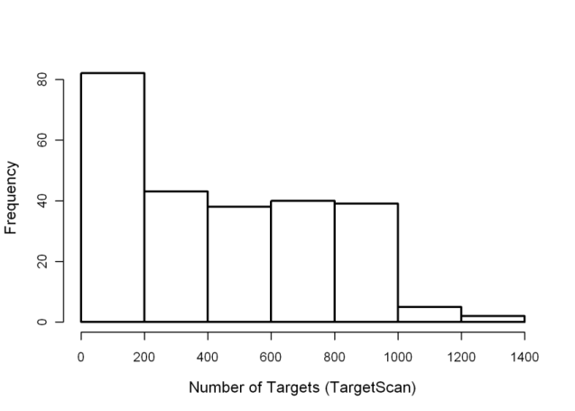
External data : target prediction algorithms
Several computational microRNA-target prediction algorithms have been developed e.g. TargetScan, PicTar, microCosm (based on miRanda), and TargetMiner
Large variations in results obtained using different algorithms
Most widely used approach combines the results from multiple target prediction algorithms
microCosm
Number of Targets per miRNA
TargetScan
Number of Targets per miRNA

Slide 8
Number of samples
Vector of p-values
~1000 microRNA
miRNA-Seq
Data
DE test
Vector of p-values
Number of samples
Vector of p-values
DE test
Gene set test (GST)
mRNA-Seq
Data
~20000 mRNA
~1000 microRNA
~1000 microRNA
Target Matrix
~20000 mRNA

Slide 9
Problems
Target information often not specific.
Perform another battery of gene set tests to identify enriched biological pathways.
Three p-value cut-offs:
microRNA DE,
Gene set test on target genes and
Gene set test of pathways within target genes.

Slide 10
We would like to…
Identify groups of genes
that are
being regulated by a miRNA
and
share some common biological
function.
gene 7
gene 1
gene 2
gene 6
mir 1
gene 3
gene 5
gene 4

Slide 11
Mir-pathways
# microRNA
# pathways
# genes
# genes
Target Matrix
Kegg Matrix
# microRNA
Mir-
pathways
# genes
# pathways

Slide 12




P-value Combination
Fisher’s Method
Stouffer’s Method
maxP
Pearson’s Method

Slide 13
genes
KEGG Pathways
Database
GP PP
pathways
mRNA data
genes
Mir-
pathways
genes
Target matrix
(TargetScan)
miRNAs
Perform gene set tests
Correlation
Or
Association
GP PP
miRNAs
miRNA data
miRNA DE

Slide 14
pMim Integration of pathways, miRNA and mRNA
pathways
Integrative
scores
miRNAs

Slide 15
Evaluation
Methods:
1. cMimDE - Classic microRNA and mRNA integration based on DE.
Tests whether a miRNA is DE and its target genes are DE in the opposite direction.
2. pMimDE - Pathway, microRNA and mRNA integration using DE.
3. pMimCor - Pathway, microRNA and mRNA integration using correlation.
Datasets | Stage | PP; years to death | GP; years to last follow up | Total (n)
(a) Ovarian Serous | Stage III | < 1yr | > 6 yrs | 49
(b) Skin cutaneous melanoma | Stage III | < 2yr | > 6yrs | 40
(c) Lung adenocarcinoma | Stage I | < 1yr | >1.5 yrs | 33
(d) Notch | Knock out | vs | Control | 6

Slide 16
(A) Evaluation via literature search
For each miRNA (eg. mir-150) and a key word of interest (melanoma)
Search PubMed for mir-150 melanoma*
Call mir-150 associated with melanoma if we see more than one search hit.
Treating this as truth, use this information to generate ROC plots.

Slide 17
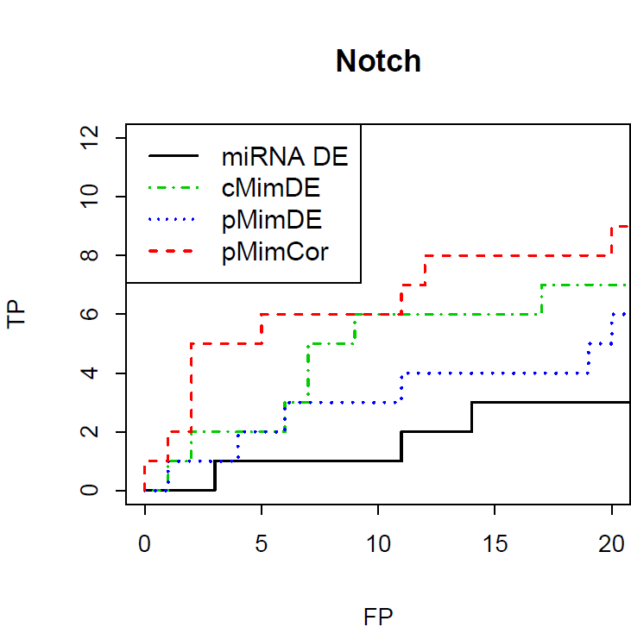
(A) Evaluation via literature search

Slide 18
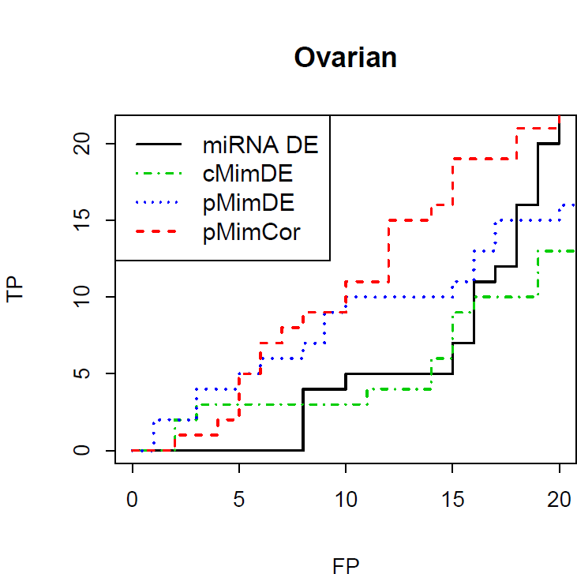
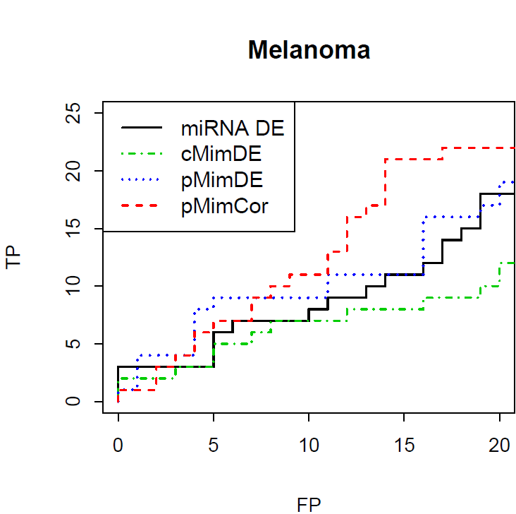
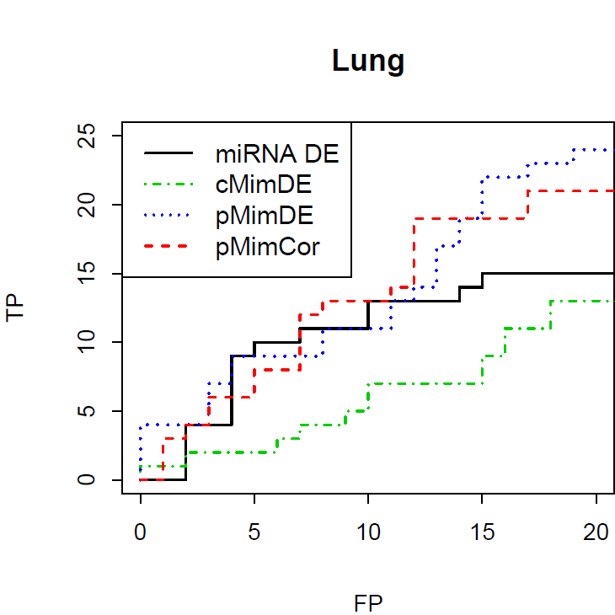

Slide 19
[B] Randomisation:
Evaluating the signal in our data
P-value cut-off | (a) Ovarian | (b) Melanoma | (c) Lung | (d) Notch
Sample size | (PP=23,GP=26) | (PP=21,GP=19) | (PP=17,GP=16) | (WT=3,MT=3)
Nothing randomised | 19 | 92 | 39 | 46
Binding site randomized | 11 | 24 | 29 | 29
KEGG randomised | 9 | 42 | 31 | 18
Both Binding site and KEGG randomized | 6 | 18 | 21 | 16
The average number of DE mir-pathways

Slide 20
An application: Melanoma
Melanoma data set from MIA.
Predict prognosis.
Investigate effects of BRAF mutations.

Slide 21
pMimCor results for down-regulated miRNAs in patients with BRAF mutations
miRNA | Integrative score | miRNA DE p-value | KEGG
hsa-miR-197 | 0.002 | 0.044 | Metabolic pathways
hsa-let-7g | 0.0022 | 0.063 | Pyrimidine metabolism
hsa-miR-30c | 0.004 | 0.087 | Hematopoietic cell lineage,
hsa-miR-197 | 0.004 | 0.044 | Pathways in cancer
hsa-miR-30c | 0.004 | 0.087 | Calcium signaling pathway
hsa-let-7i | 0.0043 | 0.091 | Pyrimidine metabolism
hsa-miR-30c | 0.0043 | 0.087 | Gap junction
hsa-let-7i | 0.0047 | 0.091 | Melanoma
hsa-miR-34a | 0.0054 | 0.064 | Small cell lung cancer
The cancer hallmark (Hanahan and Weinberg, 2011) were a major theme for most of the pathways

Slide 22
miR-197 and Metabolic pathways
Gene | Correlation | DE p-value
PAFAH1B1 | -0.34 | 0.39
ATP6V1A | -0.31 | 0.84
EPT1 | -0.24 | 0.18
P4HA1 | -0.23 | 0.58
XYLT1 | -0.22 | 0.0041
AGPAT6 | 0.33 | 0.63

Slide 23
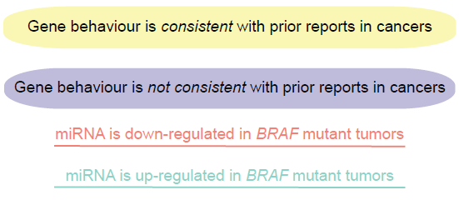
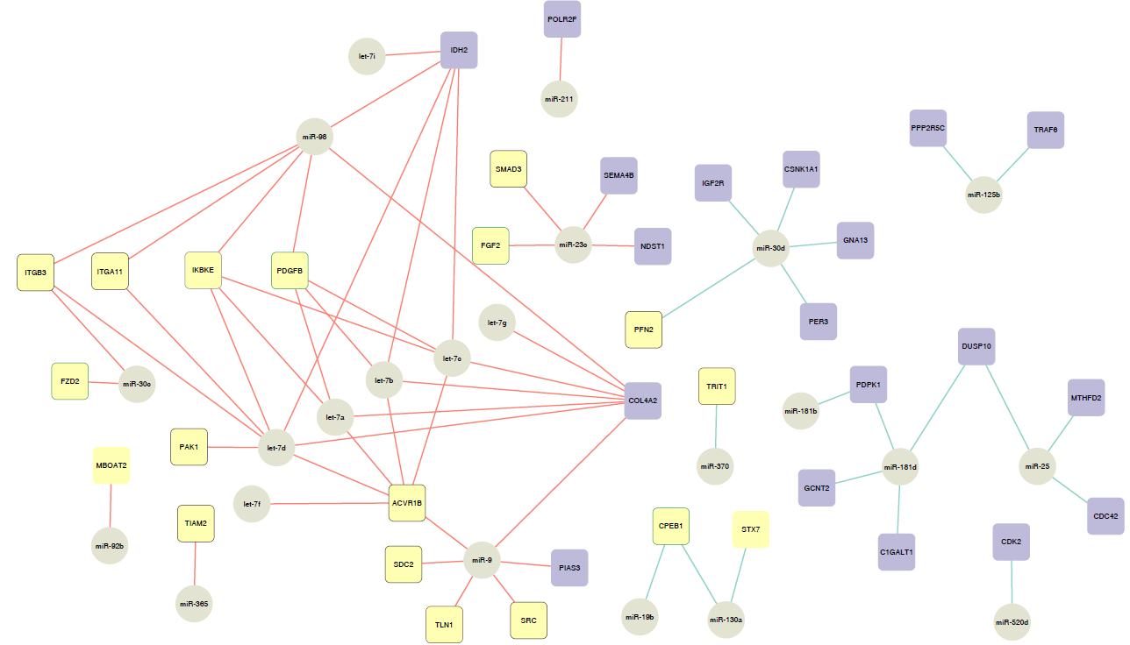


Slide 24
Melanoma conclusions
The miRNA expression phenotype of poor prognosis tumours was dominated by anti-proliferative signals that may indicate the tumours are becoming more invasive.
These findings suggested a network of miRNAs that appeared to be reacting to tumour progression, not driving it.
The DE miRNA analysis identified a few miRNAs with prognosis potential.
A number of different miRNAs – mRNA pairs were identified using “cool” approaches.
pMim identified miRNAs-pathways related to cancer; links are not as obvious in the “cool” analysis.

Slide 25
pMim summary
-- Jointly ranks miRNAs and pathways.
-- Appears to identify more meaningful miRNAs.
-- Handle small sample size.
-- Available on www.ellispatrick.com/r-packages

Slide 26


Acknowledgements
School of Mathematics and Statistics (Usyd)
Jean Yang
Samuel Mueller
John Ormerod
Kaushala Jayawardana
Dario Strbenac
Rebecca Barter
Shila Ghanazfar
Others
Michael Buckley (CSIRO)
David Lin (Cornell University)
Vivek Jayaswal (Biocon Bristol-Myers Squibb R&D)
Melanoma program at MIA/WMI/RPA
Graham Mann (Usyd)
Gulietta Pupo
Varsha Tembe
Sara-Jane Schramm
Mitch Stark (UQ)
John Thompson
Lauren Haydu
Richard Scolyer (RPA)
James Wilmott (RPA)
Proteomics research unit
Ben Crossett
Swetlana Mactier
Richard Christopherson

Slide 27
Thankyou

