Slide 1

Minimum Vertex Cover Algorithm
Ellis Rourke S5057468

Slide 2




Table of Contents
2 My Algorithm
3 Implementation
1 Introduction
A brief description of the algorithm I have designed
Implementation and data structures
What is the MVC problem?
4 Results
5 Comparisons
Runtime analysis of the algorithm
How do other algorithms compare?

Slide 3

Introduction
What is the MVC problem?

Slide 4
The minimum vertex problem is an optimisation problem that attempts to find the minimum number of edges in a graph such that all vertices are connected to at least 1 edge in the cover

Slide 5
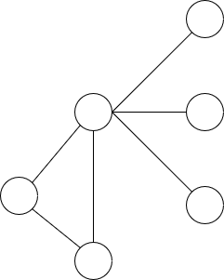
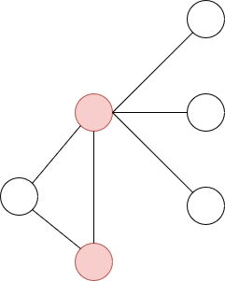
Example graph cover
Base graph
Minimum Cover

Slide 6

My Algorithm
A brief description of the algorithm I have designed

Slide 8
Implementation
How the algorithm was implemented

Slide 9
Implementation details
Implemented using modern c++
Used all optimisation where possible to improve runtime
Used STL containers for simplicity and inherit efficiency
Storing graph using unordered map for O(Log n) complexity
Random restart to avoid local getting stuck in local minimum
Depth first search

Slide 10
Results
A brief description of the algorithm I have designed

Slide 11
Experimental Results
Graph | Minimum Vertex Cover | CPU Time (Second)
Brock800_1 | 783 | 0.583
Brock800_2 | 783 | 5.263
Brock800_3 | 783 | 5.556
Brock800_4c | 782 | 19.933
C2000.9 | 1946 | 46.833
C4000.5 | 3988 | 2.233
MANN_a45 | 690 | 0.282
P_hat1500-1 | 1492 | 0.259

Slide 12


Conclusions
1
2
It’s terribly hot—even hotter than Mercury—and its atmosphere is extremely poisonous
The closest planet to the Sun and the smallest one in the Solar System—it’s only a bit larger than the Moon

Slide 13
References
Kr. Chakraborty, U., Konar, D., & Chakraborty, C. (2014). A GA based Approach to Find Minimal Vertex Cover. International Journal of Computer Applications, 0975(8887).
Wayne, K. (2005). 10. Extending Tractability [Slides]. Https://Www.Cs.Princeton.Edu/. https://www.cs.princeton.edu/~wayne/kleinberg-tardos/pdf/10ExtendingTractability-2x2.pdf

Slide 14

Thanks!
Do you have any questions?
ellis.rourke@griffithuni.edu.au

