Slide 1
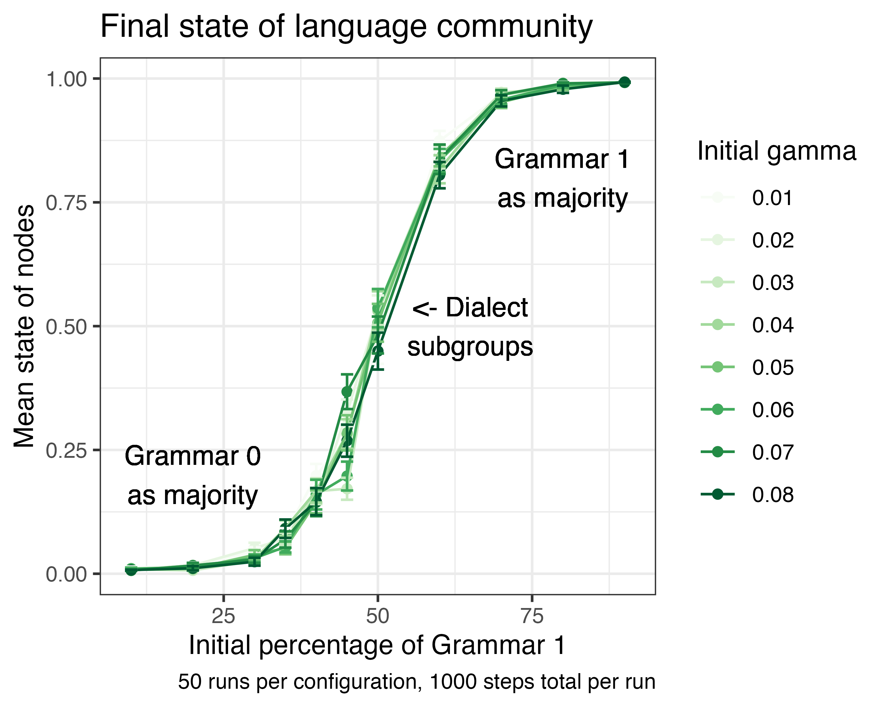
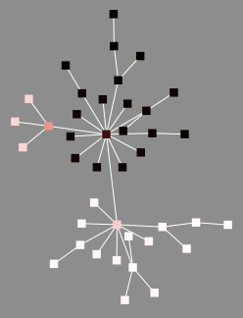
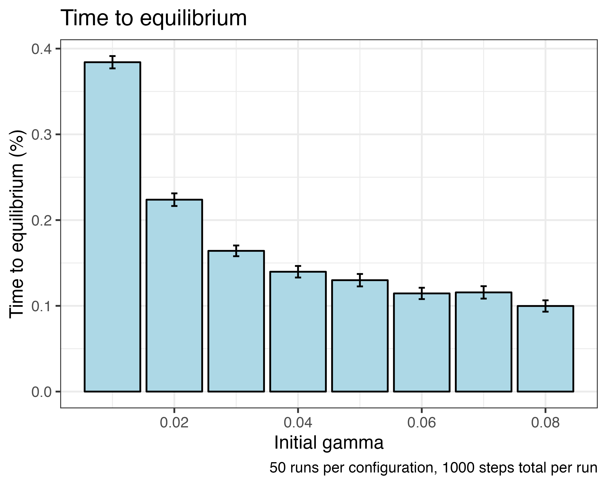
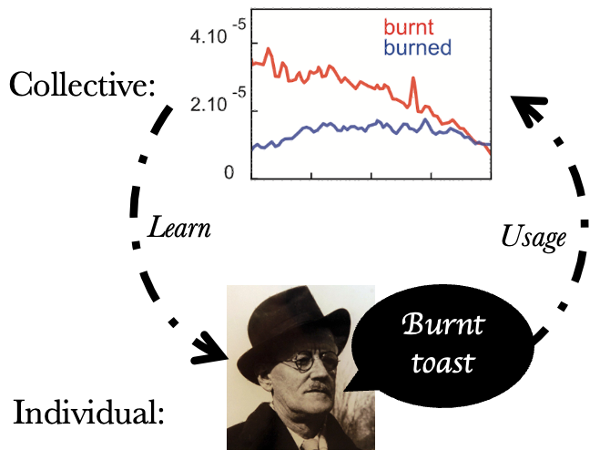
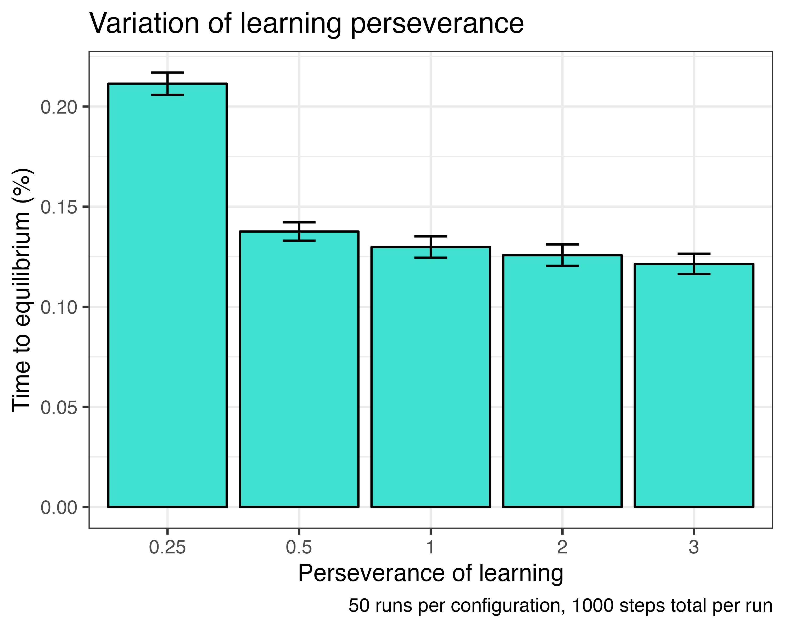
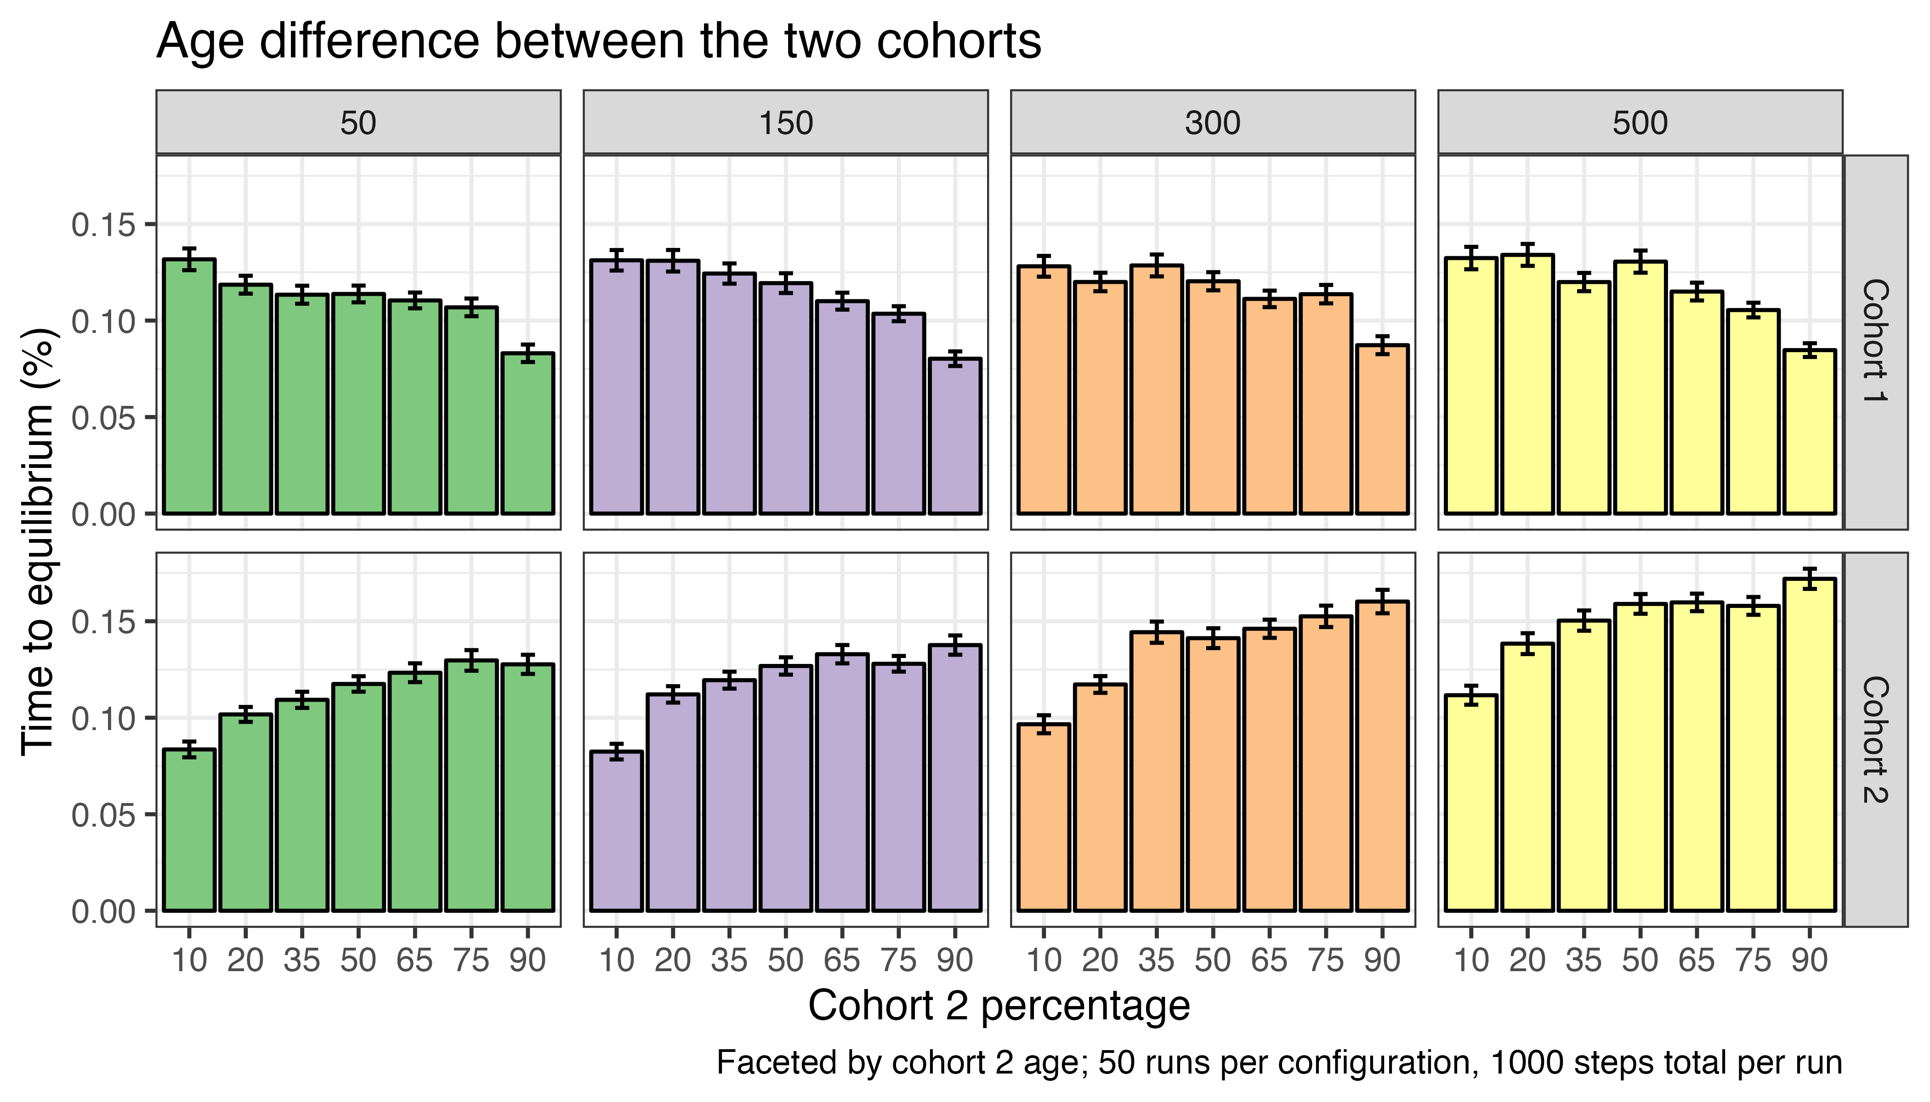
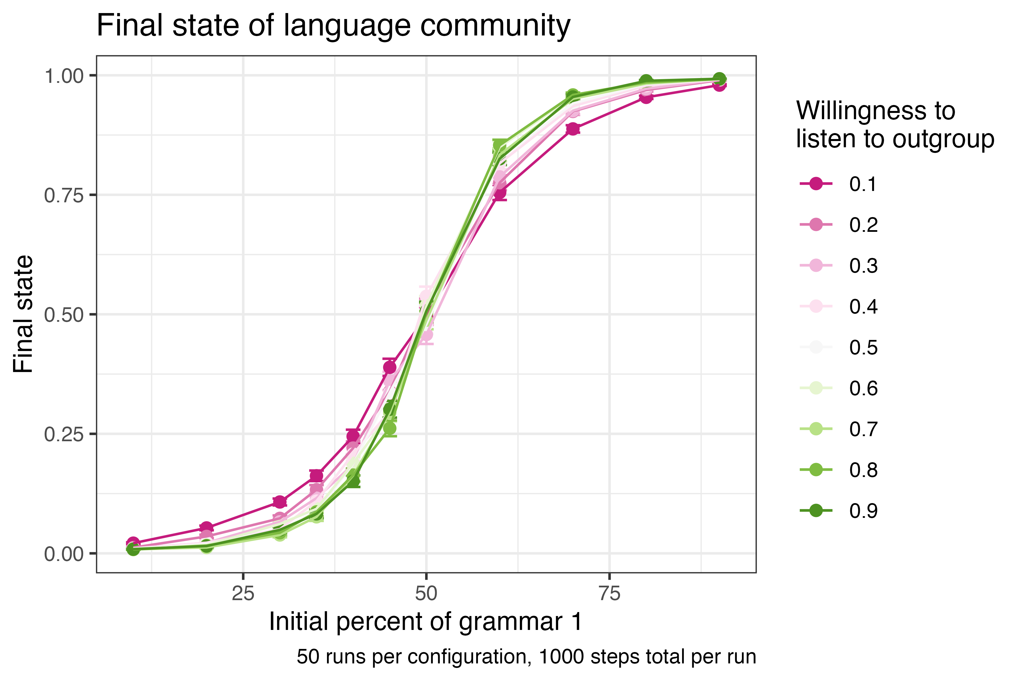
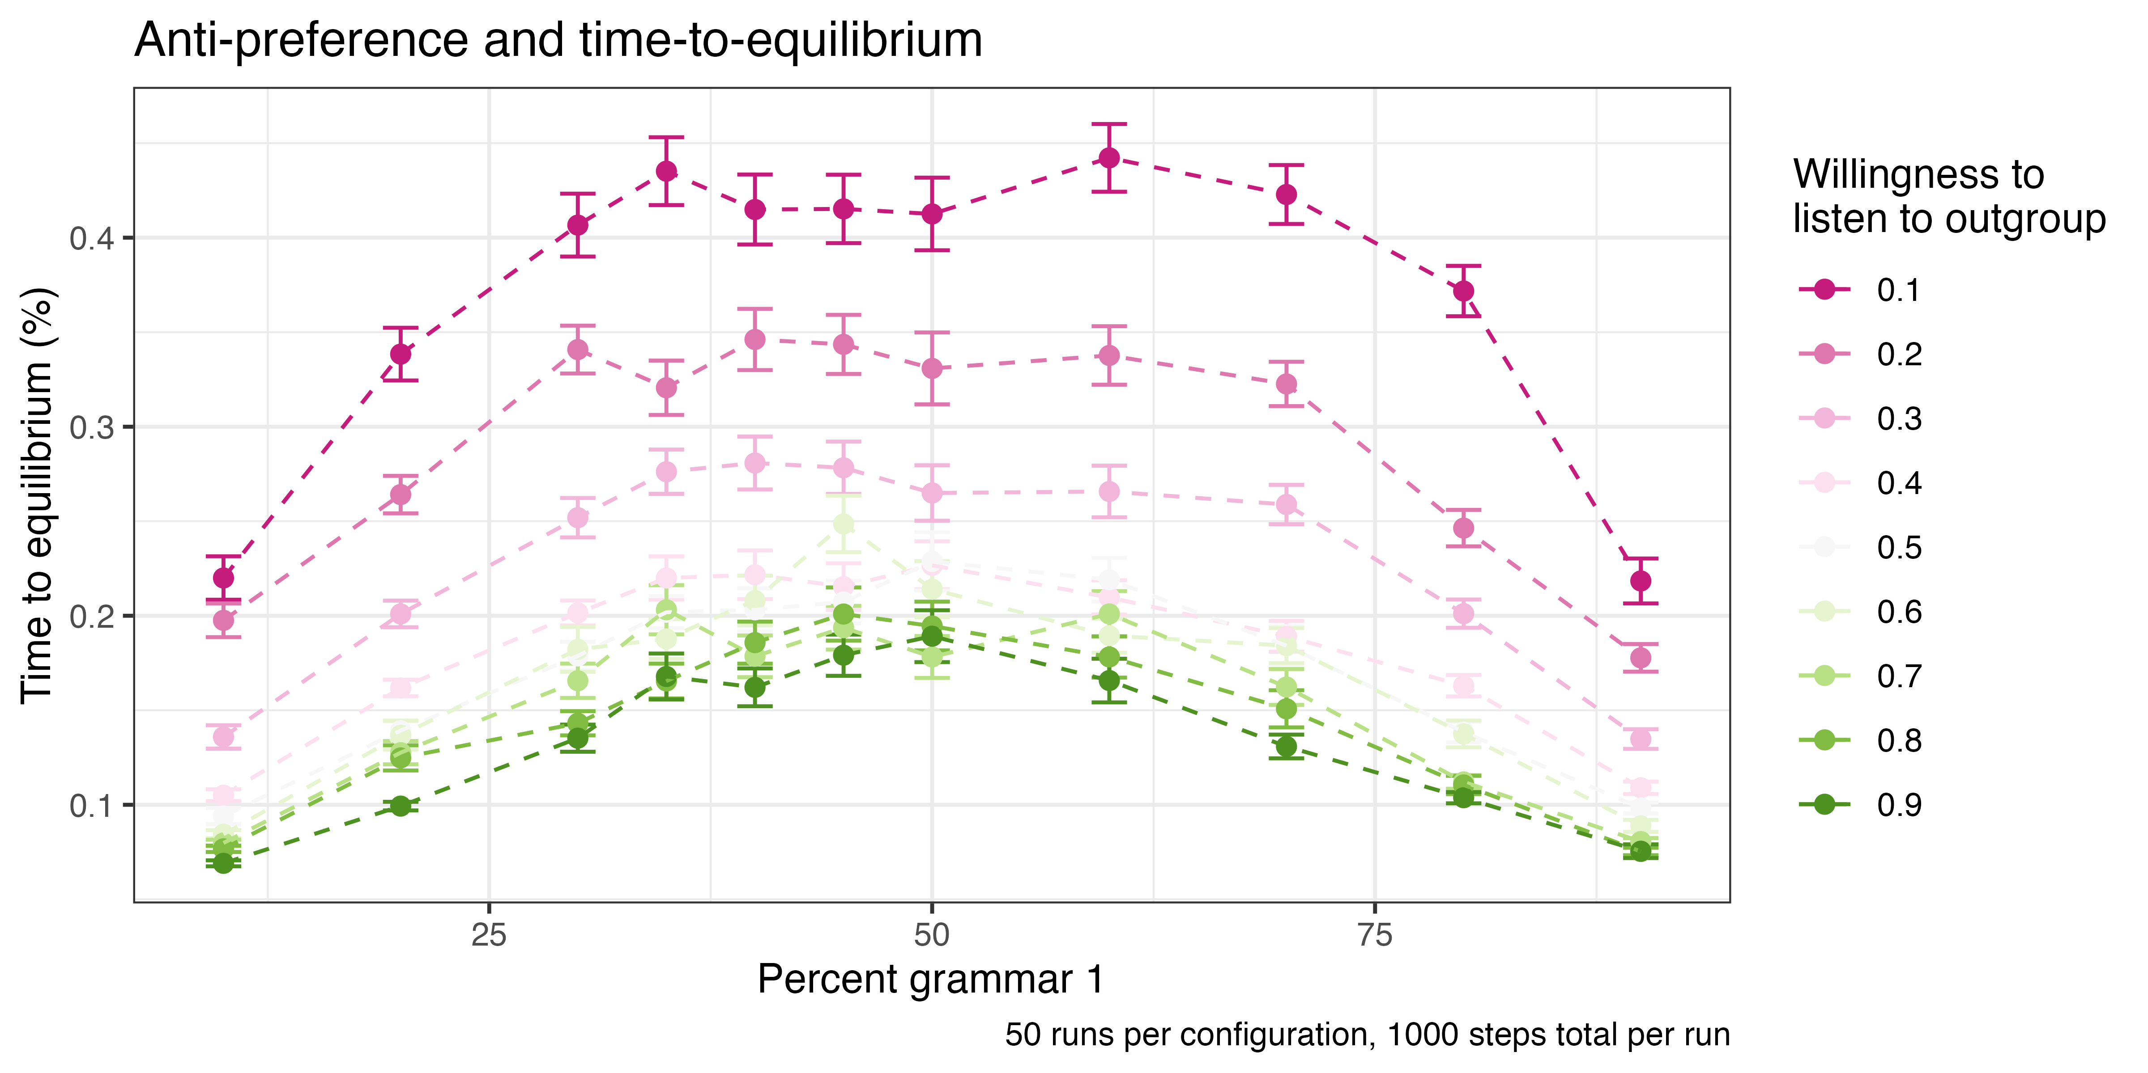
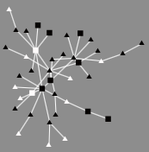
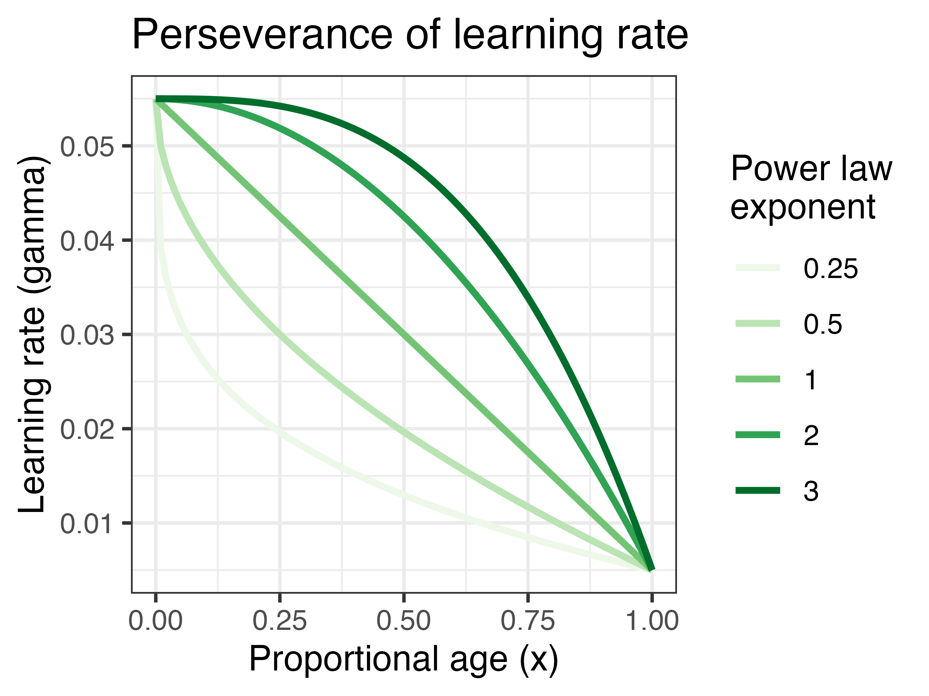
TEACHING AN OLD DOG NEW TRICKS? LEARNING RATES, AGING, AND LANGUAGE CHANGE
Ellis Cain (ecain@ucmerced.edu)
University of California, Merced
IMPACT OF LEARNING RATE
BACKGROUND
Language as a complex adaptive system (Beckner et al., 2009)
Collective patterns of language use change over time (Bybee, 2015; Bynon, 1977; Michel et al., 2011)
Age-related differences in language processing and organization (Dubossarsky et al., 2017; Federmeier et al., 2011)
Example run that ends with dialect subgroups
AGING: PERSEVERANCE AND COHORT EQUILIBRIA
OVERVIEW
Aim to explore how learning rate, aging, and group membership impact overall population-level patterns of language change
Model the usage and spread of a grammatical variant throughout a population (Original model: Troutman et al., 2008)
MODEL ASSUMPTIONS
Language learning is based on imitating others
Learning rates may change over the lifespan
Language can be influenced by external factors
Language change has multiple stable equilibria (no set outcome)
COHORT ANTI-PREFERENCE
INITIALIZATION
Preferential attachment network with specified starting grammar usage
Language users as nodes, with a state, age, cohort, and learning rate
Able to specify number of cohorts, cohort-based grammar, and willingness to listen to out-group members
Example network
DYNAMICS
Speaking: produce an utterance with a preference for a discrete grammar
Listening: connected nodes listen, using a linear reward-penalty algorithm to update their state (Bush and Mosteller 1951, 1958; Yang 2002)
Aging: learning rate can be determined by age, using a power law to determine perseverance
CONCLUSION
Learning rate impacts time to equilibrium, but not the final system outcome
Except for extreme decay (0.25), majority of learning perseverance curves have similar time to equilibrium
Older cohort delays group equilibrium
Cohort anti-preference increases the threshold for full spread
FUTURE MODIFICATIONS
Vary network structure (such as small world or random)
Cohort-based network structure (cohort 1 nodes prefer to connect to other cohort 1 nodes)
Multiple generations and node death

