Slide 1

Perpay Current Marketplace Review and Revised Underwriting Strategy
Ellis Schwartz

Slide 2

Executive Summary
On Completed Applications, Average Loan Size Far Outpaces Average Spending Limit
Key Separators For Accepted vs. Denied Loans Are Spending Limit, Loan History, and Verified Employer
D60 Delinquency is a Much Better Predictor of M12 Charge-Off Rates than D30 Delinquency
Large Loans vs. Spending Limit and No Employer are Drivers for Delinquency and Chargeoffs
Lending Strategy Should Focus on Loan Size, Loan Size vs. Spending Limit, and Loans in Repayment
Revised Strategy Cuts Chargeoff Losses By 39.5% while only Lowering Approval Rate by 3.8%

Slide 3
Agenda
Qualities and Characteristics of Completed Applications
Key Separators Between Accepted Vs. Denied Applications
Delinquency and Chargeoff Trends and Cycles
Drivers of Delinquency and Chargeoffs
Proposed Subprime Lending Strategy and Effect on Perpay’s Financial Health
Next Steps

Slide 4
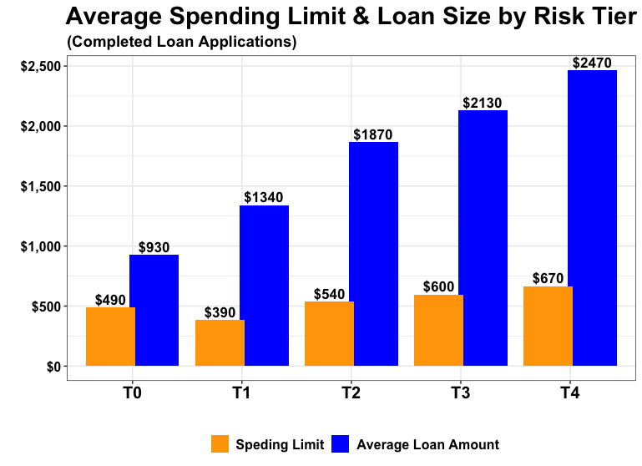
On Completed Applications, Average Loan Size Far Outpaces Average Spending Limit
The gap between average spending limit and average loan size widens as risk tier moves towards less risk
T1 completed applications have a lower average credit limit than T0 completed applications, while T1 average loan size is larger than T0

Slide 5
Key Separators For Accepted vs. Denied Loans Are Spending Limit, Loan History, and Verified Employer
Approved Vs. Denied Loan Characteristics (All Figures are Averages)
Loan Status | Loan Amount | Spending Limit | Loan Size as a % of Spending Limit | Competed Loans | Amount Deposited | Employer Listed
Approved | $509 | $1,635 | 57% | 1.8 | $1,002 | 99%
Denied | $526 | $972 | 71% | 0.2 | $104 | 0%
Approved loans, on average, are slightly smaller and make up a smaller percentage of a Perpay user’s spending limit
Completed loans are another key separator in approved vs. denied applications, as approved loans have a robust deposit history and have shown the ability to pay a loan back in full
99% of accepted loans have a verified employer attached to the application, while 0% of denied loans do

Slide 6
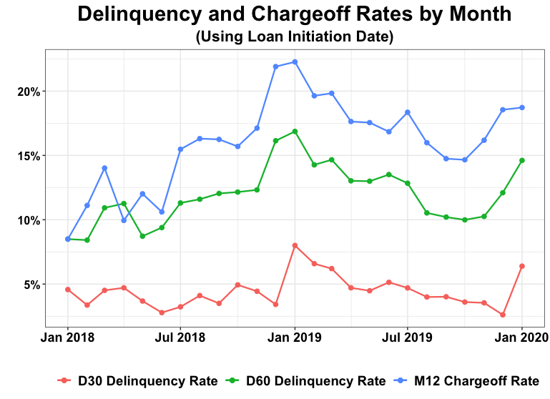
D60 Delinquency is a Much Better Predictor of M12 Charge-Off Rates than D30 Delinquency
Changes in D60 Delinquency rates mirror M12 Chargeoff rates closely
D60 Delinquency and M12 Chargeoff Rates have trended upwards since 2018
The uptick at the end of each calendar year is likely due to people spending outside their means for holiday shopping

Slide 7
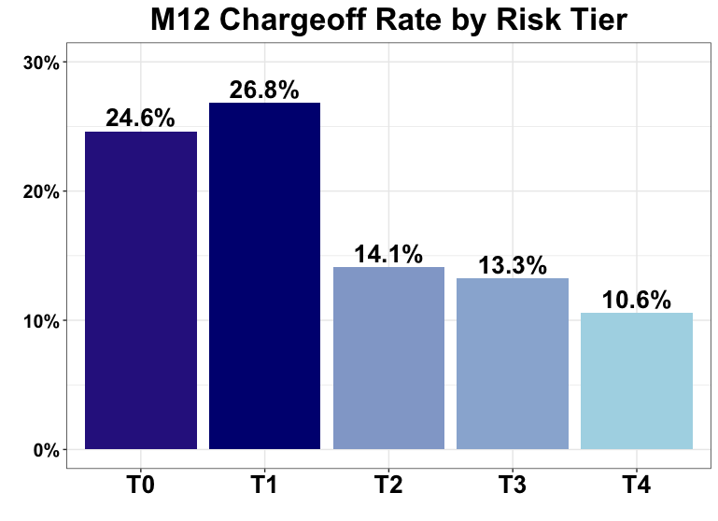
Large Loans vs. Spending Limit and No Employer are Drivers for Delinquency and Chargeoffs
33% of M12 chargeoffs come from loans that are greater than the person’s spending limit
M12 chargeoff rate for approved loans with no employer listed was 26% for T0, 36% for T1, and 18% for T2
These rates are an increase from overall chargeoff rates by Risk Tier

Slide 8
Lending Strategy Should Focus on Loan Size, Loan Size vs. Spending Limit, and Loans in Repayment
Lending Criteria (Loan and User Must Meet ALL Criteria to be Approved)
Risk Tier | Max Loan Size | Max Loan Size As % of Spending Limit | Max Loans in Repayment | Employer Listed
T0 | $1500 | 150% | N/A | Yes
T1 | $2500 | 200% | 2 | Yes
T2 | $3500 | No Limit | 4 | Yes
T3 | $3500 | No Limit | 6 | Yes
T4 | $4000 | No Limit | No Limit | Yes
Limiting loans in repayment helps to mitigate risk while maintaining high approval rates
T1 M12 chargeoff rates were 41% for loans approved with more than 2 loans in repayment
This limit would only cause a 3% decrease in approval rates for T1 loans

Slide 9
Revised Strategy Cuts Chargeoff Losses By 39.5% while only Lowering Approval Rate by 3.8%
Current Vs. Proposed Strategy KPIs
58% of the loans that were approved but would be denied with the revised criteria resulted in M12 chargeoff
The revised lending strategy was highly successful in increasing revenue through loss prevention, while maintaining relatively high approval rates
 | Chargeoff Rate | Losses From Chargeoffs | Approval Rate
Current Strategy | 17.3% | -$1,549,114 | 96.5%
Proposed Strategy | 8.6% | -$937,239 | 92.7%
Change | -8.7% | +$611,875 (+39.5%) | -3.8%

Slide 10
Next Steps
Consider adjusting lending strategy during the holiday season to mitigate risk
Obtain more complete spending limit data to enhance strategy
Monitor the effects of the COVID-19 pandemic on delinquency trends and user habits

