Slide 1

Predicting Pancreatic Cancer using Urinary Biomarkers
Ellis Suen

Slide 2
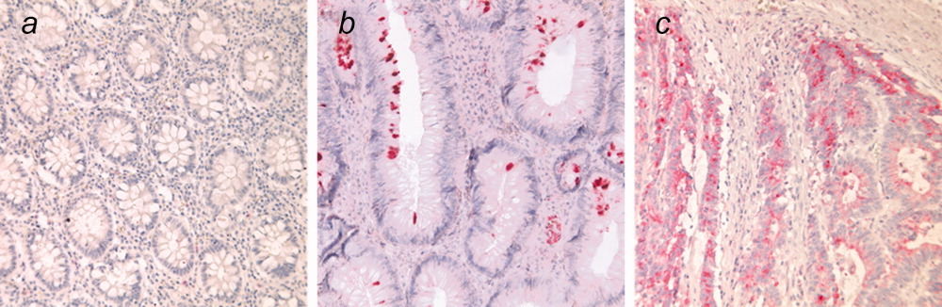
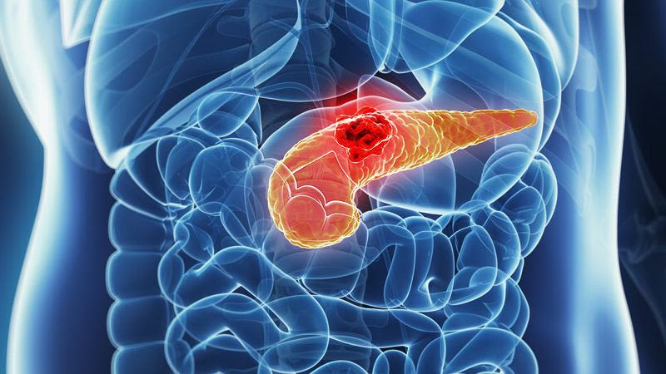
Background
~2.7% of new global cancer cases
~8% of annual global cancer fatalities
Fast progressing disease
Difficult to diagnose
Data collected include:
Age
Sex
Plasma_CA19_9
Creatinine
LYVE1
REG1B
TFF1
REG1A
Notes:
ERCP (endoscopicretrograde cholangiopancreatography)

Slide 3





Process
DATA COLLECTION
EDA / DATA PREPROCESSING
MODELING
ITERATIVE TUNING
DEPLOYMENT

Slide 4
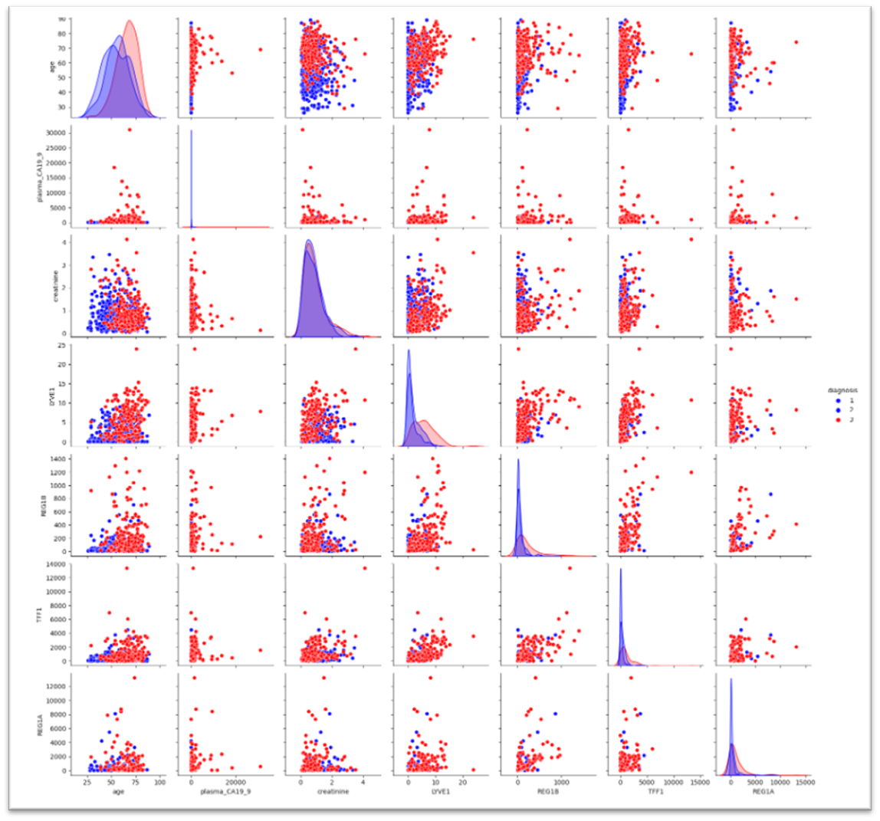
The Data

Slide 5
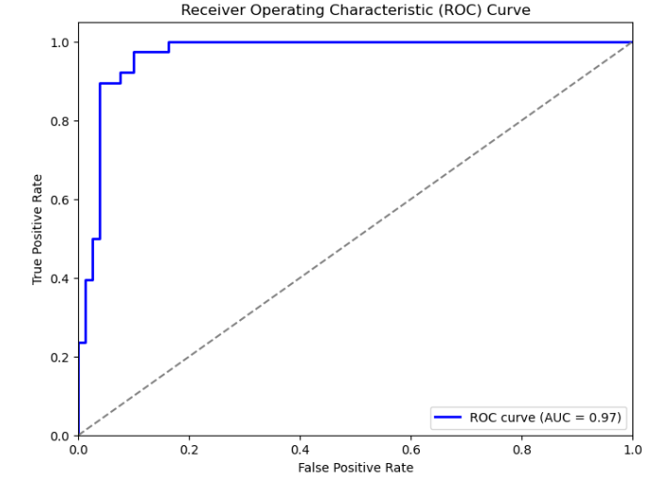
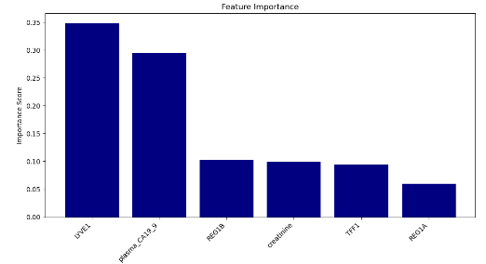
Results
 | Predicted Negative | Predicted Positive
Actual Negative | 96.25% | 3.75%
Actual Positive | 10.53% | 89.47%
Notes:
Challenge Small dataset –
Future – AWS – more features including a metric of how likely the prediction is correct

Slide 6
Thank you :)
References:
Debernardi S, O’Brien H, Algahmdi AS, Malats N, Stewart GD, et al. (2020) A combination of urinary biomarker panel and PancRISK score for earlier detection of pancreatic cancer: A case–control study. PLOS Medicine 17(12): e1003489. https://doi.org/10.1371/journal.pmed.1003489
John, D., & Debernardi, S. (Jan. 2023). Urinary biomarkers for pancreatic cancer. https://www.kaggle.com/datasets/johnjdavisiv/urinary-biomarkers-for-pancreatic-cancer/data
Survival Rates for Pancreatic Cancer. American Cancer Society. (2024, January). https://www.cancer.org/cancer/types/pancreatic-cancer/detection-diagnosis-staging/survival-rates.html
Worldwide cancer data: World cancer research fund international. WCRF International. (2022, April). https://www.wcrf.org/cancer-trends/worldwide-cancer-data/#:~:text=Breast%20and%20lung%20cancers%20were,contributing%2010.7%25%20of%20new%20cases

