Slide 1
AI / ML ENGINEER INTERVIEW
Service Priority AI
Responsible Azure MLOps for public-service case prioritisation
Ellis
30 June 2026 | Virtual interview
1

Slide 2
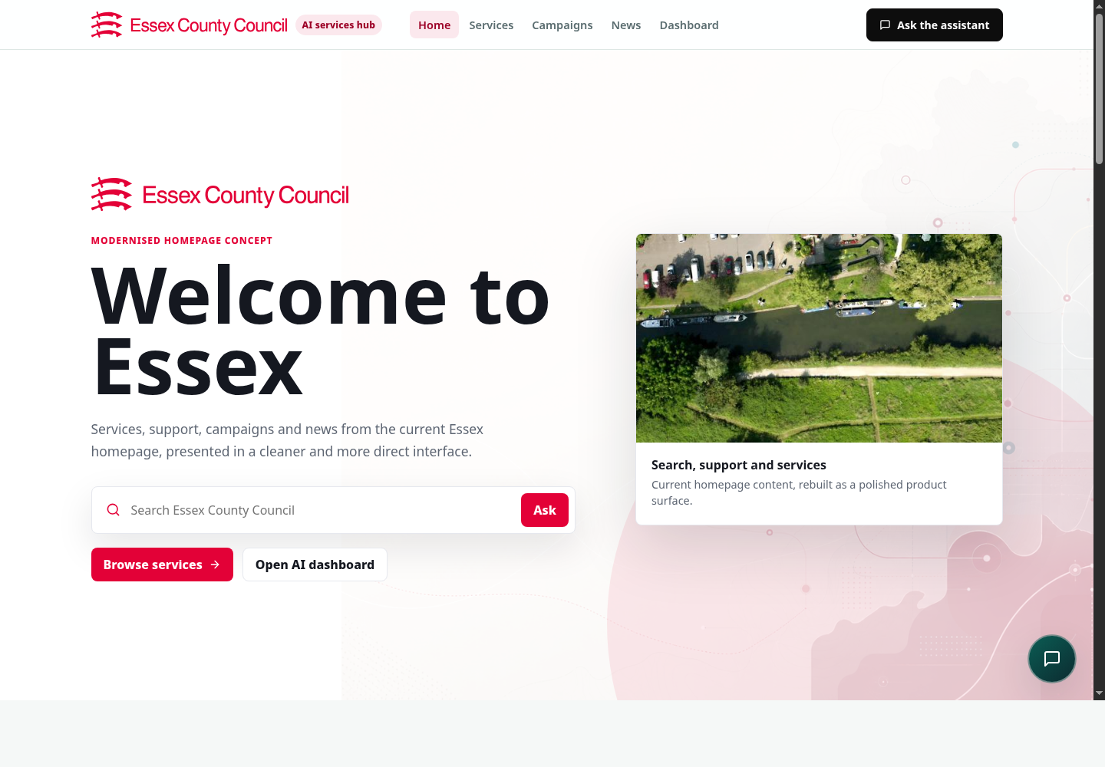
02
Context And My Role
Why the system exists, who uses it, and what I personally built
Business problem
Users
Urgent cases can be hidden in mixed service queues.
Officers need consistent triage support, not an automated decision maker.
Managers need visibility of risk, demand, overrides, and model behaviour.
Case officers reviewing service requests.
Service managers monitoring queues and exceptions.
Information Governance and responsible AI reviewers.
My contribution
Designed and built the ML lifecycle, API boundary, Azure deployment assets, monitoring outputs, and governance documentation.
Service Priority AI | Azure MLOps interview presentation
2

Slide 3
03
Data And Real-World Limitations
The data was useful for proving the pattern, but the risks are the point
TRAINING ROWS
VALIDATION ROWS
DECISION ROLE
20k
5k
Advisory
synthetic service cases
hold-out evaluation
human review required
Inputs
Limitations
Controls
Service type, SLA, district, channel, days open, previous contacts.
Vulnerability flag, deprivation band, accessibility need.
Urgency notes transformed with explainable text features.
Synthetic labels do not prove live resident-service performance.
Real notes would be sensitive, noisy, incomplete, and unevenly written.
Vulnerability and deprivation can create proxy-risk concerns.
DPIA-lite, model card, responsible AI assessment.
No raw real resident data in the demo.
Fairness slices, drift review, override monitoring, and human accountability.
Service Priority AI | Azure MLOps interview presentation
3

Slide 4
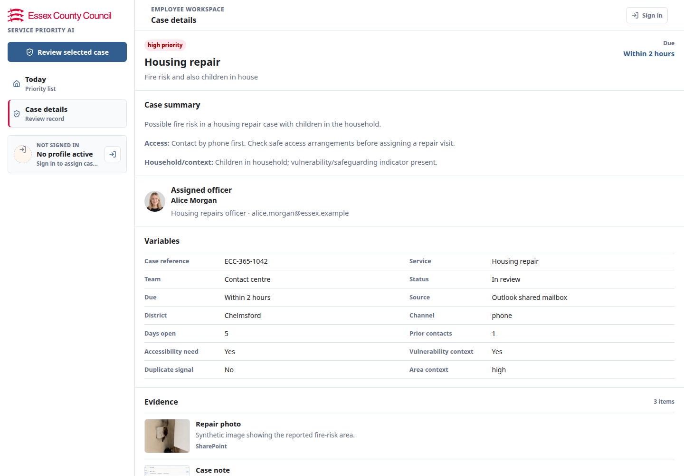
04
Model And Evaluation
Transparent baseline first, because missed urgent cases are the service risk
Baseline model
scikit-learn LogisticRegression pipeline.
ColumnTransformer over categorical, numeric, boolean, and TF-IDF text features.
Chosen for repeatability, explainability, and public-sector accountability.
ACCURACY
MACRO F1
HIGH RECALL
90.2%
90.35%
94.08%
validation
balanced view
harm-oriented
Validation checks
Hold-out metrics, confusion matrix, class recall, confidence review, fairness slices.
High-priority recall gate passed; fairness remains review_required.
Service Priority AI | Azure MLOps interview presentation
4

Slide 5
05
Azure Architecture And Service Choices
Governed serving path with online and batch scoring
Synthetic data
Azure ML pipeline
Model registry
Online endpoint
FastAPI wrapper
React dashboard
approved demo data
train / evaluate / gate
versioned artifact
real-time scoring
validation + audit
officer workflow
Batch endpoint
Audit store
Power BI
offline review queues
decisions + overrides
monitoring review
Why Azure ML
Why API wrapper
Why batch scoring
Pipelines, pinned environments, registry, managed endpoints, traffic control, and reproducibility.
Browser never handles Azure ML endpoint secrets; the API centralises validation, logging, and audit.
Supports scheduled review queues, monitoring backfills, and retrospective evaluation.
Service Priority AI | Azure MLOps interview presentation
5

Slide 6
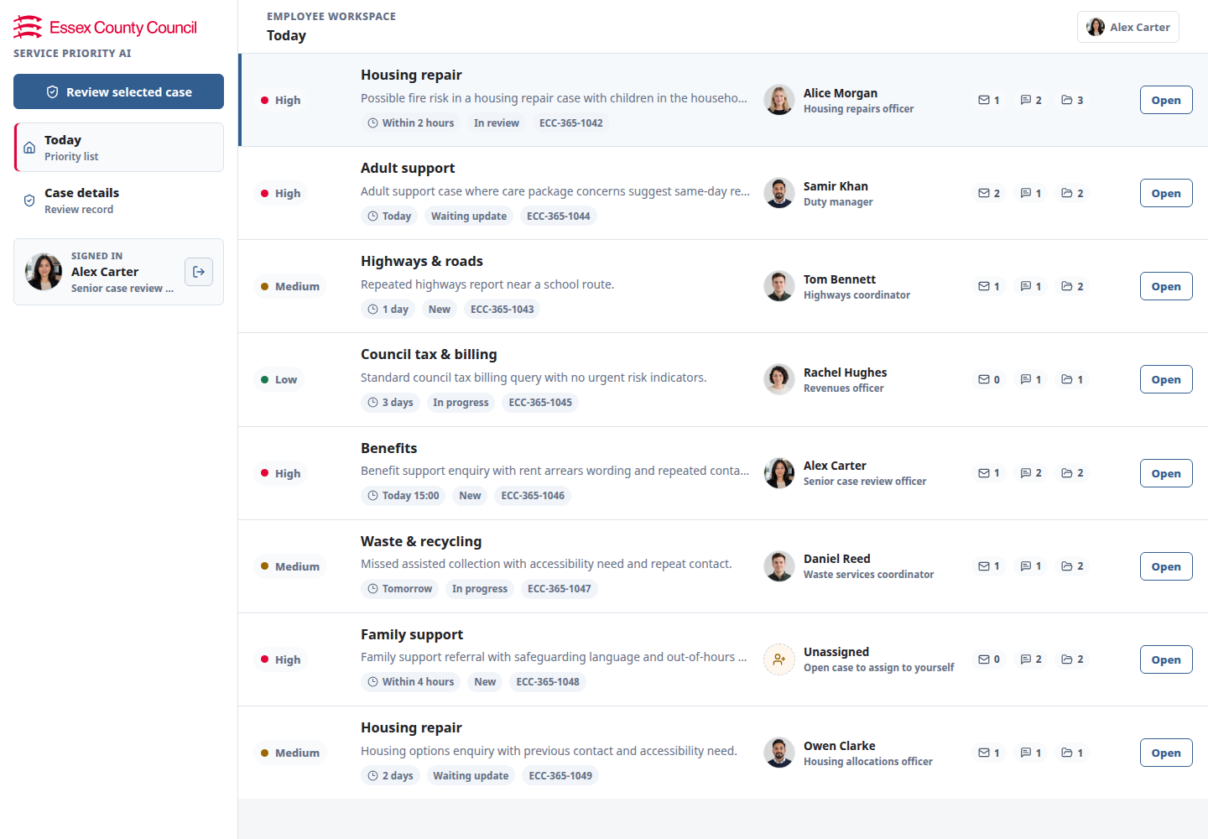
06
Production Safety Controls
The system is designed to be supportable before it is impressive
Engineering
Governance
Typed FastAPI and Pydantic contracts.
Backend tests, frontend build check, local validation script.
Versioned artifacts, registry tags, and model metadata.
Model card, DPIA-lite, responsible AI assessment.
Human review, override reasons, and audit trail.
Fairness status remains review_required before real deployment.
Operational controls
Azure Table Storage audit pattern, Application Insights/Azure Monitor health signals, endpoint rollback by traffic/deployment, small compute, scale-to-zero, and monthly budget alerts.
Service Priority AI | Azure MLOps interview presentation
6

Slide 7
07
Monitoring, Incident And Learning
How I would know the service was degrading and what changed after a rollout issue
Monitoring
Incident
Change afterwards
API health, request volume, error rate, p95 latency, model-loaded state.
Class mix, confidence, low-confidence rate, explanation coverage.
Drift, fairness slices, high-priority recall, audit completeness, and overrides.
Linux App Service plan creation in UK South was blocked by subscription VM quota.
Root cause was regional quota, not model code or schema.
No residents were affected; this was synthetic portfolio telemetry.
Used Azure Functions Flex Consumption for the browser API wrapper.
Kept Azure ML behind a governed layer.
Documented fallback hosting path and evidence checks before claiming readiness.
Service Priority AI | Azure MLOps interview presentation
7

Slide 8
08
What I Would Bring To ECC
Azure-native delivery with responsible AI controls by design
Move experiments into governed Azure ML pipelines and model promotion gates.
Deploy through managed online endpoints, batch endpoints, and supportable API boundaries.
Work with Information Governance before real data: DPIA, UK GDPR, access control, retention, and audit.
Coach analysts and data scientists on reproducible, testable MLOps workflows.
Surface monitoring through Power BI-ready outputs that service owners can actually use.
Deployment is not just getting a model behind an endpoint. It is making it reproducible, explainable, monitored, governed, and safe to challenge.
LLM use disclosure
I used an AI assistant to structure and polish the deck.
I verified the content against repository artifacts, model metrics, Azure notes, and screenshots from the running website.
Service Priority AI | Azure MLOps interview presentation
8

