Slide 1
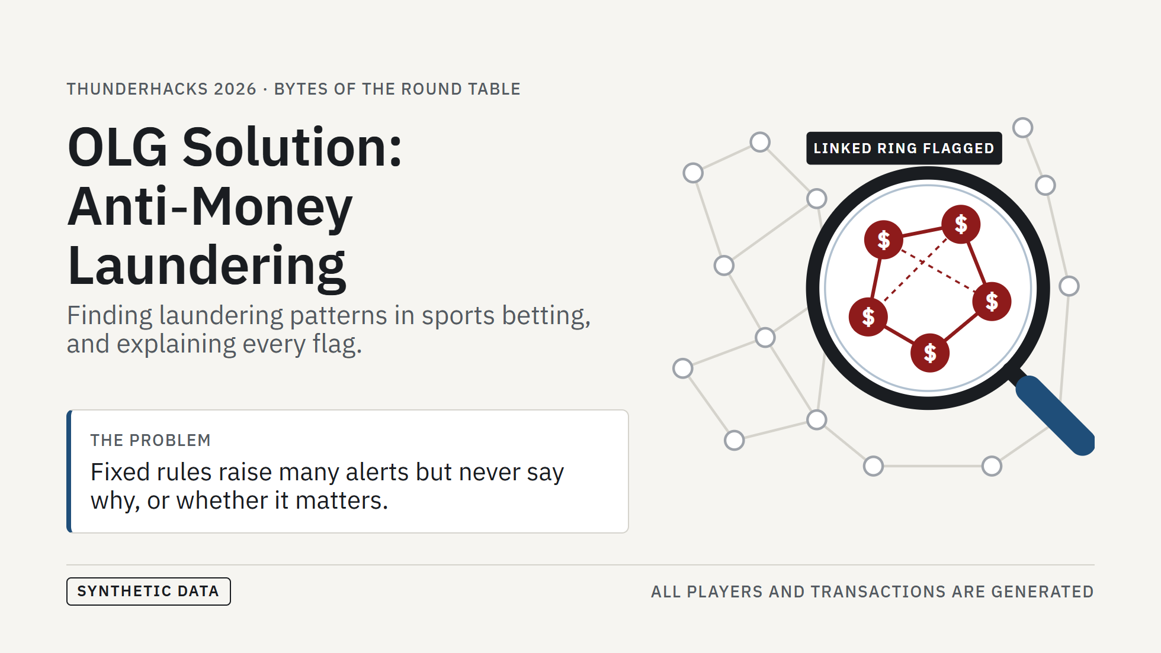
Notes:
[0:00–0:30] (~30 s)
- We're Bytes of the Round Table.
- Investigators review a huge number of alerts every day. Most come from fixed rules: they fire often, but don't say why, or whether it's unusual for that person.
- Our tool looks for laundering patterns like the linked ring in the lens: accounts sharing a device, card or address and moving money between them.
- Everything you'll see runs on synthetic data we generated. No real player data.

Slide 2
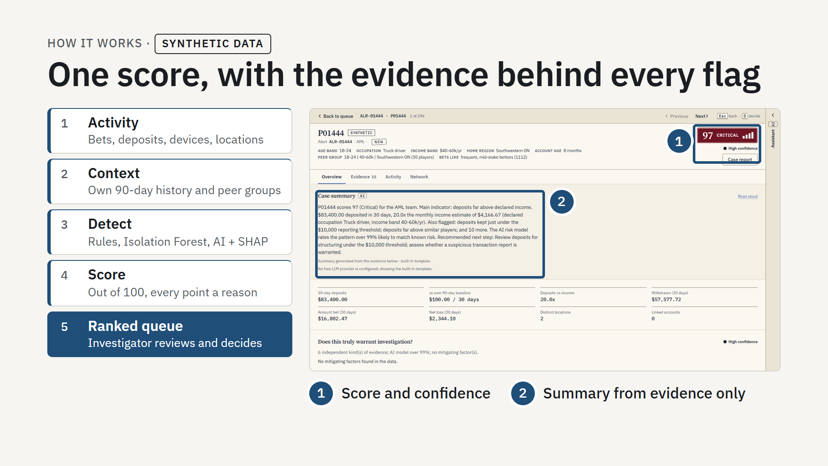
Notes:
[0:30–1:20] (~50 s)
- Left, the pipeline: activity in (bets, deposits, devices, locations, all synthetic); context, so every flag compares the player with their own 90-day history and with peers; detection with transparent rules, peer z-scores, Isolation Forest and a gradient-boosting model whose SHAP drivers become one more reason.
- The score is out of 100 and every point comes from a named reason with its numbers. Output: one ranked queue across AML, Fraud and Safer Gambling.
- Right, a real screenshot of our dashboard on synthetic data, top alert opened.
- 1: the score with a number, a label and a meter, never colour alone, plus a confidence rating and reasons it may be innocent.
- 2: a case summary written only from computed evidence; any AI-written number is checked against the case file. It ends with a recommended next step.
- The investigator decides (Accept, Escalate, Close as explained, Assign), recorded with their name. Also built: Evidence, Activity and Network tabs for linked accounts.
Sources: README.md "Our Solution" and "How the score works"; docs/VALIDATION.md "AI model (supervised)".

Slide 3
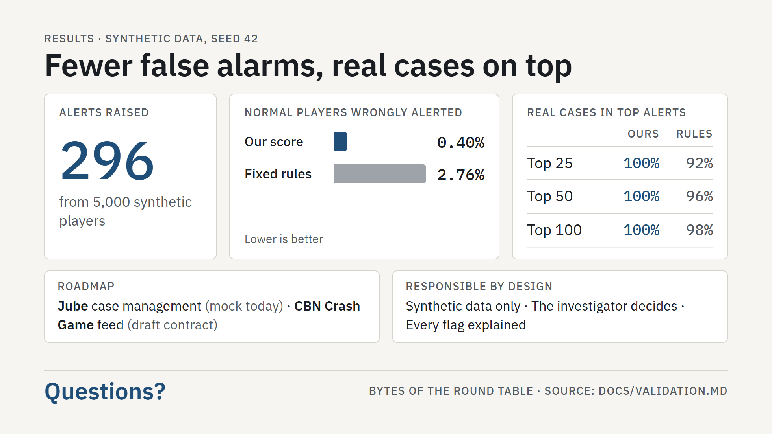
Notes:
[1:20–2:00] (~40 s)
- 296 alerts from 5,000 synthetic players.
- Only 0.40% of normal players get alerted; fixed-threshold rules flag 2.76%.
- Ranking: the top 25, 50 and 100 alerts are all real planted cases; rules alone get 92%, 96%, 98%.
- Honest caveat: our team built both the data and the detectors, so this shows the pipeline works, not real-world accuracy.
- Next: real Jube case management (today only a mock of its API) and a CBN Crash Game feed (the data contract is a draft).
- Responsible by design: synthetic data only; the investigator decides and can override with a reason; no score without its reasons.
- Thank you. Questions?
Source for every number: docs/VALIDATION.md ("Dataset", "Prioritisation: precision@k", "False positives"). See deck/SOURCES.md.

