Slide 1

POSAM
Presentation of POSAM
Catalyste+ in the Philippines

Slide 2


What is POSAM system?
POSAM is a web application that helps SMEs to manage the inventory, orders, customers, payments and production.

Slide 3
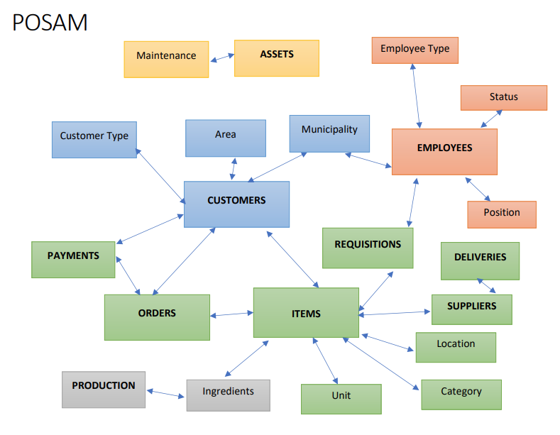
Database
More systematic and logical
than Excel

Slide 4
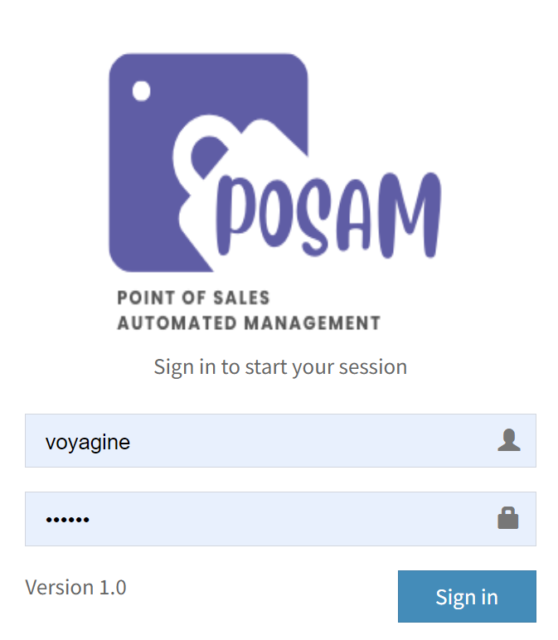
Access
Secure with code/password
Easy to use
Customizable
Users with different profile
Report flexibility

Slide 5
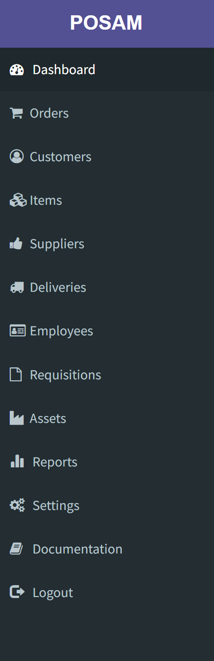




All the information in one place
Items and Assets
Customers, Suppliers and Employees
Orders, Deliveries and Requisitions
Documents
You can share all the information
Search is easy
All documents related to the customers, employees, suppliers and assets can be uploaded and downloaded

Slide 6
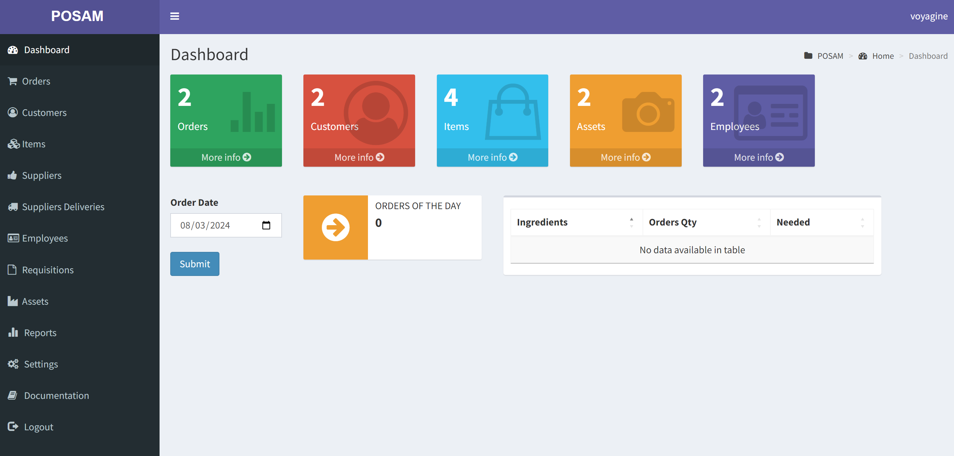
Dashboard
Give a summary of the activities

Slide 7
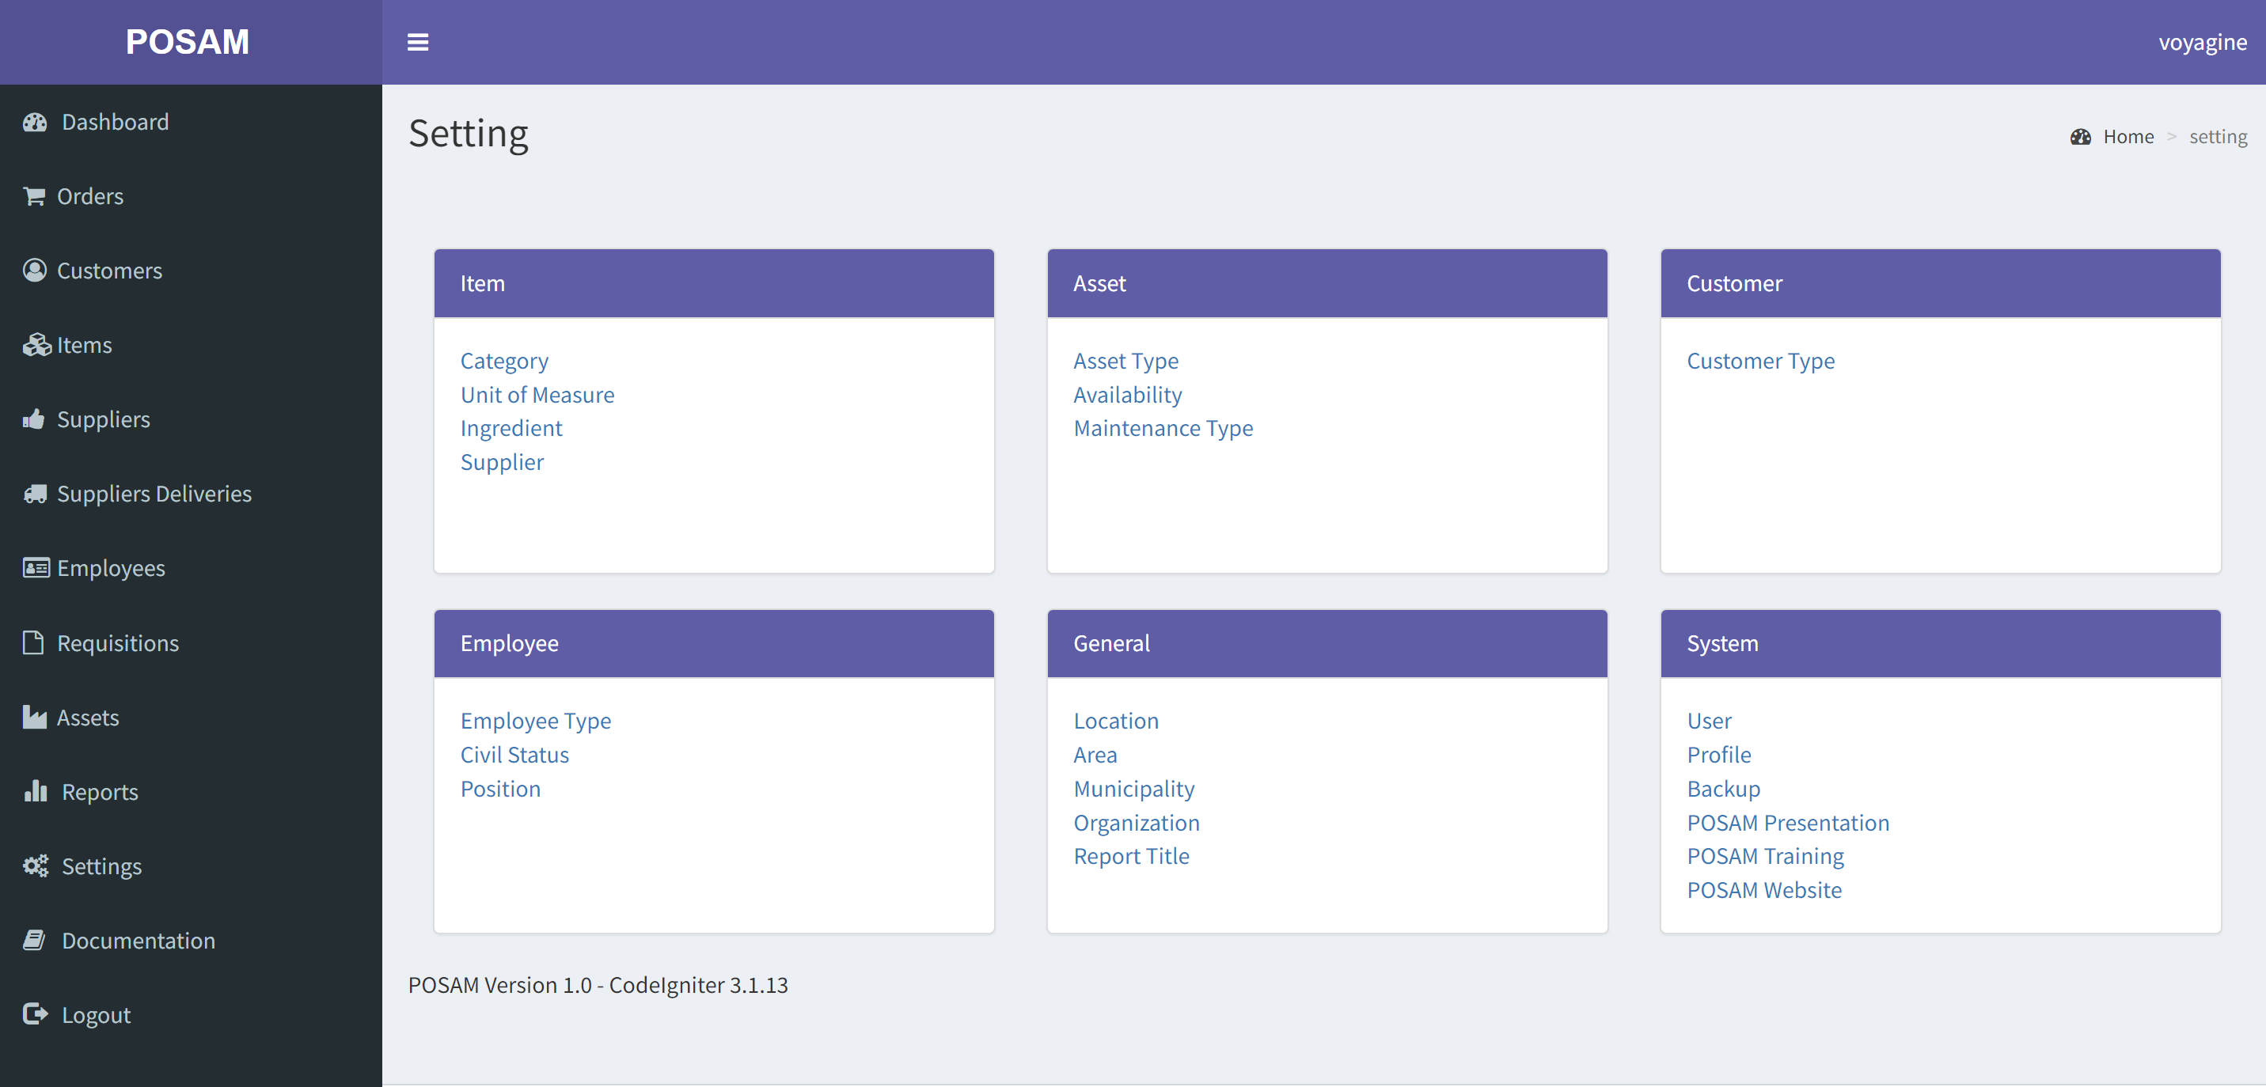
Customizable with settings

Slide 8
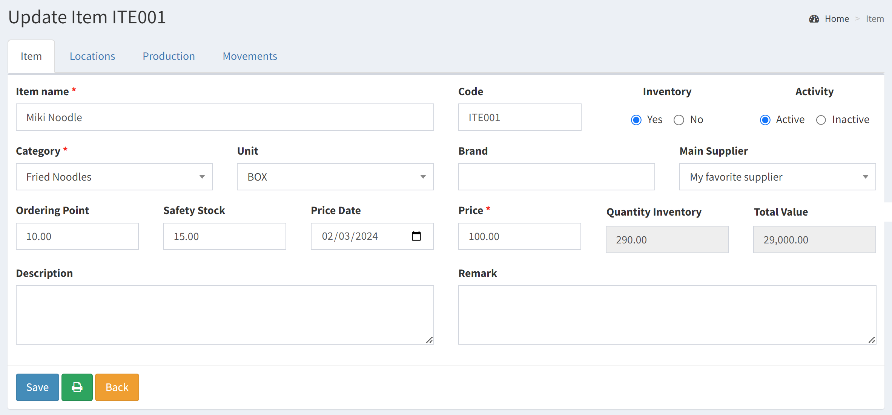

Movements IN/OUT
Items
Searching a specific item is easy
Production can be calculated on the ingredients attached to the item
Ordering Point and Safety Stock
Each movement of the item is compiled.
If an Order (OUT), a Delivery (IN) or a Requisition (OUT) are related, it will appear in the movements of the item

Slide 9
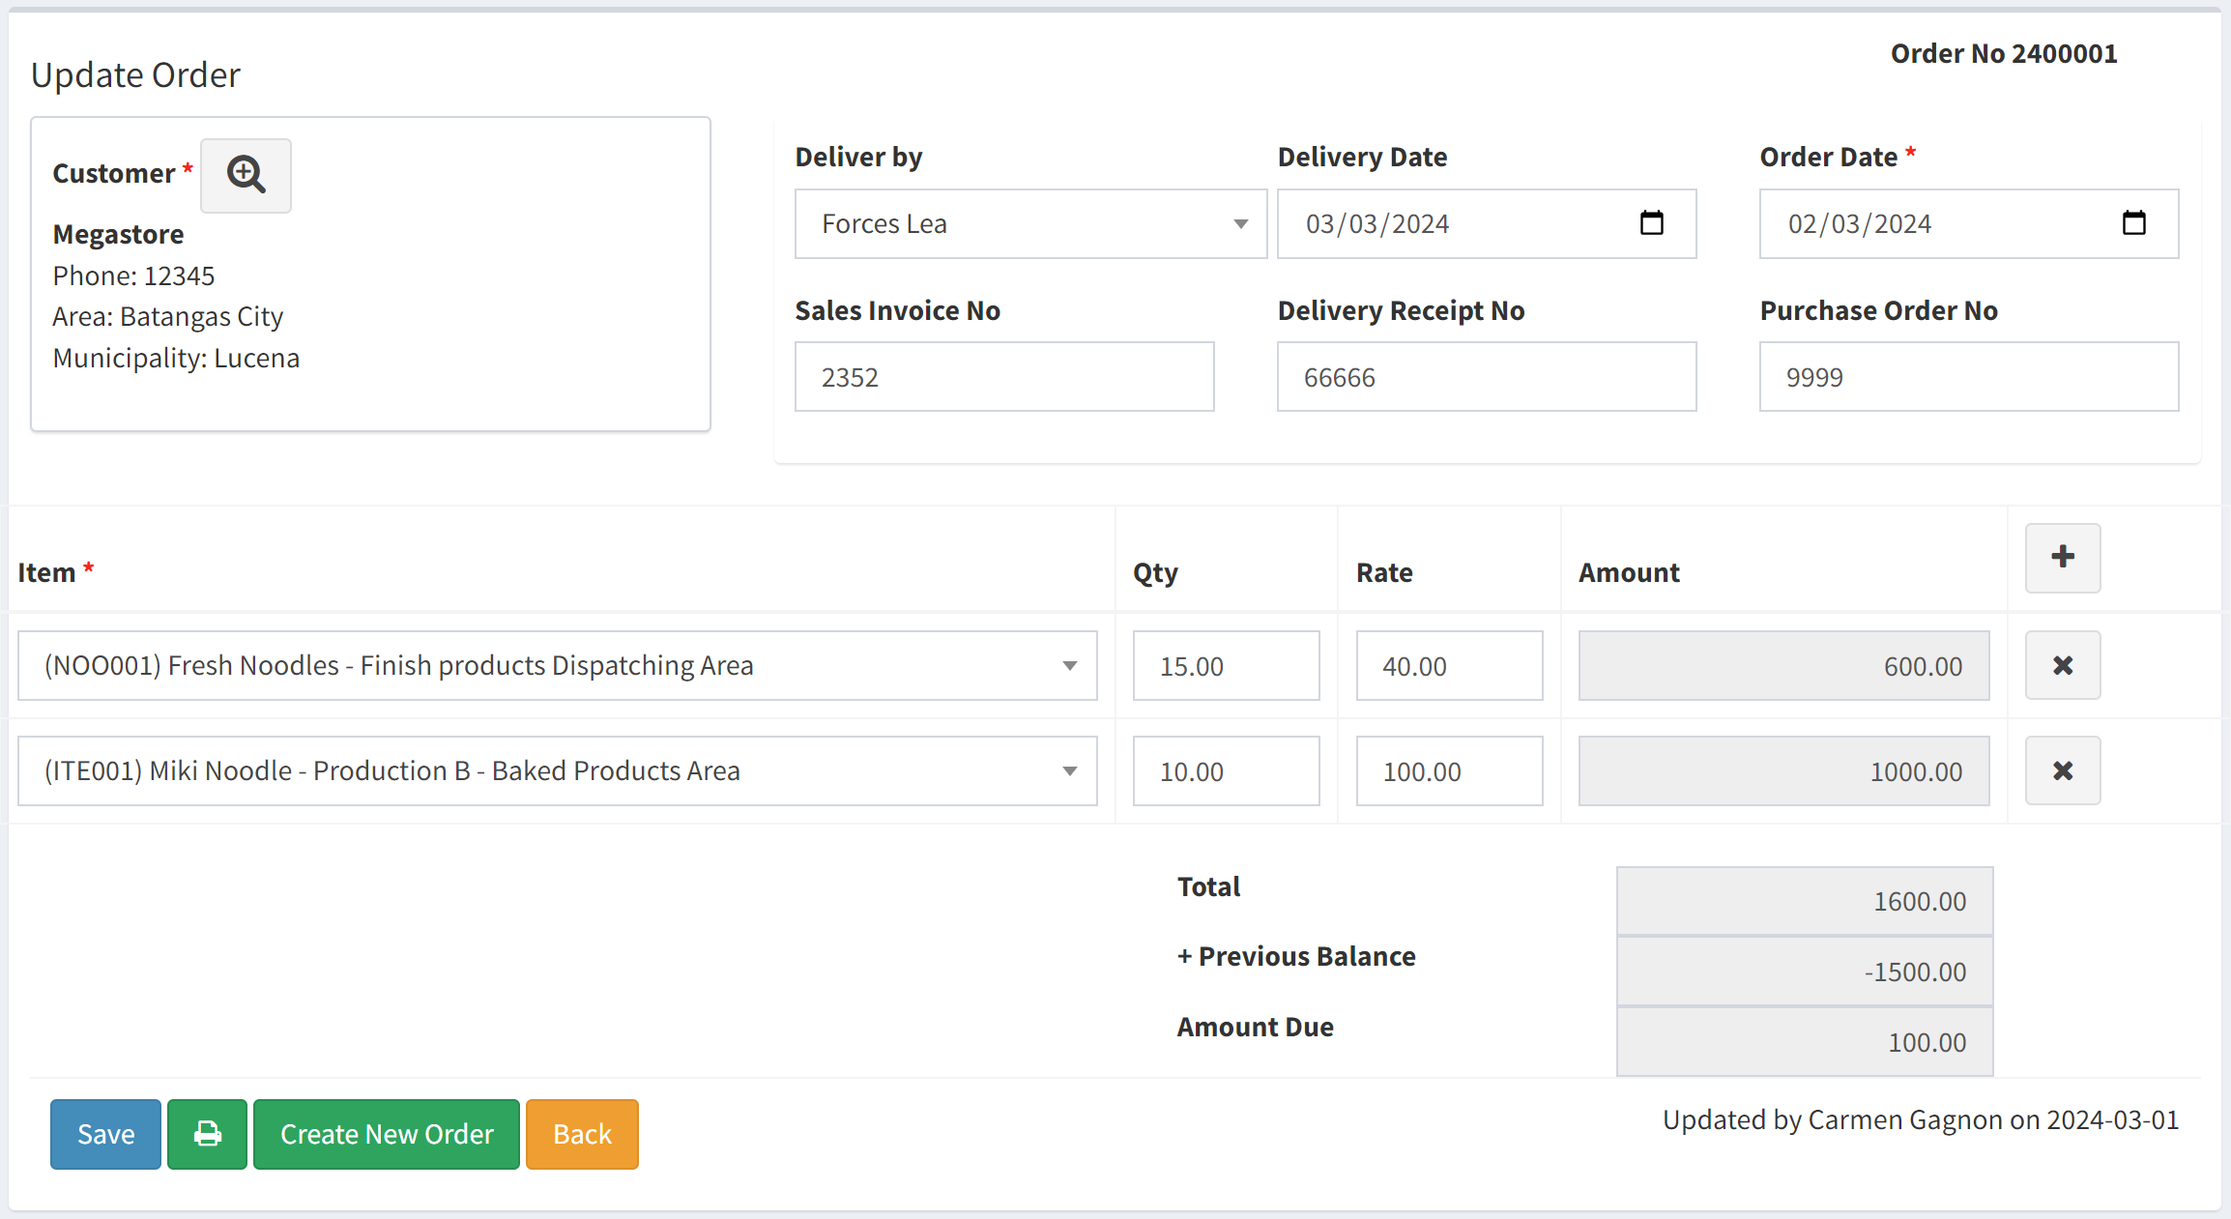
Orders
Customer / Distribution
Searching a specific order is easy
Keep inventory of the item (OUT)
Order slip for the customer
Follow-up customers orders and payments
Distribution organized on area and municipality of the customers

Slide 10
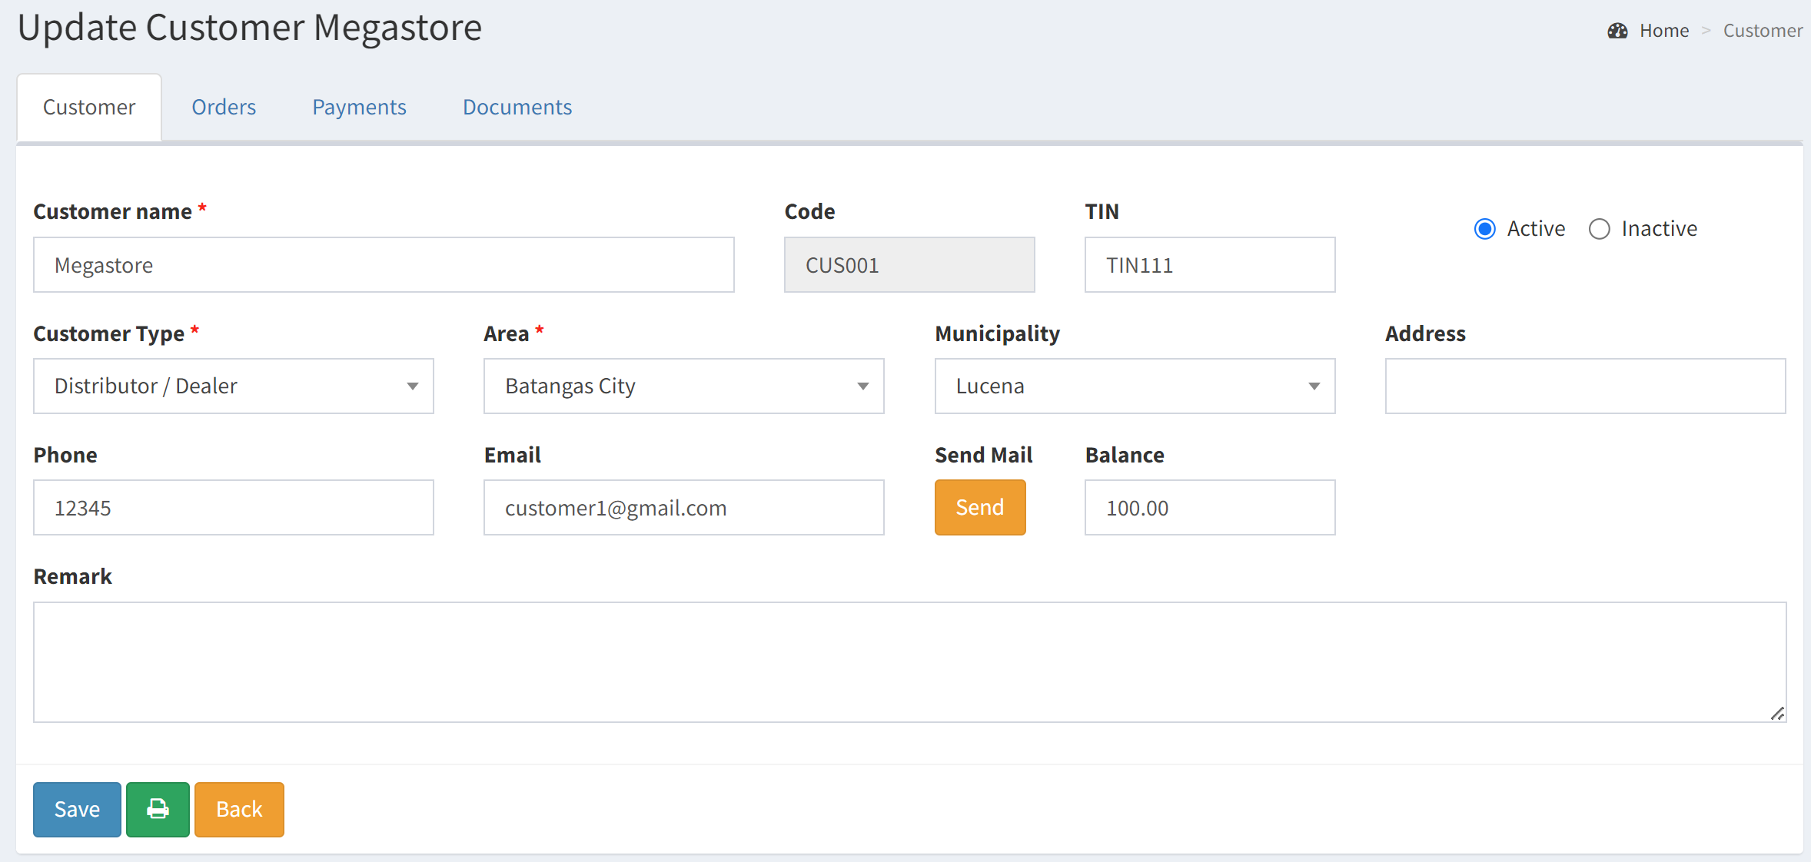
Customers
Orders - Payments
Searching a customer is easy
Documents can be uploaded in the customer page
Order slip for the customer
All the orders, payments attached to the customer
Balance of payment available

Slide 11
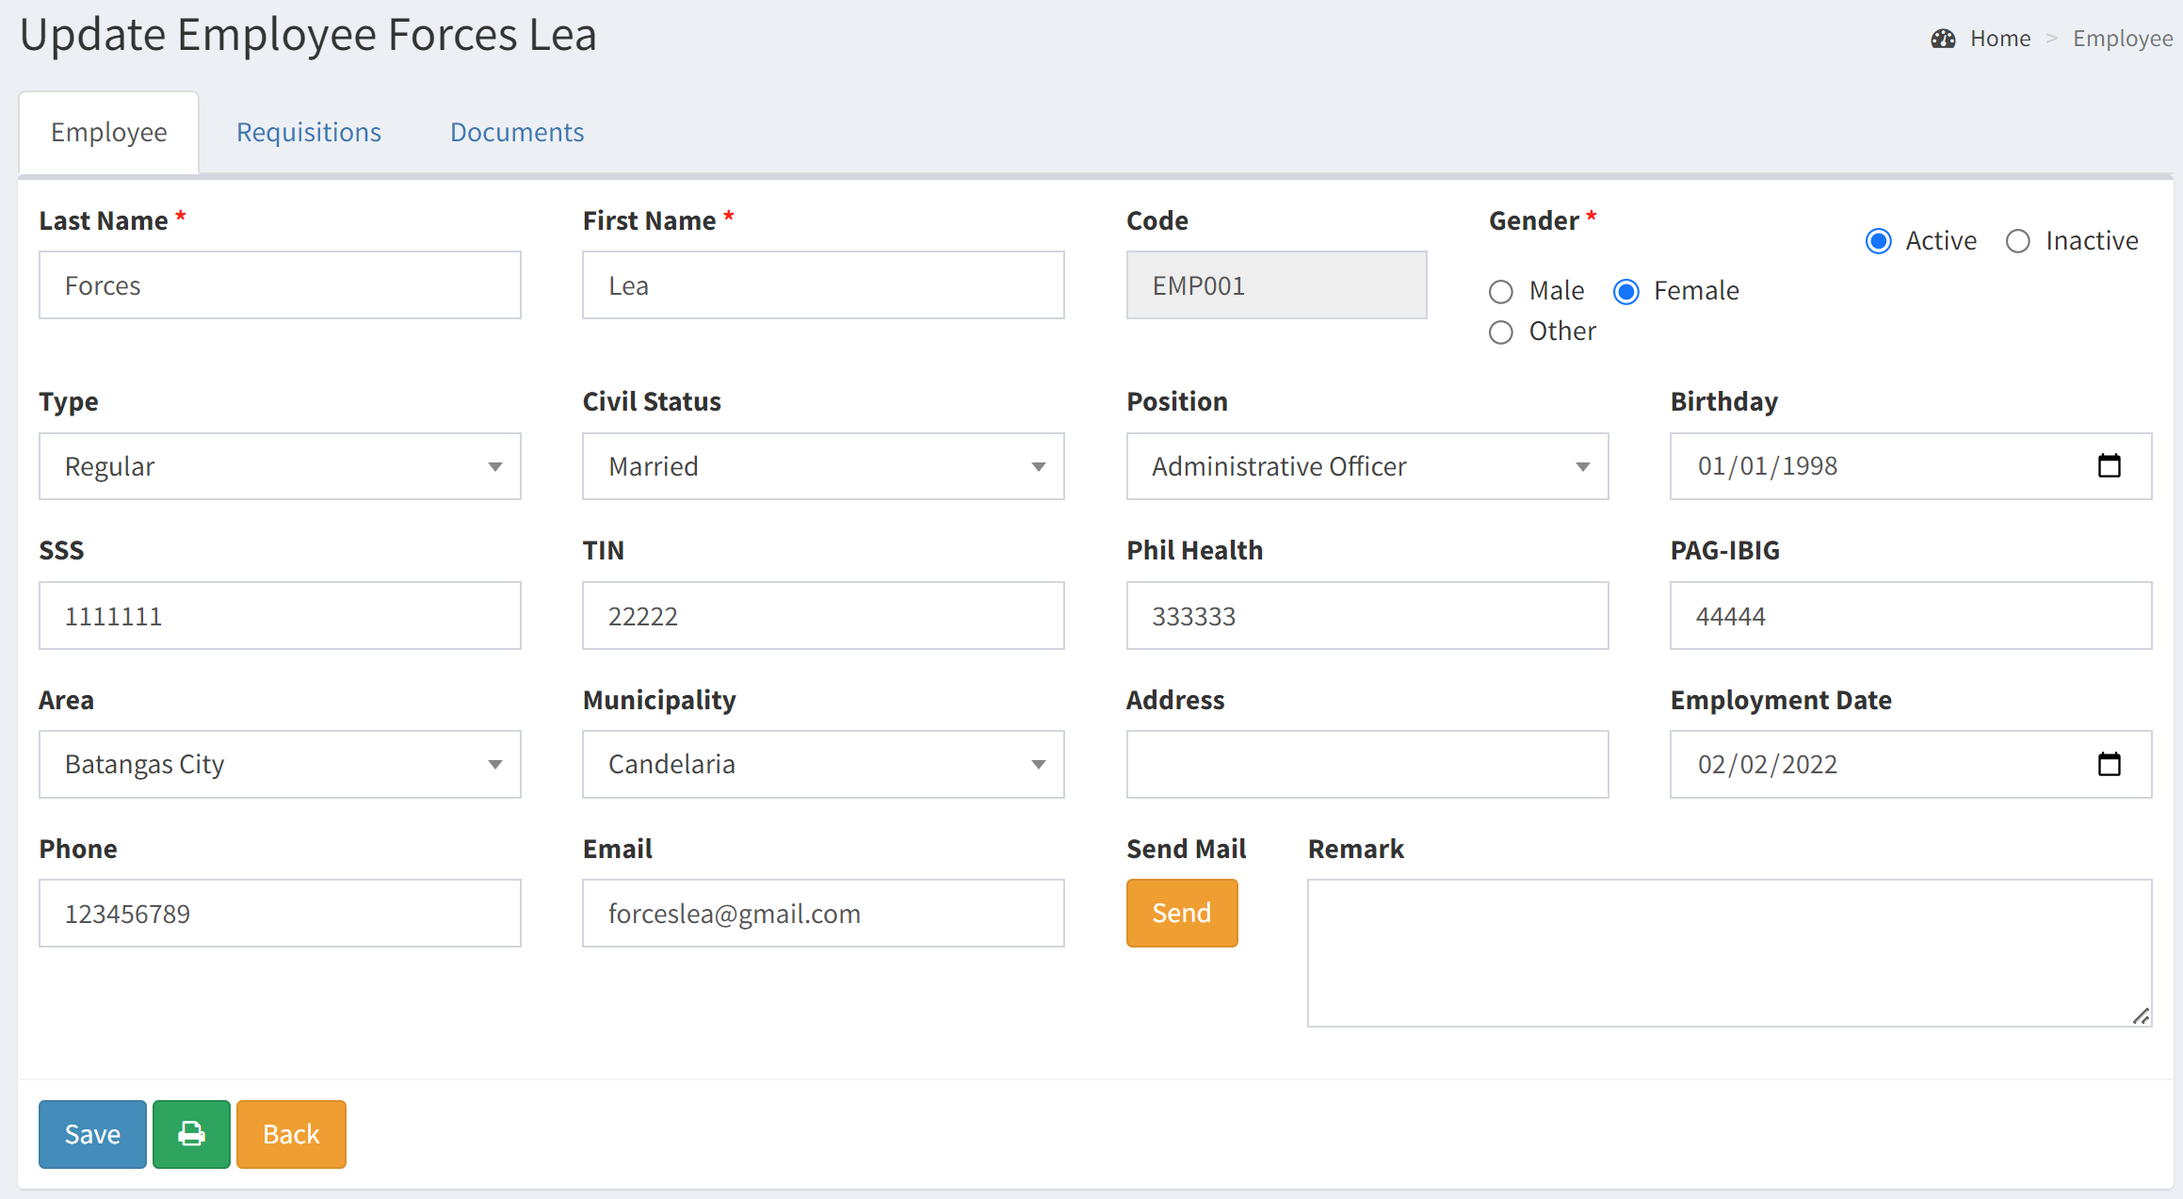
Requisitions
Employees
Keep information of employee of the organization
Documents can be uploaded for each employee
Requisition attached to the employee for better inventory control
Will help to manage the raw materials

Slide 12
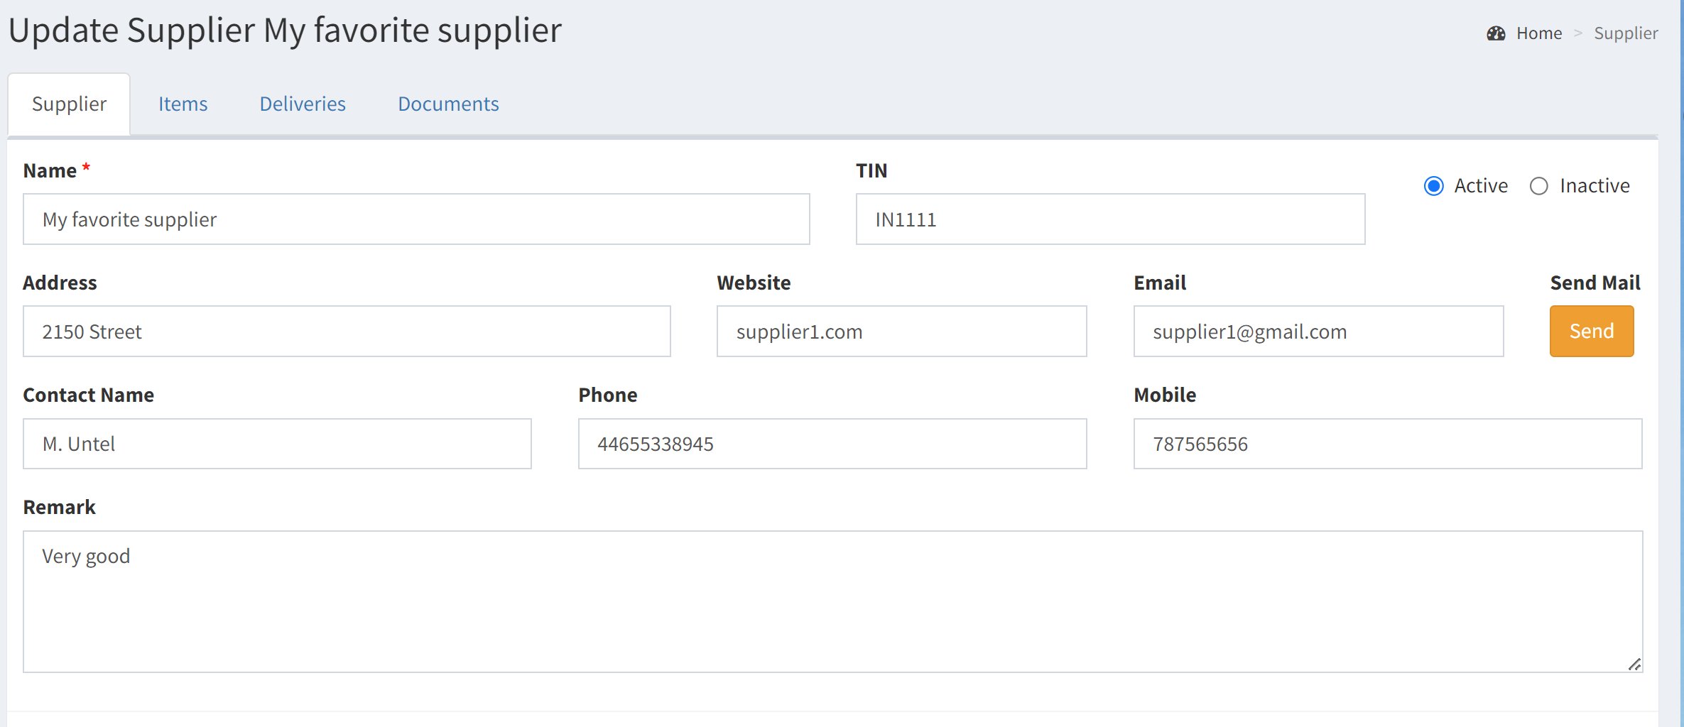
Suppliers Deliveries
Suppliers
Information on the suppliers
Main supplier are identified for items
Documents can be uploaded for each supplier
Supplier Delivery attached to the supplier and item for better inventory tracking
Production and Expiry date, Lot no, Batch can be encoded in the delivery

Slide 13
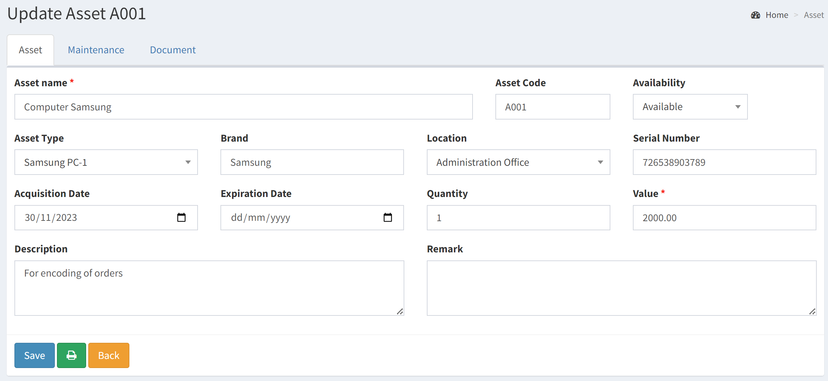
Maintenance
Assets
Details on Assets for the organization
Documents can be uploaded related to asset (user guide, invoice, warranty …)
Will keep a trace on the maintenance of the asset

Slide 14

Report flexibility
POSAM supports the generation of reports.
Reports can be generated in many format and transferred to Excel
Among the reports and responses it can provide users are:
List of Items, Assets
List of Customers, Employees, Suppliers
List of Requisitions, Deliveries
List of Orders
Summary of Payment
Statement of Account
And more to develop

Slide 15
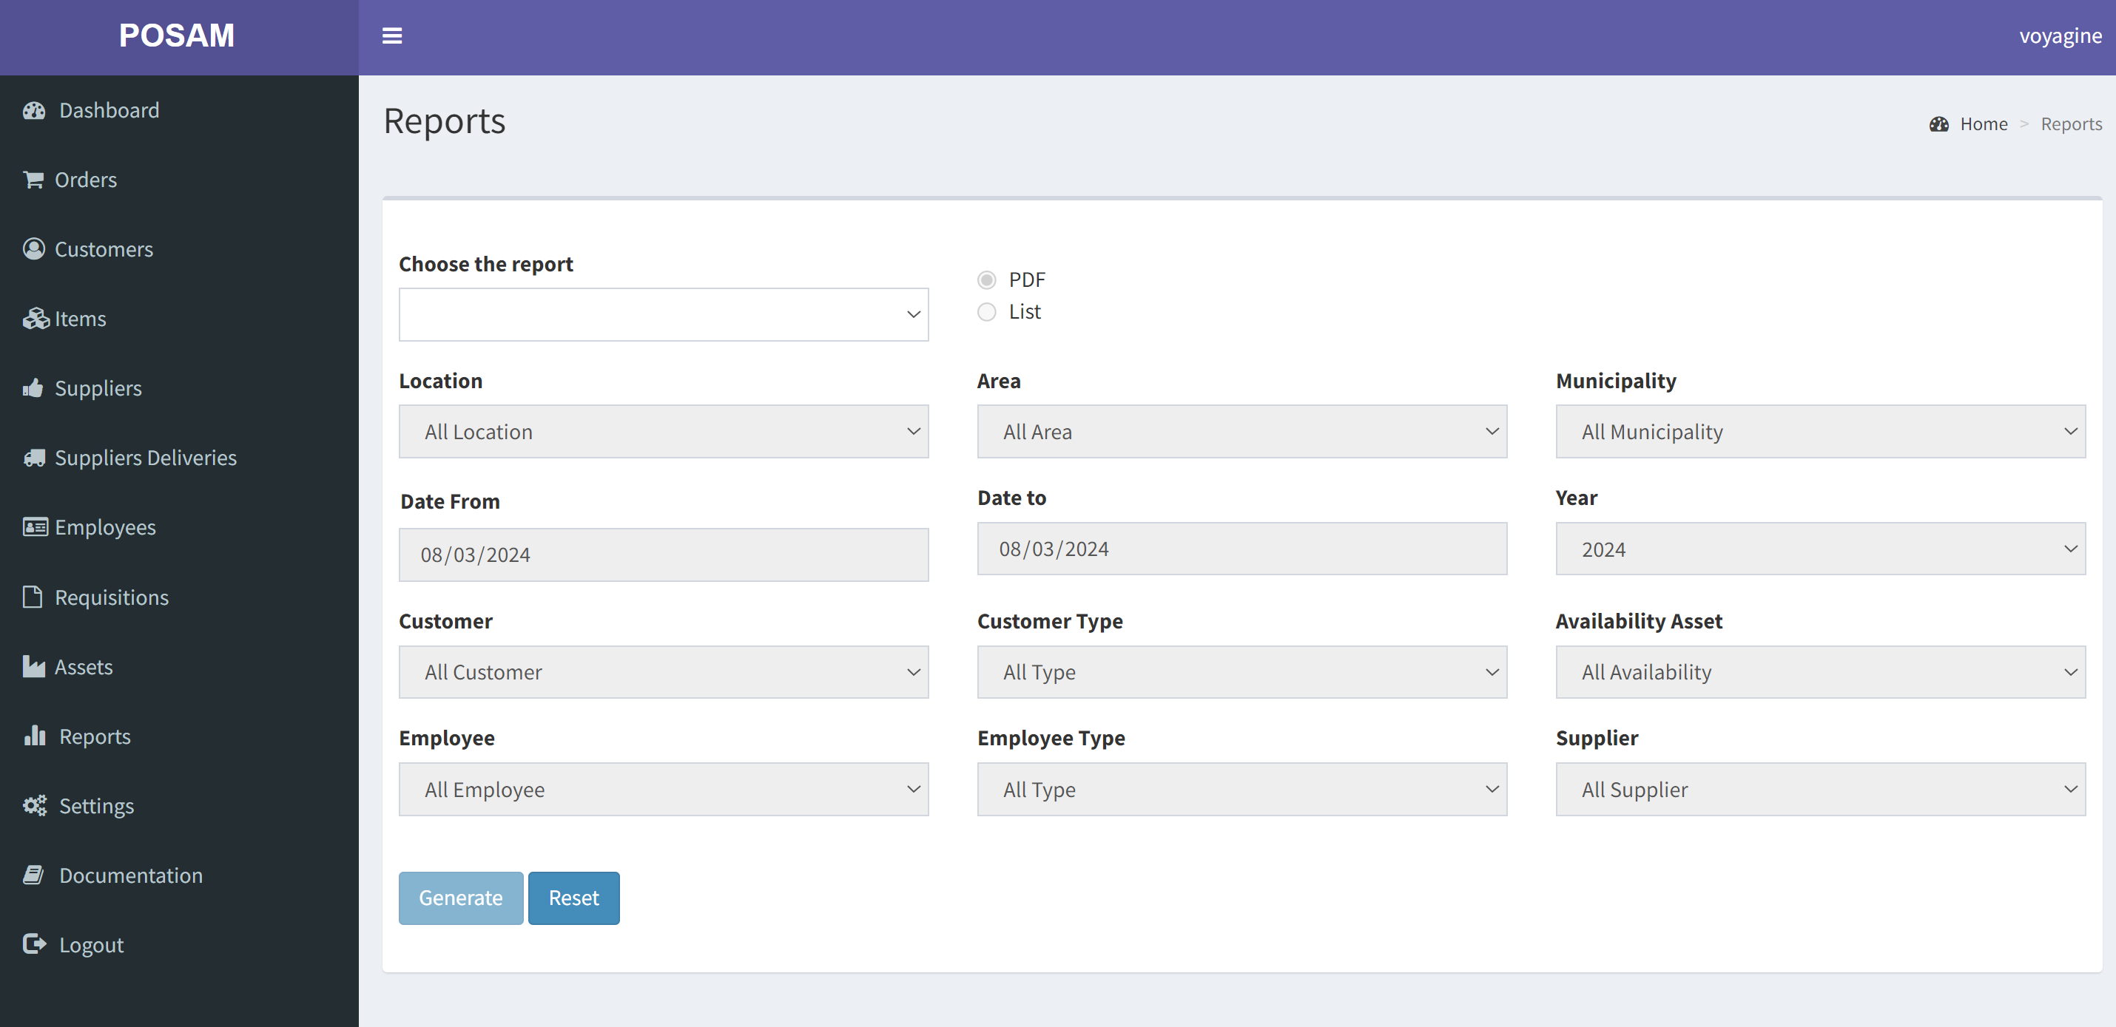
Parameters for reports
Available depending on the report chosen

Slide 16
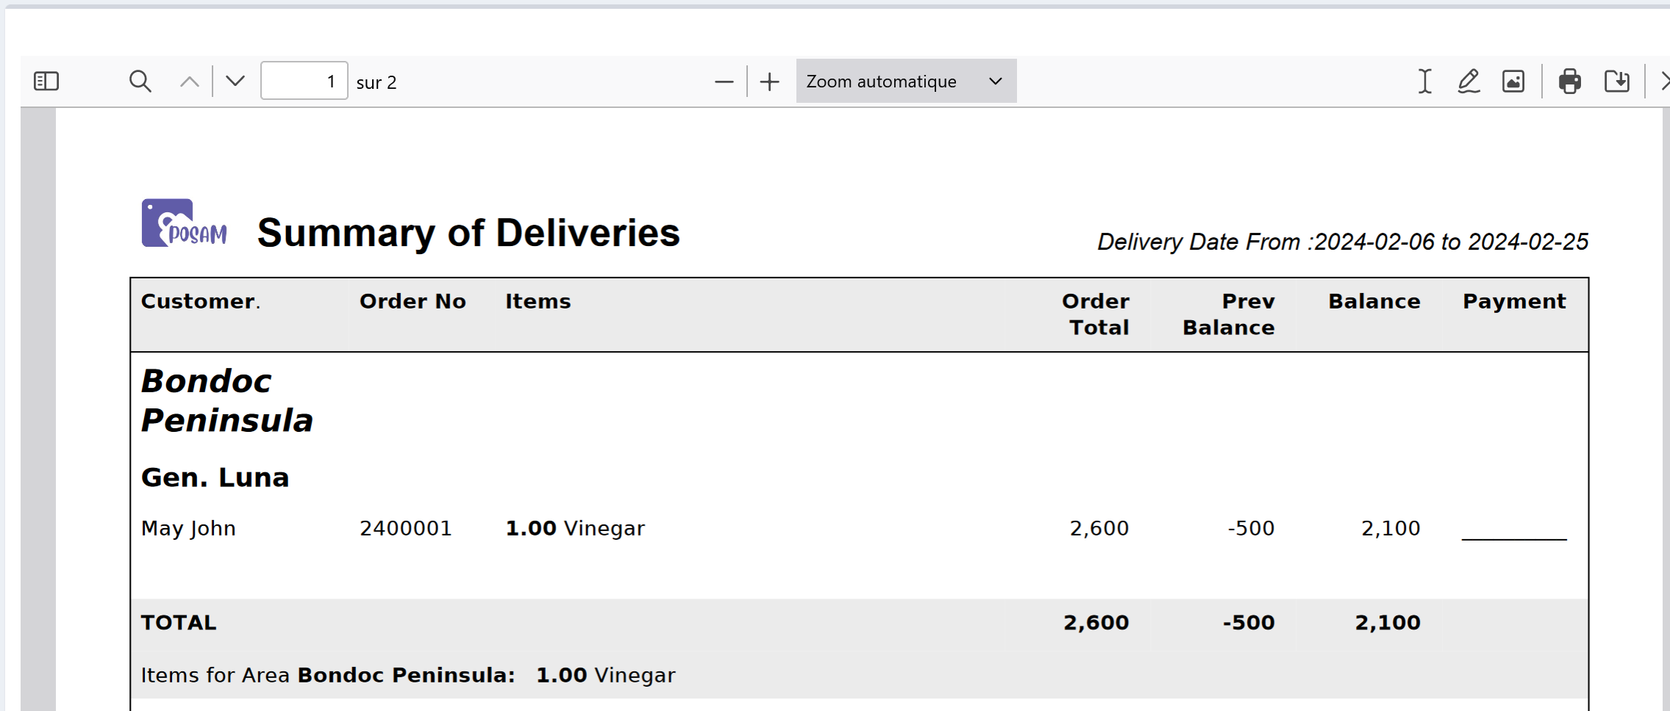
Report example

Slide 17
Are you ready?
To pass from Excel to POSAM, you might have to organize the work differently. Our team will help you overcome obstacles.

Slide 18
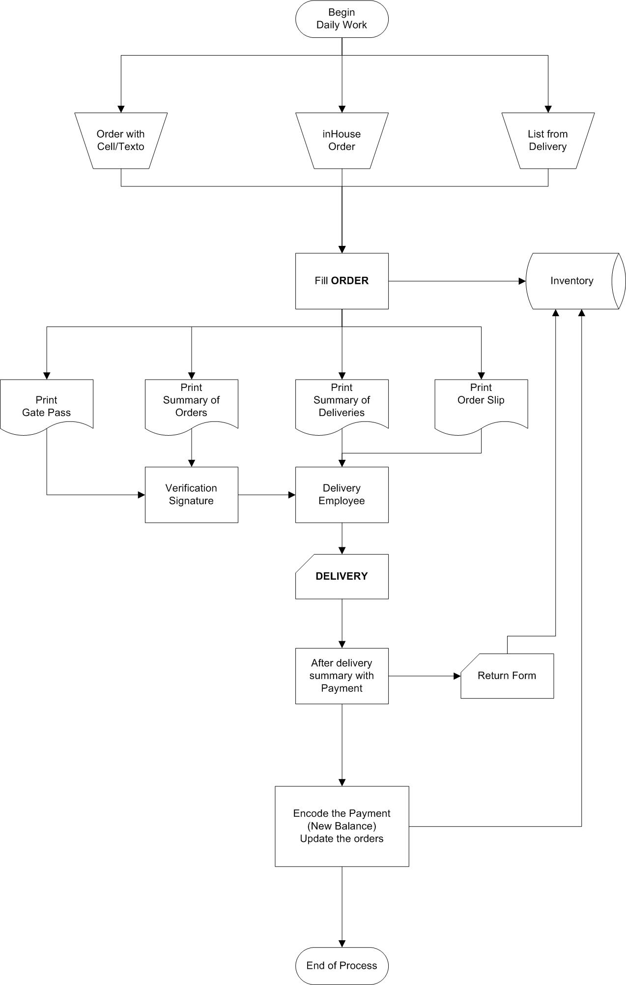
Work Organization
Do I have the required computers?
Are my employees comfortable with technology?
Will I use POSAM on the web or locally?

