Slide 1
Fuzzy frame weights (fixture deck)

Slide 2
Why not discard?
Hard frames hold the obstructed airway
Discarding gains only 0.005 Dice
Notes:
Say that discarding looks harmless but removes the cases that matter.

Slide 3
The weight
wb=m,n​αmn ρmnm,n​αmn+ϵ
${\tilde{q}}_{b}$: quality, $a_{b}$: area ratio
Notes:
Point at alpha and rho; the denominator only normalises.

Slide 4
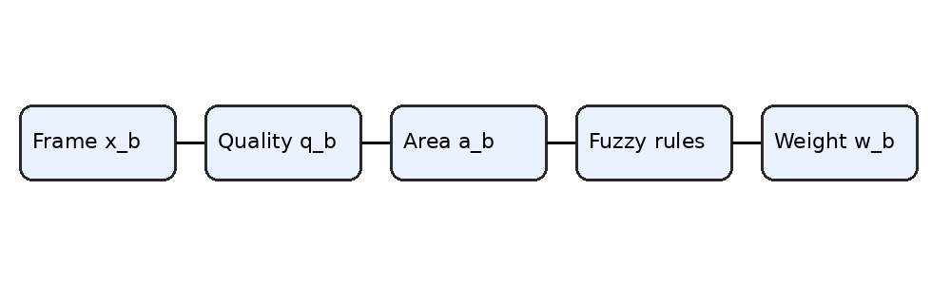
Pipeline
Pipeline from frame to weight.

Slide 5
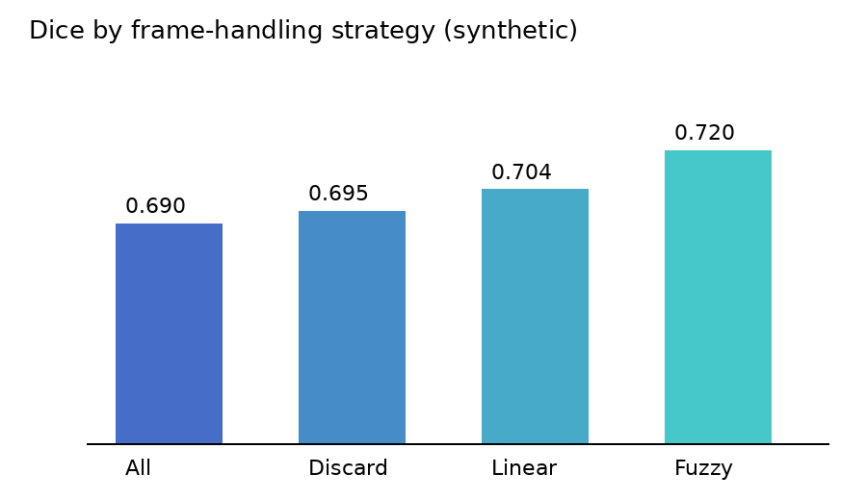
Results
Dice by strategy.
Notes:
The gap to linear is within one SD: say consistent, not large.

