Slide 1


MOBILĀS PROGRAMMATŪRAS INŽENIERIJA 2
6. lekcija
Inženierzinātņu fakultāte
Valmiera, 2019
Mg.sc.comp., Martins Jansevskis

Slide 2


Content
PhoneGap Development environment
Introduction into HTML, CSS and JavaScript
Events, Work with device
Notifications, Geolocation
PhoneGap Build
Storage options
- SQLite DataBase
- Local storage
Summary
Vidzemes Augstskola, Inženierzinātņu fakultāte

Slide 3
Content
PhoneGap Development environment
Introduction into HTML, CSS and JavaScript
Events, Work with device
Notifications, Geolocation
PhoneGap Build
Storage options
- SQLite DataBase
- Local storage
Summary
Vidzemes Augstskola, Inženierzinātņu fakultāte

Slide 4


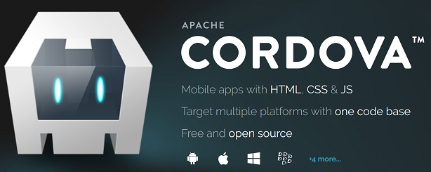
Development environment - 1
Adobe PhoneGap (Desktop App) 0.4.5
  and CLI environment as an alternative
Developer Mobile App
PhoneGap Build
Cross-platform solutions development
- on Mac, Windows and Linux OS computers
- required development tools are freely available on Web
* www.phonegap.com/products
* cordova.apache.org
Vidzeme University of Applied Sciences, Faculty of Engineering

Slide 5
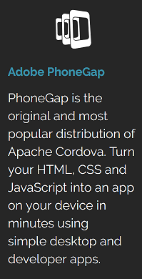
Development environment - 2
Vidzeme University of Applied Sciences, Faculty of Engineering

Slide 6
Content
PhoneGap Development environment
Introduction into HTML, CSS and JavaScript
Events, Work with device
Notifications, Geolocation
PhoneGap Build
Storage options
- SQLite DataBase
- Local storage
Summary
Vidzemes Augstskola, Inženierzinātņu fakultāte

Slide 7

Introduction into HTML, CSS and JavaScript - 1
HTML (Hypertext Markup Language ) - 1
- HTML is a rather simple language made up of elements
- Can be applied to:
* pieces of text to give them different meaning in a document
* structure a document into logical sections
* embed content (e.g. images, videos)
- Uses tags (e.g. <head> ... </head>, ... )
- Header, Body, ...
Vidzeme University of Applied Sciences, Faculty of Engineering

Slide 8
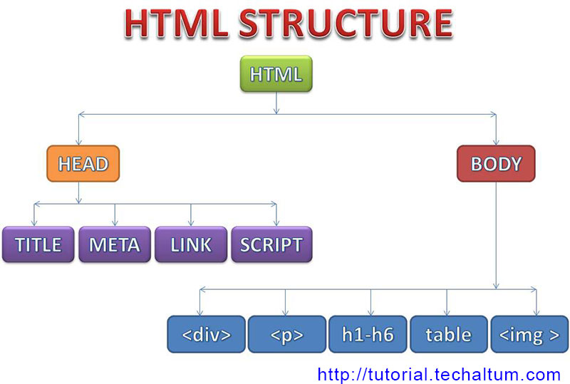
Introduction into HTML, CSS and JavaScript - 2
HTML (Hypertext Markup Language ) - 2
Vidzeme University of Applied Sciences, Faculty of Engineering

Slide 9
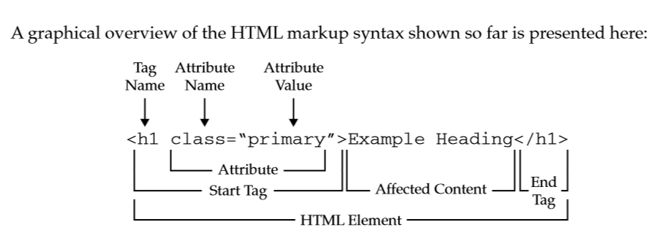

Introduction into HTML, CSS and JavaScript - 3
HTML (Hypertext Markup Language ) - 3
HTML elements reference
see more: https://developer.mozilla.org/en-US/docs/Web/HTML/Element
https://www.w3schools.com/html/default.asp
http://tutorial.techaltum.com/htmlTags.html
Vidzeme University of Applied Sciences, Faculty of Engineering

Slide 10

Introduction into HTML, CSS and JavaScript - 4
CSS (Cascading Style Sheets ) - 1
- CSS is a simple mechanism for adding style (e.g., fonts, ...) to Web documents
<!DOCTYPE html PUBLIC "-//W3C//DTD HTML 4.01 Transitional//EN"
"http://www.w3.org/TR/html4/loose.dtd">
<html>
<head>
<title> replace with your document's title </title>
<style type="text/css">
body { color: black; background: white; }
</style>
</head>
<body>
replace with your document's content
</body>
</html>
Vidzeme University of Applied Sciences, Faculty of Engineering

Slide 11
Introduction into HTML, CSS and JavaScript - 5
CSS (Cascading Style Sheets ) - 2
- Linking to a separate style sheet
<!DOCTYPE html PUBLIC "-//W3C//DTD HTML 4.01 Transitional//EN"
"http://www.w3.org/TR/html4/loose.dtd">
<html>
<head>
<title> replace with your document's title </title>
<link type="text/css" rel="stylesheet" href="style.css">
</head>
<body>
replace with your document's content
</body>
</html>
see more: https://www.w3.org/Style/CSS/
https://www.w3schools.com/css/default.asp
https://www.w3.org/MarkUp/Guide/Style
Vidzeme University of Applied Sciences, Faculty of Engineering

Slide 12

Introduction into HTML, CSS and JavaScript - 6
JavaScript - 1
- JavaScript is:
* client-side scripting language of web (developed by Netscape in 1995)
>> P.S. can be used also om server-side
* used to build interactive websites with dynamic features and to validate form data
* high-level, dynamic and browser interpreted, supported by all modern web browsers
Vidzeme University of Applied Sciences, Faculty of Engineering

Slide 13
Introduction into HTML, CSS and JavaScript - 7
JavaScript – 2.1
- JavaScript :
* was designed to add interactivity to HTML pages
* Object Based
* Case Sensitive
* can put dynamic content into a HTML page
* can react to events like click, mouse over, form submit etc.
* can validate form data
* can detect user browser
* can be used to create cookies
Vidzeme University of Applied Sciences, Faculty of Engineering

Slide 14
Introduction into HTML, CSS and JavaScript - 8
JavaScript – 2.2
- JavaScript :
* can also be used to:
draw shapes, graphs,
create animations and
games development using HTML5 Canvas
* at present, JavaScript has lot of libraries and framework (e.g. JQuery, Angular JS, React JS, Backbone JS etc.)
* can also be used in developing server side application using Node JS
Vidzeme University of Applied Sciences, Faculty of Engineering

Slide 15
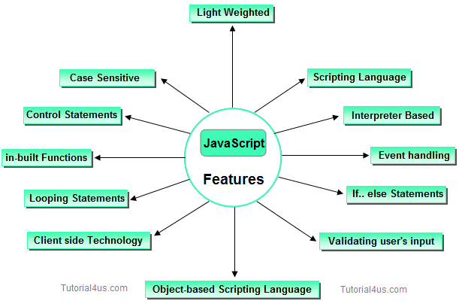
Introduction into HTML, CSS and JavaScript - 9
JavaScript - 3
Vidzeme University of Applied Sciences, Faculty of Engineering

Slide 16
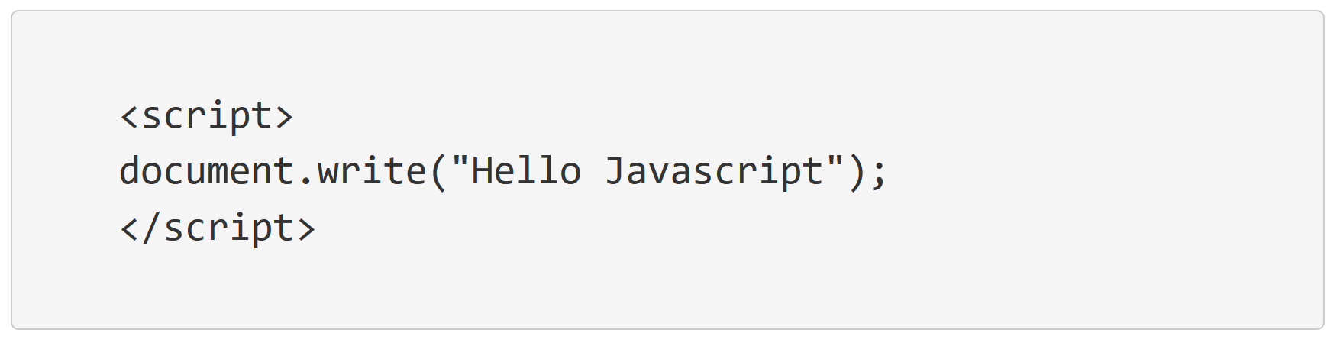
Introduction into HTML, CSS and JavaScript - 10
JavaScript - 4
- Internal JavaScript
* JavaScript code is written inside head or body within <script> tag
Vidzeme University of Applied Sciences, Faculty of Engineering

Slide 17
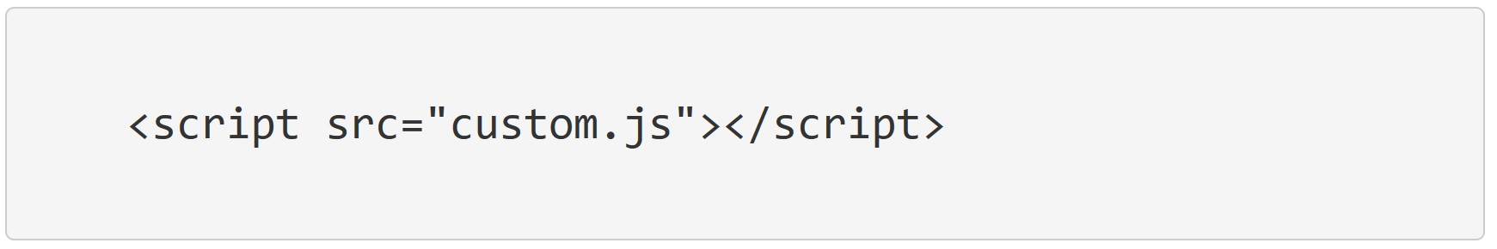
Introduction into HTML, CSS and JavaScript - 11
JavaScript - 5
- External JavaScript
* JavaScript code is written in external file with extension .js and then linked with script tag
Vidzeme University of Applied Sciences, Faculty of Engineering

Slide 18
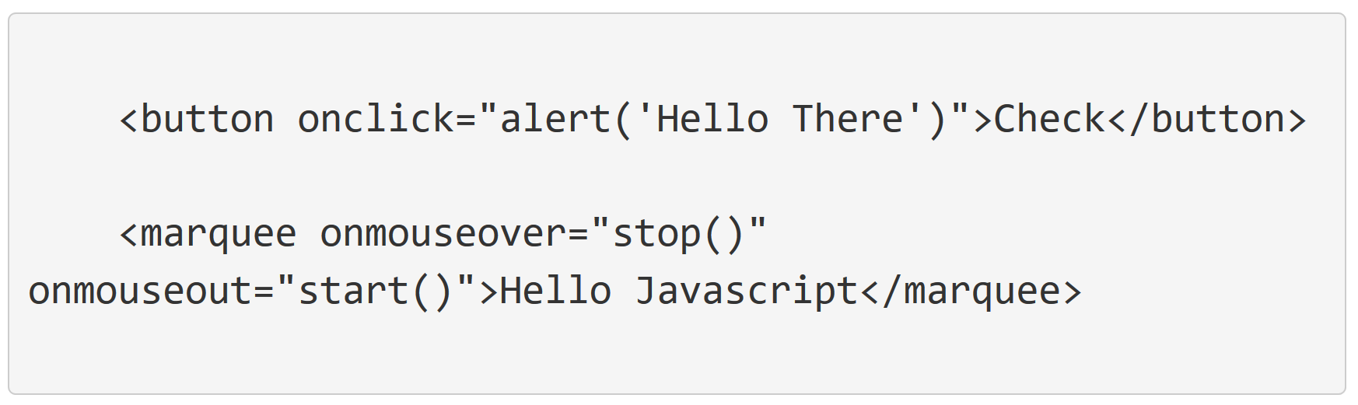
Introduction into HTML, CSS and JavaScript - 12
JavaScript - 6
- Inline JavaScript
* JavaScript code is written directly inside html tags. This is not recommended!
Script should be written in separate file ( external) or in <script> tag
Vidzeme University of Applied Sciences, Faculty of Engineering

Slide 19
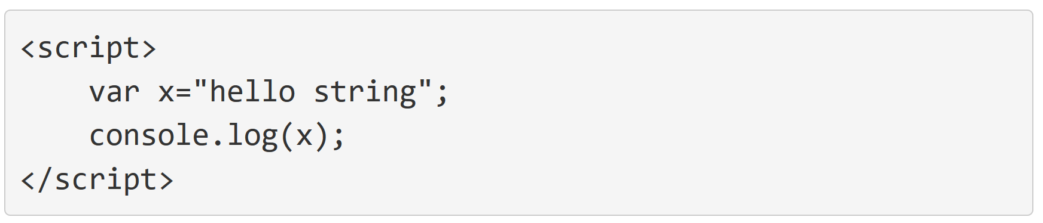
Introduction into HTML, CSS and JavaScript - 13
JavaScript - 7
- Console.log in Javascript
* To print output data in console window of browser. Use console.log() Any syntax error in JavaScript is shown in console window.
* To clear console, use console.clear()
Vidzeme University of Applied Sciences, Faculty of Engineering

Slide 20
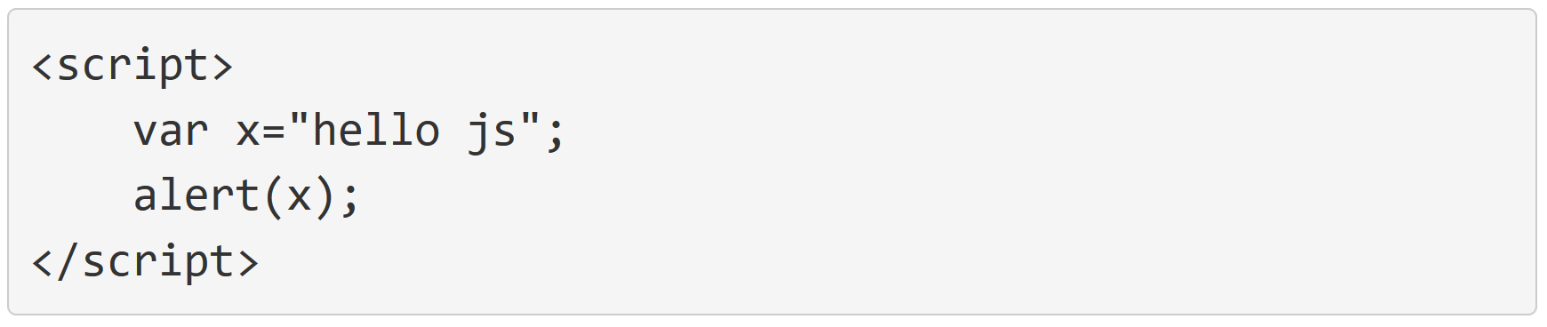
Introduction into HTML, CSS and JavaScript - 14
JavaScript - 8
- JavaScript Dialog Boxes (3):
* alert (i.e. used to show output in dialog box;
Alert generally block the code, thus next
code block will run only after alert is closed)
Vidzeme University of Applied Sciences, Faculty of Engineering

Slide 21
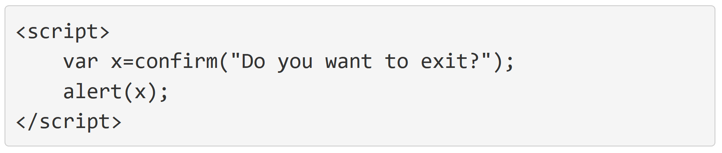
Introduction into HTML, CSS and JavaScript - 15
JavaScript - 9
- JavaScript Dialog Boxes (3):
* confirm() (i.e. used to get confirmation from user.
This will show Ok or Cancel in dialog box)
Vidzeme University of Applied Sciences, Faculty of Engineering

Slide 22
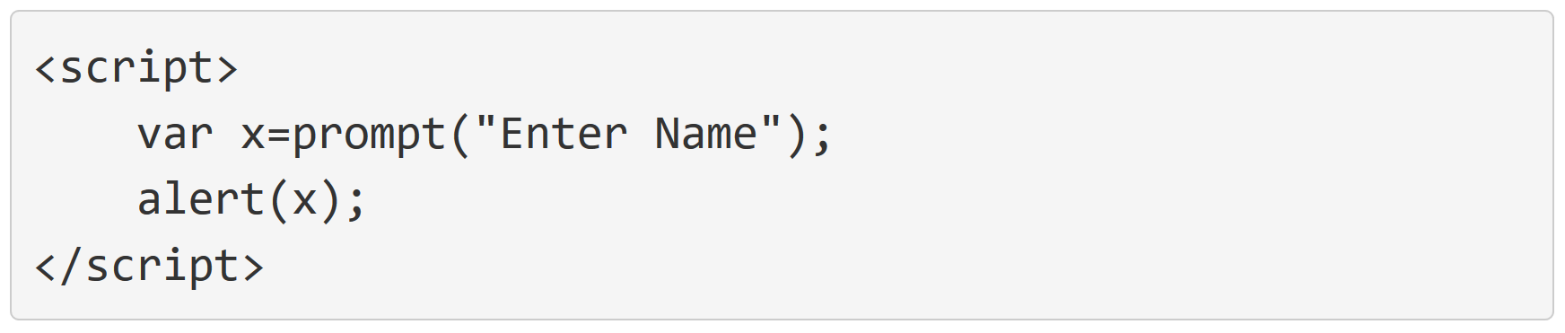
Introduction into HTML, CSS and JavaScript - 16
JavaScript - 10
- JavaScript Dialog Boxes (3):
* prompt() (i.e. or window.prompt() - used to receive input from user)
see more: https://www.w3schools.com/js/default.asp
http://tutorial.techaltum.com/javascript.html
Vidzeme University of Applied Sciences, Faculty of Engineering

Slide 23
Content
PhoneGap Development environment
Introduction into HTML, CSS and JavaScript
Events, Work with device
Notifications, Geolocation
PhoneGap Build
Storage options
- SQLite DataBase
- Local storage
Summary
Vidzemes Augstskola, Inženierzinātņu fakultāte

Slide 24
Events - 1
Events
- simple definition: any action that can be detected by PhoneGap
- PhoneGap events are similar to JavaScript events
* e.g. an action has occured on device (e.g. DOM has loaded and thus device is «ready»)
* and other similar events (like rollover) are available also in PhoneGap
- some events are specific, e.g.:
* backbutton * menubutton * searchbutton
* deviceready * pause * resume
* online * offline
Vidzeme University of Applied Sciences, Faculty of Engineering

Slide 25
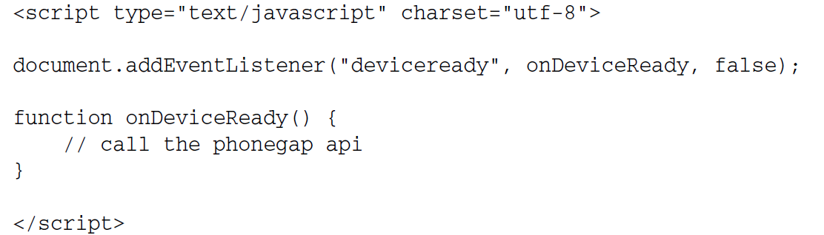
Events - 2
Events listener
Vidzeme University of Applied Sciences, Faculty of Engineering

Slide 26
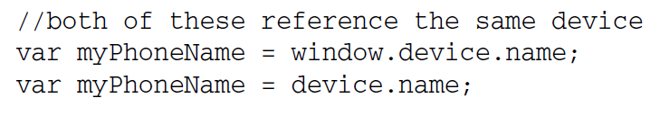
Work with Device - 1
Runtime object device
- device.name - name of the device (e.g. mySNote)
- device.platform - the type of device
- device.uuid - the unique number of the device
- device.version - the version of the OS that is running
- Device is assigned to window object
Vidzeme University of Applied Sciences, Faculty of Engineering

Slide 27
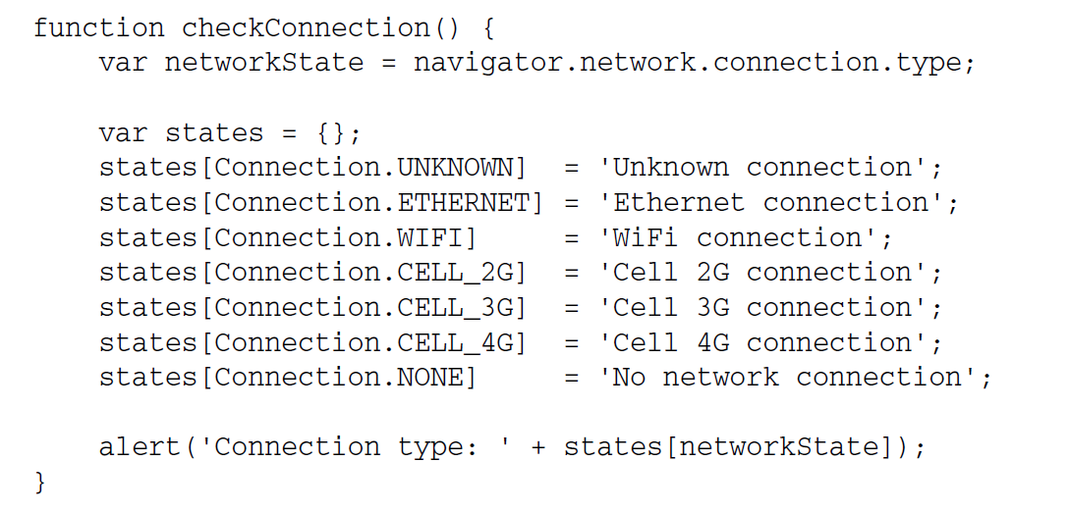
Work with Device - 2
Checking for a network
Vidzeme University of Applied Sciences, Faculty of Engineering

Slide 28
Content
PhoneGap Development environment
Introduction into HTML, CSS and JavaScript
Events, Work with device
Notifications, Geolocation
PhoneGap Build
Storage options
- SQLite DataBase
- Local storage
Summary
Vidzemes Augstskola, Inženierzinātņu fakultāte

Slide 29
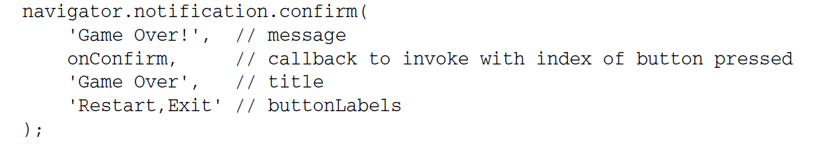

Notifications - 1
Using Notifications
- Alerts
- Confirmation dialogs (i.e. contains several buttons)
- Beeps
- Vibrations
NOTE: see also Cordova Plugin for Vibration
Vidzeme University of Applied Sciences, Faculty of Engineering

Slide 30

Geolocation - 1
Using Geolocation
identification of a real-world geographic location of device
approaches used:
* GPS
* IP address
* RFID (Radio Frequency Identification)
* WiFi Media Access Control (MAC) address
* Cell tower triangulation
Vidzeme University of Applied Sciences, Faculty of Engineering

Slide 31
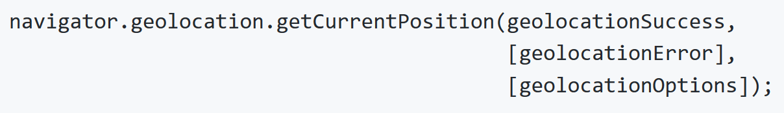
Geolocation - 2
Using Geolocation
Objects (Read-Only)
* Position
* PositionError
* Coordinates
Parameters
* geolocationSuccess: The callback that is passed the current position
* geolocationError: (Optional) The callback that executes if an error occurs
* geolocationOptions: (Optional) The geolocation options
Vidzeme University of Applied Sciences, Faculty of Engineering

Slide 32
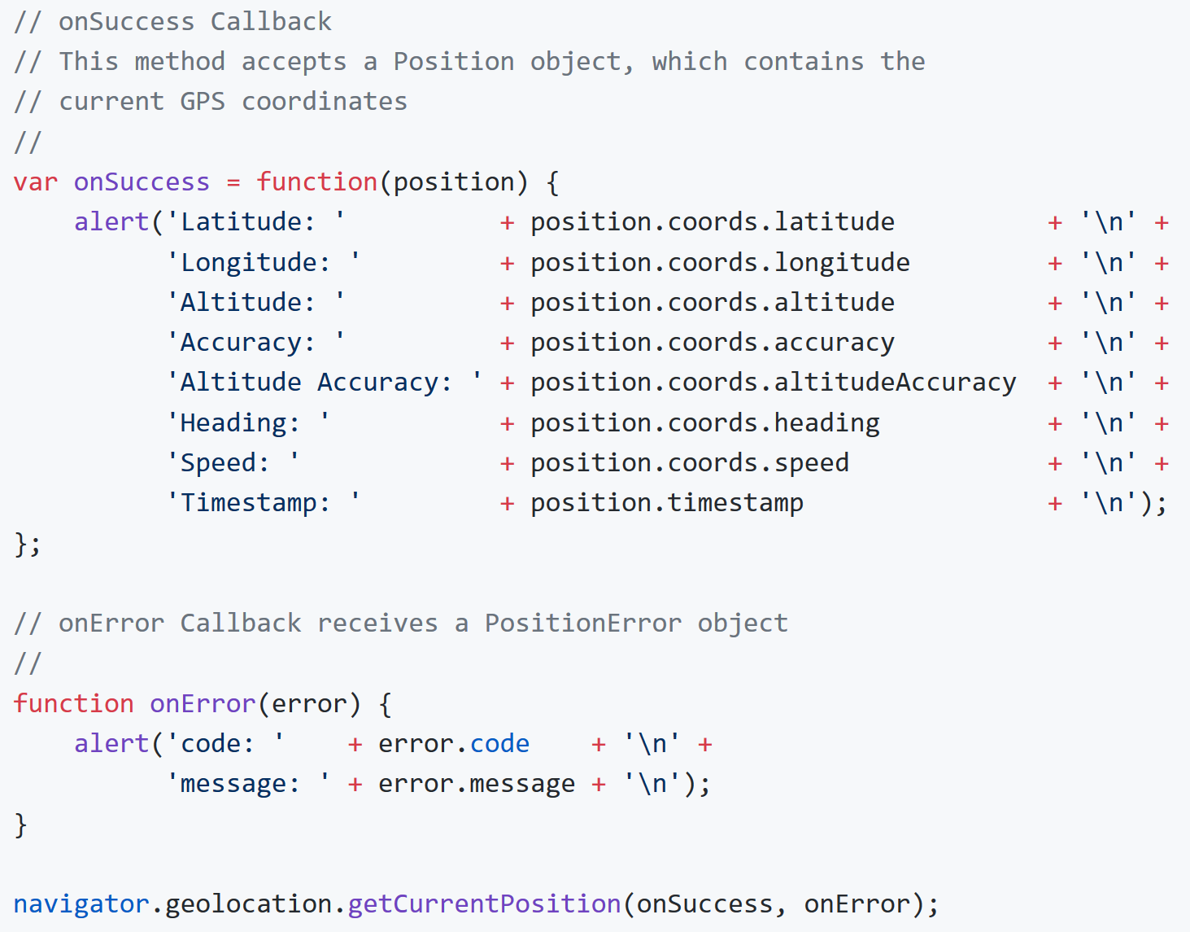
Geolocation - 3
Using Geolocation (parameters)
Vidzeme University of Applied Sciences, Faculty of Engineering

Slide 33
Content
PhoneGap Development environment
Introduction into HTML, CSS and JavaScript
Events, Work with device
Notifications, Geolocation
PhoneGap Build
Storage options
- SQLite DataBase
- Local storage
Summary
Vidzemes Augstskola, Inženierzinātņu fakultāte

Slide 34
PhoneGap Build - 1
PhoneGap Build - a cloud service for compiling PhoneGap applications:
- each mobile app store provides a different toolchain
- each PhoneGap release is compatible with a specific set of tools
→ thus PhoneGap Build comes in to the picture to help
Vidzeme University of Applied Sciences, Faculty of Engineering

Slide 35
PhoneGap Build - 2
Uploading HTML5, CSS, and JavaScript assets to the Adobe PhoneGap Build
Compiling
Supporting multiple platforms
- Android
- iOS
- Windows Phone 8
Adding team members to PhoneGap Build
Sharing apps (i.e. via a link )
Vidzeme University of Applied Sciences, Faculty of Engineering

Slide 36
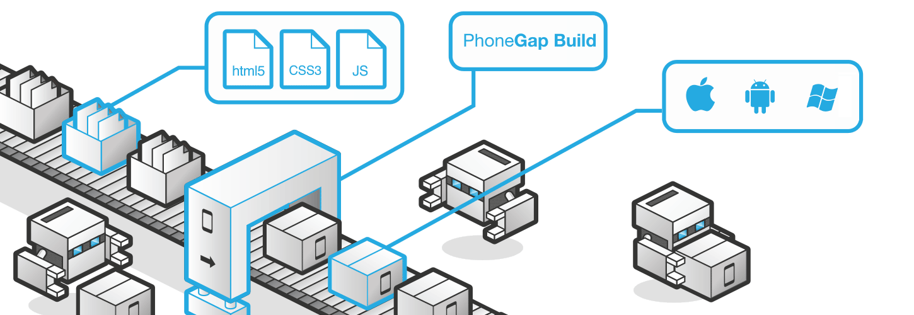
PhoneGap Build - 3
https://build.phonegap.com/
Vidzeme University of Applied Sciences, Faculty of Engineering

Slide 37
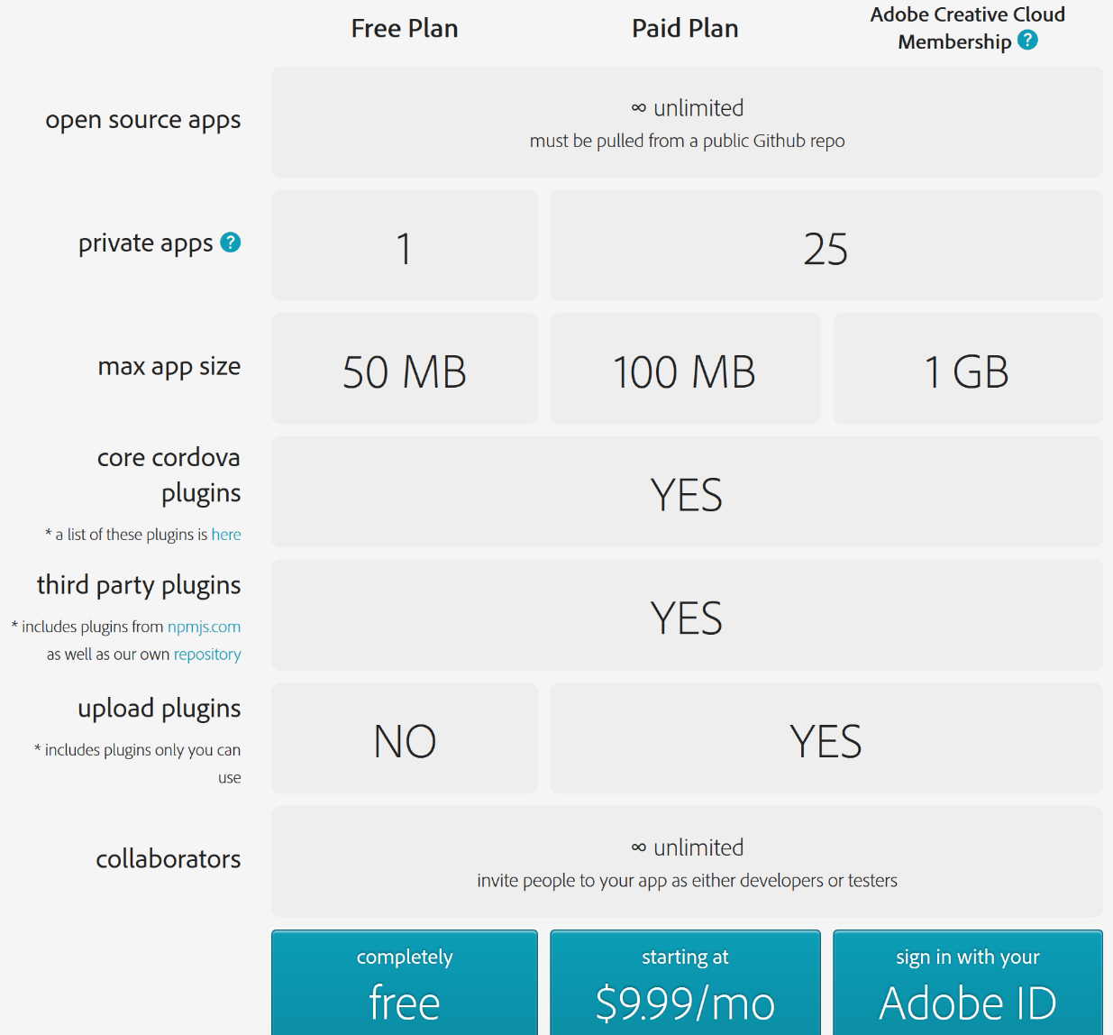
PhoneGap Build - 4
Sign Up –
Plans available
Vidzeme University of Applied Sciences, Faculty of Engineering

Slide 38
PhoneGap Build - 5
Preparing the Assets
- uses an open packaging model
(i.e. W3C Widget Packaging specification: www.w3.org/TR/widgets/ )
Consists of:
- config.xml
- web assets (e.g. html, js, css, images, …)
NOTE – not to upload:
- native app code files (.c, .h, .m, java, …)
- phonegap.js or plugin files
Vidzeme University of Applied Sciences, Faculty of Engineering

Slide 39
PhoneGap Build - 6
How to struture the App
- minimum requirement: index.html
- normally: app's JavaScript files, splash screen and icon images, media files, and any other ones
In package - App configuration file: config.xml
see more: http://docs.phonegap.com/phonegap-build/getting-started/app-project-structure
http://docs.phonegap.com/phonegap-build/configuring
http://docs.phonegap.com/phonegap-build
Vidzeme University of Applied Sciences, Faculty of Engineering

Slide 40
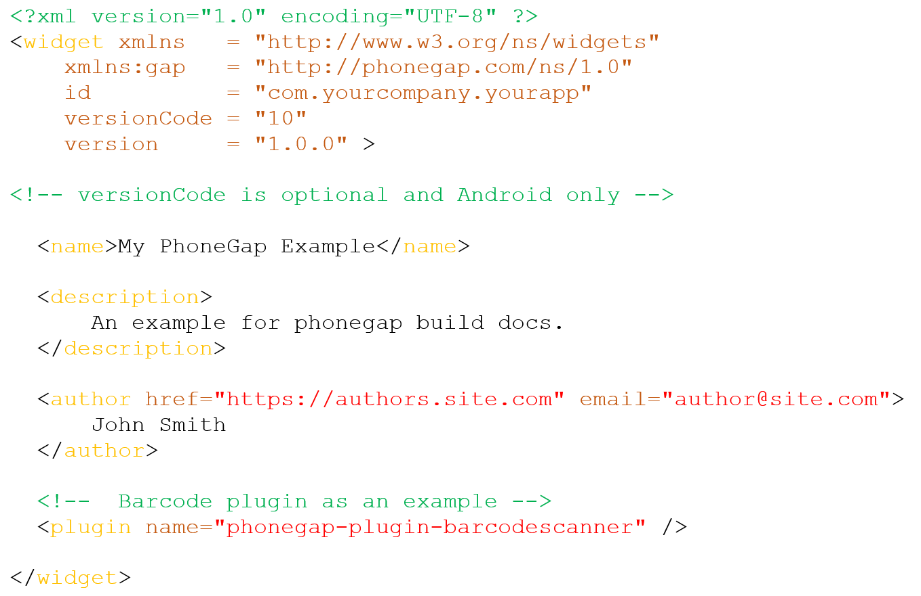
PhoneGap Build - 7
Example config.xml
Vidzeme University of Applied Sciences, Faculty of Engineering

Slide 41
Content
PhoneGap Development environment
Introduction into HTML, CSS and JavaScript
Events, Work with device
Notifications, Geolocation
PhoneGap Build
Storage options
- SQLite DataBase
- Local storage
Summary
Vidzemes Augstskola, Inženierzinātņu fakultāte

Slide 42
SQLite DataBase - 1
SQLite database (DB) created by openning it;
to open: window.openDatabase()
Four arguments:
name – name to give to DB;
version – version of DB;
displayname – display name of the DB;
size – size of the DB in bytes.
Vidzeme University of Applied Sciences, Faculty of Engineering

Slide 43
SQLite DataBase - 2
Running SQL Query
SQLTransaction object is used (i.e. has methods to execute SQL statements);
Dropping table (if exists):
Create:
Insert:
Delete:
Vidzeme University of Applied Sciences, Faculty of Engineering

Slide 44
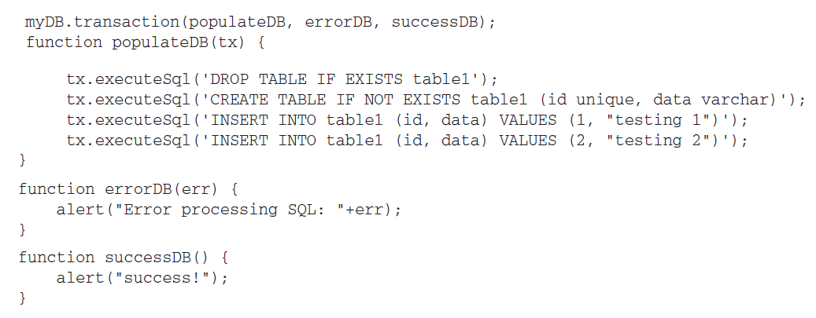
SQLite DataBase - 3
Transaction
Vidzeme University of Applied Sciences, Faculty of Engineering

Slide 45
SQLite DataBase - 4
Result Set - 1
executeSQL()method also provides success and error callbacks
Result set seen in success callback – we get SQLResultSet object
with properties:
insertId – row ID (only if insert statement is run)
rowAffected – number of rows that were changed by SQL statement
rows – is a SQLResultSetRowList representing the rows returned
Vidzeme University of Applied Sciences, Faculty of Engineering

Slide 46
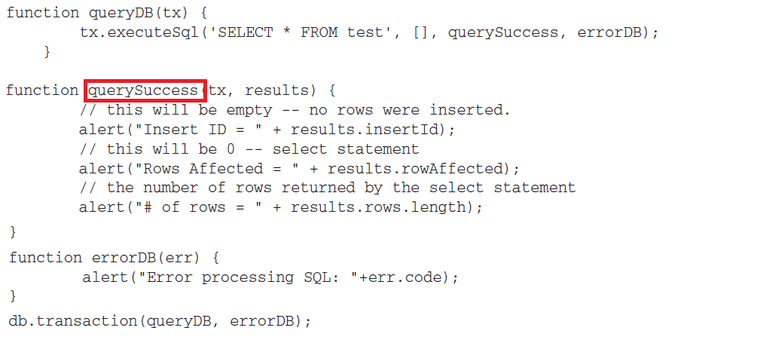
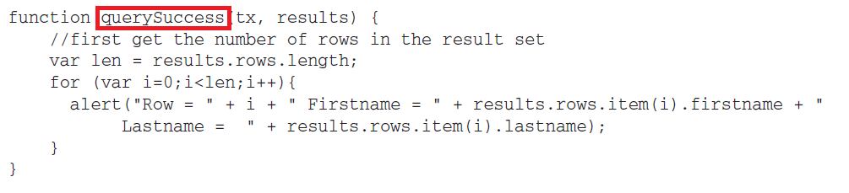
SQLite DataBase - 5
Result Set - 2
OR
Vidzeme University of Applied Sciences, Faculty of Engineering

Slide 47
Content
PhoneGap Development environment
Introduction into HTML, CSS and JavaScript
Events, Work with device
Notifications, Geolocation
PhoneGap Build
Storage options
- SQLite DataBase
- Local storage
Summary
Vidzemes Augstskola, Inženierzinātņu fakultāte

Slide 48
Local Storage - 1
Object localStorage
This object has 5 methods:
key – returns the name of the key at the position specified
getItem – returns the item identified by its key
setItem – saves an item at the key provided
removeItem – removes an item identified by the given key
clear – removes all the key/values pairs
Vidzeme University of Applied Sciences, Faculty of Engineering

Slide 49

Local Storage - 2
Examples - 1:
to retrieve key at position 5:
to store a value:
to retrieve value:
to remove an item:
to clear out all keys:
Vidzeme University of Applied Sciences, Faculty of Engineering

Slide 50
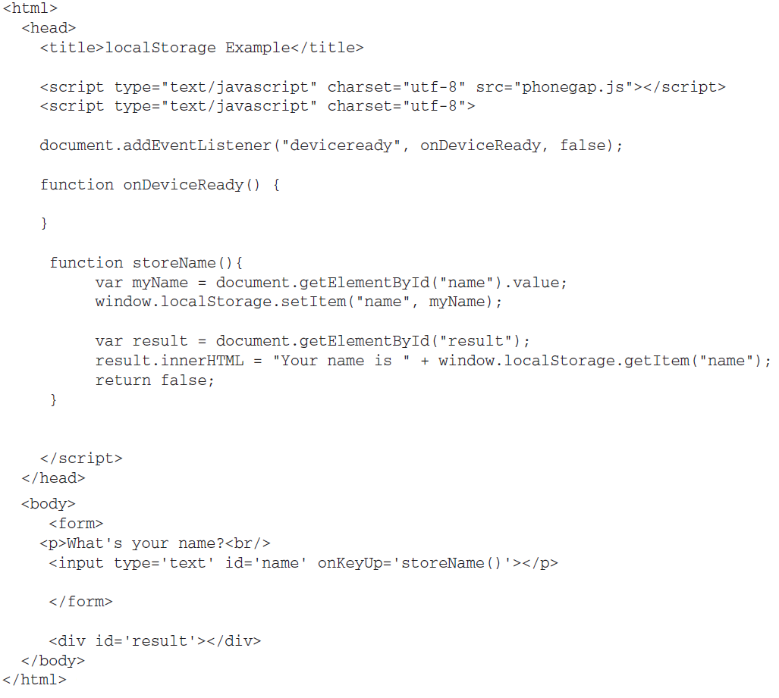
Local Storage - 3
Example – 2:
Vidzeme University of Applied Sciences, Faculty of Engineering

Slide 51
Summary
PhoneGap Development environment
Introduction into HTML, CSS and JavaScript
Events, Work with device
Notifications, Geolocation
PhoneGap Build
Storage options
- SQLite DataBase
- Local storage
Vidzemes Augstskola, Inženierzinātņu fakultāte

