Slide 1
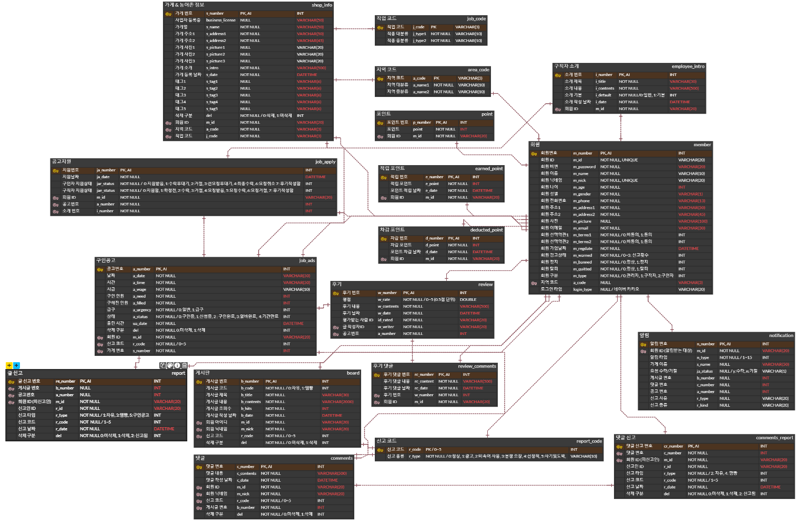
Part 4
ERD

Slide 2

