Slide 1
GitOps using Flux
Christoph Pfleger
Luis Nachtigall

Slide 2
Current Situation
Using Git for code versioning
Running images in a cluster
Issues:
Manual deployment to the cluster
No desired state versioning
Solutions:
}
Flux
Manual code testing
Manual image generation
}
GitHub CI Workflow

Slide 3
GitOps Principles
Declarative
A system managed by GitOps must have its desired state expressed declaratively.
Versioned and Immutable
Desired state is stored in a way that enforces immutability, versioning and retains a complete version history.
Pulled Automatically
Software agents automatically pull the desired state declarations from the source.
Continuously Reconciled
Software agents continuously observe actual system state and attempt to apply the desired state.
[Source: lecture slide pdf 4 / https://opengitops.dev/]

Slide 4





Technologies

Slide 5
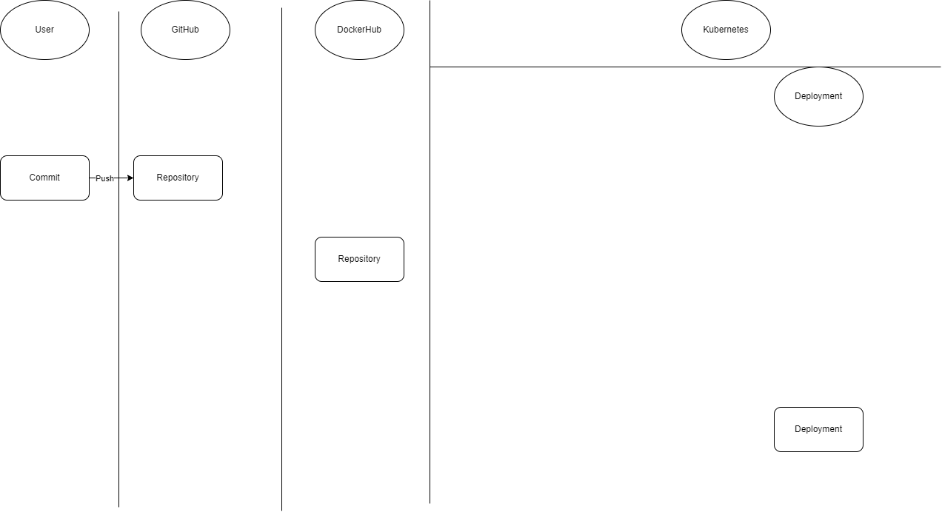
Flux
Notes:
Initial Setup
Everything separate
Connections between them manual

Slide 6
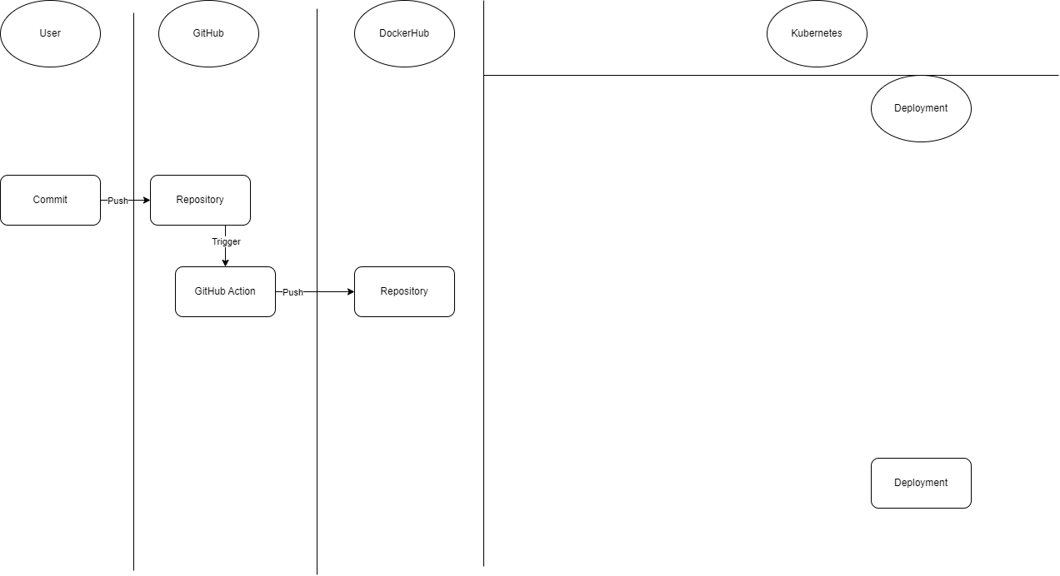
Flux
Notes:
Add GitHub action for Continuous Integration
automate code Testing and image Generation
already done in lecture, not too interesting
next: add connection between git repo and cluster

Slide 7
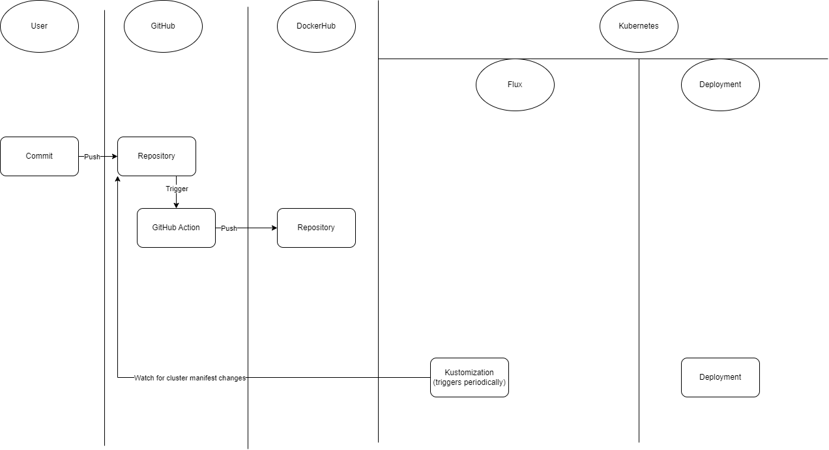
Flux
Notes:
Add flux to cluster
Establish connection between repository and cluster

Slide 8
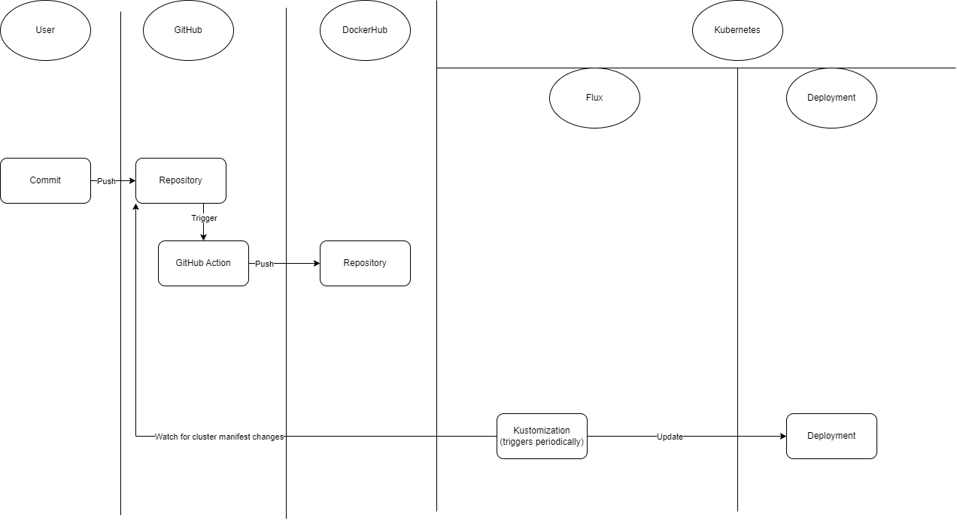
Flux
Notes:
Repository is now the main authority on what should be running in the cluster
If flux notices any changes to manifests => update deployment, do rollout
Already GitOps
now add image updates

Slide 9
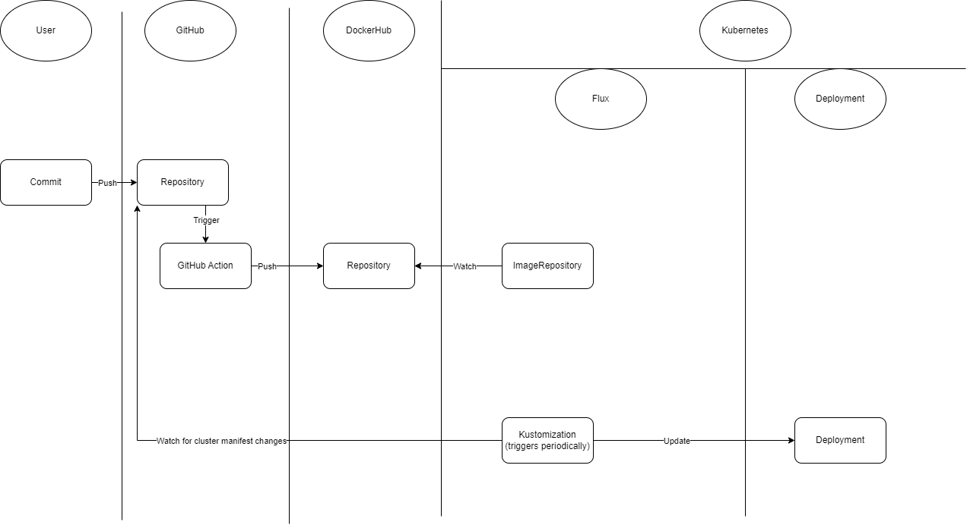
Flux
Notes:
Automatic Image deployment
First: watch docker repository for new versions
don’t want indiscriminate updates, therefore add policy

Slide 10
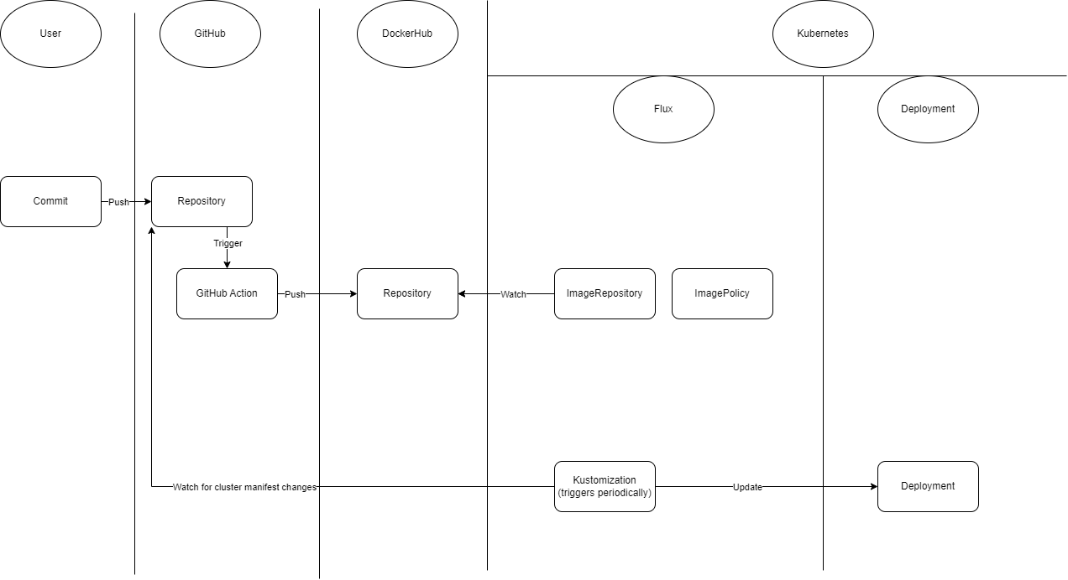
Flux
Notes:
Specify a policy, eg update to new bug fix versions
if new version in ImageRepository matches policy => update deployment, do rollout
Drawback: lose versioning of which version is being used (in git repo)

Slide 11
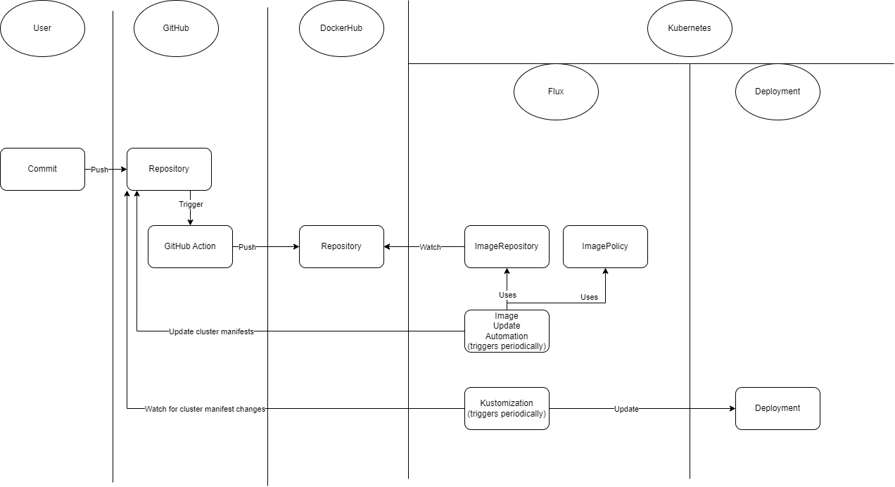
Flux
Notes:
Add Image update automation, watches the policies for any updates they perform
if updated => send commit with new version to repo

Slide 12
Live Demo
Notes:
Already set-up for the repo
show increasing number of pods => confirm in console
show generating a new image => confirm in console

Slide 13
Lessons Learned
Flexibility of GitHub Actions
disable CI for changes by Flux
Versatility of deployments
monitor outside resources for updates
Importance of pre-planning
everything has to work together

Slide 15
Expansion
Integration into e.g. GitFlow
Better branch structure
More sophisticated GitHub Actions
Webhooks instead of polling
Full CD pipeline
External tests cluster
e.g. Jenkins Integration

Slide 16
References
https://fluxcd.io/flux/get-started/
https://fluxcd.io/flux/guides/image-update/
https://fluxcd.io/flux/use-cases/gh-actions-app-builder/
https://fluxcd.io/flux/guides/repository-structure/
https://docs.github.com/de/actions

