Slide 1
IS 112: ICT for Development
Lecture 5:
Approaches for ICT4D
Project Design
Instructors: Dr. H. Mongi & Mr O. Shadrack

Slide 2
Contents
Recap
Introduction
Categories of ICT4D Design Approaches
ICT4D Design Approaches
Selecting ICT4D Design Approach
Notes:
Agenda

Slide 3
Recap
3

Slide 4
Recap: Overview
  National framework policies and sector policies
  Policy
  Laws & Regulations
  National and sector-wise legal and regulatory framework
  Strategies
  National and sector-wise strategic framework
  Programmes
  Long-term implementation of the strategy
  Projects
  Short-term implementation of the strategy
4

Slide 5
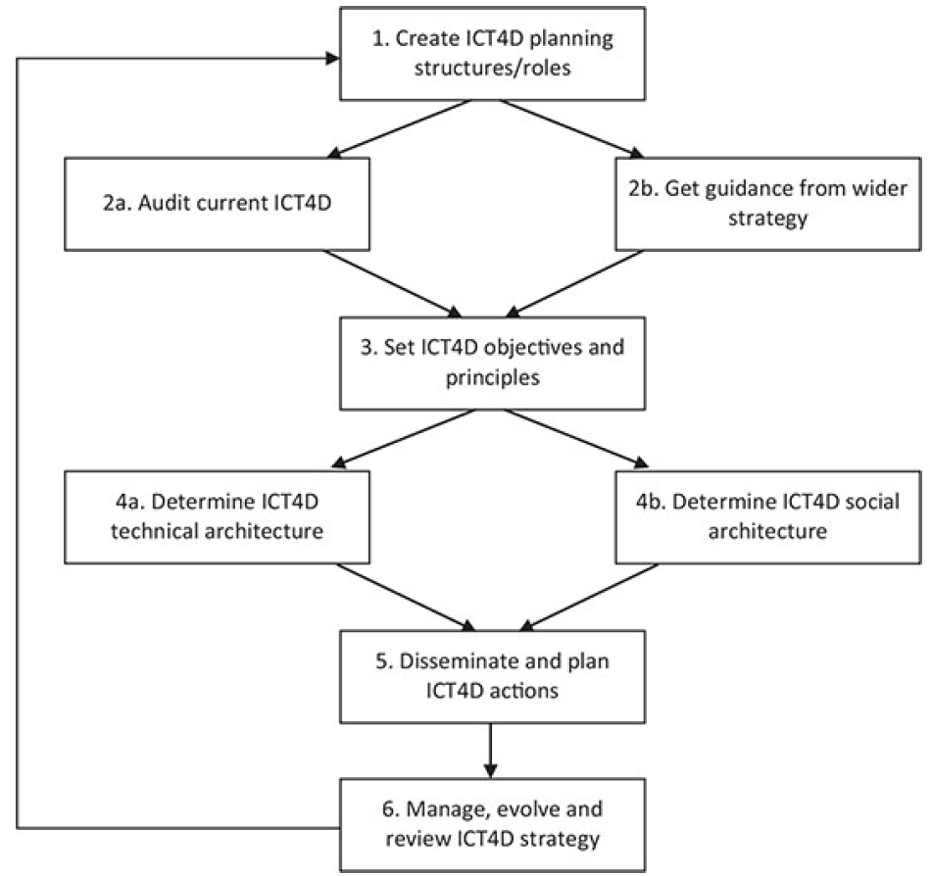
Recap: ICT4D Strategy
  The steps of ICT4D strategy
5

Slide 6

Recap: ICT4D Projects
  Design of ICT4D Project: The Process
Involve users
Informing, consulting, cooperating, co-creating, producing, controlling. Advantages?
Iterate
Use, modify, and extend existing tools, platforms, and frameworks when possible.
Make evidence-based decision
Move from subjective to the reflective and objective decision making.
6

Slide 7
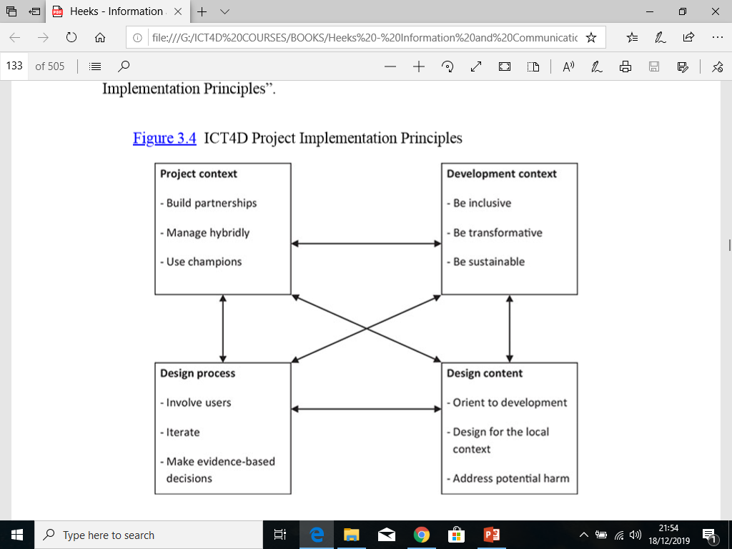
Recap: ICT4D Projects…
  ICT4D Project Implementation Principles
7

Slide 8
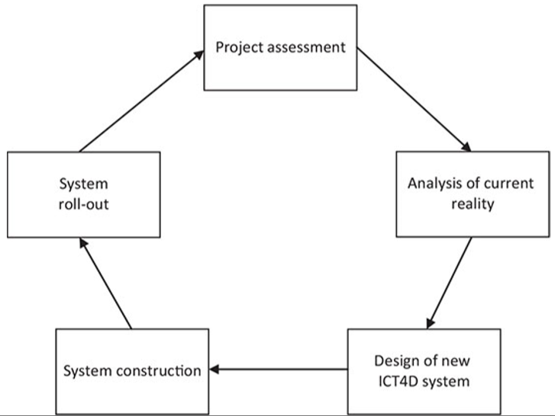
Recap: ICT4D Projects…
Problems and opportunities; possible ICT4D projects; basic project parameters; and feasible
  ICT4D Project Lifecycle
Training users; acquiring data; introducing the new system
Technology, capabilities, context, needs, issues
    Principles
Acquiring any new technological infrastructure; building and testing the new system
Setting objective; describing in general and then specific technical and social elements
8

Slide 9
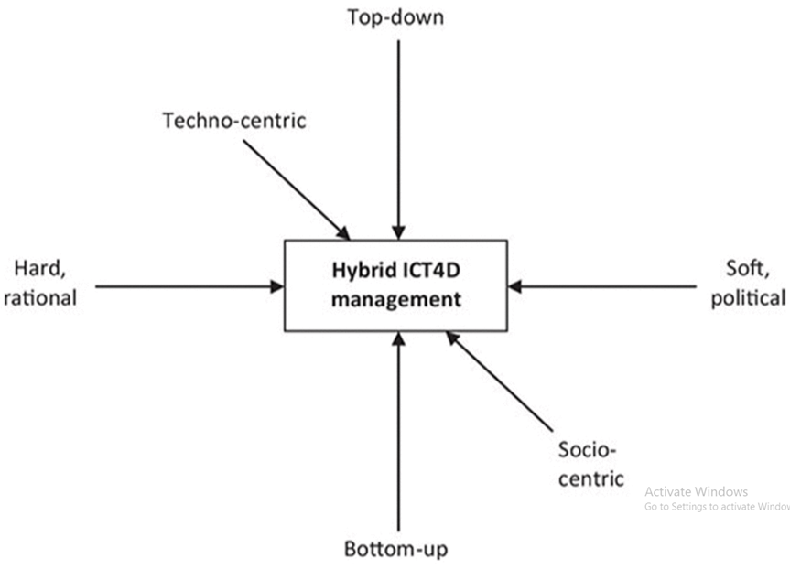
Recap: ICT4D Projects…
  ICT4D Project Management
  The Hybrid Model
Three tension that the manager face.
9

Slide 10
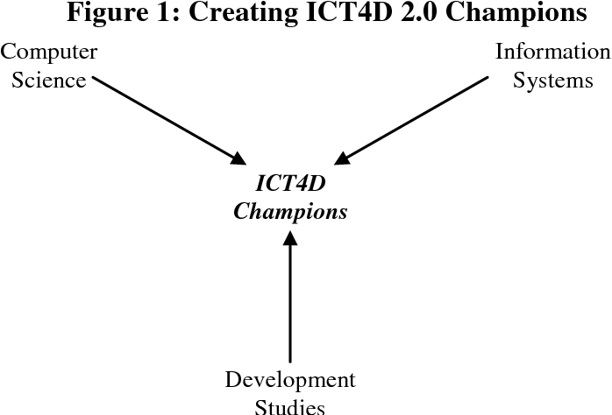
ICT4D Projects…
  ICT4D Project Management
  The Use of Champions
The person (or group) who drives the ICT4D initiative forward and seeks to justify its implementation
10

Slide 11

Recap: Design – Reality Gap
    Design-Reality Gap framework was developed by Heeks (2002)
11

Slide 12
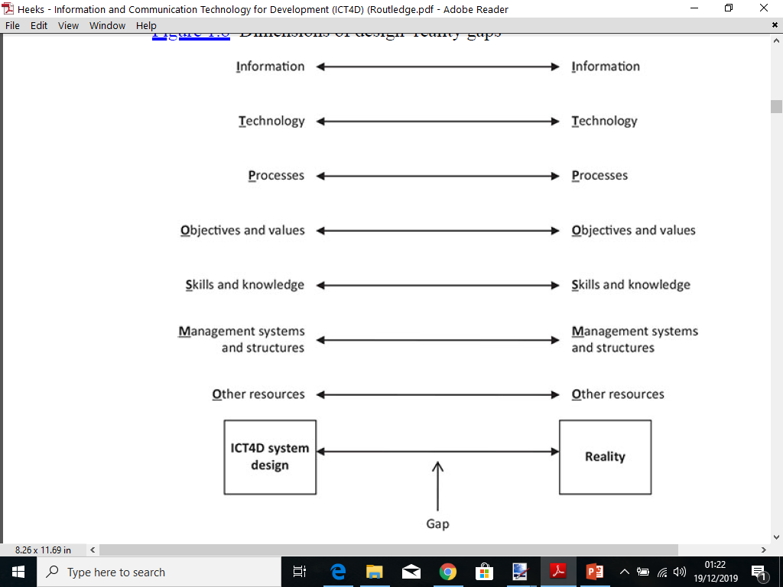
Recap: Design – Reality Gap…
  The core concept is that a gap may exist between the design of an ICT4D application and the contextual realities into which it is introduced.
12

Slide 13
Recap: Design – Reality Gap…
  The larger that gap, the greater the risk that the ICT4D application will fail.
  There are various ways in which the gap between design and reality could be understood but it is most typically assessed on seven “ITPOSMO” dimensions.
1. Information
4. Objectives and values
7. Other resources
2. Technology
5. Skills and knowledge
3. Processes
6. Management systems and structures
13

Slide 14

Closing the Gap
  How to close the gap?
Finck, 2005
14

Slide 15


Recap– Progress
Sem. Wk | Date | Lecture/Seminar | Description
1 | 08th Nov. | No Lecture | Registration
2 | 15th Nov. | Pre -Lecture | Course Outline
3 | 22nd Nov. | Lecture 1 | Overview of ICT4D
4 | 29th Nov. | Lecture 2 | Cases of ICT4D Projects
5 | 06th Dec. | Lecture 3 | Information Provision and Dev. Impact
6 | 13th Dec. | Lecture 4 | Design-Reality Gap
7 | 20th Dec. | No Lecture | Test 1
24th Dec 2023 to 1st January 2024 – Academic recess.
8 | 03rd Jan. | Seminar 1 | Case Study Group Presentations I
9 | 10th Jan. | Lecture 5 | Approaches for ICT4D
10 | 17th Jan. | Lecture 6 | Success Factors for ICT4D Projects
11 | 24th Jan. | Seminar 2 | Case Study Group Presentations II
12 | 31st Jan. | No Lecture | Test 2
13 | 07th Feb. | Seminar 3 | Case Study Group Presentations III
14 | 14th Feb. | Lecture 7 | MDGs/SDGs and ICT4D
15 | 21st Feb. | Seminar 4 | Case Study Group Presentations IV
16-17 | 26th Feb – 08th Mar. |  | University Examinations
Notes:
15

Slide 16
Introduction
16

Slide 17

Introduction
Figure out what problem your users want to solve – not what solution they want!
If I had asked people
what they wanted,
they would have said,
“Faster horses! "
Creating the solution is your job!
  Henry Ford (1863 -1947)
Notes:
Before you can work solution-oriented, you need to do work problem-oriented!

Slide 18
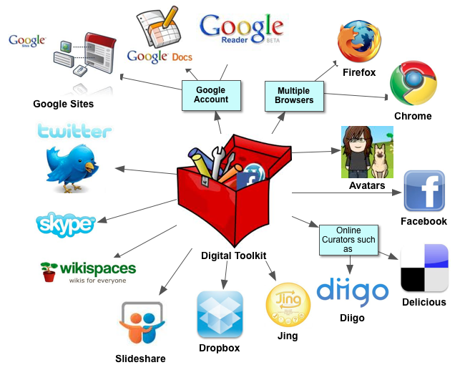
Introduction…
    ICTs can enhance capabilities for human development when applied with foresight, clear objectives, a firm understanding of the obstacles that exist in each context and proper policies that establish an institutional framework that promote the use and benefits of ICTs for the poor.
18

Slide 19

Introduction…
  1. Foresight
  Projecting the future of the ICT4D solution likely to be developed and implemented. For example:
  The technologies for the future: Block chain, Big Data, Data Science;
  Mobility of the future: Flying trains (400 mph);
  Medicine of the future: Telemedicine;
  Education of the future: Virtual.
19

Slide 20
Introduction…
  2. Objectives
  Clear [unambiguous] and SMART [Simple, Measurable, Achievable, Realistic, Time-bound] objectives. Education of the future: Virtual.
  3. Context
  Addressing the contextual obstacles [social, cultural, economic, environmental]
  4. Content
  Define institutional framework [legal, regulatory, structural and operational procedures] which determine the use and benefits of an ICT4D solution.
20

Slide 21
Introduction
  ICT4D design approaches therefore helps to ensure that the application requirements for ICT to enhance capabilities of human development are in place.
21

Slide 22
Categories of ICT4D Design Approaches
22

Slide 23
Categories ICT4D Design Appr.
  Categories of ICT4D Design Approaches in a Nutshell
  Human - Centered design approaches.
  Supply versus Demand-Driven approaches.
  User-Oriented approaches.
  Hard and Soft approaches.
23

Slide 24
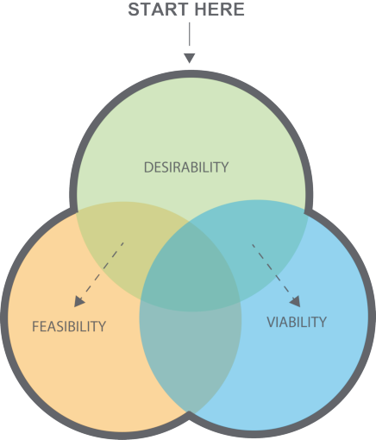
Categories ICT4D Design Appr…
  1. Human-Centered Approaches
  HCA are philosophical and methodological approaches to design that focus on users and their contexts of use throughout the planning, design, implementation and reflective phases of a design solution
  Consists of three lenses that put human interests at the centre.
24

Slide 25
Categories ICT4D Design Appr…
  1. Human-Centered Approaches …
  HCA suggests that when resolving problems, design should first seek to generate solutions that are:
              Desirable to people in that they meet their needs;
              Viable, in that solutions are financially and environmentally sustainable, and;
              Feasible in the sense that the solution can be produced on a technological level, that the technology is appropriate for the people who will use it, and lastly that the solution is socially and culturally appropriate.
25

Slide 26
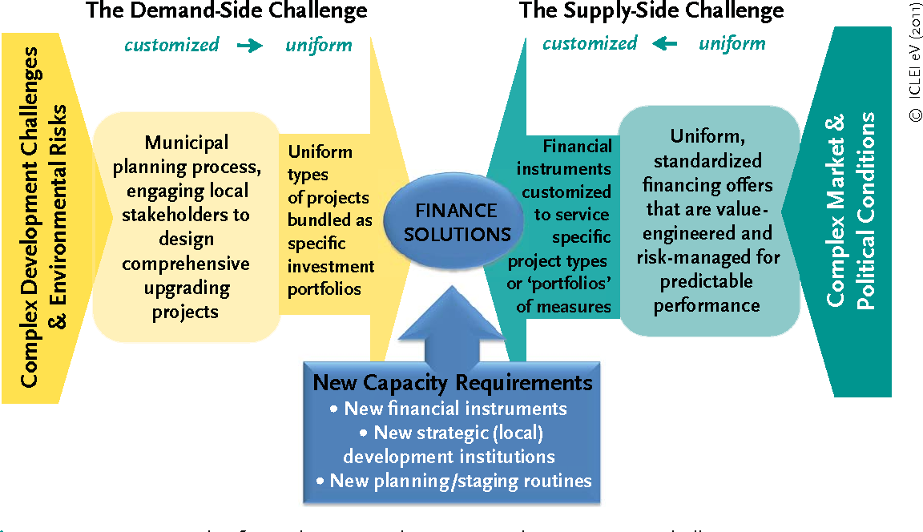
Categories ICT4D Design Appr…
  2. Supply versus Demand-Driven approaches
  SDDA suggests that when resolving development problems, design should identify challenges from both supplying and receiving sides
  Also negotiate for the optimum solution.
26

Slide 27
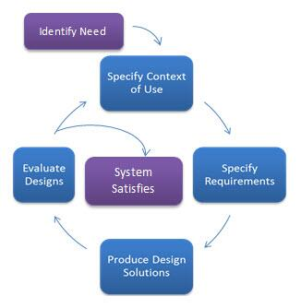
Categories ICT4D Design Appr…
  3. User-Oriented approaches
  User-oriented/centered design starts with identification of user needs
  Then iterative phases of specifying context, requirements, design, and evaluate designs
  It ends if the designs satisfy the user.
27

Slide 28
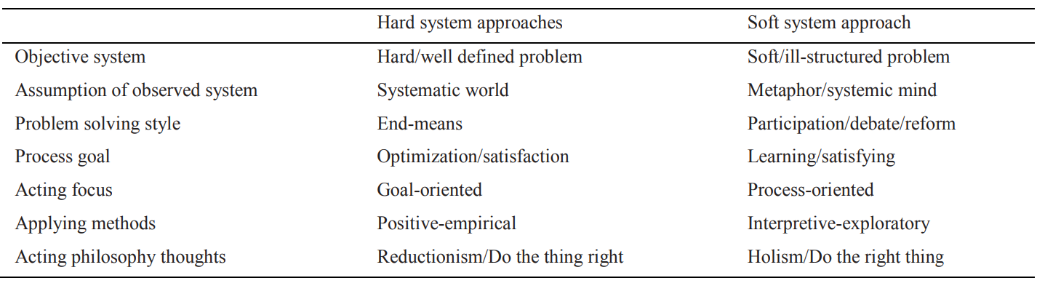
Categories ICT4D Design Appr…
  4. Hard and Soft approaches
  These are approaches which either base on functionalities (hard) or interpretation (soft) leading to quantitative (hard) and qualitative (soft) methodologies respectively.
28

Slide 29
ICT4D Design Approaches
29

Slide 30
ICT4D Design Approaches
  ICT4D Design Approaches in a Nutshell
  Sustainable Livelihood Approach
  Vulnerability Approach
  Design Science Approach.
  Capability Approach.
  Systems Approach.
30

Slide 31
ICT4D Design Approaches…
  1. Sustainable Livelihood Approach
  SLA/SLF was developed by the UK’s Department for International Development (DFID) in the late 1990s as a diagnostic tool to analyse projects oriented towards poverty alleviation.
  It is based on the recognition that livelihood strategies include multiple components in the form of access (or lack thereof) to financial, human, natural, social and physical assets.
31

Slide 32
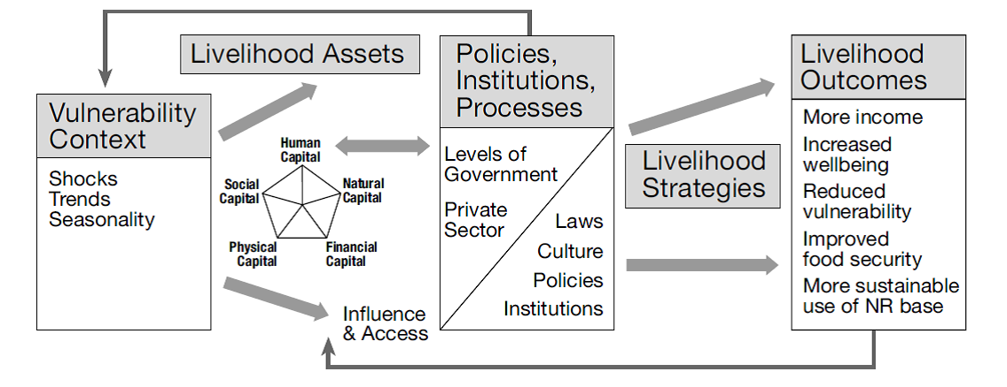
ICT4D Design Approaches…
  1. Sustainable Livelihood Approach…..
32

Slide 33
ICT4D Design Approaches…
  2. Vulnerability Approach
  Dimensions
  Descriptions
The prediction of damage, bereavement and stoppage of income in a dire event.
Susceptibility
  =
VULNERABILITY
Coping abilities and methods determine the ability or difficulty of recovering from a disaster.
Coping capacity
  =
33

Slide 34
ICT4D Design Approaches…
  2. Vulnerability Approach…
  vulnerabilities approach has shifted and enlarged into three different views:
      Nature as cause of people’s vulnerability, e.g. disasters and hazards;
      Cost as a cause of vulnerability, e.g. prediction and mitigation technologies are expensive even though they can detect natural disasters or economic shocks;
      Societal structures: socio-economic and political processes in society.
34

Slide 35
ICT4D Design Approaches…
  2. Vulnerability Approach…
  Examples of ICT interventions
  Vulnerabilities approach has the following classes:
      Social: The reduction of asset possession because it often means lower opportunities for social mobility;
      Economic: Existence within the lowest standard levels. For example BoP, LDC etc.
      Environmental: Exposure to natural disasters and human activities which make a country’s natural surroundings susceptible to hostile environmental threats.
ICT for Health
ICT for sustainable livelihood
ICT and disasters
35

Slide 36
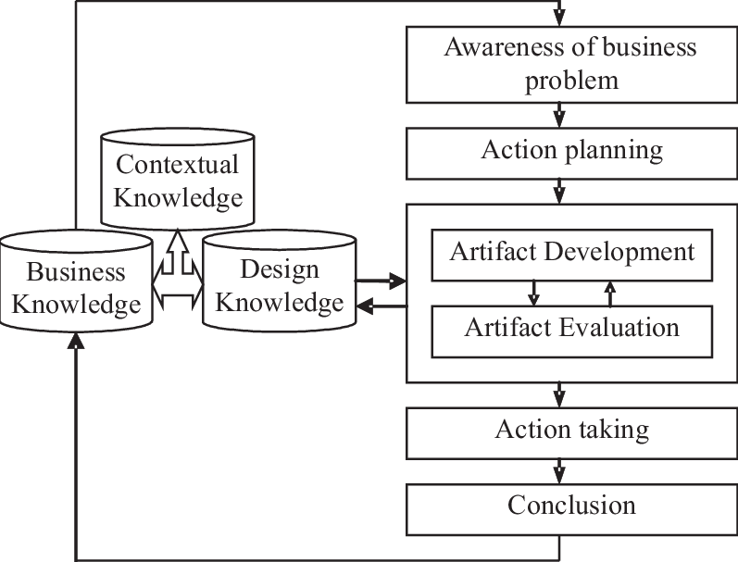
ICT4D Design Approaches…
  3. Design Science Approach
  DSA involves the process of conceiving, constructing, and implementing an artifact as a tool for the study.
  Artifact can be a software, framework, guideline etc
36

Slide 37
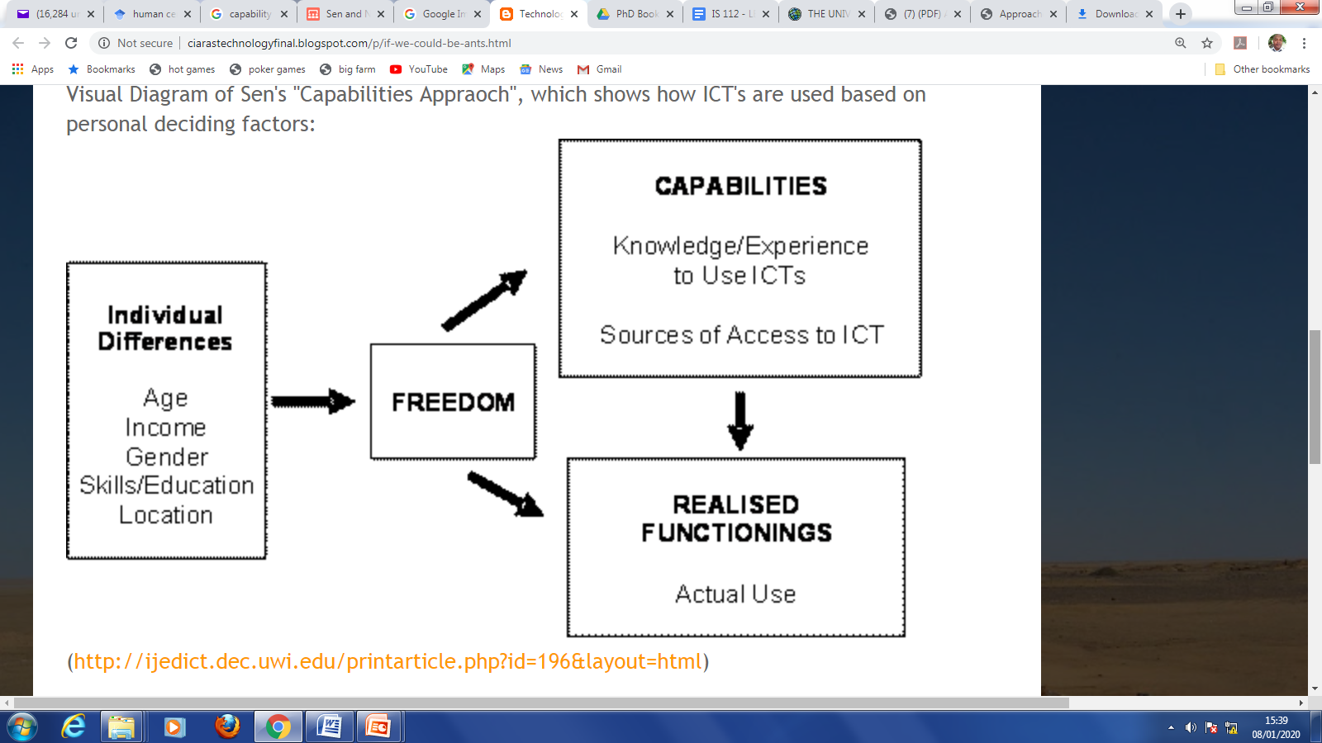
ICT4D Design Approaches…
  4. Capability Approach
  CA places the individual’s human capabilities at its centre.
37

Slide 38
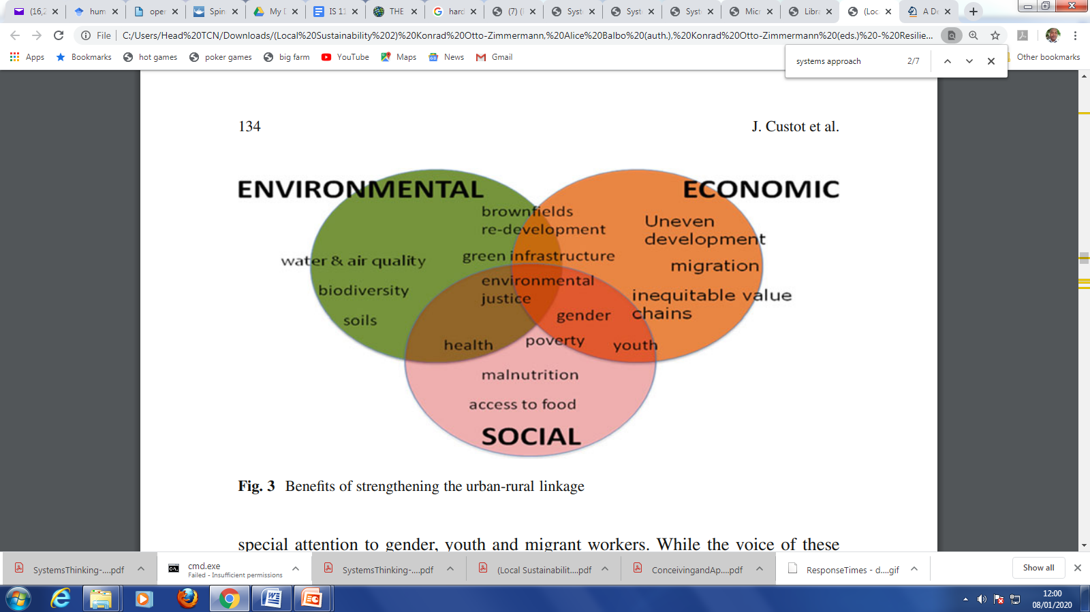
ICT4D Design Approaches…
  5. The Systems Approach
  A systems approach can be used to reveal the sensitive and vulnerable natural and human systems. Systems approach considers:
      Input, process and output
      Nature of the system boundaries;
      Type of the subsystems
      Interactivity of subsystems
      Contexts of subsystems
38

Slide 39
ICT4D Design Approaches…
  5. The Systems Approach
  A systems approach can be used to reveal the sensitive and vulnerable natural and human systems. Systems approach considers:
      Input, process and output
      Nature of the system boundaries;
      Type of the subsystems
      Interactivity of subsystems
      Contexts of subsystems
39

Slide 40
Selecting ICT4D Design Approach
40

Slide 41
Selecting ICT4D Design Appr.
  Criteria for Selecting ICT4D Design Approaches in a Nutshell
  Consideration of stakeholders and their needs
  Performance of technology Versus anticipated needs
41

Slide 42
Selecting ICT4D Design Appr…
  1. Consideration of stakeholders and their needs
  Stakeholders interests and powers
  Availability of measurements for AS-IS situation and TO-BE situation
42

Slide 43
Selecting ICT4D Design Appr…
  2. Performance of Technology versus anticipated needs
  Favourable cost-benefit analysis
  Unintended benefits (positive or negative)
  3. Others – please read
43

Slide 44
PAUSE
44

Slide 45
THE END
To Lecture 6
45

