Slide 1

THE UNIVERSITY OF DODOMA
CHSS

Slide 2

THE UNIVERSITY OF DODOMA
COLLEGE OF HUMANITIES AND SOCIAL SCIENCE
DEPARTMENT OF POLITICAL SCIENCE AND PUBLIC ADMINISTRATION
COURSE TITLE: INTRODUCTION TO INFORMATION TECHNOLOGY
GROUP NUMBER; 17
COURSE CODE: IT 111
COURSE INSTRUCTOR: Dr MWALONGO
NATURE OF WORK: GROUP ASSIGMENT
SUBMISSION: FEB 5, 2025

Slide 3
GROUP MEMBERS
S/N | NAME | REG NUMBER | PROGRAM
1 | FESTUS MWENGE JOHN | T24-03-15678 | BA-PSPA
2 | HELEN HENRY LUHWAGO | T24-03-10923 | BA-PSPA
3 | GETRUDA DENIS KIMARO | T24-03-24306 | BA-PSPA
4 | JACKLINE SOSPETER WILLIAM | T24-03-16194 | BA-PSPA
5 | JESTINA PARTICK PANGILIGOS | T24-03-21064 | BA-PSPA
6 | JOHN PASKALI MMBANDO | T24-03-19481 | BA-PSPA
7 | SADAMU ABDALLAH KAWANGA | T24-03-14377 | BA-PSPA
8 | ABDULI-RASULI AMIRI MALEDA | T24-03-24048 | BA-PSPA
9 | SWAUM JAFARI LAIDA | T24-03-20955 | BA-PSPA
10 | FRECK PETER JULIUS | T24-03-20603 | BA-PSPA

Slide 4
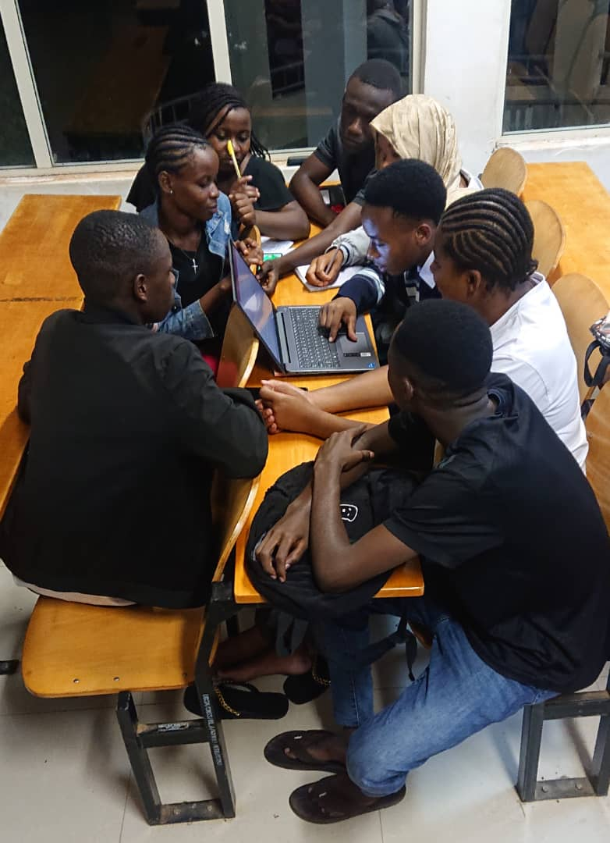
GROUP PICTURE
Inserted picture

Slide 5

AUDIO DISCUSSION
This is discussion voice recorded

Slide 6
SHAPE
Inserted shape

Slide 7
Chart
Inserted chart

Slide 8
TEXT BOX
Inserted text-box
I have understood well the topic of powerpoint

Slide 9
WordArt
Inserted WordArt
We are Happy with IT 111

Slide 10
SmartArt
Inserted SmartArt
Jesus
is
my
Unique
choice

Slide 11
Hyperlink, Date and Time
Inserted Date and Time

