Slide 1

THE UNIVERSITY OF DODOMA
CHSS

Slide 2

THE UNIVERSITY OF DODOMA
COLLEGE OF HUMANITIES AND SOCIAL SCIENCES
DEPARTMENT OF FOREIN LANGUAGE AND LITERATURE
COURSE TITLE: INTRODUCTION TO INFORMATION TECHNOLOGY
COURSE CODE: IT 111
GROUP NUMBER:11
NATURE OF WORK: GROUP ASSIGNMENT.
DATE OF SUBMISSION: 05,FEB.2025.

Slide 3
GROUP MEMBERS
S/N | NAME | REG NUMBER | PROGRAM
01 | LAUREEN MICHAEL | T24-03-23809 | BA-ENGLISH
02 | SILA MWAKISU | T24-03-10703 | BA-ENGLISH
03 | AYUBU PHILIPO | T24-03-16865 | BA-ENGLISH
04 | AVILA KILEO | T24-03-18044 | BA-ENGLISH
05 | MARY PAUL | T24-03-10708 | BA-ENGLISH
06 | AWEMA MSAFIRI | T24-03-2238 | BA-ENGLISH
07 | MARIA NCHAMA | T24-03-14440 | BA-ENGLISH
08 | NAOMI NICODEMAS | T24-03-20245 | BA-ENGLISH

Slide 4
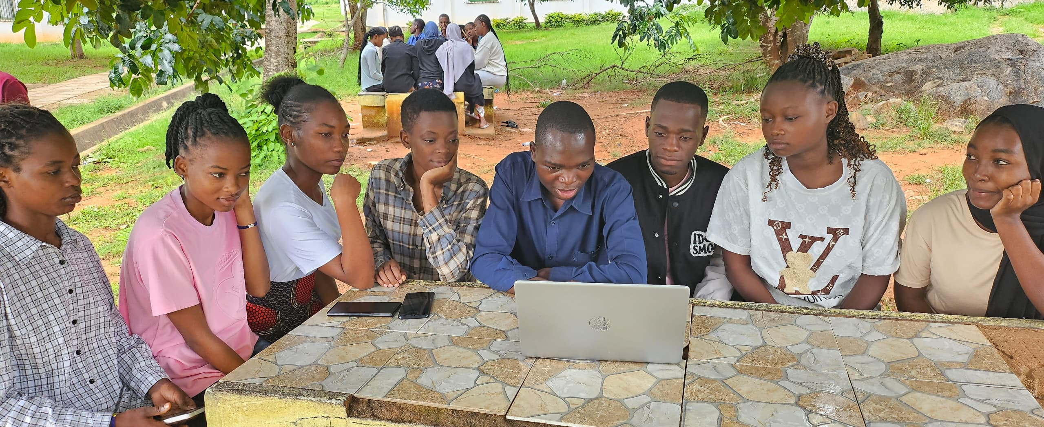
GROUP PICTURE
Inserted picture

Slide 5

AUDIO DISCUSSION
This is discussion voice recorded

Slide 6
SHAPE
Inserted shape

Slide 7
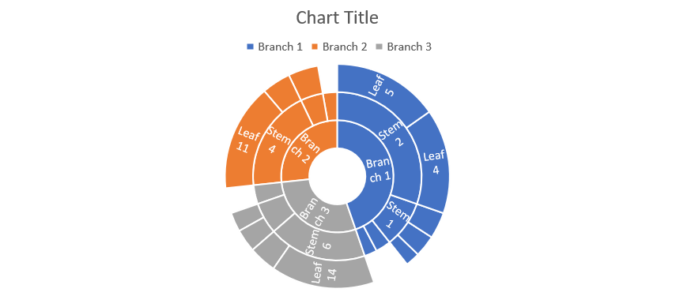
Chart
Inserted chart

Slide 8
TEXT BOX
Inserted text-box
I have understood well the topic of
the power point

Slide 9
WordArt
Inserted WordArt
We are Happy with IT 111

Slide 10
SmartArt
Inserted SmartArt
Jesus
is
my
Unique
choice

Slide 11
Hyperlink, Date and Time
Inserted Date and Time

