Slide 1


rightmodeler
The right model for every layer of your AI agents, proven on your own traces.
rightmodeler.com
Notes:
One breath: we are the decision layer for the models inside AI agents. Everything downstream of this slide is evidence for that sentence.

Slide 2






We were picking models by vibes. Then the bill arrived.
We build multiagent systems for a living. Every system asked the same question: which model belongs at each layer?
We built an internal tool to answer it. Engineers at every company we talked to had the same problem.
Notes:
The headline is the title of our founding-story essay. Company set spans big tech (Amazon), SBA lending (B:Side), impact investing (Vanderbilt Financial Group), an autonomous phone-call agent (Colyap), and an AI operating system for VC (VCOS). The internal tool ran at B:Side, VCOS, and Colyap; at the others we ran the same workflow by hand before the tool existed. This is the validated-learning chain, not a customer list.

Slide 3
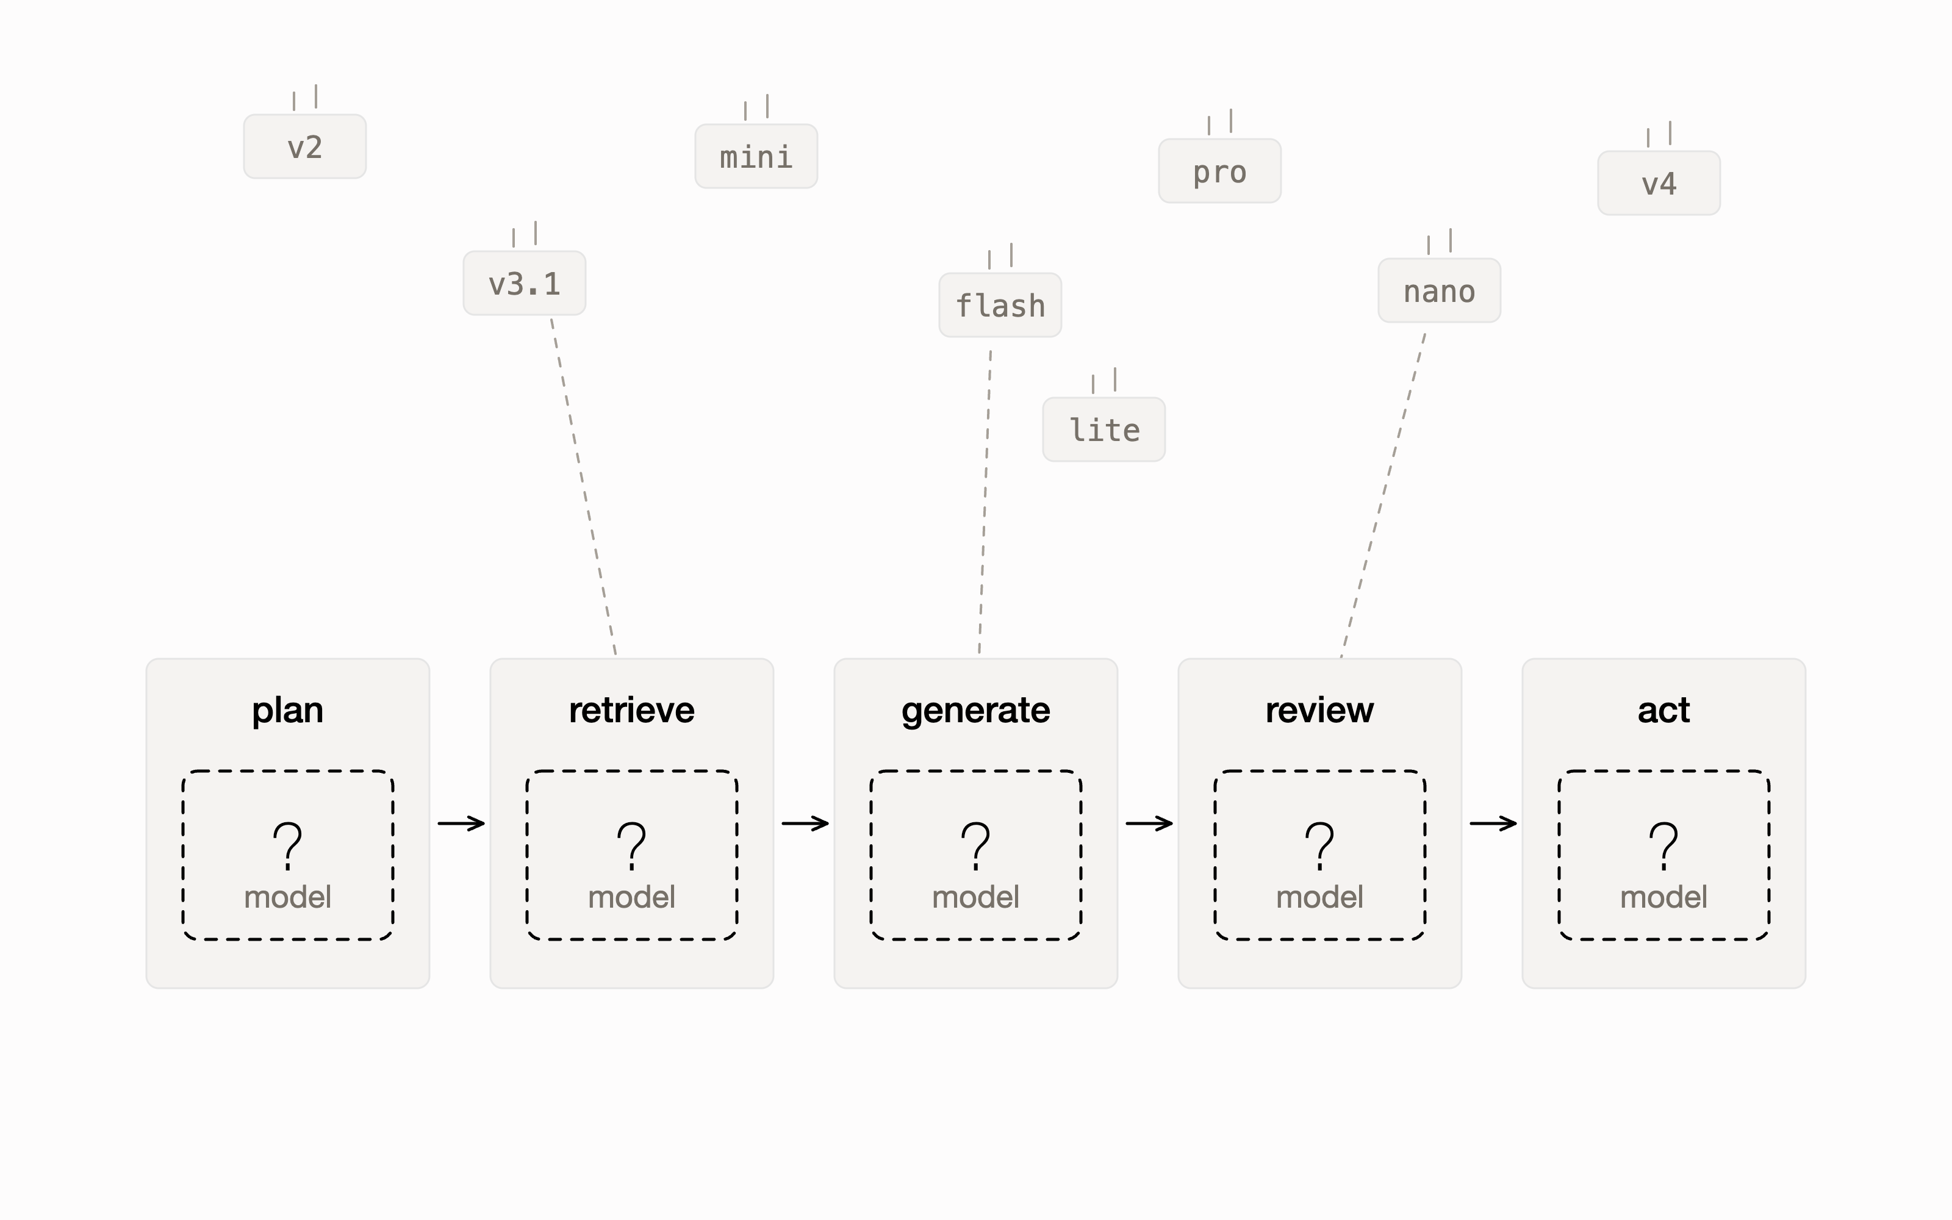
Every layer is a model decision. Every release reopens it.
59
notable US model releases in 2025, one every few weeks
Stanford HAI, AI Index Report 2026
11% vs 45%
of builders switched vendors in a year, yet a single launch flipped 45% of one provider's users in a month
Menlo Ventures, 2025 Mid-Year LLM Market Update
An agent is a stack of steps, and each step has its own cost, speed, and quality bar. Evaluating one model once is a project. Evaluating every model forever is a job.
Notes:
Two forces compound: stacks got deep (many decisions) and releases got frequent (each decision reopens every few weeks). Teams resolve the tension by not deciding: they stay put (the 11%) until a launch shockwave forces a migration scramble (the 45% in a month). Both failure modes are expensive.

Slide 4
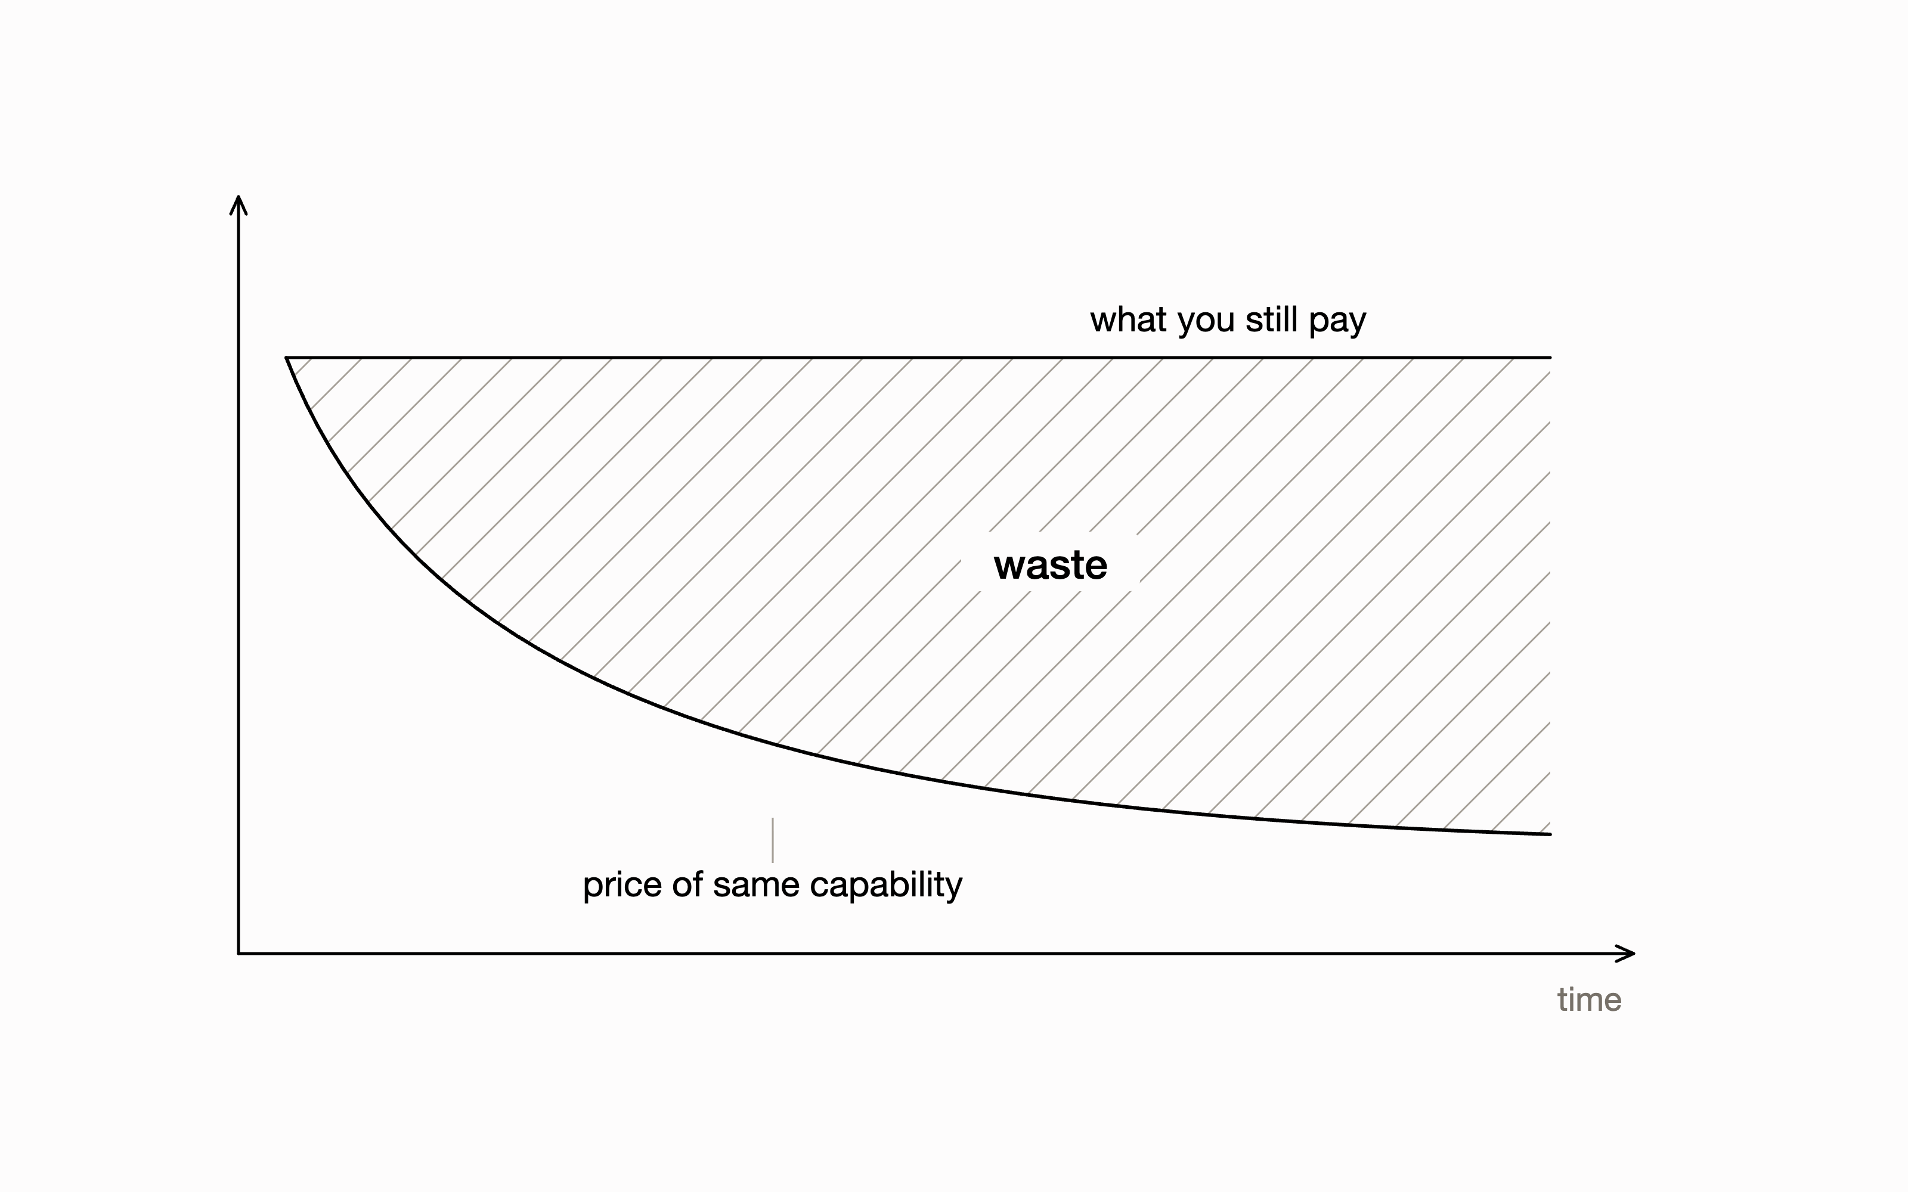
The default is over-provisioned, and it decays.
10x cheaper
same capability, roughly every year
a16z, Welcome to LLMflation, 2024; corroborated by Epoch AI, 2025
10x the price
frontier tier vs small tier per token on today's Anthropic price list
Anthropic pricing, verified July 2026
A model choice that was right in January is overpriced by summer. Most agent layers never get re-asked.
Notes:
This is why the problem never closes: even if no new model beats yours on quality, the price floor drops under you continuously. Checkr's public case lands here if asked: one workload moved from GPT-4 to a fine-tuned 8B model, roughly 90% cheaper, accuracy up from 88% to 97% (Computerworld, 2024). Proof that right-sizing is real money, not margin-of-error.

Slide 5
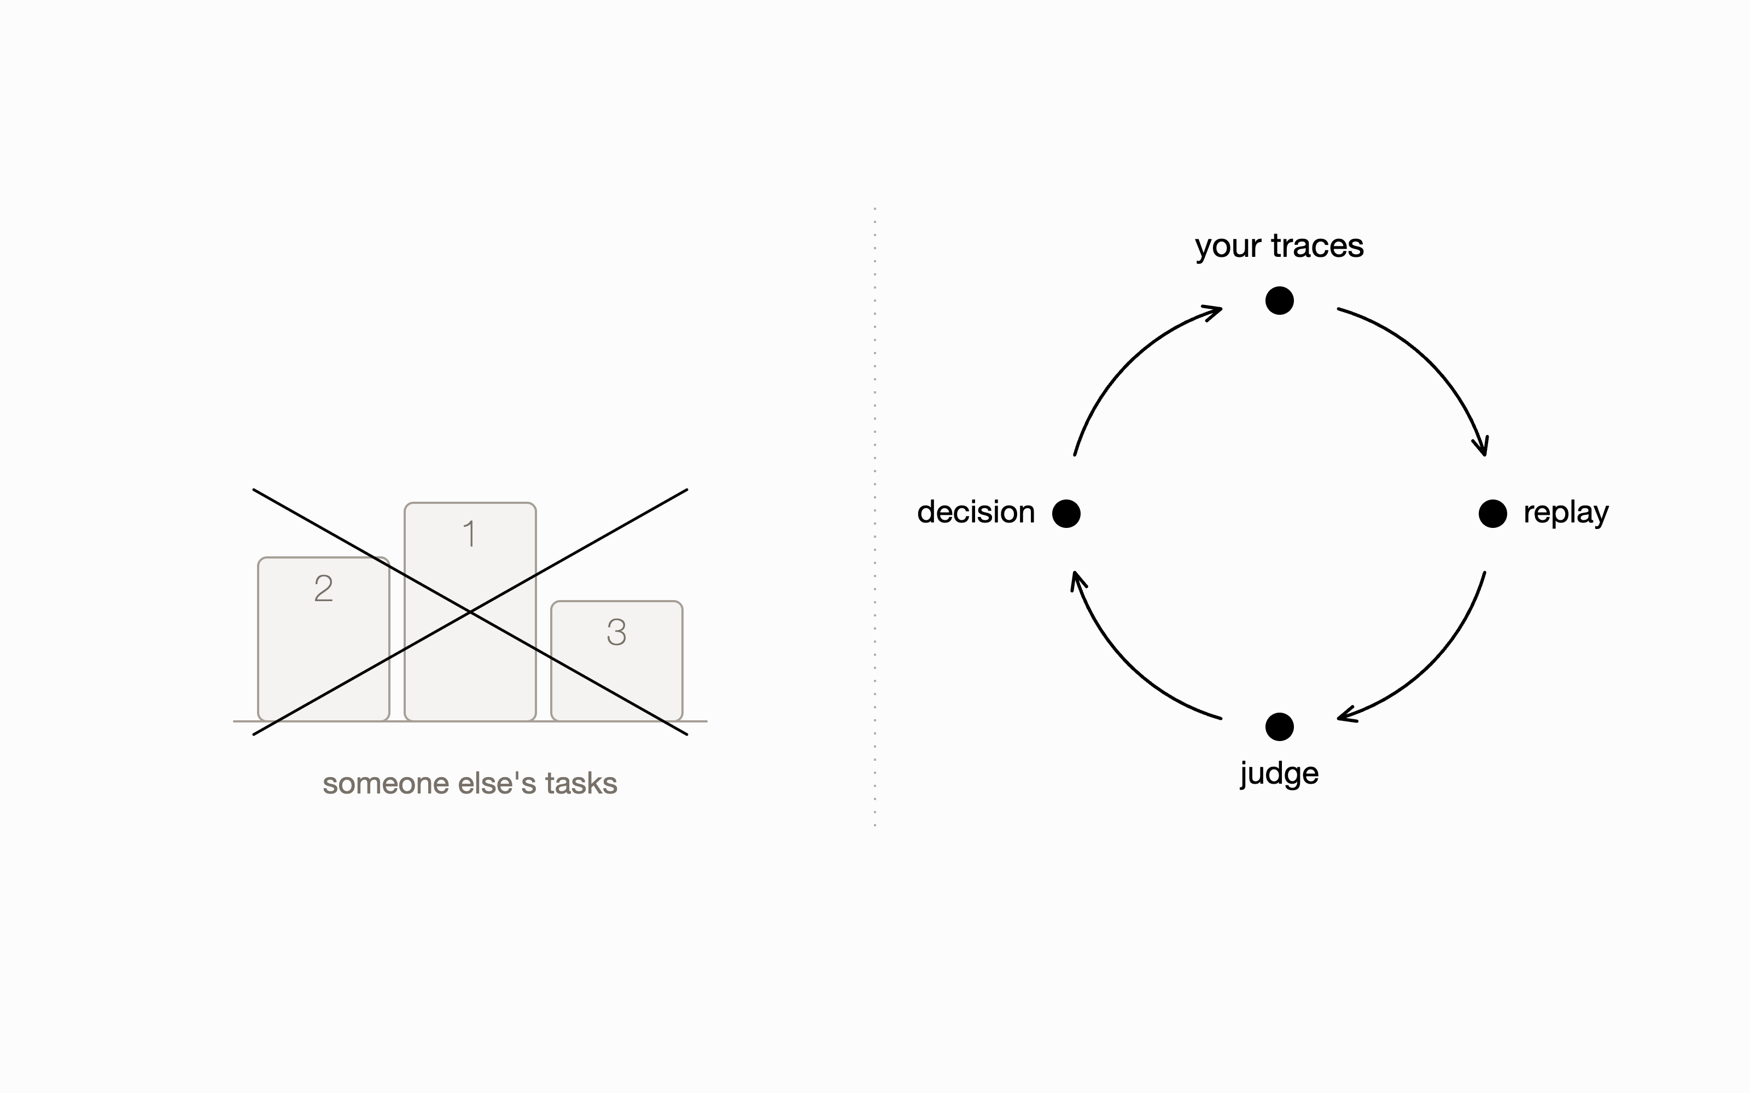
Generic benchmarks can't answer it. Your traces can.
Leaderboards rank models on someone else's tasks. The only benchmark that matters is what your agent already shipped and you accepted.
Replay real traces through candidate models, judge against your own accepted outputs, and the decision makes itself.
Notes:
This is the core belief the products are built on: your traces are the benchmark. It is also the moat argument in miniature: the data that makes decisions trustworthy already belongs to the customer, and we are the only ones who turn it into a decision where it lives, in the repo.

Slide 6
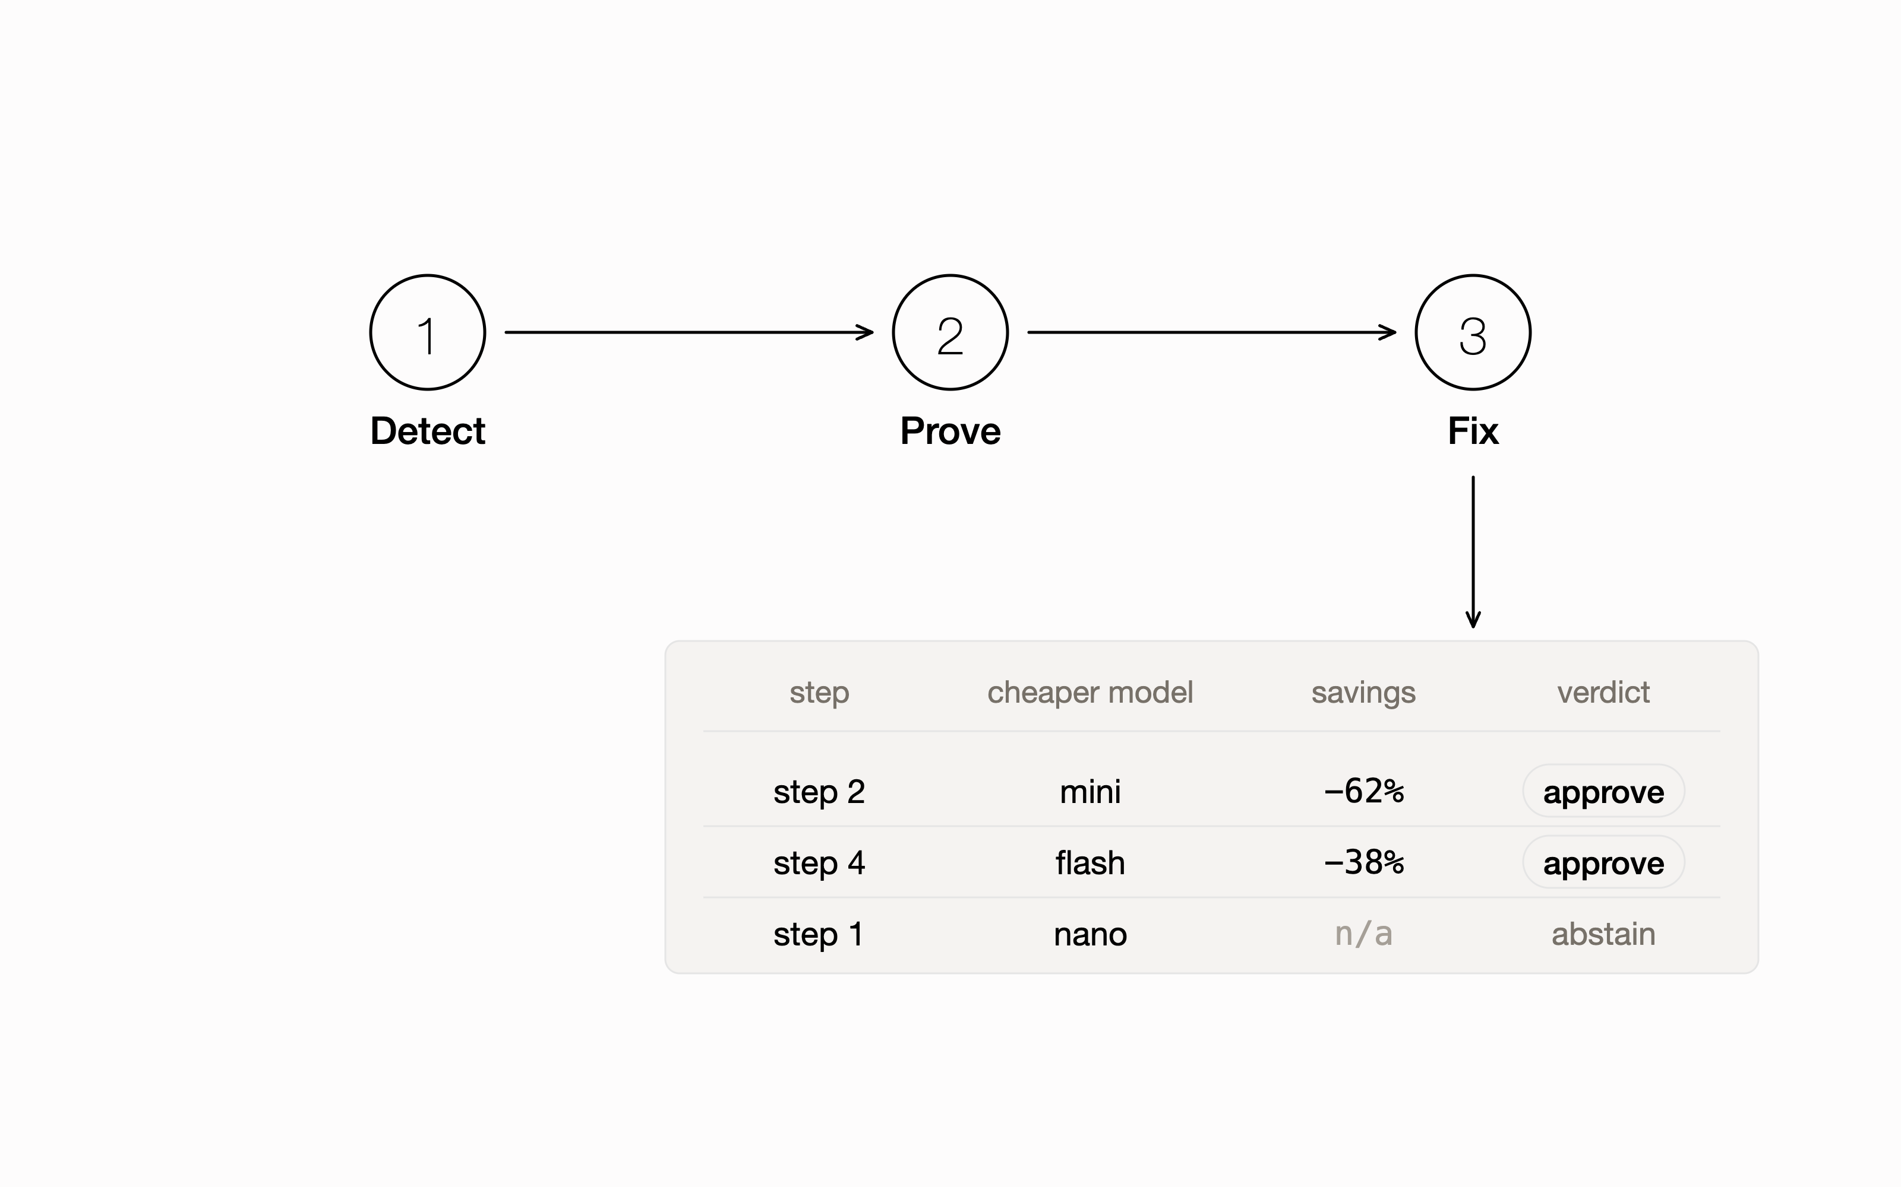
Detect. Prove. Fix. Shipped and open source.
available now
1
Reads the traces you already have. Autodetects 8 trace formats.
2
Replays each step through cheaper models, judges against your shipped outputs. High-risk steps abstain: it can say no.
3
Hands you a per-step swap plan with dollar savings. You approve every swap.
$npx skills add elm-os/rightmodeler
Notes:
Show, don't describe: this exists, installs in one line, and runs on the user's own OpenRouter key. Judging discipline matters: deterministic checks first, cross-family judges, order-swapped verdicts, abstention on weak evidence. It is a report with evidence, not observability and not a runtime gateway.

Slide 7
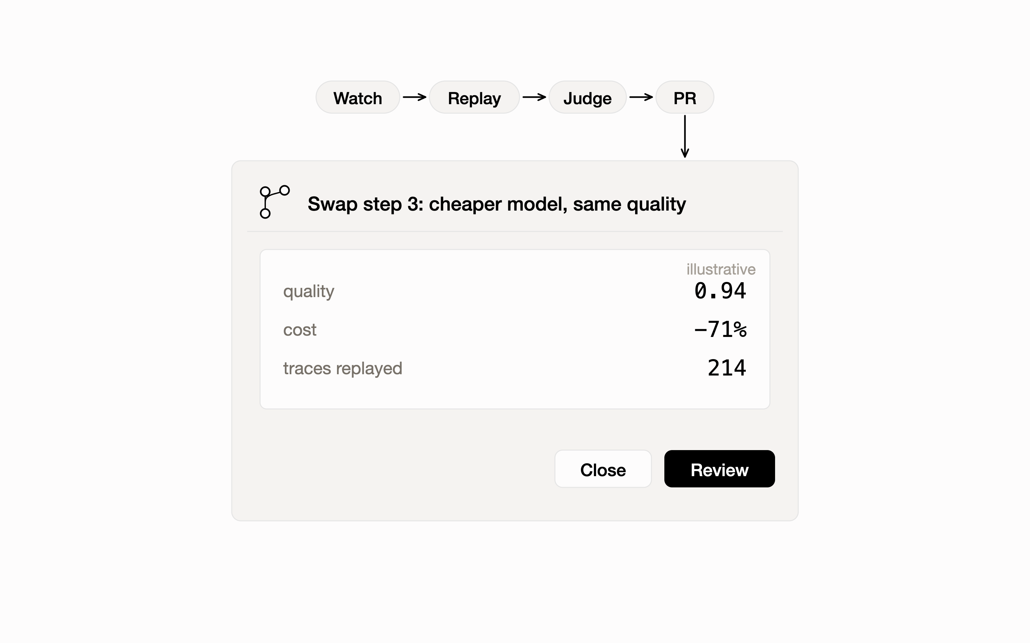
The last model migration you do by hand.
coming soon, waitlist live
A new model ships. The agent replays it against your traces in CI, prices the swap, and opens a pull request with the evidence attached.
Weak evidence means no PR. Nothing merges without you.
Notes:
The mental model: platforms ship first-party agents now (Vercel has one for deploys); this is ours, for model decisions, living in your repo and CI. It turns the skill's one-time report into a standing service: every release evaluated against your stack, forever. That recurring loop is what people pay for.

Slide 8
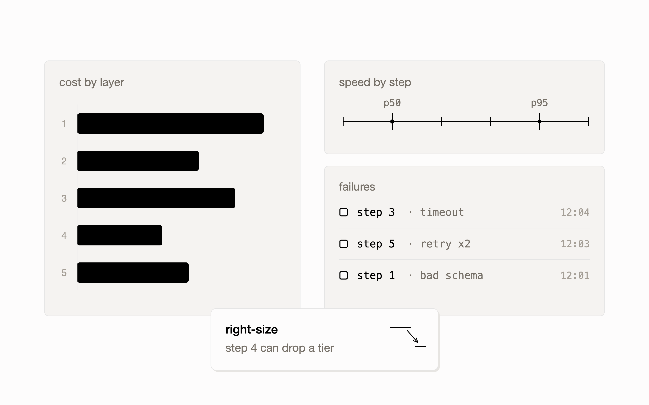
Crucible: every layer, measured and right-sized.
early access
The analytics suite for AI agents: cost by layer, speed by step, failures as they happen, continuously right-sized.
Connects over MCP. Your keys, your routes. Not a gateway.
Notes:
Crucible closes the loop: the agent decides at release time, Crucible watches production continuously and feeds drift back into the next decision. Together they make model choice a managed system instead of an annual scramble.

Slide 9
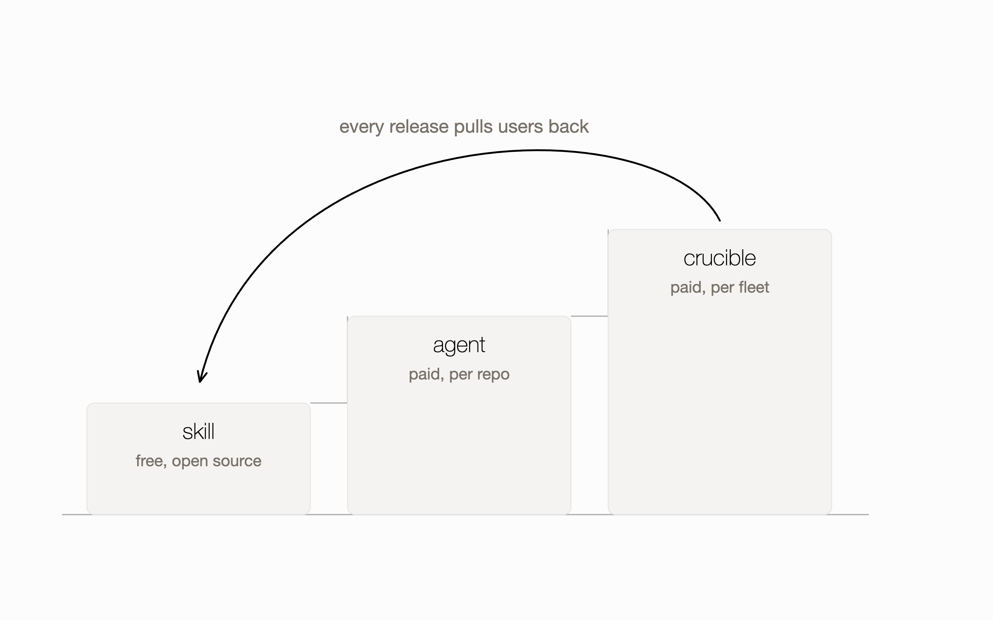
Open source is the wedge. The decision layer is the business.
The skill stays free and open source: it earns trust and teaches us every trace format in the wild.
The agent and Crucible are the paid products: open-core SaaS, priced per repo and per agent fleet.
Notes:
The growth engine is sticky by construction (Lean Startup's sticky engine): a one-time model choice decays, so staying current is a subscription-shaped problem. Every headline model launch is a free re-activation event for us. Pricing specifics are deliberately not public yet; do not quote numbers.

Slide 10
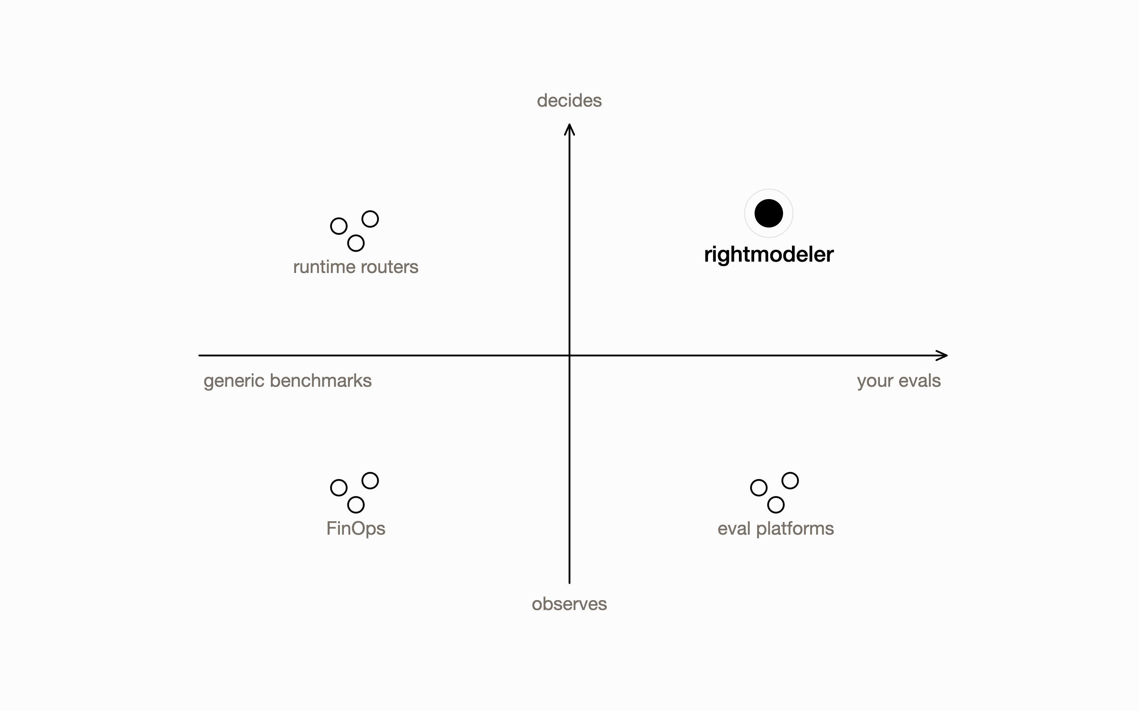
Routers pick a lane per request. We decide the stack.
Runtime routers
OpenRouter, Martian: route each request at the proxy, blind to your quality bar.
Eval and observability platforms
LangSmith, Braintrust, Arize: measure outputs, stop short of the decision.
FinOps
CloudZero, Finout: see the bill after the fact, never the quality.
Nobody else sits in the repo, runs your evals against every release, and ships the decision as a PR. Also not: a cost trimmer for coding assistants.
Notes:
Adjacent funding prices the problem: OpenRouter $113M at $1.3B (2026), LangChain $125M at $1.25B (2025), Braintrust $80M (2026), Arize $70M (2025), Galileo $45M (2024), CloudZero $56M (2025), Finout $40M (2025). All validated, none in our seat. We happily ride on routers as rails (the skill replays through OpenRouter) while owning the decision above them.

Slide 11
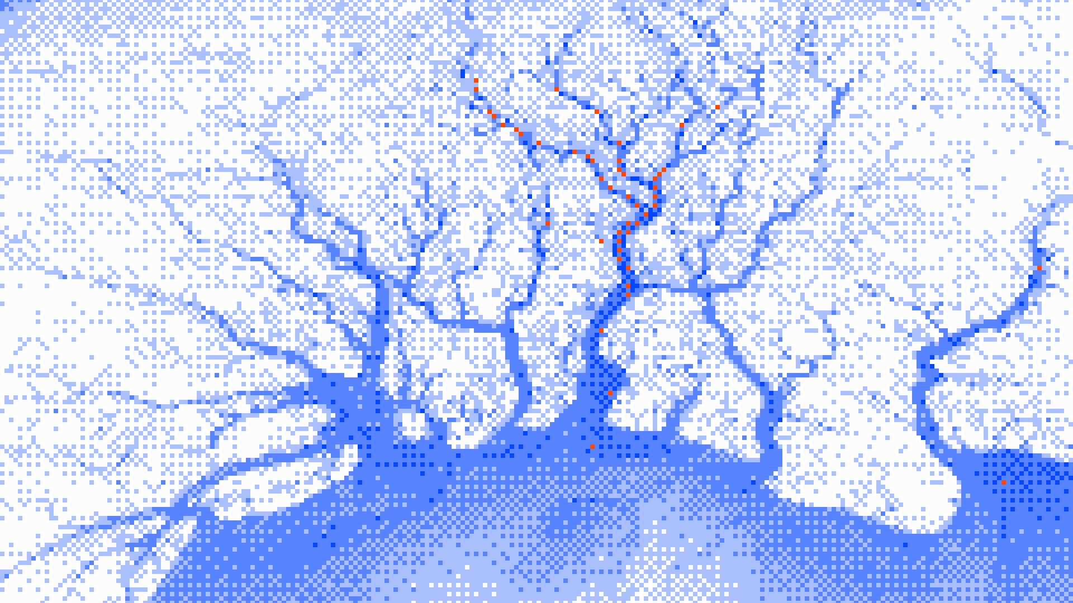
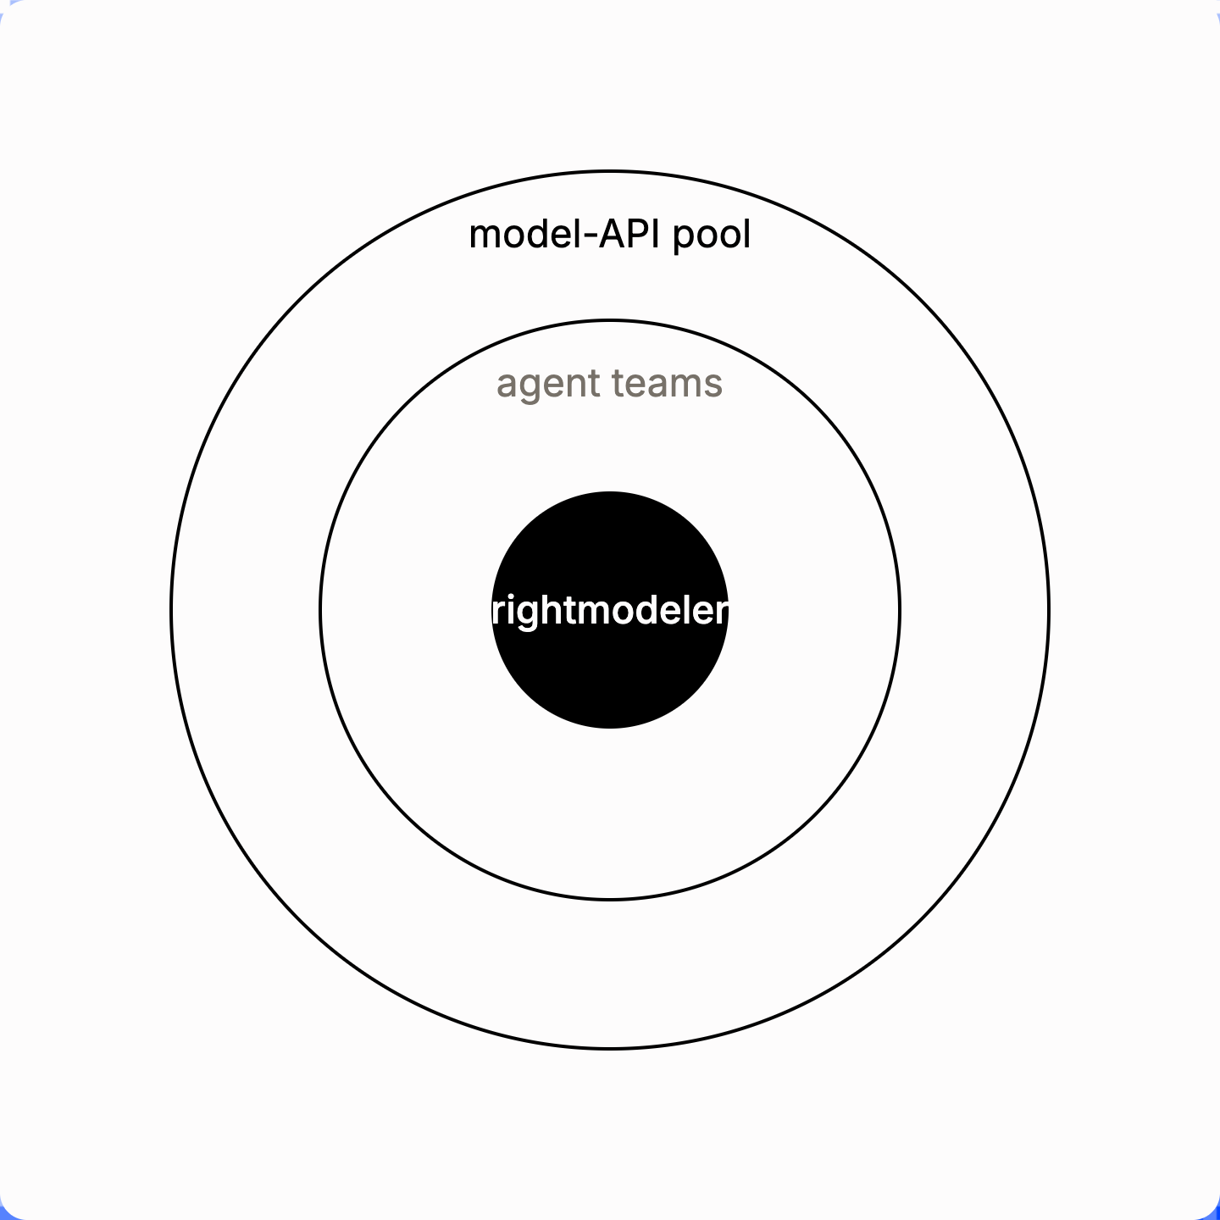
The spend is real. The decision layer is missing.
$37B
US enterprise genAI spend in 2025, up 3.2x year over year
Menlo Ventures, 2025
$12.5B
of it on foundation model APIs, the pool model decisions steer
Menlo Ventures, 2025
$52.6B
AI agents market by 2030, from $7.84B in 2025, a 46.3% CAGR
MarketsandMarkets, 2025
Bottom-up, re-deciding model fit by hand is on the order of $1.5B a year of engineering time, before any savings are counted.
Notes:
Bottom-up math, stated as assumptions: roughly 20,000 teams running agents in production, each seriously re-evaluating about 8 releases a year at about 40 engineering hours and $120 loaded cost: 20,000 x 8 x 40 x $120 is $1.5B of labor we automate. Savings side: if 20 to 40% of the $12.5B pool is over-provisioned and right-sizing recovers half or more, $1.25B to $3.75B a year is recoverable. Both roads land in the same order of magnitude, and the pool compounds at 46% underneath.

Slide 12
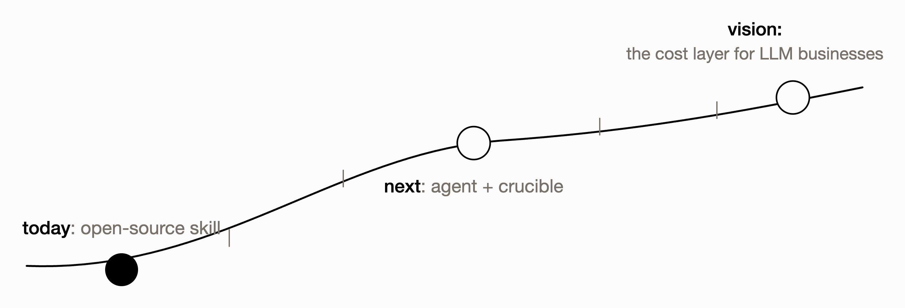
Felt the pain. Built the tool. Shipped the wedge.
Today
Next
Vision
Open-source skill, available now. Born as an internal tool, used in production work at B:Side, VCOS, and Colyap.
rightmodeler agent (waitlist live) and Crucible (early access): from one-time report to always-current decisions.
The cost-optimization layer for every business building on LLMs.
Notes:
Frame strictly as learning velocity, not adoption claims: each stage exists because the previous one taught us something at a real company. No user counts or revenue yet, and we say so plainly if asked; the waitlists are the only public funnel today.

Slide 13

Four engineers who lived this problem.
Aakash Harish
Ameya Lambat
Co-founder
Co-founder
Founder of VCOS; built B:Side Assist; AI products across fintech and VC.
AI systems at ASU's DigitalDx lab; built Token Receipt, cost tracking for AI agents; previously PayPal, Onshape, Corsair.
Piyussh Singhal
Chaitanya Chaurasiya
Co-founder
Co-founder
Built B:Side Assist and Colyap; founder of Alchemy Labs, AI agents for SMB automation.
Engineer at eero (Amazon); mesh-wifi stability patent; cut fleet noise events from about 1M a day to 10k.
We built multiagent systems at Amazon, B:Side, Vanderbilt Financial Group, Colyap, and VCOS. rightmodeler is the tool we kept wishing existed.
Notes:
Spelling check before export: the user writes Chaurasiya; his site styles it Chaurasia. Confirm with Chai and use his preferred form. Every line above traces to the founders' own sites.

Slide 14

A model decision deserves evidence, not a vibe.
Prove it on your own traces today. Let the agent keep it true tomorrow.
rightmodeler.com · npx skills add elm-os/rightmodeler · waitlists open for agent and Crucible
Notes:
End where the manifesto begins: evidence beats vibes. The three doors for any audience: run the skill (developers), join a waitlist (design partners), or continue the conversation (investors, recruits).

