Slide 1
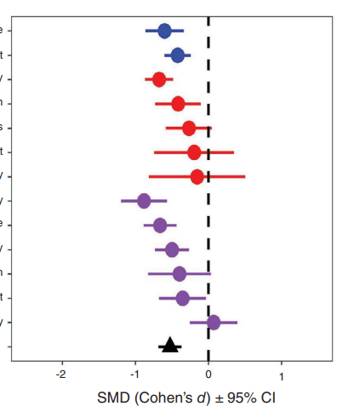
Why do we perform Meta-analysis?
Assess generalities in the literature (e.g., “does A affect B overall” or “is there a positive correlation between A and B”)
Address hypotheses
Increase power and precision
Explore differences in the literature (e.g., “does A affect B only under some circumstances”)
Moderator variables used to explain differences / ‘heterogeneity’
Overall effect
Overall effect

Slide 2

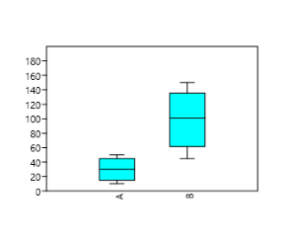
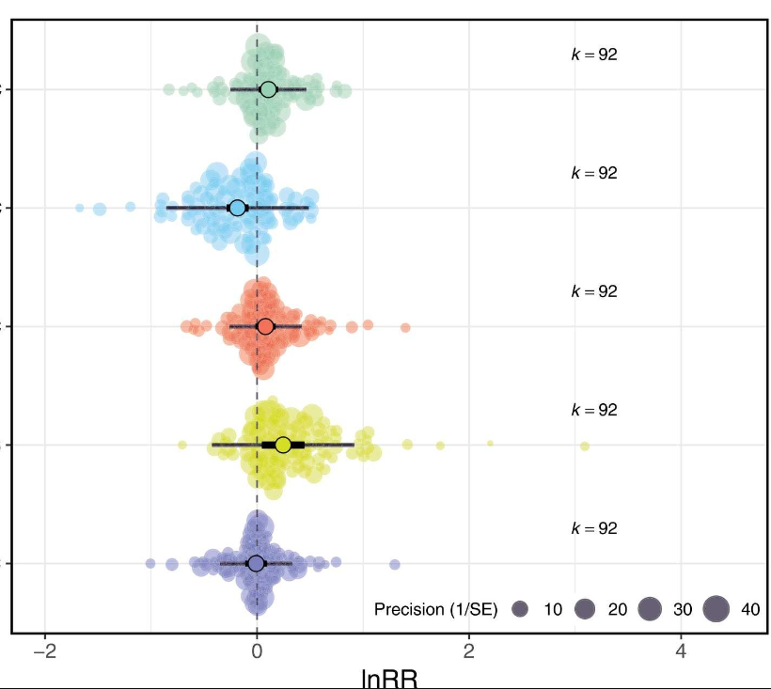



The process of meta-analysis
ANALYSIS
Data extraction
Write up paper and publish!
Literature search and screening for relevant papers
Hypothesis/question formulation
Piloting
For help on the first steps:
Nakagawa, S., Noble, D.W.A., Senior, A.M. et al. Meta-evaluation of meta-analysis: ten appraisal questions for biologists. BMC Biol 15, 18 (2017). https://doi.org/10.1186/s12915-017-0357-7

Slide 3
Effect sizes
SMD (e.g., Cohen’s D)
lnRR (log response ratio)
Zr (correlation)
OR (odds ratio)
Comparing the mean of two groups (i.e., treatment vs control)
Correlation
Likelihood of an outcome

Slide 4
Example data
First author | Year | Effect size ID | Study ID | Species | Mod1 (e.g., sex) | Mod3 (e.g., age) | Mean control | SD control | N control | Mean treatment | SD treatment | N treatment
Macartney | 2022 | 1 | 1 | Drosophila_melanogaster | M | Juv
Macartney | 2022 | 2 | 1 | Drosophila_melanogaster | M | Adult
Macartney | 2022 | 3 | 1 | Drosophila_melanogaster | F | Juv
Note: can convert median to mean; SE, CI etc to SD; N from df (depending); can use test stats etc.

Slide 5
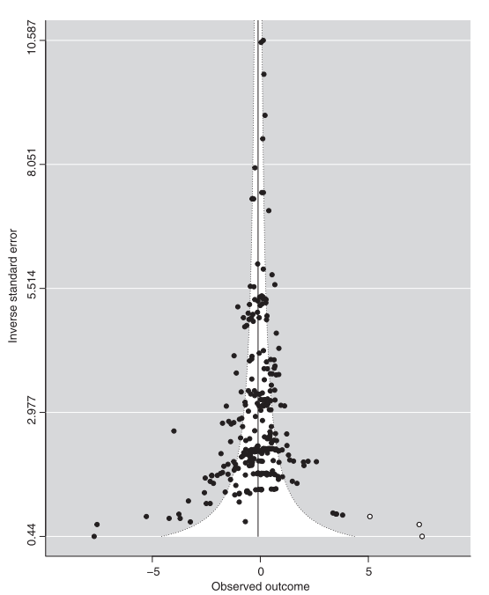
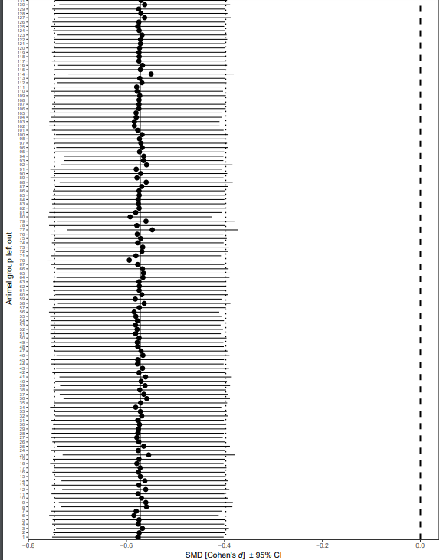
Basic steps your analysis should include
Global meta-analytic mean (overall effect)
Heterogeneity (I²): proportion of variance not due to sampling error
Meta-regression (marginal R²): Variance explained by fixed effects (e.g., moderators)
Publication bias (funnel plot, eggers regression etc)
Sensitivity analysis (leave on group out analysis) – not covered in code
Moderator variables used to explain differences / ‘heterogeneity’
Overall effect

