Slide 1














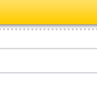


Mac OS Simulator for power point
Youssef EL MANSOURI

Slide 2



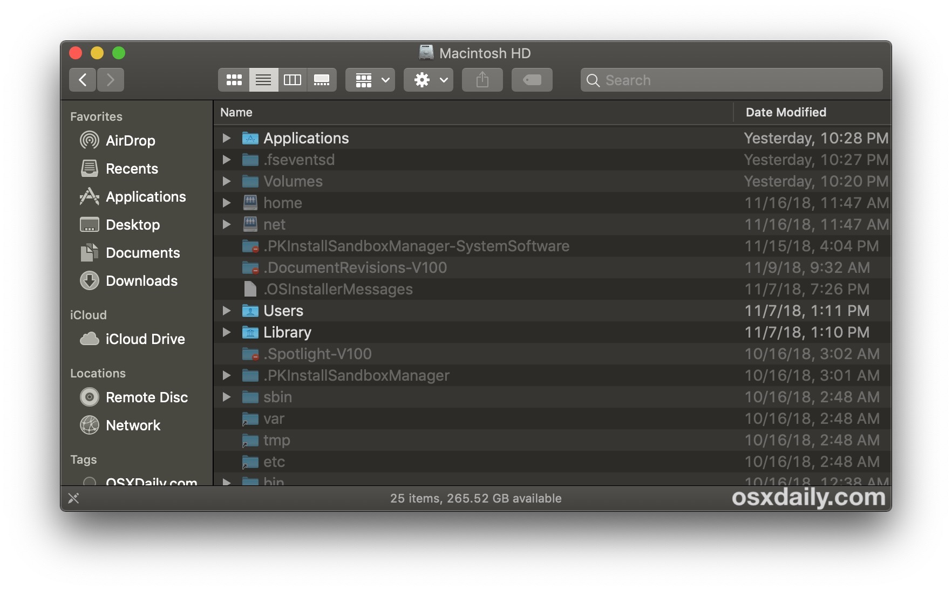







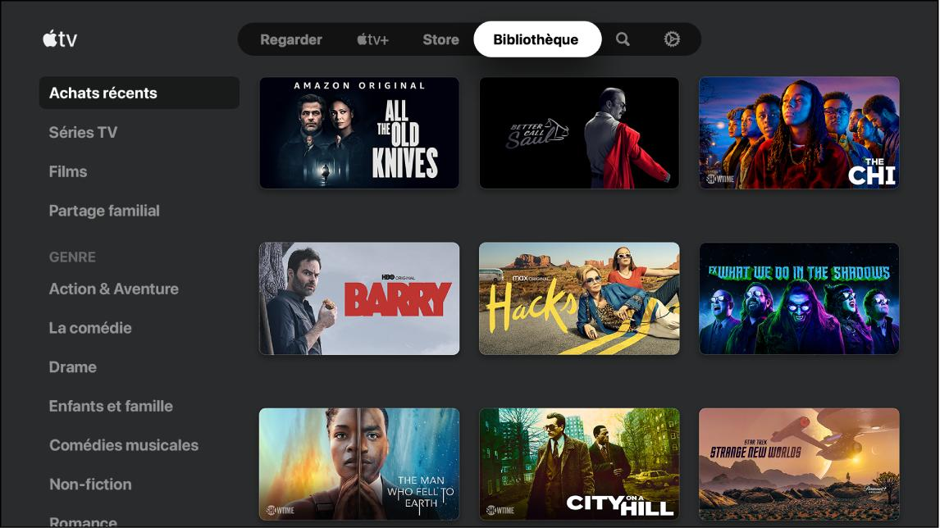
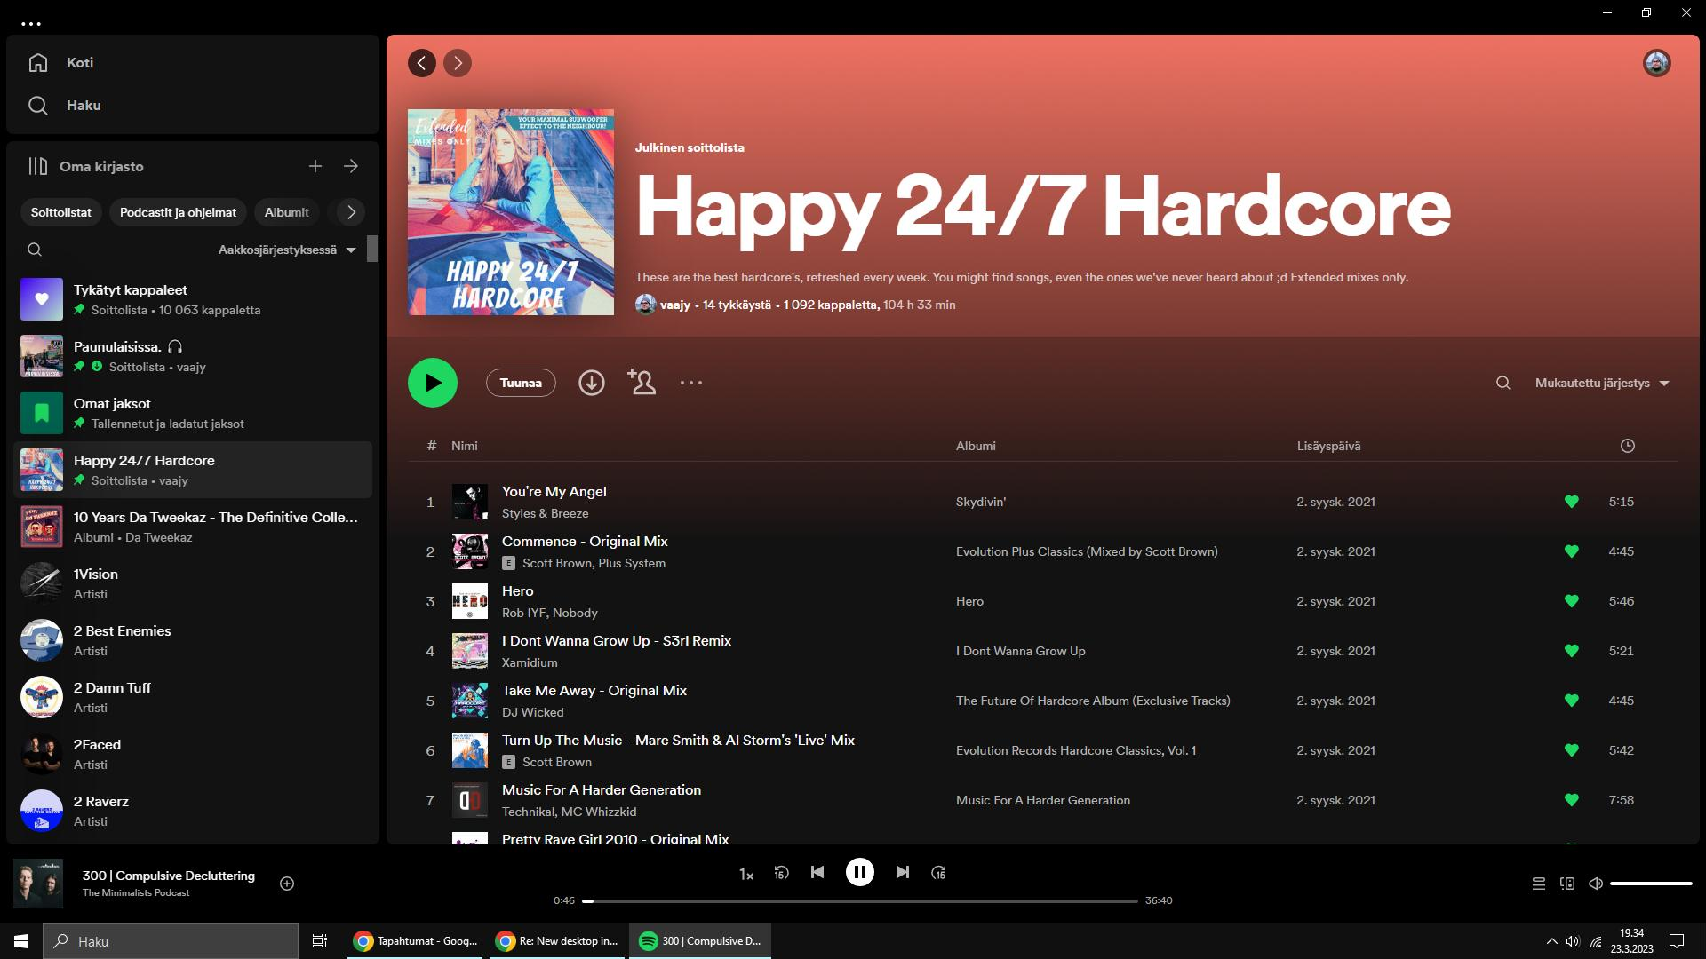
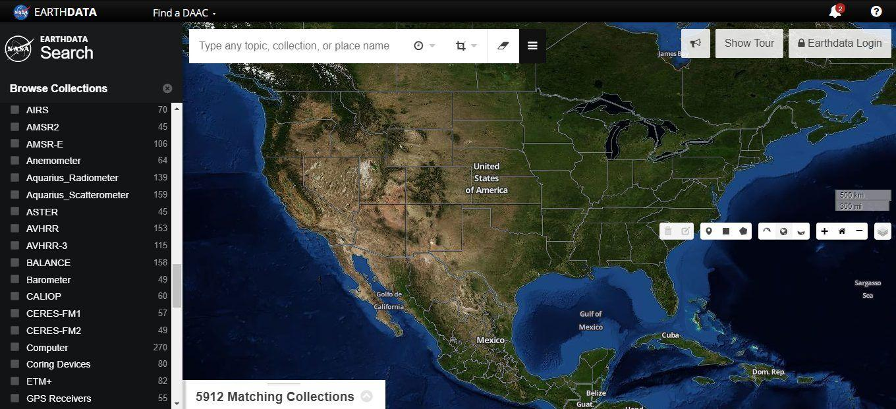
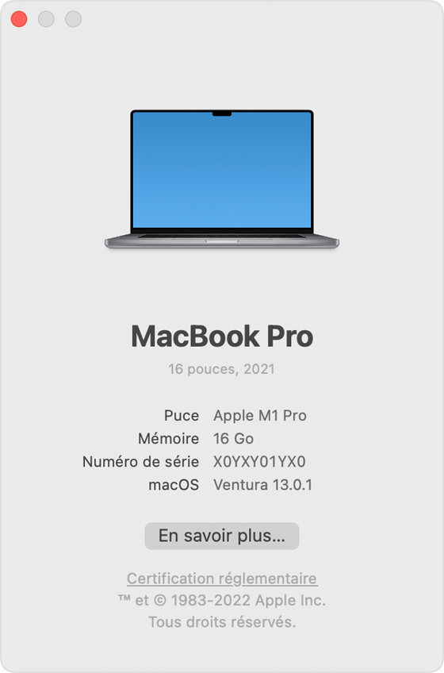
Notes:
spotify

Slide 4
Notes:
spotify

Slide 5
Notes:
spotify

Slide 6
Notes:
spotify

Slide 7
Notes:
spotify

Slide 8
Notes:
spotify

Slide 9
Notes:
spotify

Slide 10
Notes:
spotify

