Slide 1
UML
(Sequence Diagrams, Collaboration and State Chart Diagrams)
Presentation By
- SANDEEP REDDY CHEEDEPUDI (Student No: 17037032)
- VISHNU CHANDRADAS
(Student No: 16029094)
- MADHU VARMA CHEKURI
(Student No: 17034703)
- PRAVEEN KUMAR EULUKA
(Student No: 17036682)

Slide 2
Introduction:
UML is a standardized visual specification language for object modeling.
Is a general-purpose modeling language that
includes a graphical notation.
Is used to create an abstract model of a system, referred to as a UML model.
UML is used for systems engineering modeling,
business process modeling, and representing organizational structures.
The available version now is UML 2.0.

Slide 3
Diagrams of UML
UML has thirteen types of diagrams divided into three categories.
The three categories are
  Structure Diagrams
  Behavior Diagrams
  Interaction Diagrams

Slide 4
Structure Diagrams
A type of diagram that depicts the elements of a specification that are irrespective of time. These include……
Class Diagrams:
Shows the classes of the system, the operations and attributes of the classes, and their interrelationships (including inheritance, aggregation, and association).
Object Diagrams:
Looks similar to that of a class diagram.
These are also referred as instance diagrams.
Component Diagrams:
Used to represent the different high-level reusable parts of a system.
Also captures the inter-relationships between these parts.

Slide 5
Composite Structure Diagrams:
Same as that of a class diagram.
The difference is it depicts individual parts instead of whole classes.
Package Diagrams:
The grouping of objects into sets of objects that provide related services are called package diagrams.
Grouping makes the UML diagrams simpler and easier to understand.
Deployment Diagrams:
Least understood and more important of the diagrams of UML.
There are four elements used in Deployment diagrams. They are nodes, components, dependencies, and links.

Slide 6
Behavior Diagrams:
A type of diagram that depicts behavioral features of a system or business process. These include……
Use case Diagrams:
Used during the analysis phase of a project and are helpful in designing and understanding the project.
Depict the relationship between the users and the actors.
Activity diagrams:
Shows the flow of activities through the system.
Look like a tree consisting of branches.
State Machine diagrams:
objects which have both behaviour and state are called state machine diagrams.
Shows interesting behaviour about one particular object.

Slide 7
Interaction diagrams:
Interaction diagrams are a subset of behavior diagrams which emphasize object interactions. These include……
Communication Diagrams:
Show the message flow between the objects and the relationships between the classes.
Used to explore the dynamic behavior of the systems.
Interaction Overview Diagrams:
Notation is same as that of an activity diagram in most of the cases.
These diagrams introduce two new elements. They are interaction occurrences and interaction elements.
Timing Diagram:
The focus will be on timing constraints i.e., in a given period of time, these diagrams are used to explain more about the behavior of one or more objects.
Often used in designing embedded software such as fuel injection system in automobiles.

Slide 8
Sequence Diagram
A sequence diagram is a visual representation of how objects in a system interact.
Used to represent or model the flow of messages.
Sequence diagrams describe interactions among classes in terms of an exchange of messages over time.
A Sequence diagram is two-dimensional in nature.
A sequence diagram has four key elements.
  Object appears along the top margin.
  Each object has a life line; dashed line represents the life and perhaps the death of the object.
  A focus of control is tall, thin rectangle that sits on the top of an object's lifeline. The rectangle shows the period of the time during which the given object is the control of the flow-for instance, when the object is creating another object.
  Message shows the action that object performs on each other and on themselves.

Slide 9



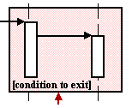
Symbols used in Sequence Diagrams:
Class roles:
The way an object will behave in the diagram
is described by class roles.
Activation:
Activation boxes represent the time an object needs to complete a task.
Messages: Simple
Messages are arrows that represent Synchronous
communication between objects. Asynchronous
Lifelines:
These are the vertical dashed lines that indicate the object's presence over time.
Destroying Objects:
Using an arrow labeled "< < destroy > >" that points to an X
the objects can be terminated early
Loops:
A repetition or loop within a sequence diagram is depicted as a rectangle.
Object: Class

Slide 10
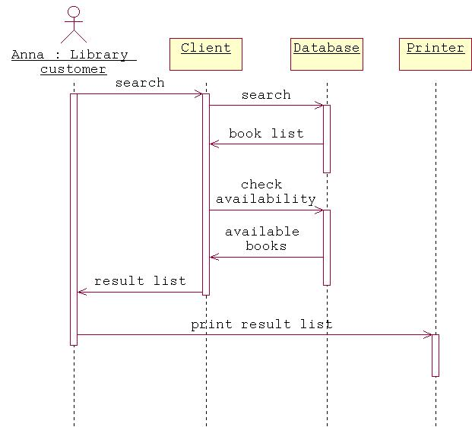
Example of a Sequence Diagram:
Customer

Slide 11


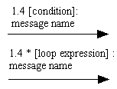
Collaboration Diagram:
Collaboration diagrams illustrate the relationship and interaction between software objects, and the sequence of messages exchanged between the objects during the interaction.
Each system operation initiates a collaboration diagram. Therefore, there is a collaboration diagram for every system operation.
This makes it easier to show how the objects are linked together, but harder to see the sequence at a glance.
Symbols used in collaboration diagrams
Class roles:
Class roles describe how objects behave.
Association roles:
Association roles describe how an association will behave given a particular situation.
Messages:
Sequence numbering can become nested
using the Dewey decimal system.

Slide 12
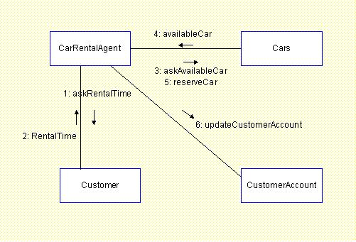
Example of collaboration Diagram:

Slide 13
State Chart Diagrams:
State chart diagrams are used for describing the behavior of classes, use cases, actors, subsystems, methods or operations.
The state chart diagrams are used to show the life cycle of a class.
This diagram models the dynamic flow of control from state to state within a system.
How to draw a State chart Diagram?
Drawing a state chart diagram is straightforward and also easy. We need to identify the following things to draw a state chart diagram.
  Identify the initial and final states.
  Identify the transitions leaving a state.
  Identify potential sub states.
  Identify a target state to which the transition leads.

Slide 14
Elements of state chart diagrams:
Initial State: This shows the starting point of the
state chart diagram that is where the activity starts.
State: A state represents a condition of a
modeled entity for which some action is performed.
The state is indicated by using a rectangle with
rounded corners and contains compartments.
Transition: It is indicated by an arrow. Transition is a
relationship between two states which indicates that Event/ Action
an object in the first state will enter the second state
and performs certain specified actions.
Final State: The end of the state chart diagram is
represented by a solid circle surrounded by a circle.

Slide 15
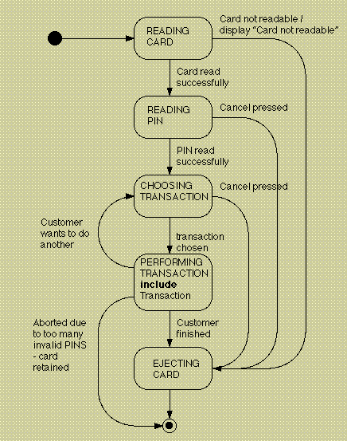
Example of a state chart diagram:

Slide 16
Queries ….. ?

