Slide 1
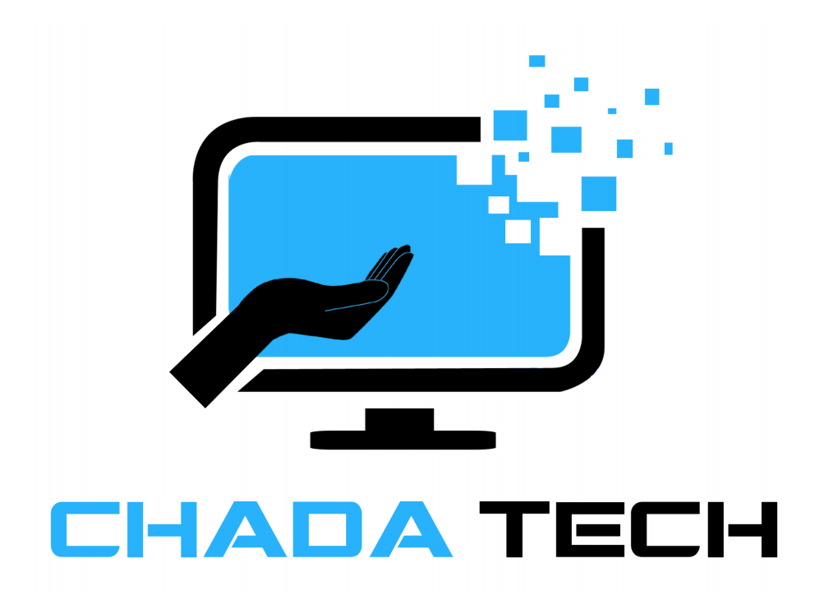
Final Project
Understanding Agile Methodologies
Mohamed Elmarzougui
2-25-2024

Slide 2

Roles in a Scrum-Agile Team
Product Owner:
The Product Owner represents the stakeholders and is responsible for defining and prioritizing the product backlog.
Importance: The Product Owner ensures that the team is working on the most valuable features and that the product meets the needs of the customers and stakeholders.
Scrum Master:
The Scrum Master serves as a facilitator for the team, ensuring that the Scrum framework is understood and followed.
Importance: The Scrum Master removes impediments, fosters an environment of collaboration, and helps the team become self-organizing and cross-functional.
Development Team:
The Development Team consists of professionals who are responsible for delivering the product increment.
Importance: The Development Team collaborates closely with the Product Owner to understand requirements and with the Scrum Master to address any obstacles, ensuring the timely delivery of high-quality work.

Slide 3
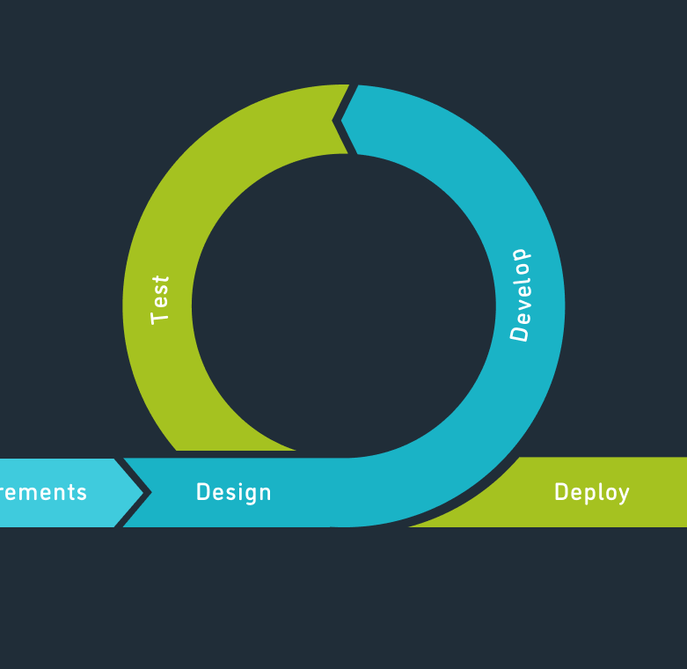
Phases of SDLC in Agile Approach
Planning:
Create a prioritized product backlog.
Importance: Align team and stakeholders and set project goals.
Development:
Work in short iterations (sprints).
Importance: Deliver small, incremental releases.
Testing:
Continuous testing alongside coding.
Importance: Identify and address defects promptly.
Deployment:
Deploy potentially shippable increments.
Importance: Gather feedback and validate assumptions.

Slide 4

Contrasting Waterfall with Agile
Waterfall Approach:
Sequential, linear approach with distinct phases: Requirements, Design, Implementation, Testing, and Deployment.
Each phase is completed before moving to the next.
Emphasis on extensive upfront planning and documentation.
Agile Approach:
Iterative, incremental approach with flexible phases: Planning, Development, Testing, and Deployment.
Phases overlap and are revisited iteratively.
Emphasis on adaptive planning, continuous collaboration, and delivering working software.
Notes:
Example:
Problem Scenario:
Requirement change occurs midway through development.
Waterfall Approach:
Change requires revisiting the requirements phase, possibly impacting design and subsequent phases.
Delayed change implementation may lead to increased costs and time.
Agile Approach:
Change accommodated within ongoing Sprint or addressed in subsequent sprints.
Flexibility allows for quick adaptation without major disruptions to project timeline.

Slide 5

Factors for Choosing Approach
Considerations:
Project Requirements:
Complexity, scope, uncertainty.
Waterfall: Well-defined, stable requirements.
Agile: Evolving or uncertain requirements.
Team Expertise:
Skill level, familiarity.
Waterfall: Experience in sequential processes.
Agile: Collaboration, self-organization.
Client Involvement:
Collaboration, feedback.
Waterfall: Clear, fixed expectations.
Agile: Ongoing collaboration, and feedback.

Slide 6
References
Sarah M. Hoban. "Agile vs Waterfall: Which Methodology To Choose?" The Digital Project Manager, Dec 6, 2023. [Link: https://thedigitalprojectmanager.com/projects/pm-methodology/agile-vs-waterfall/]
Charles G. Cobb. (2015). The Project Manager’s Guide to Mastering Agile : Principles and Practices for an Adaptive Approach.

