Slide 1
Homicide Trends in Major Cities (2000–2007)
290353

Slide 2
Introduction
This presentation analyzes homicide trends from 2000 to 2007 in four major cities: Berlin, Warsaw, Ankara, and London. Data comes from Eurostat’s CRIM_HOM_CITY dataset.

Slide 3
Dataset Overview
We use the dataset estat_crim_hom_city_filtered_en.csv.gz. It includes the number of homicides reported annually by police departments in selected European cities.
city year homicides 1 Berlin 2000 225 2 Berlin 2001 114 3 Berlin 2002 89 4 Berlin 2003 72 5 Berlin 2004 66 6 Berlin 2005 51

Slide 4
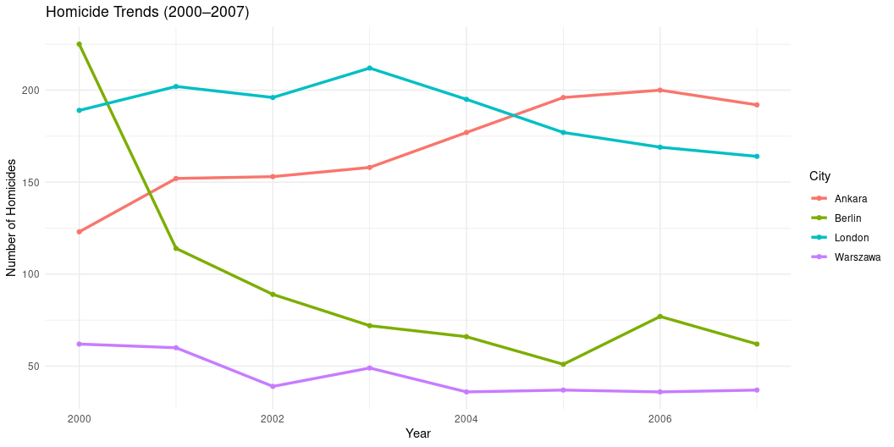
Homicide Trends by City

Slide 5
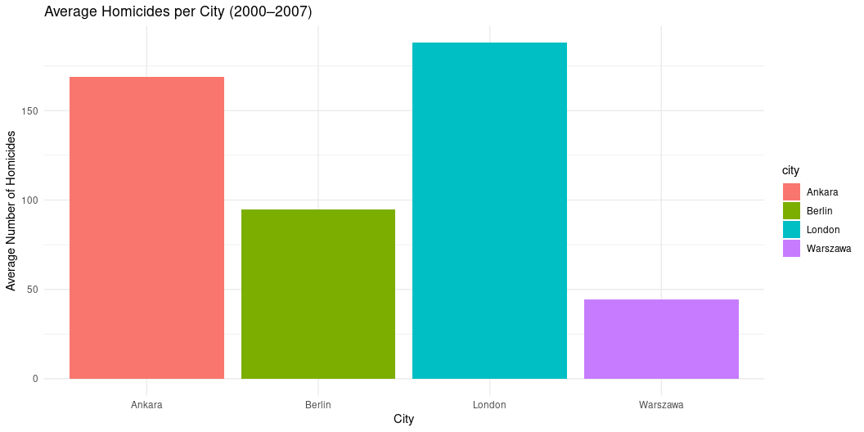
Average Homicides per City

Slide 6
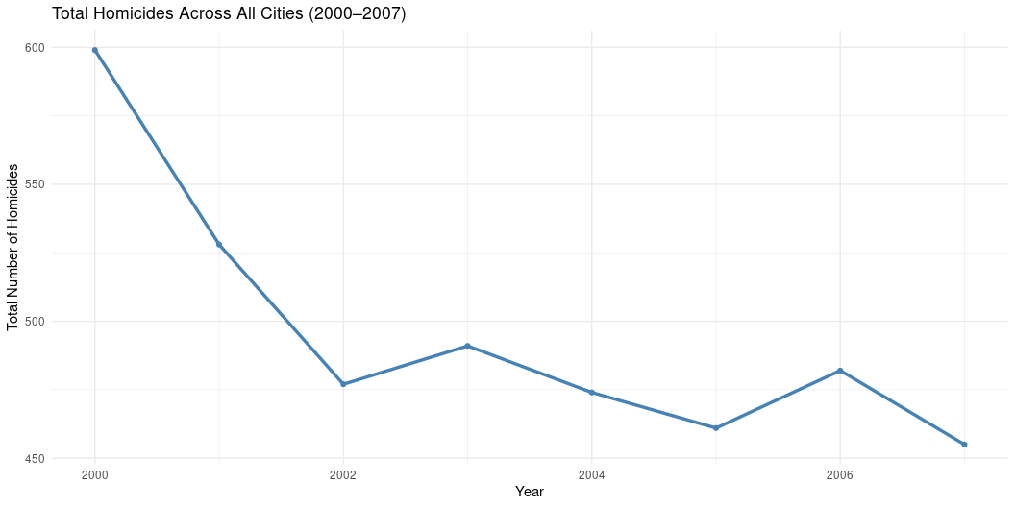
Total Homicides Over Time

Slide 7
Conclusion
Berlin and London show declining homicide trends.
Ankara and Warsaw maintain higher, steady rates.
Overall, total homicides decrease slightly across the selected cities.
We recommend continued monitoring and cross-city collaboration on violence prevention.

