Slide 1

Foldseek
Presented by Emelie Koza and Pauline Moser

Slide 2
What is Foldseek?
A protein structure search tool that compares 3D protein structures at remarkable speed
Compares based on structure, allows for detection of distantly related proteins
The problem: millions of protein structures now exist and traditional search tools are far too slow to handle this scale.
The solution: Foldseek converts the 3D shape of a protein into a linear sequence of characters
The result: Structures can be compared faster than with classical tools

Slide 3
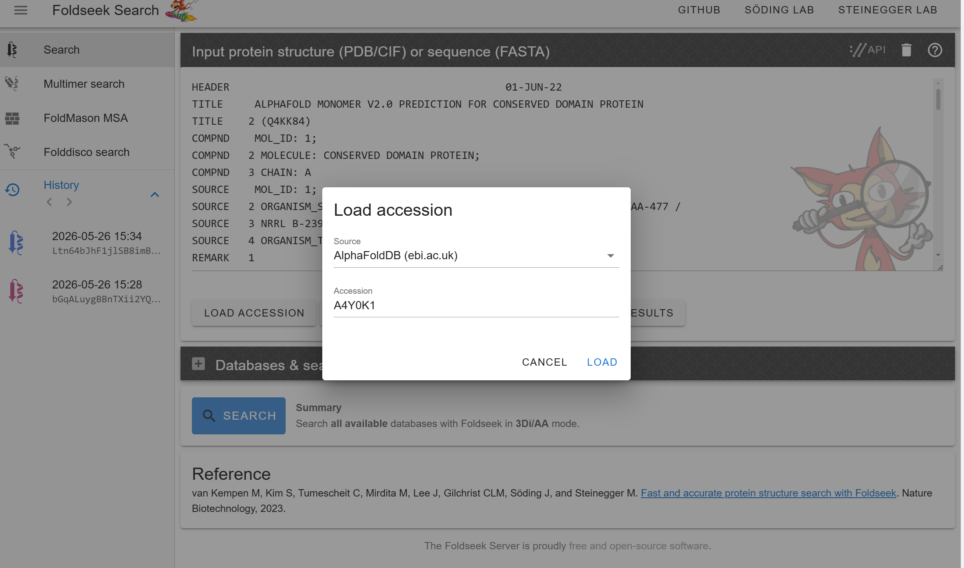
How does it work?
Notes:
Copy the accession number and change the database to Alpha Fold

Slide 4
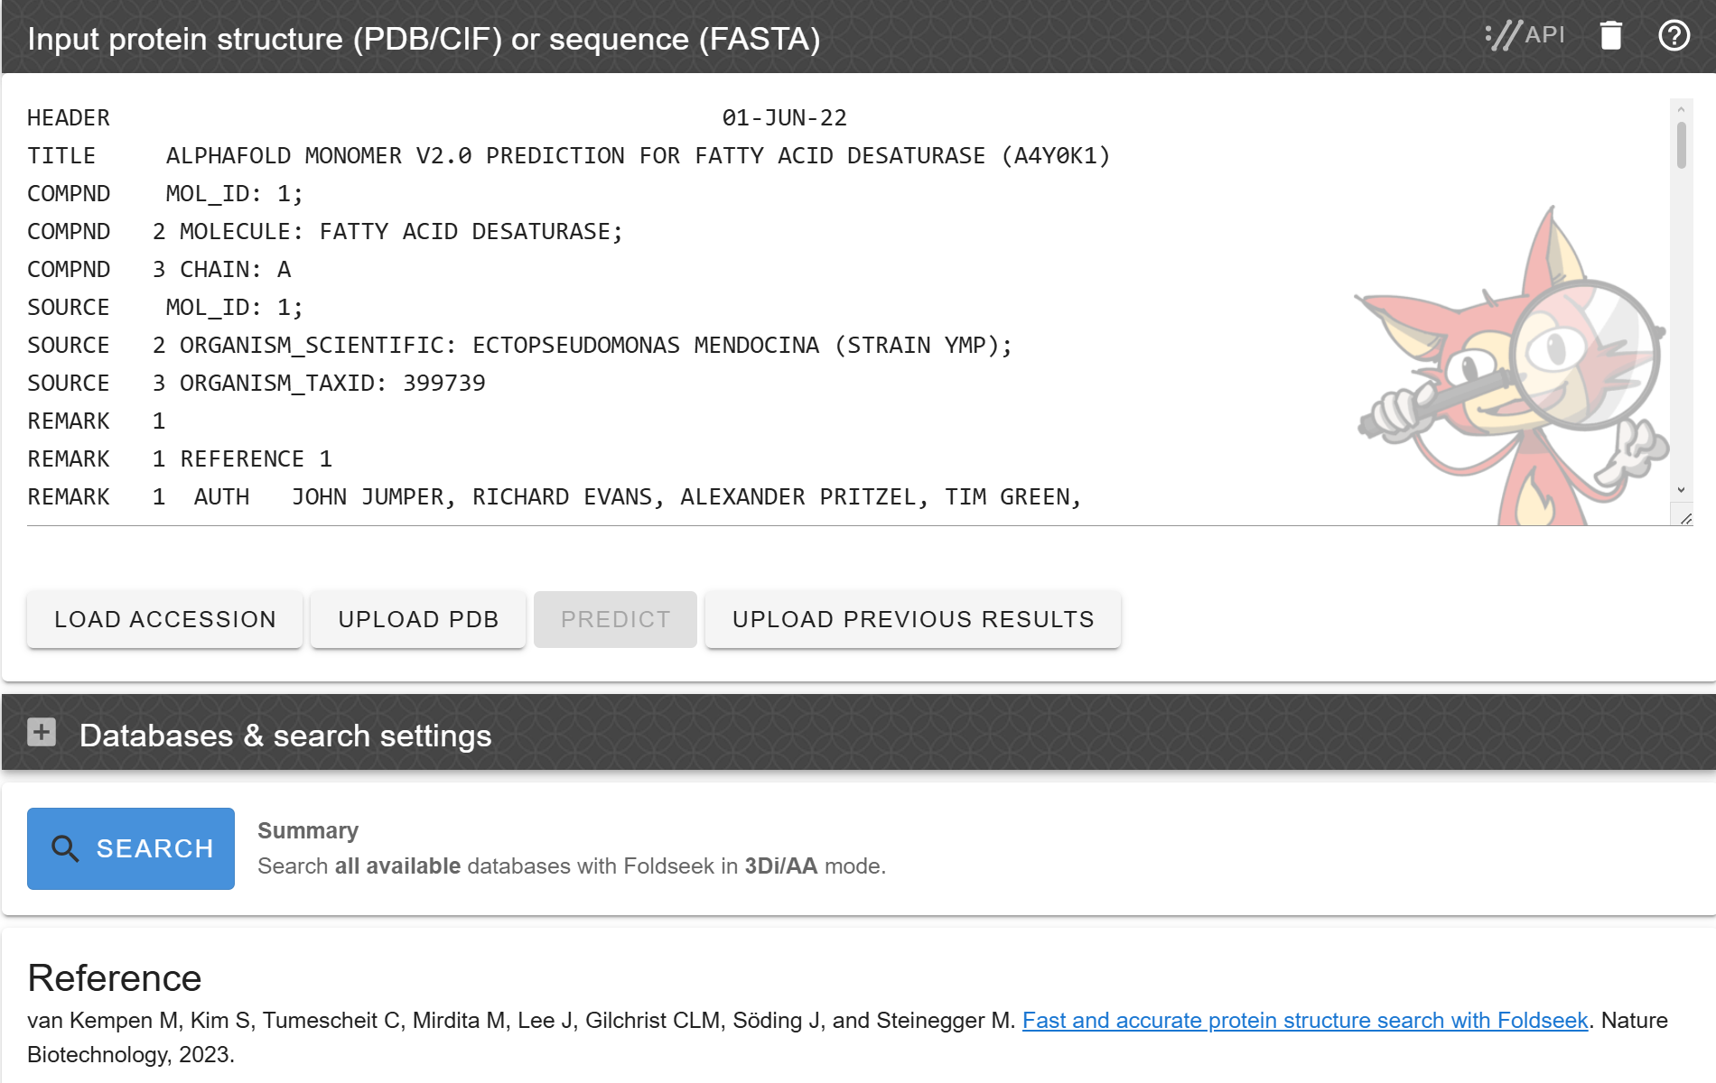

Slide 5
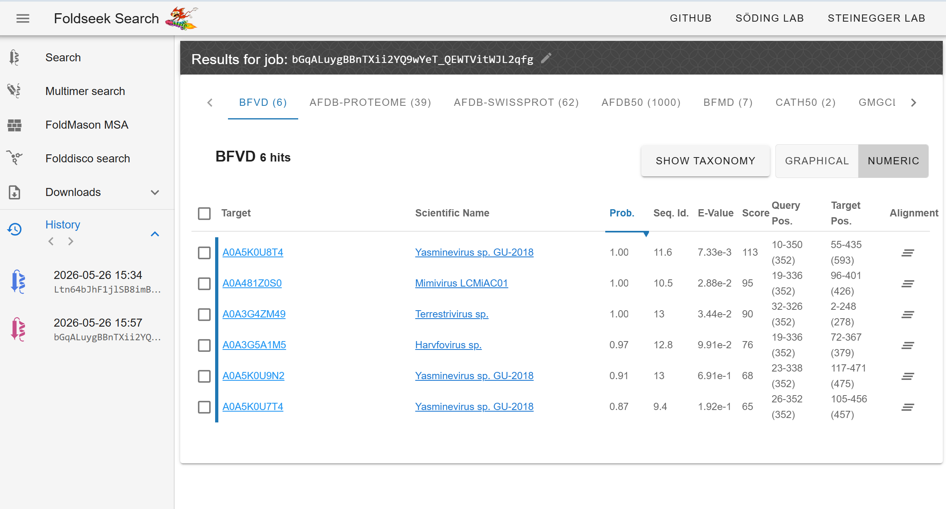
Notes:
Foldseek supports both Monomer and Multimer search

Slide 6
Why Foldseek Matters
The Problem => Comparing protein structures is usually:
Computationally expensive
Slow for huge databases
Difficult at large scale
What Foldseek enables:
Ultra-fast protein structure search
Comparison of millions of structures
Scalable structural bioinformatics
=> Foldseek made structures comparison practical for the AI-generated protein era.
Notes:
“Foldseek is a modern tool for fast protein structure comparison. Since another presenter explains how it works, I will focus on its advantages, disadvantages, and applications.”

Slide 7
Advantages & Disadvantages
Advantages
Extremely fast
High sensitivity
Scalable
Open & accessible
Disadvantages
Approximation trade-off
Less accurate than full structural alignment
Requires structural data
Learning curve
Notes:
“The biggest advantage is speed. Foldseek can compare millions of protein structures very efficiently. It is also sensitive enough to detect structural similarities even when sequences differ strongly.”
“The main disadvantage is that the speed comes from approximations. Therefore, very detailed alignments may be less accurate than with classical structural alignment tools.”

Slide 8
Applications
Protein function prediction
infer protein function from structural similarity
Evolutionary biology
identify distant homologs
Drug discovery
search for structurally related drug targets
AI protein databases
analyze AlphaFold-generated structures at scale
Academic research
large-scale comparative structural studies
Notes:
“Foldseek is widely used in protein function prediction, evolutionary biology, and analysis of AlphaFold databases. It is also becoming important in drug discovery.”

Slide 9
It is not always the most precise method, but it enables protein structure searches at a scale that was previously impossible.
Notes:
“In summary, Foldseek changed structural bioinformatics by making large-scale protein structure search practical.”

