Slide 1
Taylan Özgür Elma SE 4458 Midterm 1 API Project for Mobile Provider Bill Payment System PresentatIon

Slide 2




Technologies i used in my API project
Python-Flask
SQLAlchemy(ORM)
Postman (Test and Documentation)
IDE PyCharm

Slide 3
ER Diagram

Slide 4
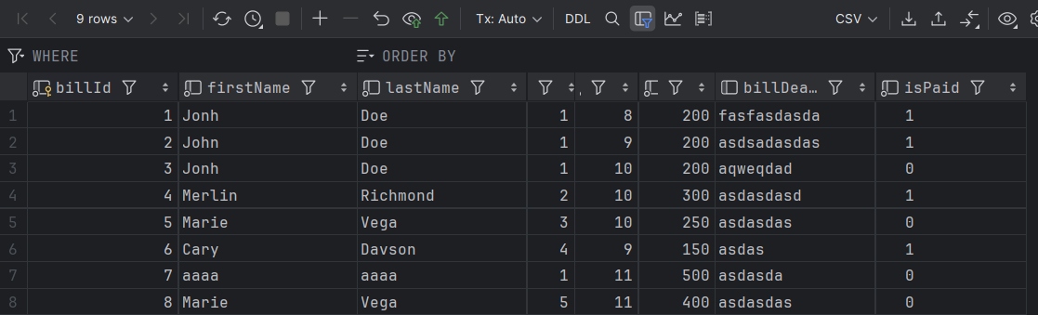
SAMPLE DATABASE

Slide 5
All Possible Scenarios for My APIs

Slide 6
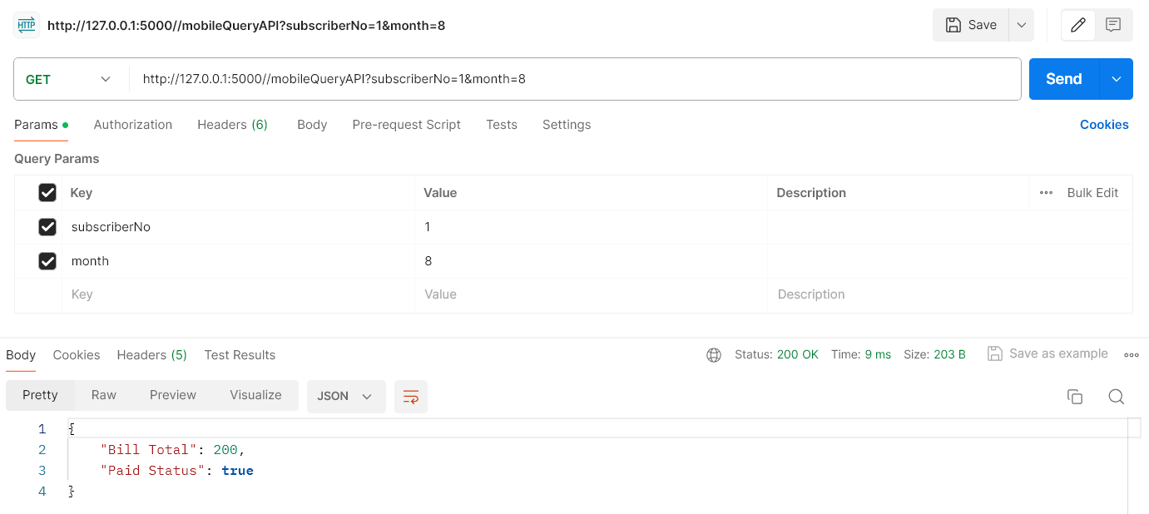
MobileProviderAppQueryBillAPI GET
SUCCESSFUL (200)
Parameters: (SubscriberNo, Month) API Response: (Bill Total, Paid Status)

Slide 7
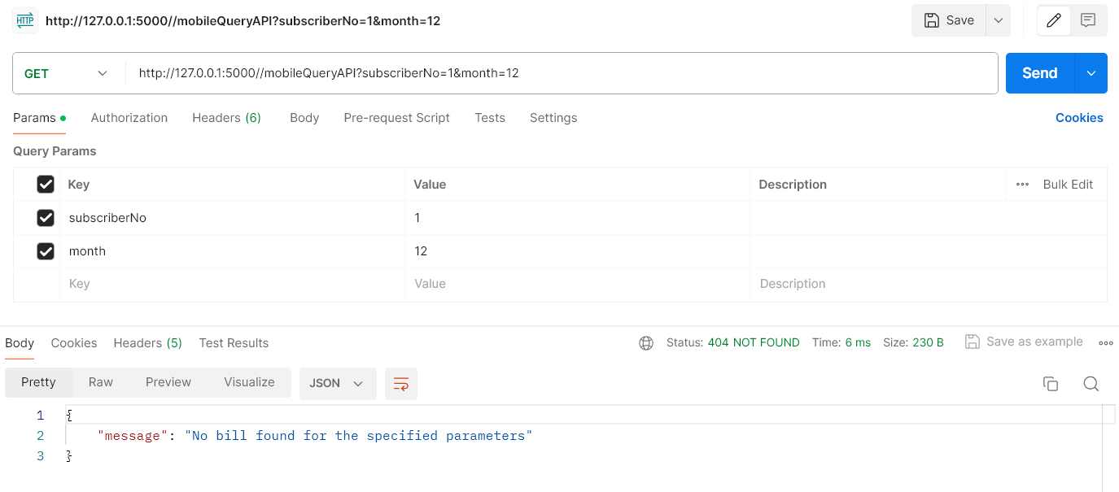
MobileProviderAppQueryBillAPI GET
NOT FOUND (404)
Parameters: (SubscriberNo, Month) API Response: (Bill Total, Paid Status)

Slide 8
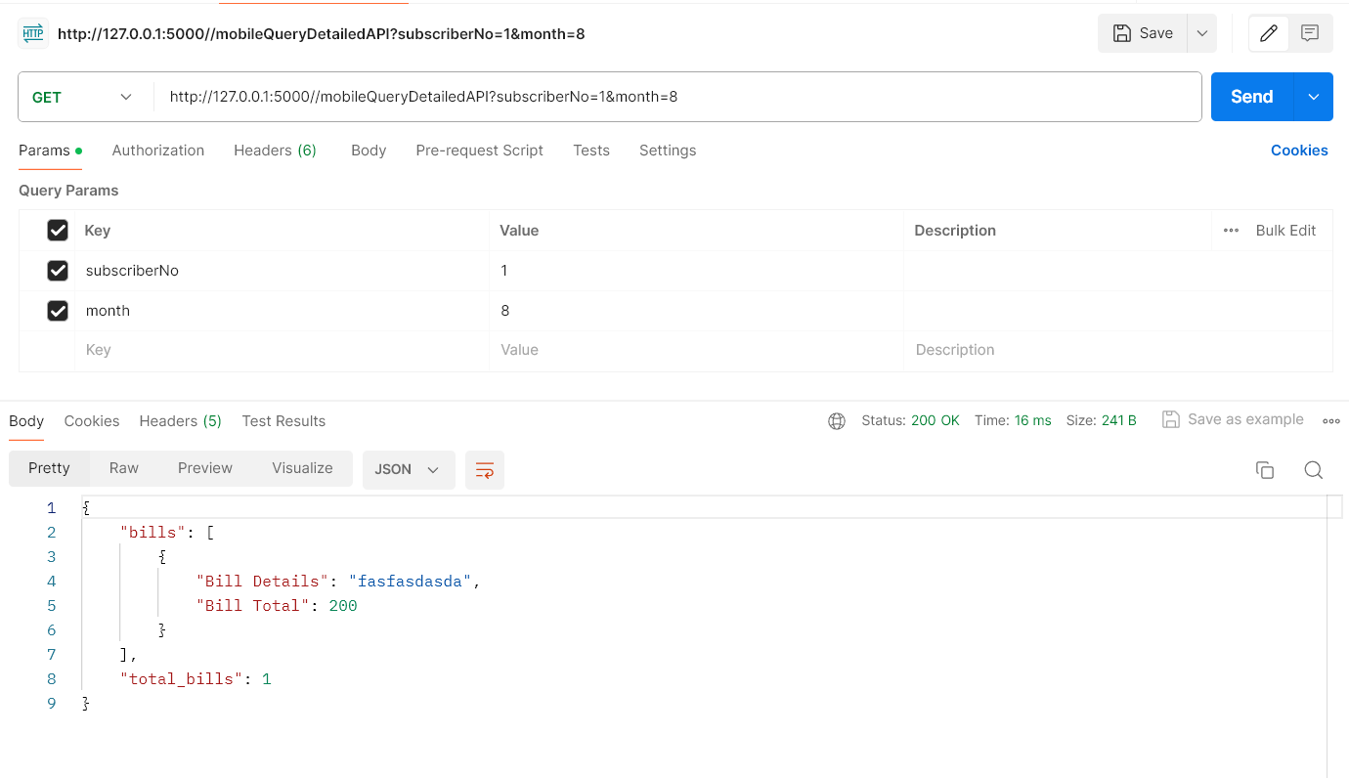
MobileProviderAppQueryBillDetailedAPI GET
SUCCESSFUL (200)
Parameters: (SubscriberNo, Month) API Response: (Bill Details, Bill Total)

Slide 9

MobileProviderAppQueryBillDetailedAPI GET
NOT FOUND (404)
Parameters: (SubscriberNo, Month) API Response: (Bill Details, Bill Total)

Slide 10
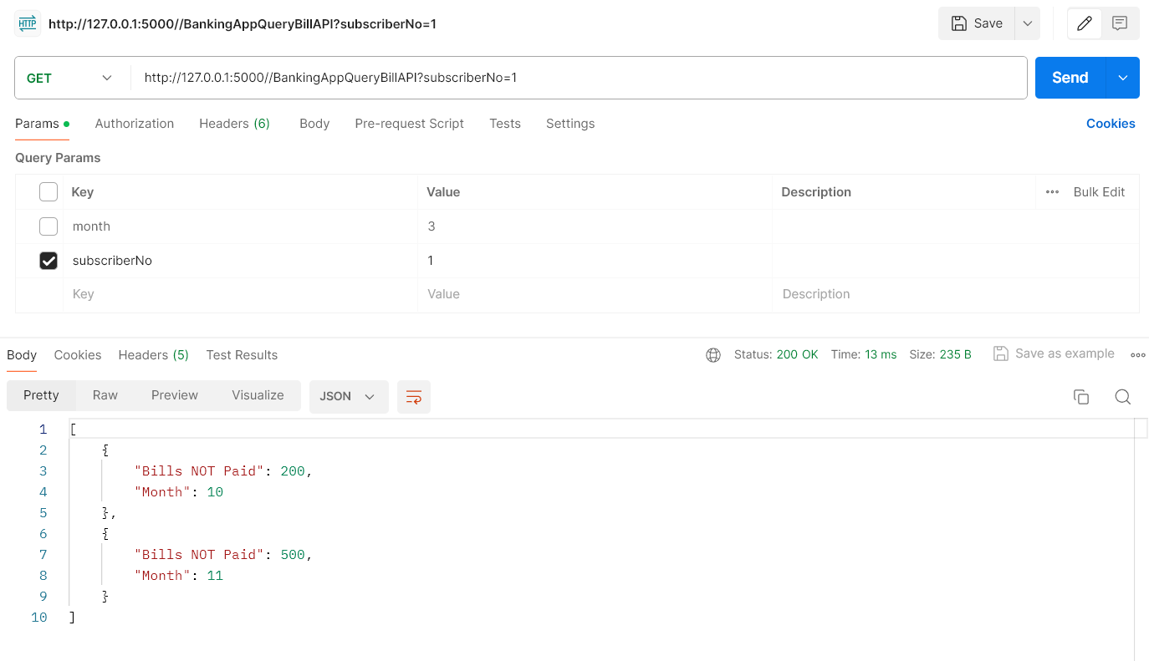
BankingAppQueryBillAPI GET
SUCCESSFUL (200)
Parameters: (SubscriberNo) API Response: (Bills NOT Paid, by month)

Slide 11
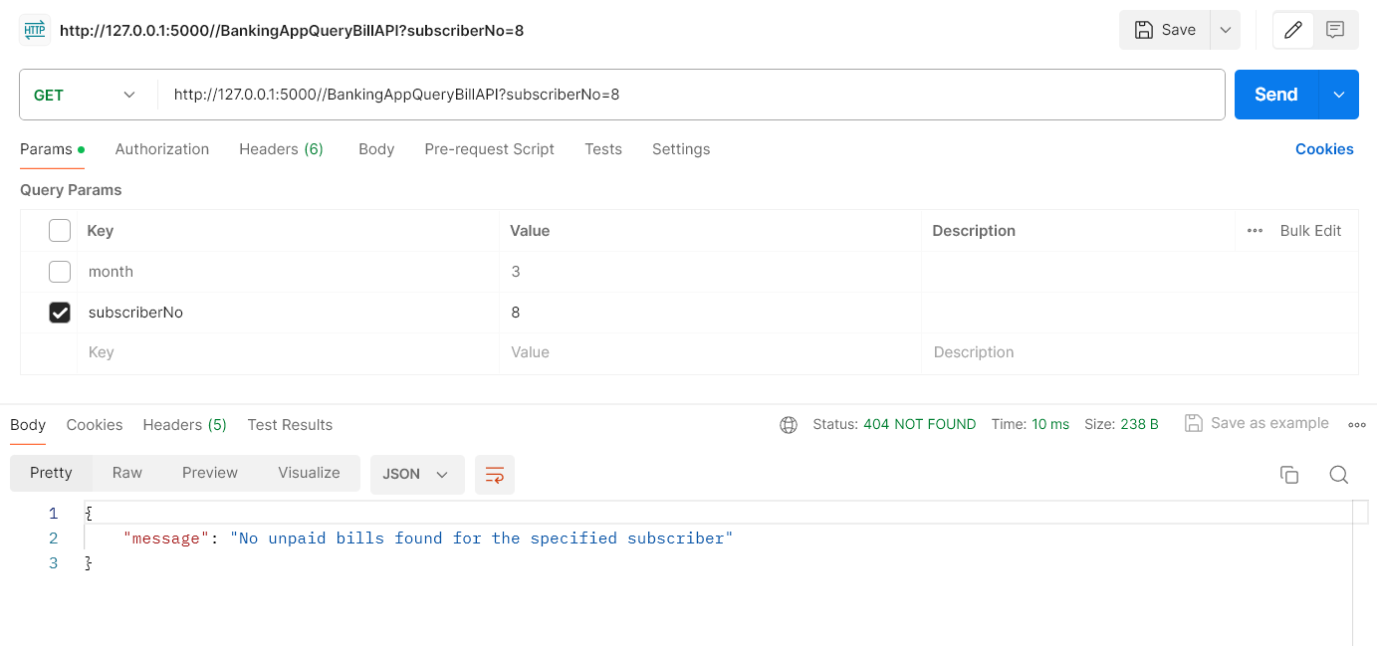
BankingAppQueryBillAPI GET
NOT FOUND (404)
Parameters: (SubscriberNo) API Response: (Bills NOT Paid, by month)

Slide 12

WebSitePayBillAPI PUT
SUCCESFUL (200)
Parameters: (SubscriberNo, Month)
API Response: (Payment Status: Successful, Error)

Slide 13
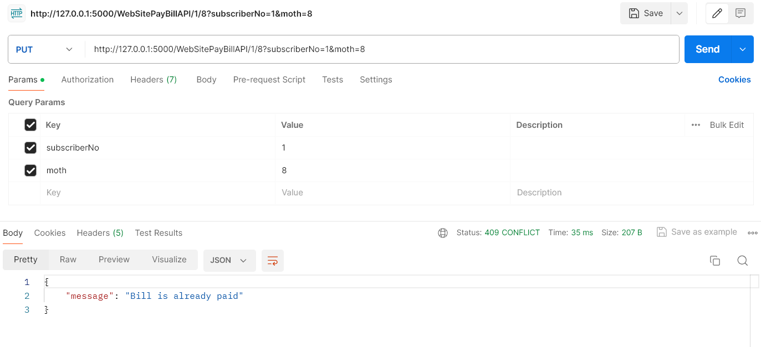
WebSitePayBillAPI PUT
CONFLICT (409)
Parameters: (SubscriberNo, Month)
API Response: (Payment Status: Successful, Error)

Slide 14
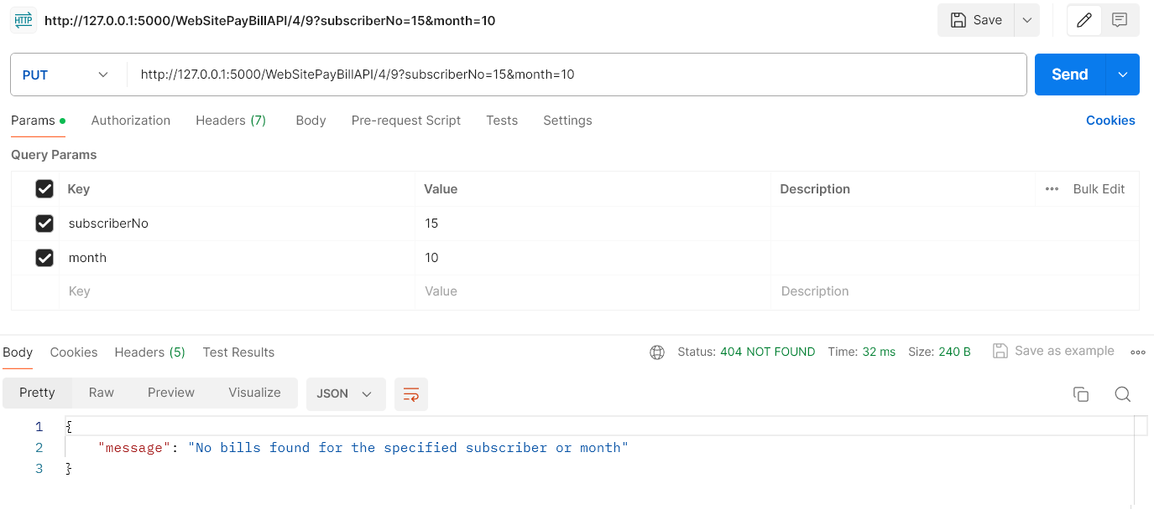
WebSitePayBillAPI PUT
NOT FOUND (404)
Parameters: (SubscriberNo, Month)
API Response: (Payment Status: Successful, Error)

Slide 15
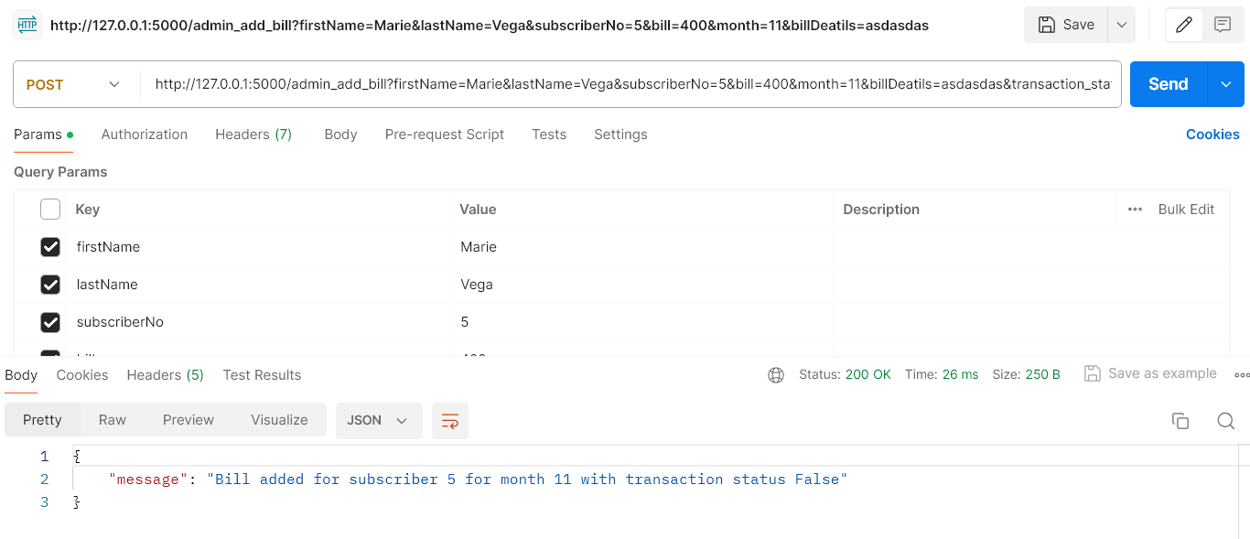
WebSiteAdminAddBillAPI POST
SUCCESFULL (200)
Parameters: (SubscriberNo, Month, Transaction Status, First Name, Second Name, Bill Total, Bill Details) API Response: (Transaction status)

Slide 16
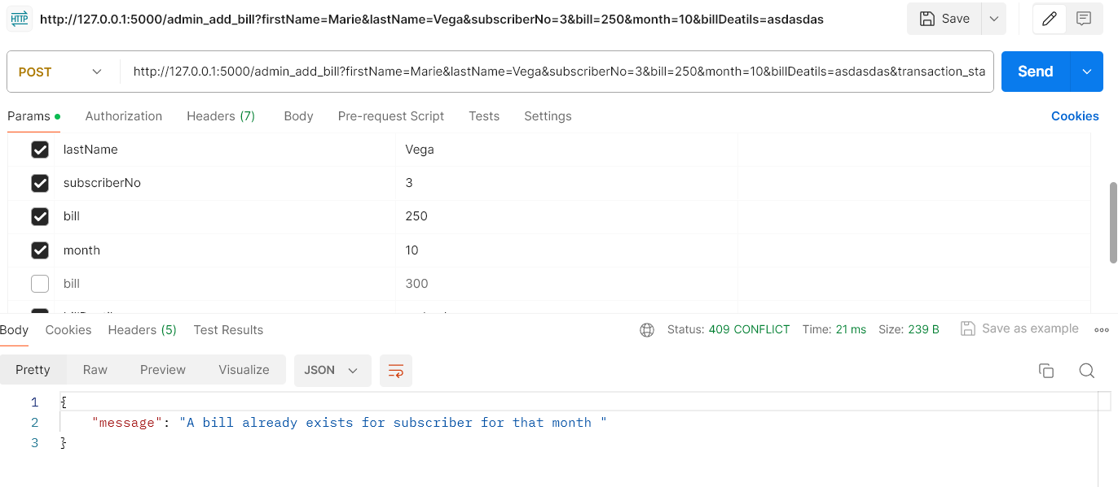
WebSiteAdminAddBillAPI POST
CONFLICT (409)
Parameters: (SubscriberNo, Month, Transaction Status, First Name, Second Name, Bill Total, Bill Details) API Response: (Transaction status)

Slide 17
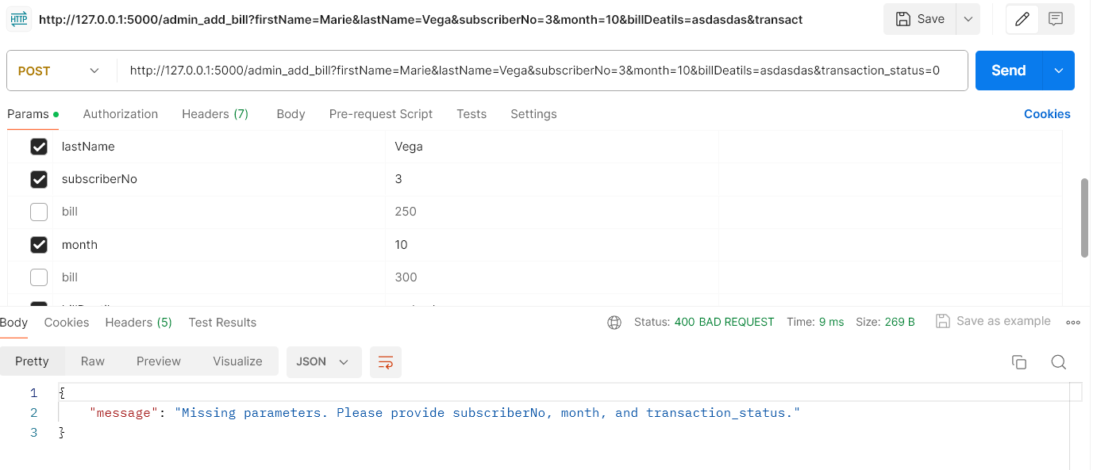
WebSiteAdminAddBillAPI POST
BAD REQUEST (400)
Parameters: (SubscriberNo, Month, Transaction Status, First Name, Second Name, Bill Total, Bill Details) API Response: (Transaction status)

Slide 18
THANK YOU For LISTENING

Slide 19
REFERENCES

