Slide 1
Police involved Fatalities
May 2013 to June 2015

Slide 2
This project explores data around police involved fatalities that occurred in the United States between: May of 2013 and June of 2015.
Information gathered includes:
Name
Date of Death
Cause of Death
Age - victim
Race - victim
Gender - victim
City , State
Whether or Not the victim was armed
Whether or Not the victim had priors
Photos of the deceased
Attending news stories
Whether or Not the officer involved was fired
Information included in analysis:
Cause of Death – all considered Fatalities
Age Range - victim
Race - victim
Average Household Income Range – State
Population Density – State
Political Leaning (Rep / Dem) – State
Whether or Not the victim was armed
Whether or Not the victim had priors
Whether or Not the officer involved was fired

Slide 3
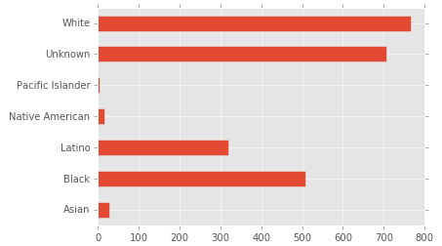
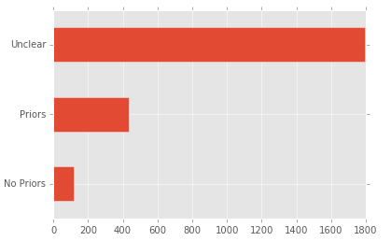
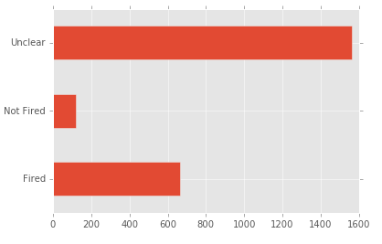
The Grains of Salt
1. I’m bipartisan as can be and have no political science background. Any and all theorizing based on the data was done for fun and free will with no intent to cast judgment on any party.
2. Variable Transformations were gross, very gross:
Political Leaning of State – was based on 2014 data. There is only about a 1o percent swing that assigns these, this cannot be read into too much.
Average household income of state was calculated based on 2014-2016 data. These dates do not entirely align with date range of fatality data.
Population Density should just never be looked at and assessed on the State level. All States are a mix of urban and rural.
3. The data acquired relatively clean but plagued with ambiguity:

Slide 4
All Disclaimers Aside
Hypothesis:
This project attempted to answer the question of whether or not it was possible to predict – with any accuracy – whether or not the police officer involved in the fatal encounter was fired based on relevant features of the data.
A larger part was inferential – the assumption being this could not be predicted with any accuracy: 70 percent of the samples were labeled as unclear with regard to whether or not the police officer involved was fired. So, the journey became determining which variables were the highest contributors to whether or not the police officer involved was fired….

Slide 5



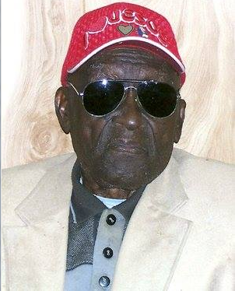
The Data
Samples / Outliers
Monroe Isadore was my only outlier.
After irrelevant fields were dropped Age was really my only field upon which to find outliers.
Data was acquired while trying to suck up to Crowdflower while interviewing for a position.
Visualization of the data was started in Tableau.
Do you think he was 107?

Slide 6
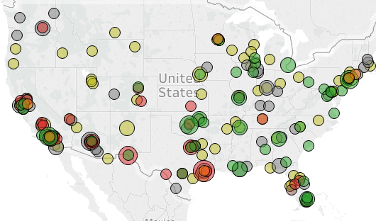
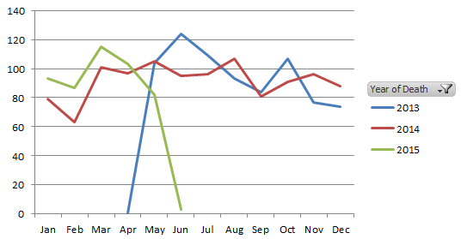
Without further ado…the other two fields that were debatably removed were:
City &
Time
I didn’t have enough data (2354 samples) to assess the fatalities as a time series.
Because of the segmented nature of the years, it was difficult to assess for seasonality as well
So time got dropped.
Data was classified based on characteristics of the state where the incident occurred, in hindsight I would have assessed more based on city, I just didn’t think I had enough data to do this.

Slide 7
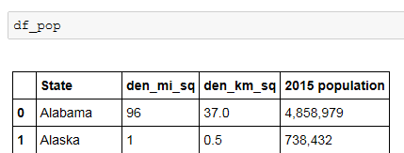
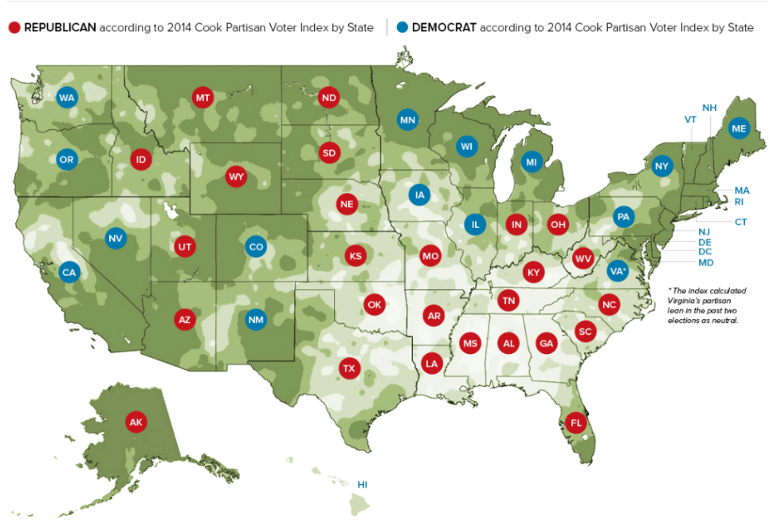
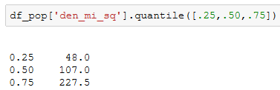
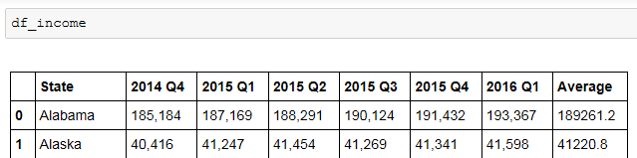
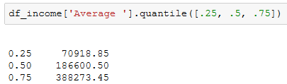
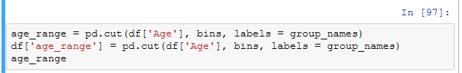
Variable Transformations
Population Density /
Avg. Household Income
Political Leaning /
Age Range
< 50 K per sq. mi.
50 K – 110 K per sq. mi.
110 K – 200 K per sq. mi.
> 250 K per sq. mi
Age Range:
< 75 K per year
75 K – 200 K per year
200 K – 400 K per year
> 400 K per year
< 25, 25 -34, 35 - 44, 45 - 54, 55 - 65, > 65
Notes:
2014 was selected as the year to base the categories on because the bulk of the date comes from 2014. Only the latter half of the 2013 was included in the data set and the early half of 2015 was included in the data set.
The assumption that drove the desire to look at these variables in this manner was that was perhaps there were legislative differences in the states based on whether they were republican or democratic 2014. I did not have time to do the research to verify this but at a later date I would like to.
This provides a pretty gross categorization for the states, the dates do not entirely line up and I am using the average to classify the states anyway. The dates of the police involved fatality data spans mid 2013 to mid 2015 and the income data spans Q4 of 2014 to Q1 of 2016. Unfortunately with the time that I had this was the cleaniest and easiest data for me to find and work with. All data was incorporated including 2016 simply because I figured the more data I had the better my average would be.
In hindsight this might not have been the best choice simply because unemployment was at it's lowest since the recession in 2016 and obviously this would have a positive impact on the average income. Since unemployment is a feature that I assumed or anticipated would have an impact on the number of police involved fatalities it would have been best for this variable to be as accurate as possible but, alas, time.

Slide 8




The Workable Data

Slide 9
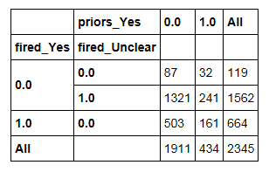
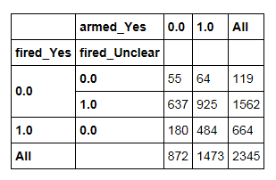


Crosstabs
Priors
Armed
The above two crosstabs reveal an interesting aspect about the data:
From the priors crosstab it is clear that more officers were fired in instances where the victim did not have priors and the armed crosstab reveals that more officers were fired in instances where the subject was armed than in instances where the subject was not.
This seeming discrepancy is explained by the counts below, there were significantly more victims that were definitively armed than there were instances where the victim definitively had priors.
Notes:
The coefficients here are kind of the opposite of what I would have anticipated. They are all negatively correlated, which we would expect because the response variable is about 70 percent 0 (fired_no and fired_unclear) but the coefficients show that if it is unclear whether the victim was armed or it is definitively known that the victim was not armed then positive input of 1 for these variables drives the target variable to zero (meaning the officer would not be fired) faster than if it is definitely known that the victim was armed. I would have thought that if the victim was definitely armed the officer involed ouwld be less likely to be fired.

Slide 10
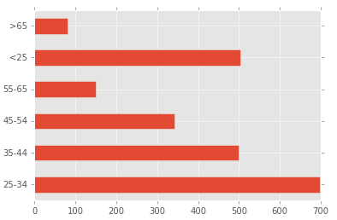
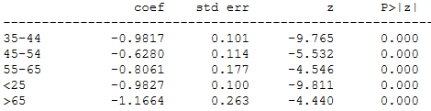
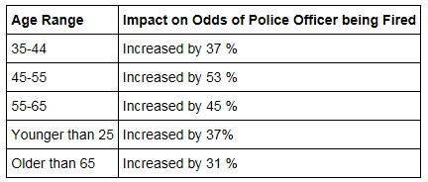
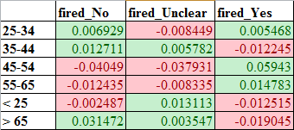
Age Range Analysis
Every age range is negatively correlated with the police officer involved being fired compared to the baseline age range of 25-34.
All age ranges are significant compared to baseline of 25-34.
In hindsight it would have been interesting to break out minors.

Slide 11
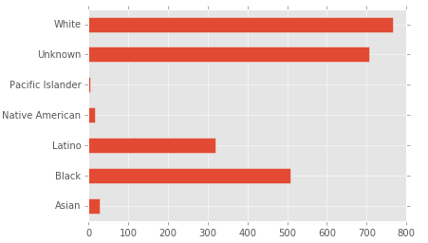
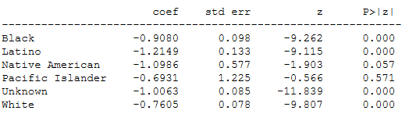
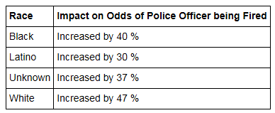
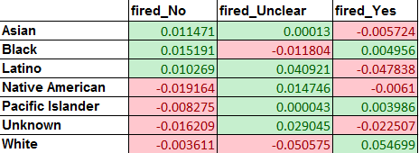
Race Analysis
Native American and Pacific Islander are not significant compared to baseline. (Asian).

Slide 12
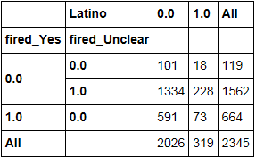
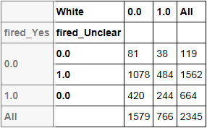
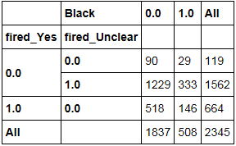
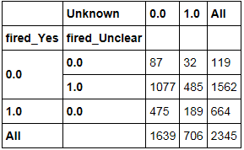
Race Analysis Continued
17.0 % of U.S. Population
63 % of U.S. Population
319 / 2345 = 14 %
73 / 319 = 23% of fatal encounters involving a Latino victim resulted in the officer being fired.
766 / 2345 = 33 %
244 / 766 = 32% of fatal encounters involving a White victim resulted in the officer being fired.
12.3 % of U.S. Population
Multi-Racial Americans - 2.4 % of U.S. Population
508 / 2345 = 22 %
146 / 508 = 29% of fatal encounters involving a Black victim resulted in the officer being fired.
706 / 2345 = 30 %
189 / 706 = 27% of fatal encounters involving a victim of Unknown race resulted in the officer being fired.

Slide 13
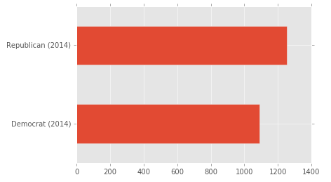


Political Leaning Analysis
This is compared to democratic states as baseline. The odds ratio below reveals that if the fatal encounters location moved from a blue state to a red state the odds of the officer involved being fired increases by 47 percent.
This is also intriguing because it seems like the majority of the uproar socially comes from the more liberally leaning. However, it appears that there might be some legislative inertia in these states that makes it difficult for the police officer involved to be fired, and vice-versa.

Slide 14
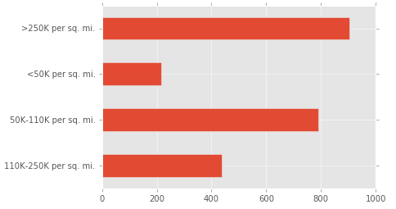
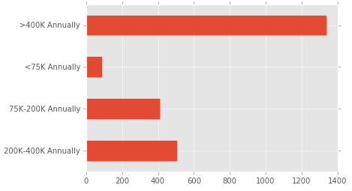
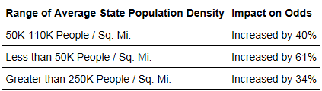
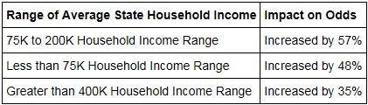
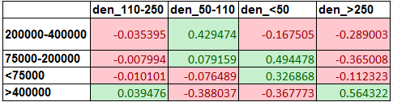

Income and Population Density
Notes:
These variables are not as highly correlated as I was expecting, especially within the more average ranges. Where there actually seems to be correlations is within the extremes:
Population density of less than 50K per square mile is highly correlated with an income range of 70K to 200K per year and is quite highly correlated with an income range of less than 75K per year. As one would anticipate it is negatively correlated with the other two income ranges.
At the other end of the spectrum, a population density of greater than 250K per square mile is highly correlated an income range of > 400K per year. It is negatively correlated with all other income ranges. The most negatively correlated with middle income (between 75K to 200K per year) this is indicative of wealth disparity that is generally seen in populous / urban areas.
All the various population density ranges of the 50 states are significant and they're all negatively correlated with the police officer involved being fired. The population density of 110-250 thousand people per square mile was used as baseline so the increase in the odds of the officer involved being fired can be understood as the population density deviates from that range.
The highest population density is most negatively correlated with the officer involved being fired and this is as I would have anticipated. It should be noted that looking at population density on the scale of state isn't very interpretable and is a very gross approximation. I didn't have time to look at this by city but doing so would have a lot more value and I may try to cut the data that way at a later date.
Regardless the order of correlations was more or less as would have anticipated, with the most populous places leading to the least number of police officers involved being fired. With the median income level's range being the baseline.
My reasoning here is that populous implies urban meaning which would indicate that probably more samples came from these areas and given that 70 percent of all samples did not lead the officer involved being fired one might anticipate this high negative correlation.
Again, all variables are negatively correlated with the officer involved in the fatal encouter being fired and all relevant variables are significant compared to the baseline of the average household income range of 200000 to 400000.
It should definitely be noted that high density areas are probably correlated with high income. Similar to San Francisco. And there is also probably a corrleation between low density and the political leaning of the state.
An average household income of greater than 400000 was the most negatively correlated with the police officer involved being fired. All disclaimers aside about the quality of the data and the gross generalizations and wild assumptions but solely for the fun of theorizing it this implies that higher income populations are more sympathic to police and less sympathetic to lower income populations.
The same issue exists here as it did above, that looking at average income of the state is probably too gross of a classification, this should probably be looked at on a more granular scale and then be grouped by the larger classification of republican / democrat. I think because of this, this is largely not interpretable. I am starting to think this because average income would be shifted by cost of living etc., (particularly, I think this because of where we live) it seems as though household income could be much more relative than I initally really gave it credit for.
All that aside, what the data suggests based on the analysis done is that, the police officer involved in a fatal encounter is more likely to be fired if the fatal encounter occured in both a less populous state (from above) and a less wealthy state. These seems like correlated variables now that I am thinking about that, I am not sure how to check and see if this is or isn't the case right now.

Slide 15
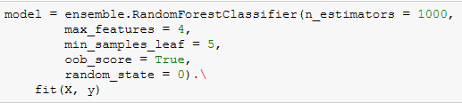

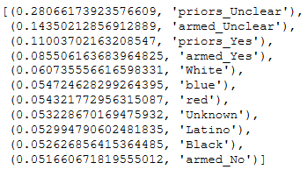
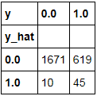


Lastly, the model

