Slide 1
Saline Lakes Land Ownership - Great Basin & Great Salt Lake

Slide 2
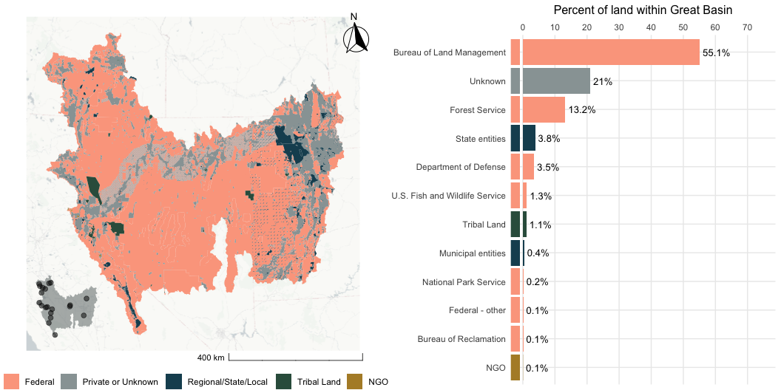
Great Basin

Slide 3
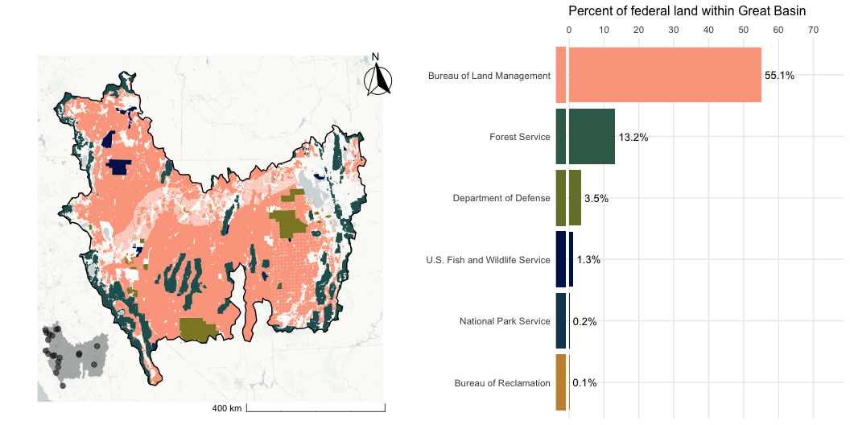
Great Basin - Federal Lands

Slide 4
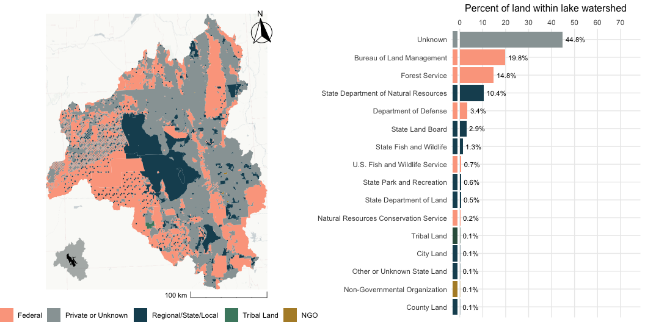
Great Salt Lake, UT

Slide 5
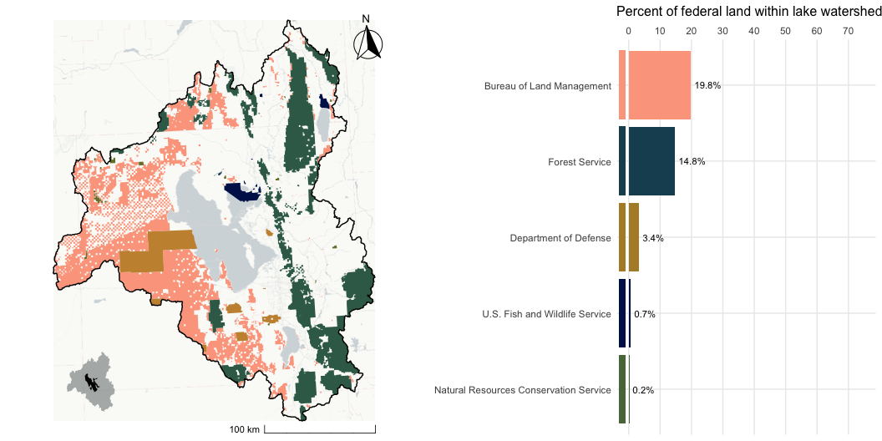
Great Salt Lake, UT - Federal Lands

