Slide 1
Trees and graphs
Joe Napoli
7-29-19

Slide 2
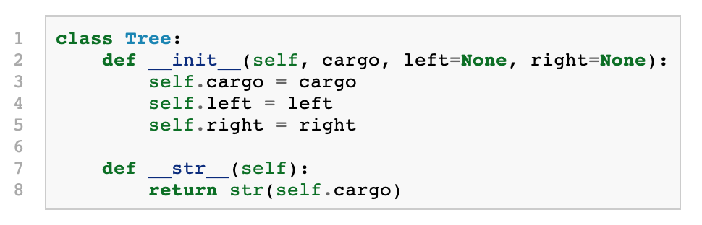
Trees
Process of constructing trees is analogous to that of linked lists, except each node may have more than one connection to other nodes.
Like linked lists, each node contains cargo (a value) and pointers:

Slide 3
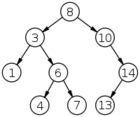
Terminology: binary search tree example
Root
Branch
Leaves
Depth = 3

Slide 4
Tree traversal
Unlike linked lists or arrays, trees are not linear data structures and therefore they can be traversed in multiple ways.
Traversal may be implemented iteratively using data structures like stacks or queues, or recursively. Depth-first traversal is inherently recursive.
Orderings
Pre-order (N-L-R)
In order (L-N-R), which retrieves data in sorted order for binary search tree.
Post-order (L-R-N)
Name refers to when the parent node is processed

Slide 5
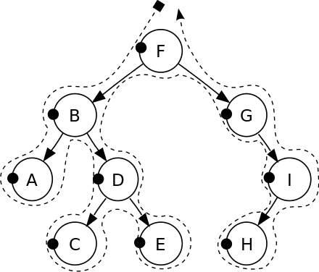
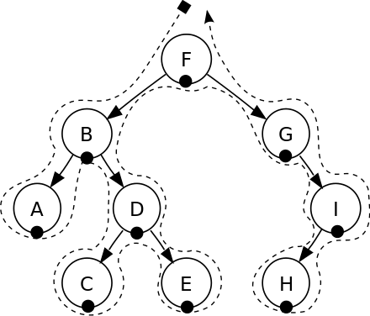
Tree traversal: pre-order vs in order
pre-order
in-order

Slide 6
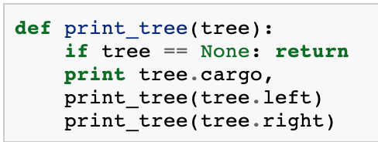
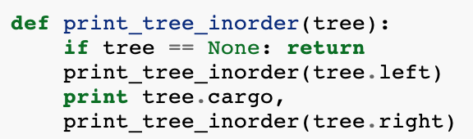
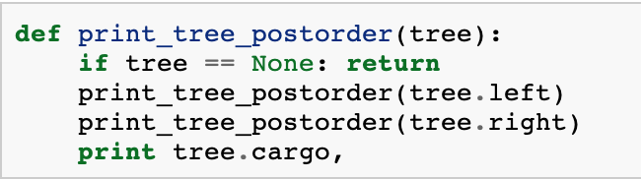
In code: DFS recursive implementation
Only thing that varies between these implementations is where the print statement is.
Notes:
http://www.openbookproject.net/thinkcs/python/english2e/ch21.html

Slide 7
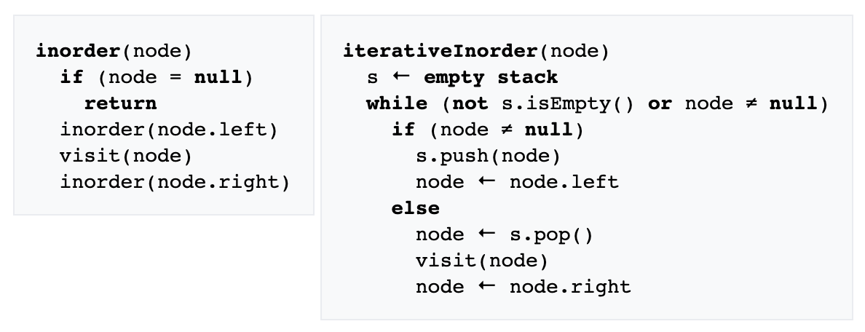
Pseudocode: DFS iterative vs recursive
Required stack space is proportional to the height of the tree.
Notes:
Source: https://en.wikipedia.org/wiki/Tree_traversal#Depth-first_search

Slide 8
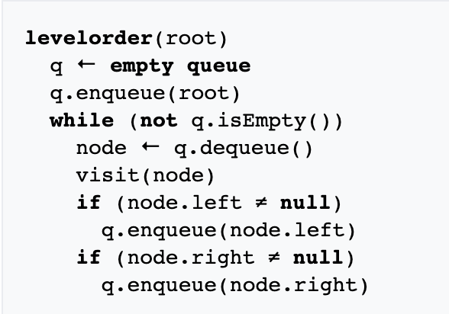
In code: BFS iterative implementation
Space required that is proportional to max number of nodes at a given depth.
Notes:
Source: https://en.wikipedia.org/wiki/Tree_traversal#Depth-first_search

Slide 9
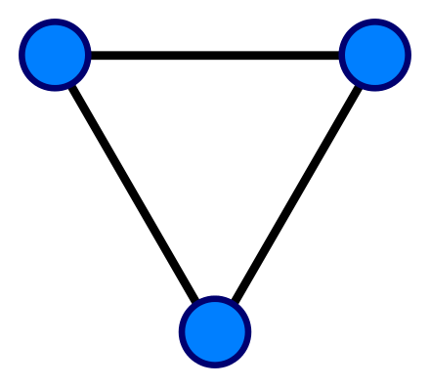
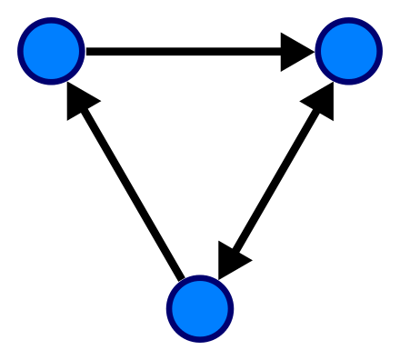
Graphs: basics
More general data structure, comprised of a collection of nodes that may or may not be connected by edges. Edges can be directed or undirected, and may contain weights.
Undirected graph
Directed graph

Slide 10
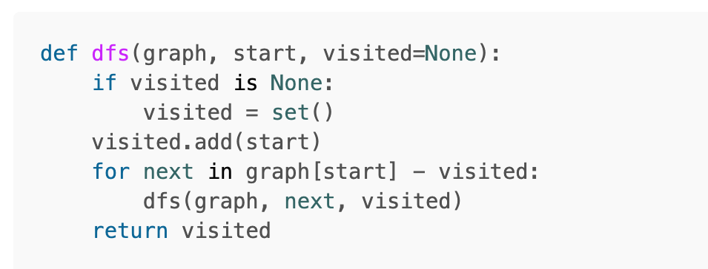
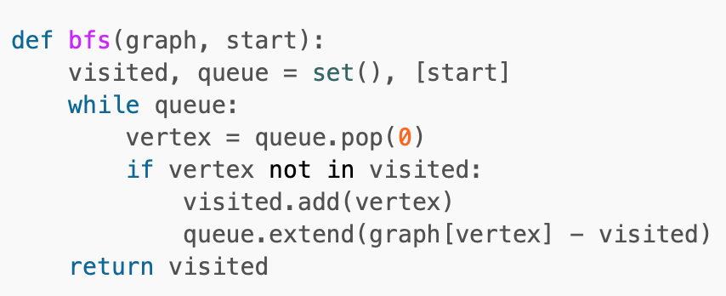
Graphs: traversal via BFS and DFS
Unlike trees, with graphs it is possible to visit nodes more than once, so to avoid redundancy it is important to keep track of which nodes have already been visited.
Like trees, traversal can proceed in a DFS or BFS manner.
Notes:
Source: https://eddmann.com/posts/depth-first-search-and-breadth-first-search-in-python/

Slide 11
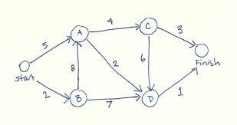
Algorithm: Dijkstra’s
-Objective: Find the minimum distance between a source node and all other nodes over a given graph.
Notes:
Source: https://bradfieldcs.com/algos/graphs/dijkstras-algorithm/

Slide 12
Algorithm: Dijkstra’s
def calculate_distances(graph, starting_vertex):
distances = {vertex: float('infinity') for vertex in graph}
distances[starting_vertex] = 0
pq = [(0, starting_vertex)]
while len(pq) > 0:
current_distance, current_vertex = heapq.heappop(pq)
# Nodes can get added to the priority queue multiple times. We only
# process a vertex the first time we remove it from the priority queue.
if current_distance > distances[current_vertex]:
continue
for neighbor, weight in graph[current_vertex].items():
distance = current_distance + weight
# Only consider this new path if it's better than any path we've
# already found.
if distance < distances[neighbor]:
distances[neighbor] = distance
heapq.heappush(pq, (distance, neighbor))
return distances
Notes:
Source: https://bradfieldcs.com/algos/graphs/dijkstras-algorithm/

