Slide 1
Recommending games
Steam users and their valuable time

Slide 2
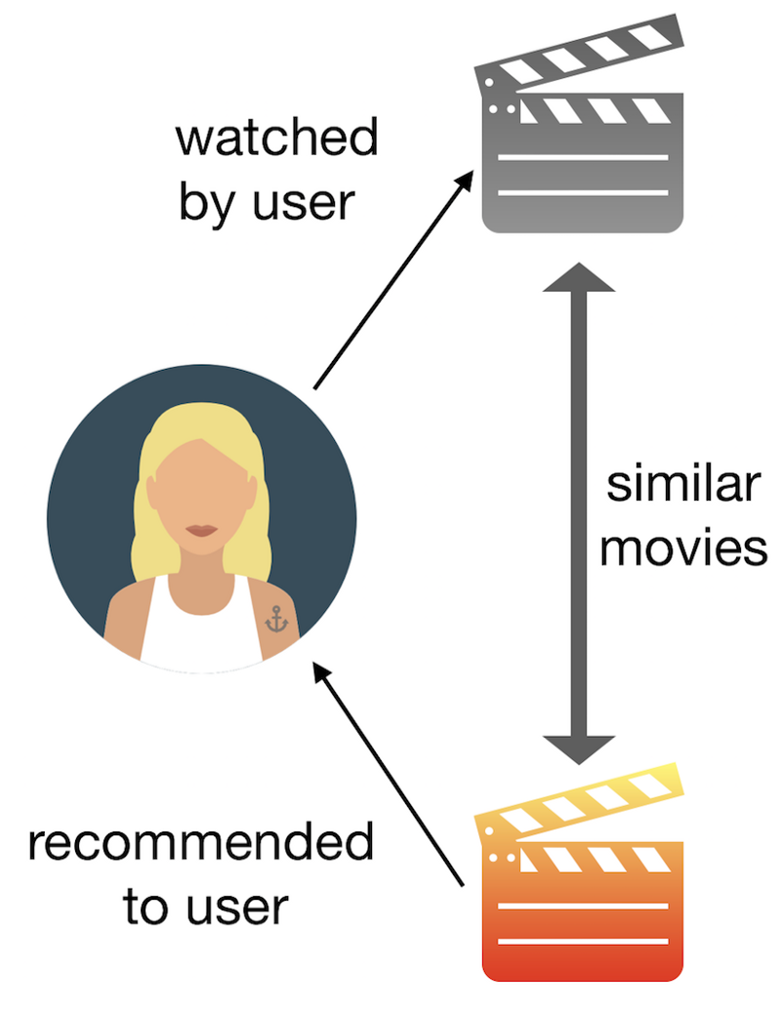
Background
Content-based recommender system
Attributes
User preference of attributes
Evaluation
Text classification
User study
Online vs offline methods
Metrics
Accuracy
Serendipity
Notes:
Content-based often use text classification methods.
Online pros: Most accurate in the long-term.
Online cons: Logistical problems.
Offline pros: Do not require access to a large user base.
Offline cons: Do not measure the actual propensity of the user.
Do not accurately measure serendipity
Implicit measuring of accuracy by re-recommending a user’s top list of games.

Slide 3

Background
Steam
One billion registered users
90 million monthly active users
30 000 games
Notes:
Game distribution/social platform with features like friends, chats, forums and more.

Slide 4
Problem
Steam users weekly time dedicated to gaming
Can spend a lot or very little time
What if the game is:
Too long?
Too short?
A frustrating gaming experience for the user
A solution: Recommend games with an appropriate time requirement
Satisfaction in completing games in a timely manner
Notes:
Relatively timely manner? Spend a whole year to complete one game?

Slide 5
Method
Content-based recommender system
Attributes
User weekly playtime – Game total average playtime
User preferred genres – Game genres
User preferred release year – Game release year
Implicit user data
Evaluation
Accuracy?
Serendipity?
Notes:
Implicitly retrieved from the dataset

Slide 6
Implementation
The dataset
MariaDB
Python
Dask
Pandas
Scipy
Game Recommendations
Linux
Extract tables into separate files
Import tables to database
Export tables to CSVs
Import CSVs
Big data cleaning and aggregation
One hot encoding genres
Similarity calculation
Final aggregations
Preprocessing
A 17 GB compressed SQL-file
Feature extraction
Recommendations

Slide 7
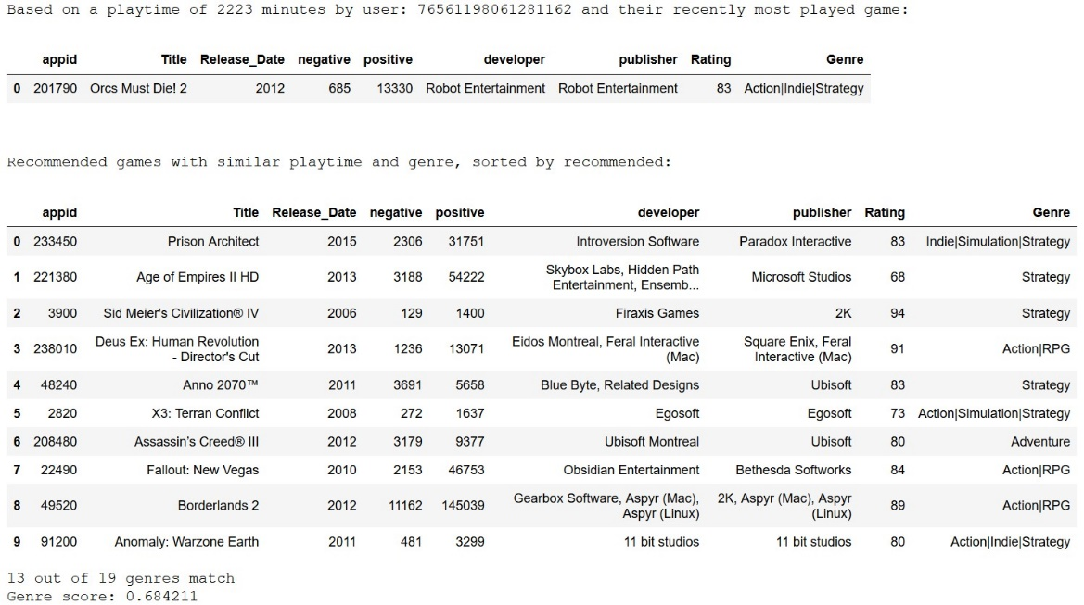
Results
Problems with evaluation
Offline method
No relevant ground truth
No user study was conducted
Recommendations make sense subjectively

Slide 8
Discussion
Promising, albeit subjective, results
Could benefit from further work:
An actual user study
More game attributes
More explicit user history and preferences

Slide 9
References
http://pzs.dstu.dp.ua/DataMining/recom/bibl/1aggarwal_c_c_recommender_systems_the_textbook.pdf
https://variety.com/2019/gaming/news/steam-one-billion-accounts-1203201159/

