Slide 1
DDM-AKKA
ELMO PRIMMER, CHRIS NECKEL

Slide 2
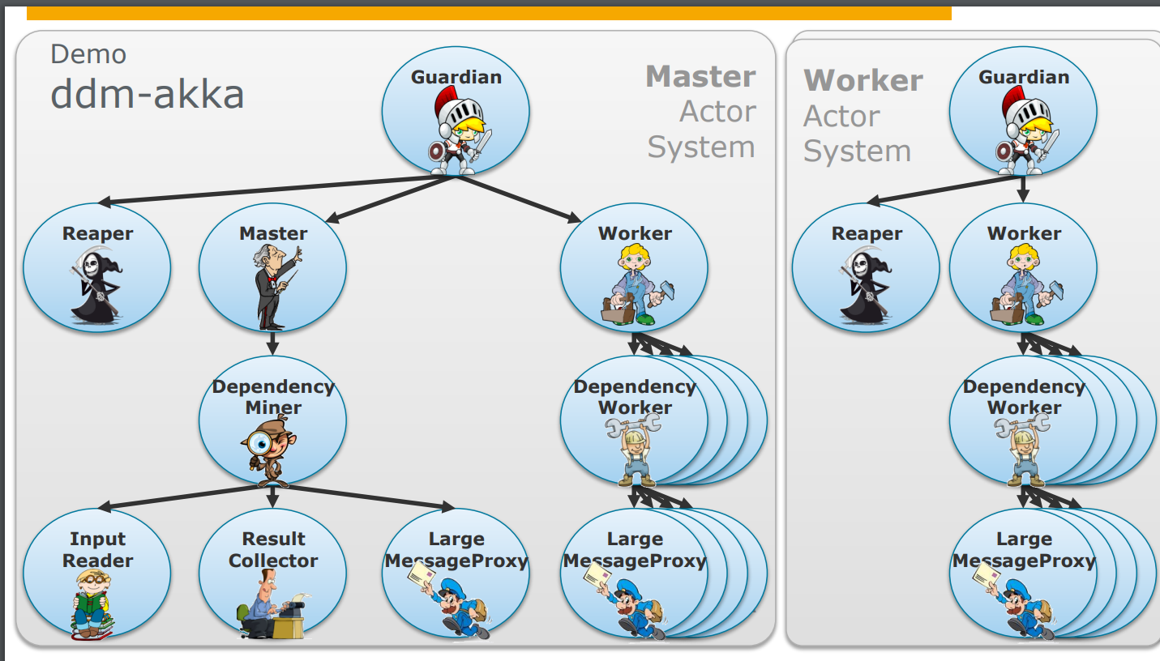
STRUCTURE
We did not alter the structure of the project

Slide 3
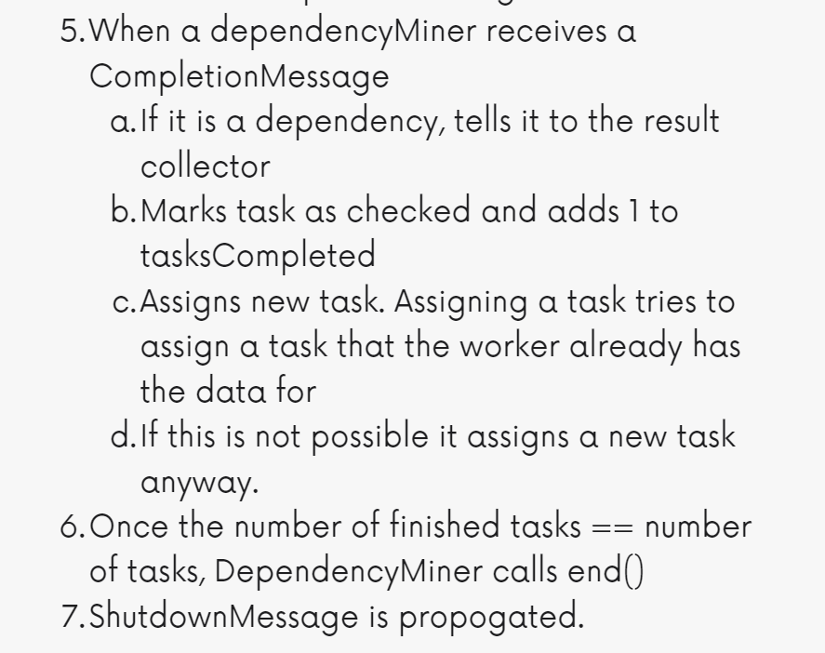
Step by step process
Master spawns DepencencyMiner
Who reads the data into a TreeSet.
Workers spawn DependencyWorkers
Who register and wait for data to be read
Once entire dataset is read:
Generate a TaskArray object that contains all possible combinations of sets of elements
Assign tasks to all registered workers
When a worker receives a task
It checks wether it already has all required data, if so it checks for dependency
If not, it requests the data from the DependencyMiner
Who responds with data, allowing dependency to be checked
Sends CompletionMessage
When a dependencyMiner receives a CompletionMessage
If it is a dependency, tells it to the result collector
Marks task as checked and adds 1 to tasksCompleted
Assigns new task. Assigning a task tries to assign a task that the worker already has the data for
If this is not possible it assigns a new task anyway.
Once the number of finished tasks == number of tasks, DependencyMiner calls end()
ShutdownMessage is propogated.

