Slide 1
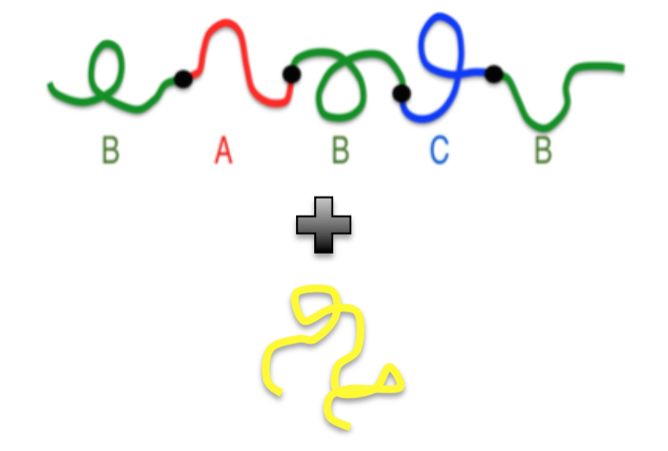
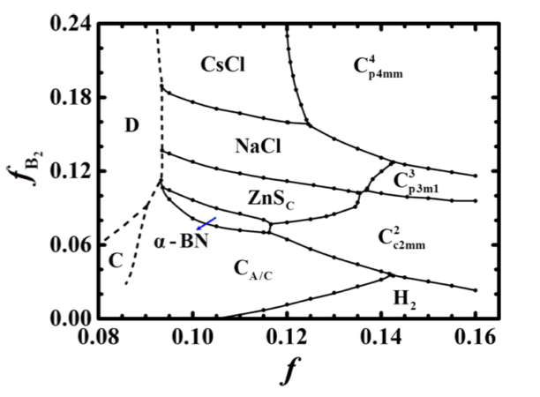
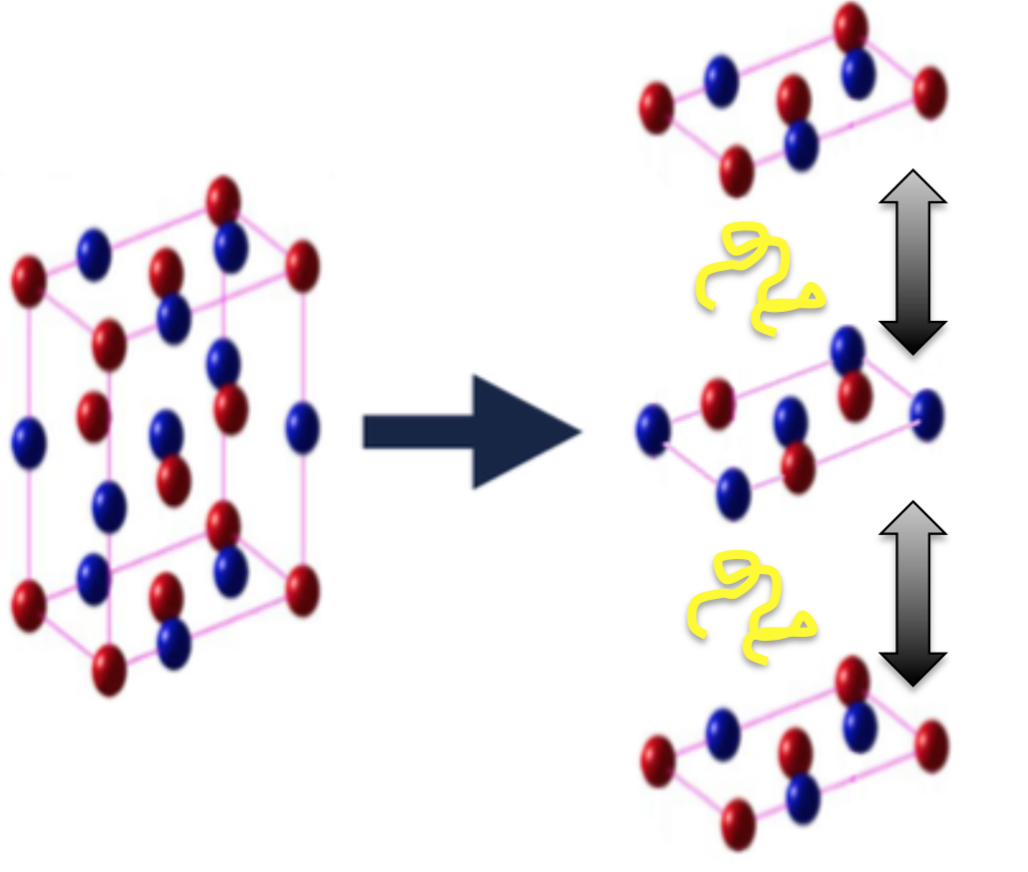
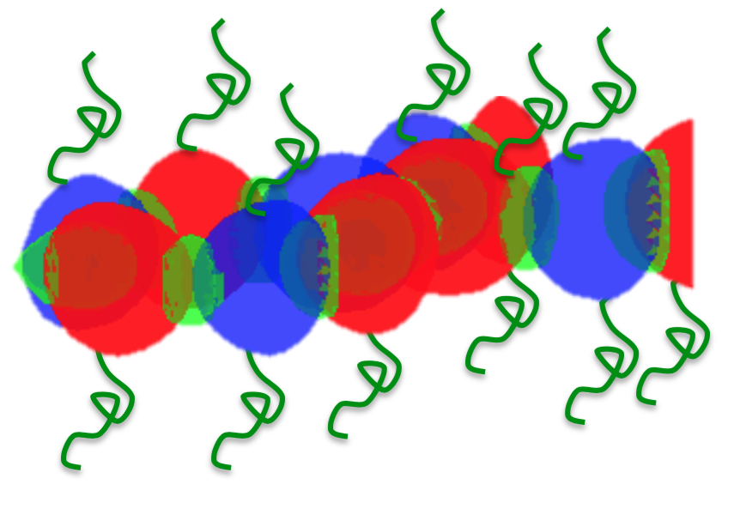
Overview:
Homopolymer

Slide 2
Model:
B₁AB₂CB₃
H
Using Grand Canonical Ensemble
Control the homopolymer concentration using μ_{H}
Phase transition between the α-BN and the single layer Graphene phase
Considering the possibility of macrophase separation

Slide 3
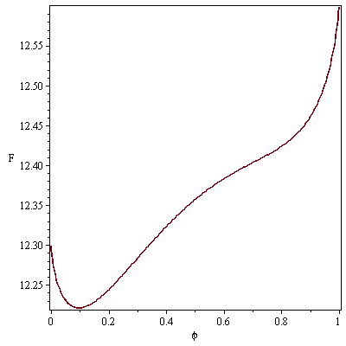
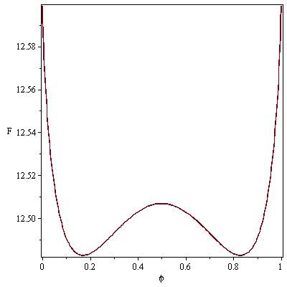
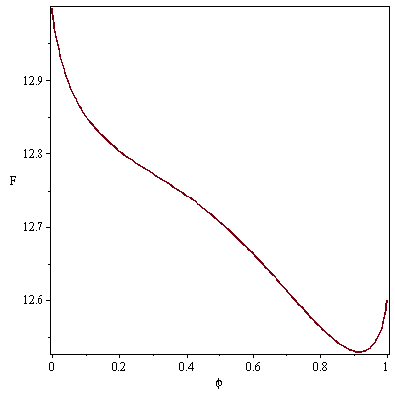
Homogenous Phase:
Increasing μ_{H}
Block copolymer concentration φ
Homopolymer concentration (1-φ)

Slide 4
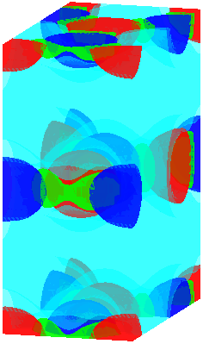
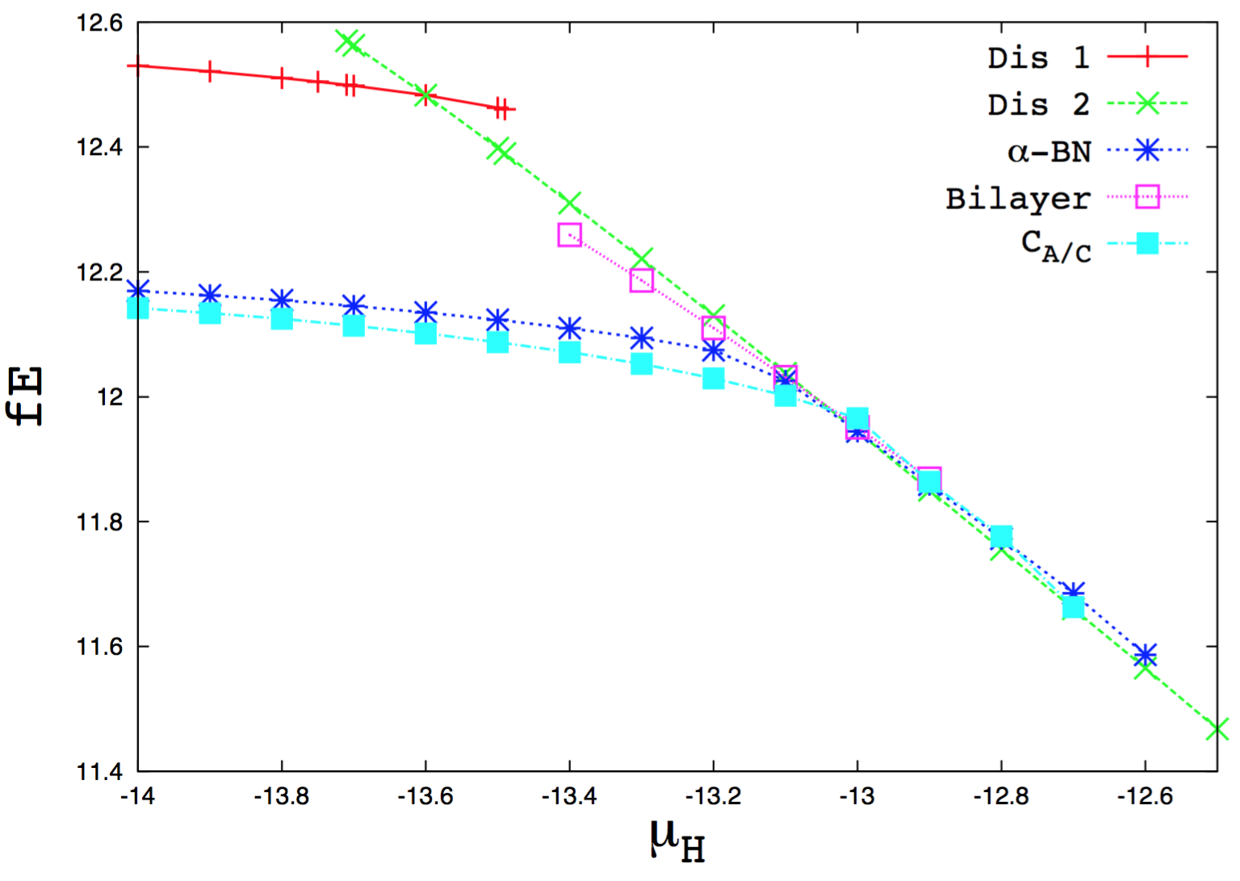

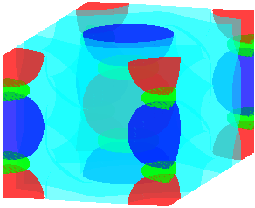
Free Energy Calculation:
We choose: f_{B}=0.8, f_{A}=f_{C}=0.1 and χ=80
Here, homopolymer is the same type as B₁ , B₂ and B₃

Slide 5


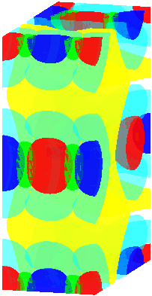


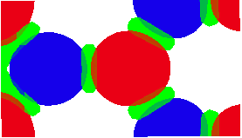
Phase Behavior of α-BN Phase:
1
2
3
4
1
3
2
4
Increasing μ_{H}

Slide 6
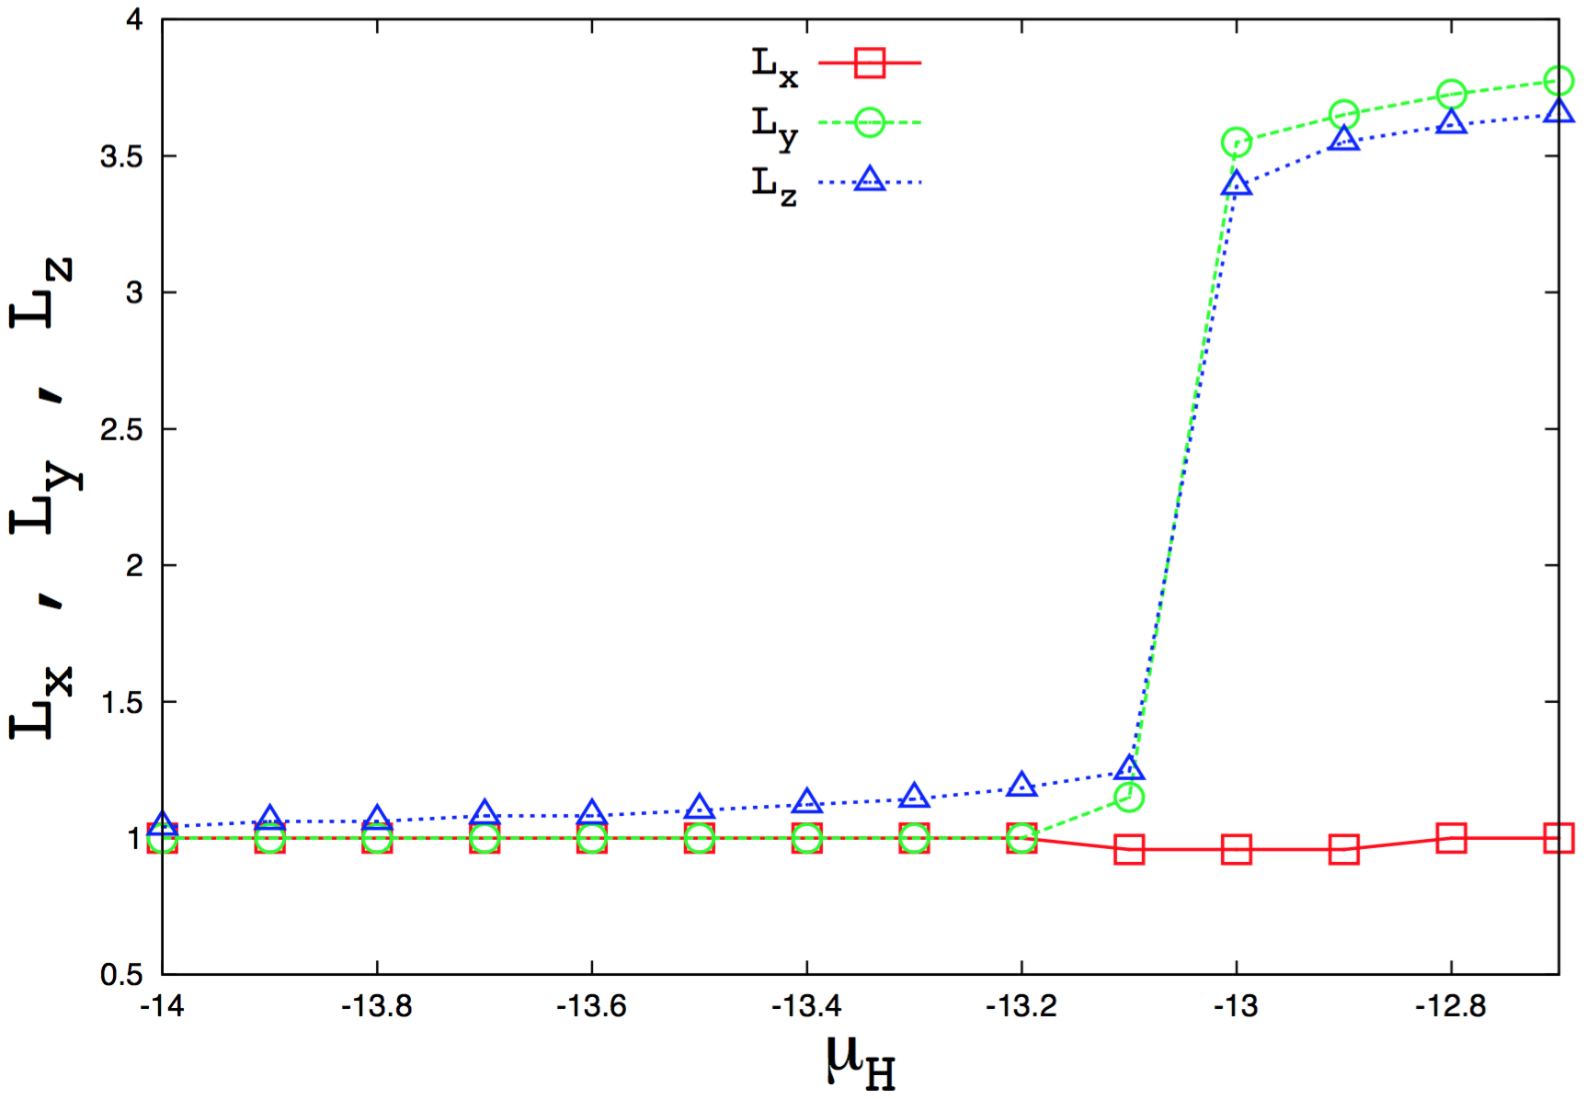
Phase Behavior of α-BN Phase:

Slide 7
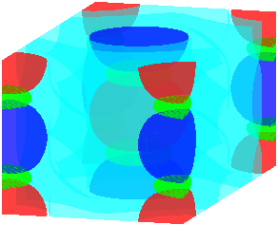
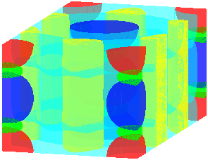
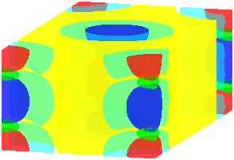
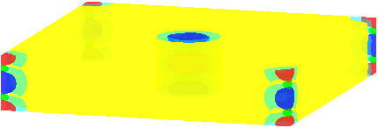
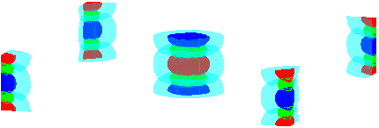
Phase Behavior of C_{A/C} Phase:
Increasing μ_{H}

Slide 8
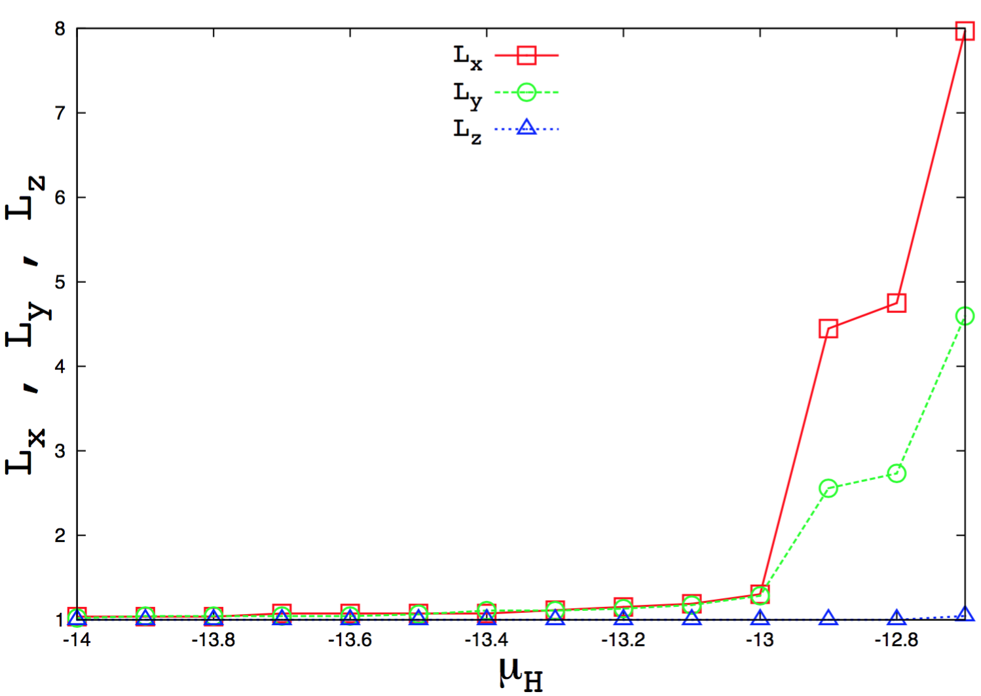
Phase Behavior of C_{A/C} Phase:

Slide 9
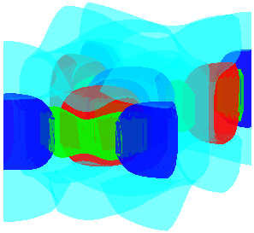
Phase Behavior of α-BN Bilayer Phase:

