Slide 1
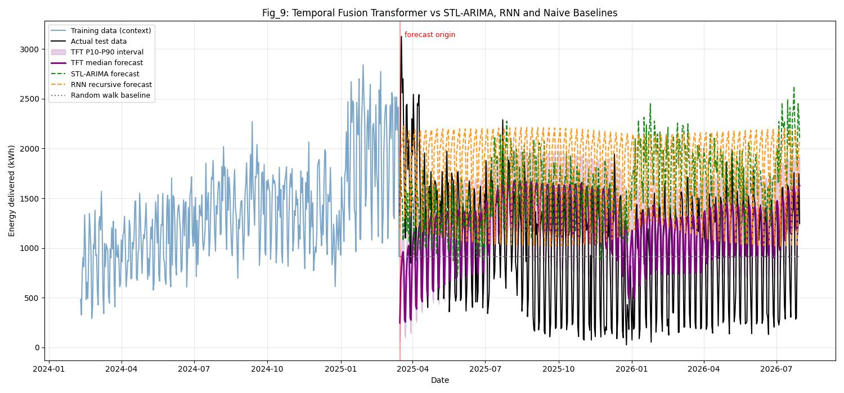
NOTEBOOK MODEL COMPARISON
Forecasting EV charging demand
STL‑ARIMA vs RNN vs Temporal Fusion Transformer
TFT wins on RMSE — with important caveats
Santa Barbara County · daily energy delivered
Notes:
This notebook asks which model best forecasts daily energy delivered by Santa Barbara County's EV charging network?
[Sources]
- /Users/carlosm.kampff/Desktop/dev/sbcc-ev-charging-stations/data_analysis_days_colab.ipynb
- /Users/carlosm.kampff/Desktop/dev/sbcc-ev-charging-stations/images/days/tft_forecast.jpg

Slide 2
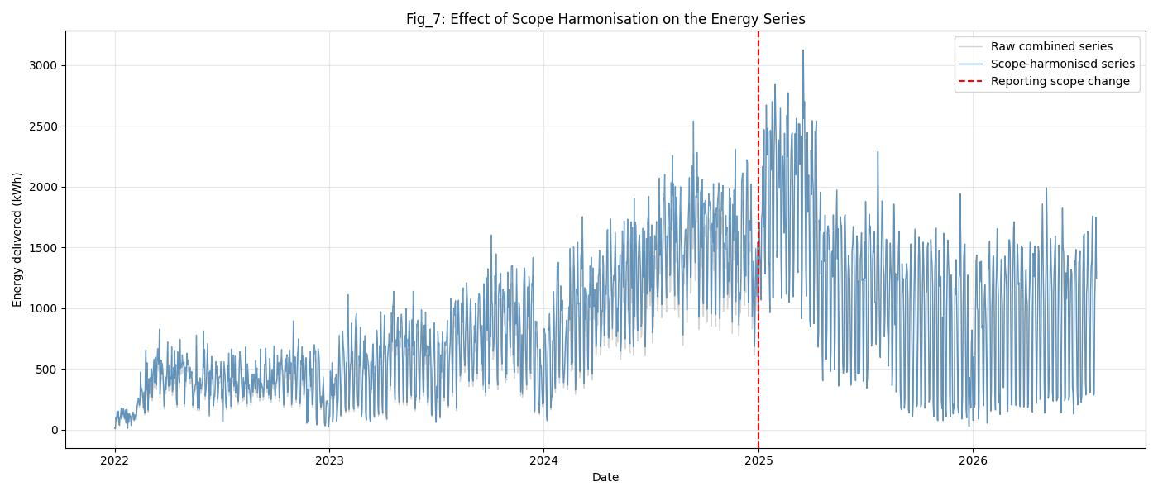
EVALUATION DESIGN
One fair test across all three models
1,170 days
training · 2022-01-01 to 2025-03-15
502 days
held out · no test observations
Same origin. Same horizon. Same target.
02
Notes:
All three models train on eleven hundred seventy days, then forecast the next five hundred two without seeing any test observation. That long horizon is deliberately difficult.
[Sources]
- /Users/carlosm.kampff/Desktop/dev/sbcc-ev-charging-stations/data_analysis_days_colab.ipynb
- /Users/carlosm.kampff/Desktop/dev/sbcc-ev-charging-stations/images/days/scope_harmonisation.jpg

Slide 3
HOW THEY FORECAST
Three architectures, three failure modes
STL‑ARIMA
RNN · LSTM
TFT
Decompose seasonality + trend, then model residuals
30-day look-back; predict one day and feed it back
90-day encoder + calendar; output 502 days directly
Transparent and fast
Risk: trend extrapolation
Nonlinear memory
Risk: recursive drift
Multi-horizon + interpretable
Risk: calibration
03
Notes:
STL ARIMA separates seasonality and trend. The RNN uses thirty days of energy history and forecasts recursively. TFT uses ninety days of history plus calendar features, and emits the full horizon in one pass.
[Sources]
- /Users/carlosm.kampff/Desktop/dev/sbcc-ev-charging-stations/data_analysis_days_colab.ipynb

Slide 4
RESULTS
TFT makes the smallest absolute forecast error
39.8%
lower RMSE than STL‑ARIMA
44.7%
lower RMSE than the RNN
Also 7.3% better than the random-walk baseline.
04
Notes:
STL ARIMA scores RMSE nine hundred four point nine five. The RNN finishes last at nine hundred eighty three point nine one. TFT scores five hundred forty four point three three: thirty nine point eight percent better than STL ARIMA, and forty four point seven percent better than the RNN.
[Sources]
- /Users/carlosm.kampff/Desktop/dev/sbcc-ev-charging-stations/data_analysis_days_colab.ipynb

Slide 5
WHY TFT WON
The forecast path explains the ranking
STL‑ARIMA overshoots
RNN compounds error
TFT emits one direct path
05
Notes:
Across five hundred two recursive steps, the RNN's error compounds. STL ARIMA projects a fitted linear trend through a period that rises and then falls. TFT avoids recursive drift and an explicit extrapolated trend.
[Sources]
- /Users/carlosm.kampff/Desktop/dev/sbcc-ev-charging-stations/data_analysis_days_colab.ipynb
- /Users/carlosm.kampff/Desktop/dev/sbcc-ev-charging-stations/images/days/tft_forecast.jpg

Slide 6
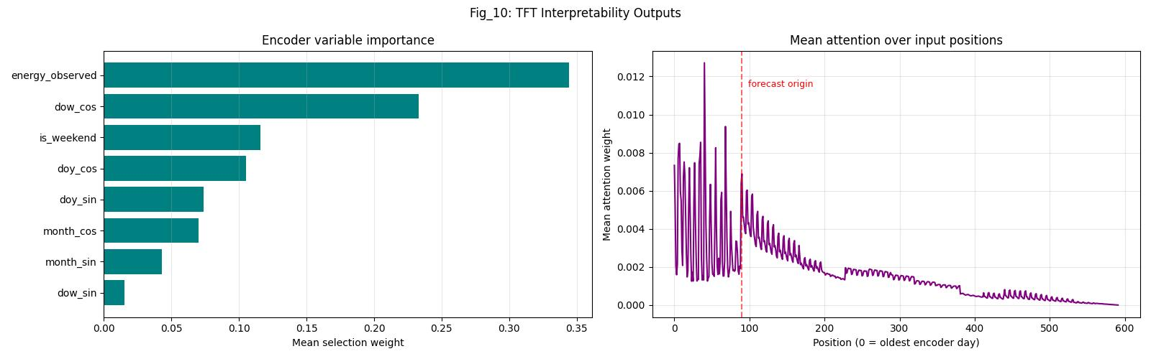
INTERPRETATION AND CAVEATS
Sensible signal, unreliable uncertainty
50% coverage
for a nominal 80% interval
One seed · one split
The 7.3% baseline margin is promising, not established.
34.4%
weight on recent observed energy
62.3%
weight on annual month seasonality
06
Notes:
TFT anchors the level on recent observed energy, then shapes the future with annual seasonality. But the nominal eighty percent interval covered only fifty percent of actual days, and percentage error remained high on low-demand days.
[Sources]
- /Users/carlosm.kampff/Desktop/dev/sbcc-ev-charging-stations/data_analysis_days_colab.ipynb
- /Users/carlosm.kampff/Desktop/dev/sbcc-ev-charging-stations/images/days/tft_interpretability.jpg

Slide 7
BOTTOM LINE
Advance TFT — then prove it
Leading candidate
Before production
Lowest RMSE and the only model with positive out-of-sample R².
Rolling origins · 30/90-day horizons · per-site forecasts · calibrated intervals · naive baselines
Use TFT for the next experiment, not yet as the final answer.
Notes:
Treat TFT as the leading candidate, not a finished production model. Validate it across seeds and rolling origins, shorten the horizon, forecast each site separately, recalibrate intervals, and keep naive baselines visible.
[Sources]
- /Users/carlosm.kampff/Desktop/dev/sbcc-ev-charging-stations/data_analysis_days_colab.ipynb

