Slide 1
Adversarial Search
Game Playing
Chapter 6

Slide 2
Outline
Games
Perfect Play
  Minimax decisions
  α-β pruning
Resource Limits and Approximate Evaluation
Games of chance

Slide 3
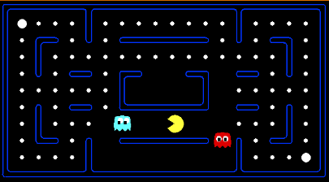
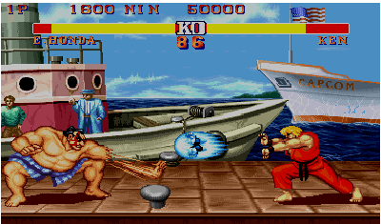
Games
Multi agent environments : any given agent will need to consider the actions of other agents and how they affect its own welfare.
The unpredictability of these other agents can introduce many possible contingencies
There could be competitive or cooperative environments
Competitive environments, in which the agent’s goals are in conflict require adversarial search – these problems are called as games

Slide 4
What kind of games?
Abstraction: To describe a game we must capture every relevant aspect of the game. Such as:
  Chess
  Tic-tac-toe
  …
Accessible environments: Such games are characterized by perfect information
Search: game-playing then consists of a search through possible game positions
Unpredictable opponent: introduces uncertainty thus game-playing must deal with contingency problems
Slide adapted from Macskassy

Slide 5
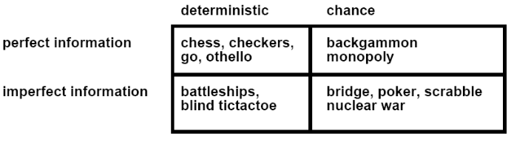
Type of Games

Slide 6
Games
In game theory (economics), any multi-agent environment (either cooperative or competitive) is a game provided that the impact of each agent on the other is significant*
AI games are a specialized kind - deterministic, turn taking, two-player, zero sum games of perfect information
  a zero-sum game is a mathematical representation of a situation in which a participant's gain (or loss) of utility is exactly balanced by the losses (or gains) of the utility of other participant(s)
In our terminology – deterministic, fully observable environments with two agents whose actions alternate and the utility values at the end of the game are always equal and opposite (+1 and –1)
  If a player wins a game of chess (+1), the other player necessarily loses (-1)
* Environments with very many agents are best viewed as economies rather than games

Slide 7
Deterministic Games
Many possible formalizations, one is:
  States: S (start at s₀)
  Players: P={1...N} (usually take turns)
  Actions: A (may depend on player / state)
  Transition Function: SxA →S
  Terminal Test: S → {t,f}
  Terminal Utilities: SxP → R
Solution for a player is a policy: S → A

Slide 8
Games vs. search problems
“Unpredictable" opponent → solution is a strategy specifying a move for every possible opponent reply
Time limits → unlikely to find goal, must approximate
Plan of attack:
  Computer considers possible lines of play (Babbage, 1846)
  Algorithm for perfect play (Zermelo, 1912; Von Neumann, 1944)
  Finite horizon, approximate evaluation (Zuse, 1945; Wiener, 1948; Shannon, 1950)
  First chess program (Turing, 1951)
  Machine learning to improve evaluation accuracy (Samuel, 1952-57)
  Pruning to allow deeper search (McCarthy, 1956)

Slide 9
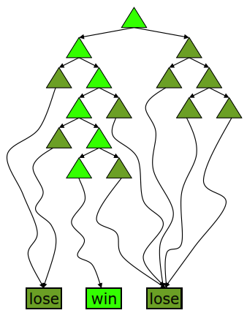
Deterministic Single-Player?
Deterministic, single player, perfect information:
  Know the rules
  Know what actions do
  Know when you win
  E.g. Freecell, 8-Puzzle, Rubik’s cube
… it’s just search!
Slight reinterpretation:
  Each node stores a value: the best outcome it can reach
  This is the maximal outcome of its children (the max value)
  Note that we don’t have path sums as before (utilities at end)
After search, can pick move that leads to best node
Slide adapted from Macskassy

Slide 10
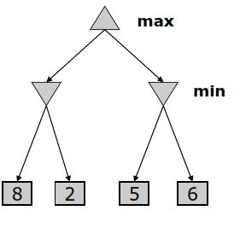
Deterministic Two-Player
E.g. tic-tac-toe, chess, checkers
Zero-sum games
  One player maximizes result
  The other minimizes result
Minimax search
  A state-space search tree
  Players alternate
  Each layer, or ply, consists of a round of moves
  Choose move to position with highest minimax value = best achievable utility against best play
Slide adapted from Macskassy

Slide 11
Searching for the next move
Complexity: many games have a huge search space
  Chess: b = 35, m=100 nodes = 35 ¹⁰⁰
  if each node takes about 1 ns to explore then each move will take about 10⁵⁰ millennia to calculate.
Resource (e.g., time, memory) limit: optimal solution not feasible/possible, thus must approximate
1. Pruning: makes the search more efficient by discarding portions of the search tree that cannot improve quality result.
2. Evaluation functions: heuristics to evaluate utility of a state without exhaustive search.
Slide adapted from Macskassy

Slide 12
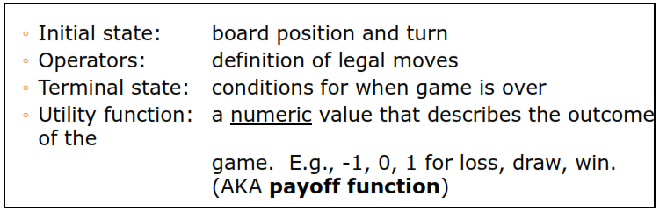
Two-player Games
A game formulated as a search problem:
Slide adapted from Macskassy

Slide 13
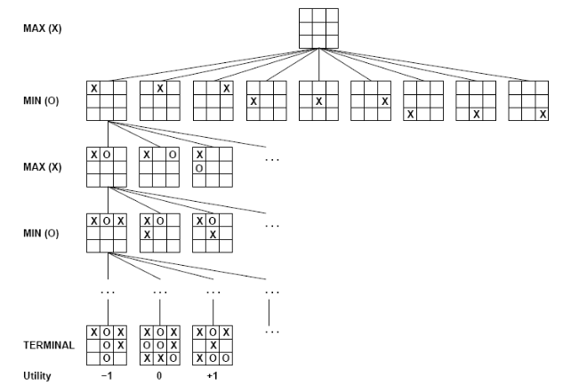
Example: Tic-Tac-Toe

Slide 14
The minimax algorithm
Perfect play for deterministic environments with perfect information
Basic idea: choose move with highest minimax value
= best achievable payoff against best play
Algorithm:
1. Generate game tree completely
2. Determine utility of each terminal state
3. Propagate the utility values upward in the three by applying MIN and MAX operators on the nodes in the current level
4. At the root node use minimax decision to select the move with the max (of the min) utility value
Steps 2 and 3 in the algorithm assume that the opponent will play perfectly.

Slide 15
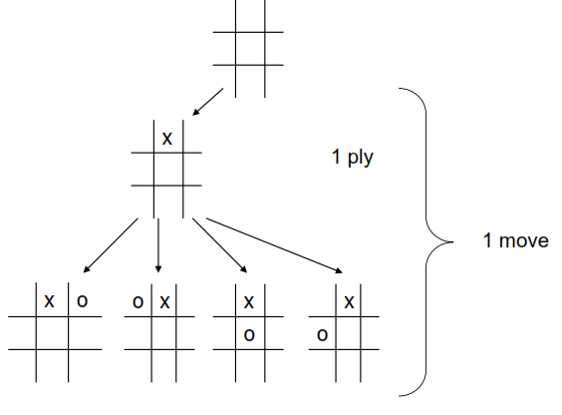
Generate Game Tree

Slide 16
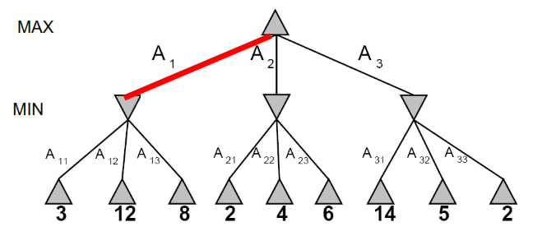
Minimax Example

Slide 17
Minimax value
Given a game tree, the optimal strategy can be determined by examining the minimax value of each node (MINIMAX-VALUE(n))
The minimax value of a node is the utility of being in the corresponding state, assuming that both players play optimally from there to the end of the game
Given a choice, MAX prefer to move to a state of maximum value, whereas MIN prefers a state of minimum value

Slide 18
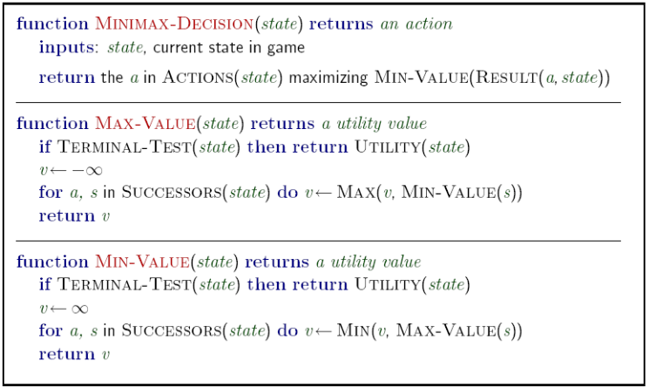
Minimax: Recursive implementation

Slide 19
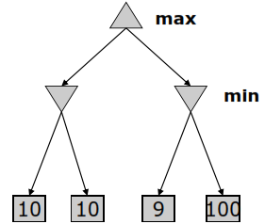
The Minimax Algorithm Properties
Performs a complete depth-first exploration of the game tree
Optimal against a perfect player.
Time complexity?
  O(b^{m})
Space complexity?
  O(bm)
For chess, b ~ 35, m ~ 100
  Exact solution is completely infeasible
  But, do we need to explore the whole tree?
Minimax serves as the basis for the mathematical analysis of games and for more practical algorithms

Slide 20
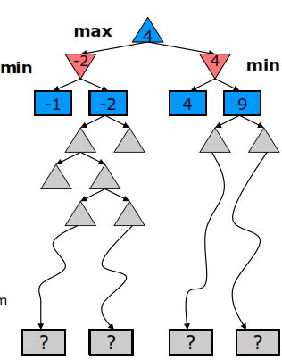
Resource Limits
Cannot search to leaves
Depth-limited search
  Instead, search a limited depth of tree
  Replace terminal utilities with an eval function for non-terminal positions
Guarantee of optimal play is gone
More plies makes a BIG difference
Example:
  Suppose we have 100 seconds, can explore 10K nodes / sec
  So can check 1M nodes per move
  α-β reaches about depth 8 – decent chess program
Slide adapted from Macskassy

Slide 21
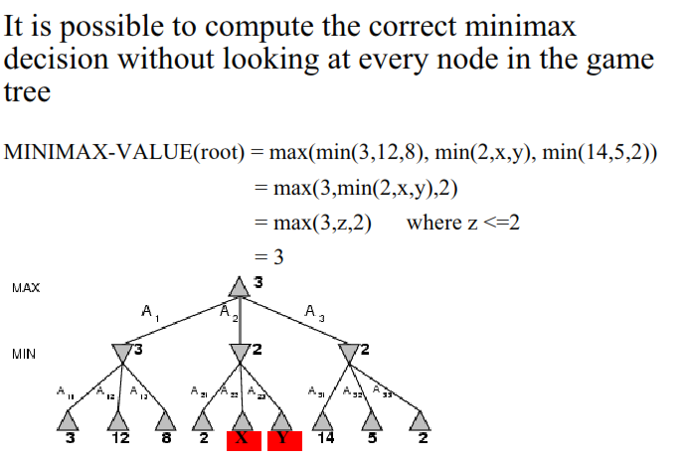
α-β pruning

Slide 22
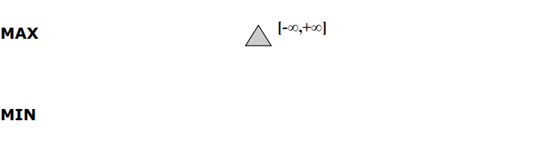
α-β pruning: example

Slide 23
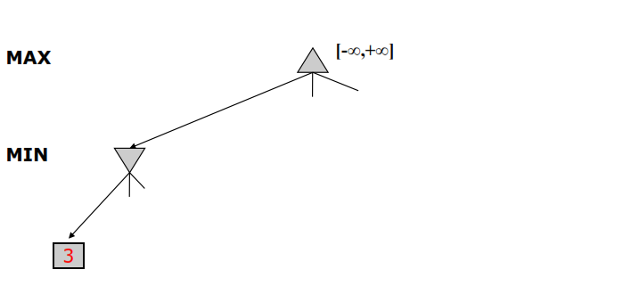
α-β pruning: example

Slide 24
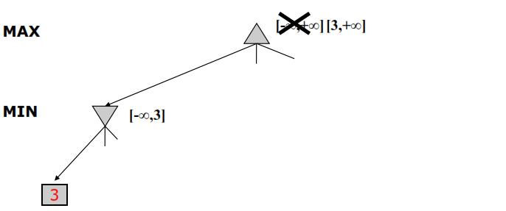
α-β pruning: example

Slide 25
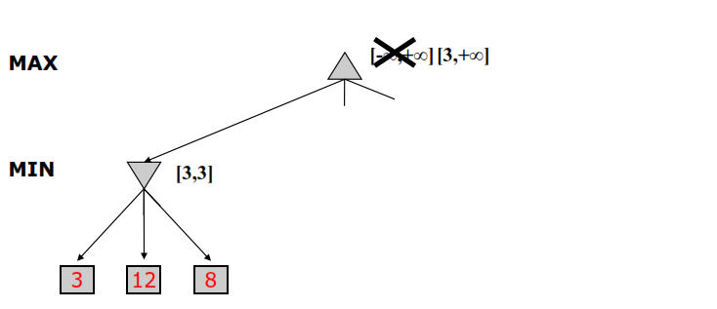
α-β pruning: example

Slide 26
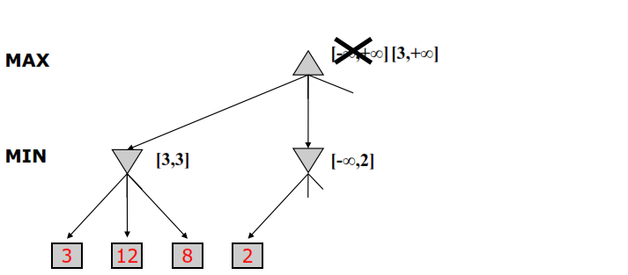
α-β pruning: example

Slide 27
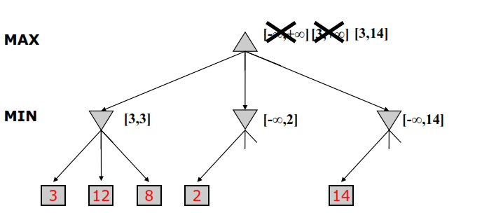
α-β pruning: example

Slide 28
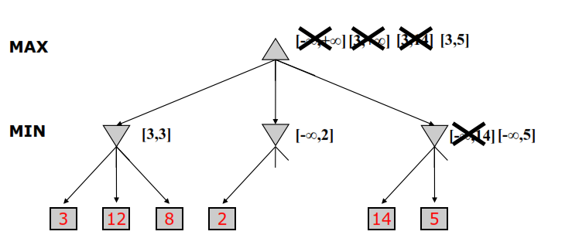
α-β pruning: example

Slide 29
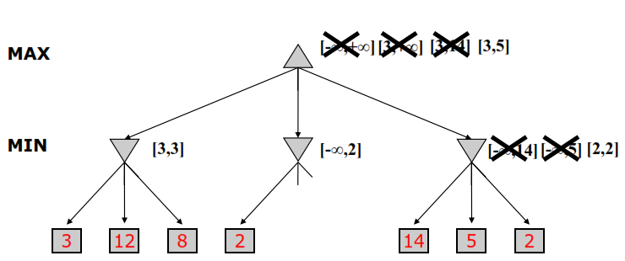
α-β pruning: example

Slide 30
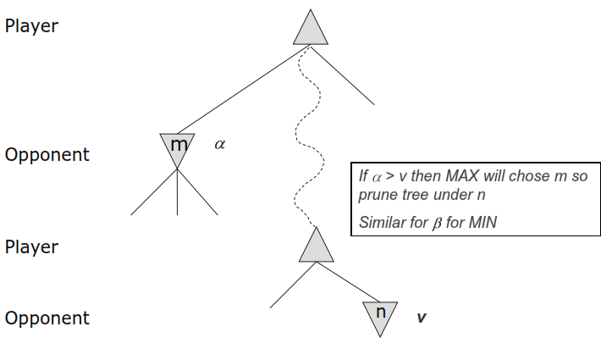
α-β pruning: General Principle

Slide 31

Why is it called α-β?
α is the value of the best (i.e., highest-value) choice found so far at any choice point along the path for max
If v is worse than α, max will avoid it
  → prune that branch
Define β similarly for min

Slide 32
α-β pruning
Alpha-beta search updates the values of α and β as it goes along and prunes the remaining branches at a node as soon as the value of the current node is known to be worse than the current α or β value for MAX or MIN, respectively.
The effectiveness of alpha-beta pruning is highly dependent on the order in which the successors are examined.

Slide 33
Properties of α-β
Pruning does not affect final result
Good move ordering improves effectiveness of pruning
With "perfect ordering," time complexity = O(b^{m/2})
  → doubles depth of search
A simple example of the value of reasoning about which computations are relevant (a form of metareasoning)

Slide 34

The α-β algorithm

Slide 35

The α-β algorithm

Slide 36
Imperfect Real-Time Decisions
Suppose we have 100 secs, explore 10⁴ nodes/sec
→ 10⁶ nodes per move
Standard approach:
cutoff test:
  e.g., depth limit (perhaps add quiescence search)
evaluation function
  = estimated desirability of position
  * Replace the utility function by a heuristic evaluation function EVAL, which gives an estimate of the position’s utility

Slide 37
Evaluation Functions
First proposed by Shannon in 1950
The evaluation function should order the terminal states in the same way as the true utility function
The computation must not take too long
For non-terminal states, the evaluation function should be strongly correlated with the actual chances of winning
  Uncertainty introduced by computational limits

Slide 38
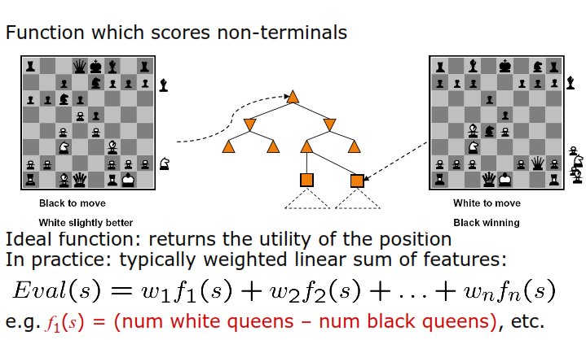
Evaluation Functions

Slide 39
Evaluation Functions
Material value for each piece in chess
  Pawn: 1
  Knight: 3
  Bishop: 3
  Rook: 5
  Queen: 9
  This can be used as weights and the number of each kind can be used as features
Other features
  Good pawn structure
  King safety
These features and weights are not part of the rules of chess, they come from playing experience

Slide 40
Cutting off search
MinimaxCutoff is identical to MinimaxValue except
  Terminal? is replaced by Cutoff?
  Utility is replaced by Eval
Does it work in practice?
b^{m} = 10⁶, b=35 → m=4
4-ply lookahead is a hopeless chess player!
  4-ply ≈ human novice
  8-ply ≈ typical PC, human master
  12-ply ≈ Deep Blue, Kasparov

Slide 41
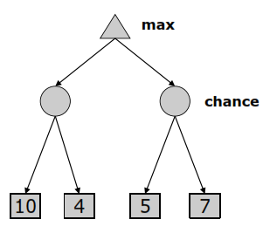
Expectimax Search Trees
What if we don’t know what the result of an action will be? E.g.,
  In solitaire, next card is unknown
  In minesweeper, mine locations
  In pacman, the ghosts act randomly
  Games that include chance
Can do expectimax search
  Chance nodes, like min nodes, except the outcome is uncertain
  Calculate expected utilities
  Max nodes as in minimax search
  Chance nodes take average (expectation) of value of children

Slide 42
Games : State-of-the-Art
Checkers: Chinook ended 40-year-reign of human world champion Marion Tinsley in 1994. Used an endgame database defining perfect play for all positions involving 8 or fewer pieces on the board, a total of 443,748,401,247 positions. Checkers is now solved!
Chess: Deep Blue defeated human world champion Gary Kasparov in a six-game match in 1997. Deep Blue examined 200 million positions per second, used very sophisticated evaluation and undisclosed methods for extending some lines of search up to 40 ply. Current programs are even better, if less historic.
Othello: In 1997, Logistello defeated human champion by six games to none. Human champions refuse to compete against computers, which are too good.
Go: Human champions are beginning to be challenged by machines, though the best humans still beat the best machines. In Go, b > 300, so most programs use pattern knowledge bases to suggest plausible moves, along with aggressive pruning.
Backgammon: Neural-net learning program TDGammon one of world’s top 3 players.

